Slide 1
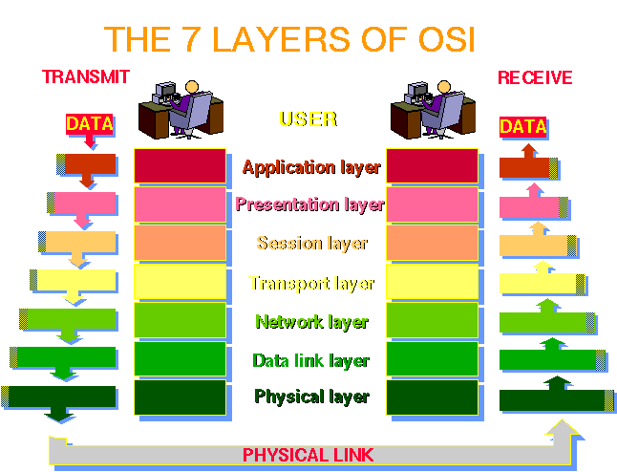
Networking basics
Courtesey of Abdus Salam International Centre for Theoretical Physics, Trieste

Slide 2
Physical Layer
This layer is concerned with the transmission of bits.
Some of the issues handled in this layer are : how many volts for 0, how many for 1; number of bits per second to be transmitted; whether it is a one-way or two-way communication etc.
Many standards have been developed, e.g., RS-232 for serial communication lines.

Slide 3
Data Link Layer
This layer groups bits into frames and ensures their correct delivery.
It adds some bits at the beginning and end of each frame plus the checksum. Receiver of the frame verifies the checksum and requests retransmission if the checksum is not correct.
This layer consists of two sublayers.

Slide 4
Logical Link Control and Medium Access Control
The LLC defines how data is transferred over the network medium (e.g., cables) and provides data link service to the higher layers.
The Medium Access Control (MAC) layer defines who can use the network medium when multiple computers are trying to access it simultaneously.
For example, token passing or CSMA/CD for Ethernet.

Slide 5
Network Layer
This layer is concerned with the transmission of packets. It takes routing decisions, e.g., the best path to send a packet.
The network layer may be quite complex in a large network, e.g., the Internet.
Most protocols are connection oriented (packets are sent when the destination accepts a connection) or connection-less, like IP.

Slide 6
Transport Layer
This layer ensures reliable service and deals with lost messages.
It breaks the messages into smaller packets, assigns sequence number and sends them. Reliable transport connections are built on top of X.25 or IP.
Examples are TCP (Transfer Control Protocol), TCP/IP, UDP etc.

Slide 7
Sessions Layer
Very few applications use this layer. It is mostly an enhanced version of the transport layer.
It facilitates dialog control and synchronization.
Many network implementations do not support it. For example, Internet suite does not support this layer.

Slide 8
Presentation Layer
Very few applications use this layer. This layer is concerned with the semantics of the bits.
It defines records and fields in them. The sender can tell the receiver about the format.
It makes machines with different internal representations to communicate. It is the best layer for implementing cryptographic services.

Slide 9
Application Layer
This is a collection of miscellaneous protocols for high level applications.
Typical services are electronic mail, file transfer, connecting remote terminals etc.
FTP, telnet, HTTP, NFS etc.

Slide 10
Multiplexing
In a mobile and wireless network, the wireless medium is shared by many nodes.
Hence, multiple use of a shared medium is a major challenge in wireless networking.
Most decisions for accessing the wireless medium is made in the MAC layer.

Slide 11
Multiplexing
The wireless channels can be multiplexed (used by multiple machines) in four dimensions :
  Space (s)
  Time (t)
  Frequency (f)
  Code (c)

Slide 12
Space multiplexing : Cellular Networks
Same frequency can be reused when the base stations are separated in space.
The reuse of frequencies depend on signal propagation range.
Example : fixed frequency assignment for reuse with distance 2.

Slide 13
Frequency Division Multiplex (FDM)
The whole spectrum is separated into smaller frequency bands.
A band is allocated to a channel for the whole time.
This is somewhat inflexible if the traffic is non-uniform.
An example is radio or TV broadcast. The bandwidth is wasted if a station is off the air.
f
t

Slide 14
Time Division Multiplex (TDM)
A channel gets the whole frequency spectrum for a certain amount of time.
Only one user for the medium at a time.
Usually the throughput is high even with many users.
However, no two users should use the medium at the same time. Precise synchronization is needed.
f
t

Slide 15
An example of TDM
Ethernet uses a protocol called CSMA/CD
Carrier Sense Multiple Access with Collision Detection
When a node wants to broadcast, it checks whether any other node is broadcasting (senses the carrier).
A node broadcasts when no other node is broadcasting. Otherwise, it tries later at a random interval.

Slide 16
CSMA Problems in Wireless Medium
Collision detection is easy in wired networks but difficult in wireless medium.
With only one antenna, nodes can only listen or send.
Full duplex radios are extremely expensive.
CSMA gives rise to hidden terminal and exposed terminal problems.

Slide 17
Hidden Terminal Problem
Wireless transmission is usually short range. Even if the medium is free near the transmitter, it may not be free near the intended receiver.
A
B
C
Collision at B

Slide 18
Exposed Terminal Problem
Even if the medium is busy near the transmitter, it may be free near the intended receiver.
A
B
C
D
C cannot transmit because B is transmitting.

Slide 19
Message Loss due to Collision
Using CSMA in wireless medium results in message loss and requires retransmission of lost messages.
A node spends much more energy while receiving or transmitting messages. Hence, retransmission wastes a lot of energy.
The other alternative is to use a reservation based TDM protocol.

Slide 20
Demand Assignment Multiple Access (DAMA)
In a DAMA protocol, nodes first reserve slots which they intend to use for broadcasting.
Each round of broadcast is preceded by a reservation round.
DAMA protocols are widely used in satellite communication and increasingly being used in wireless networking.

Slide 21
Code Division Multiplex (CDM)
Each channel uses a unique code for transmitting.
All channels use the same frequency spectrum at the same time.
However, signal regeneration is very complex and requires complex HW/SW support.
c
t
f

Slide 22
Code Division Multiplexing
CDMA has ben adopted for the 3G mobile phone technology.
CDMA is not very suitable for ad hoc networking as we cannot expect specialized hardware/software support at the nodes.
TDMA and its variations are most suitable for ad hoc networking.

Slide 23
The Organization of the Course
We will mainly study routing protocols in this course.
Routing messages is the most important issue in any network. Conventional protocols for wired networks do not work well for ad hoc networks.
We will study routing protocols both for ad hoc mobile networks and static wireless networks.

