Slide 1
Mobile Communications
Chapter 3 : Media Access
Motivation
SDMA, FDMA, TDMA
Aloha
Reservation schemes
Collision avoidance, MACA
Polling
CDMA
SAMA
Comparison

Slide 2
Motivation
Can we apply media access methods from fixed networks?
Example CSMA/CD
  Carrier Sense Multiple Access with Collision Detection
  send as soon as the medium is free, listen into the medium if a collision occurs (original method in IEEE 802.3)
Problems in wireless networks
  signal strength decreases proportional to the square of the distance
  the sender would apply CS and CD, but the collisions happen at the receiver
  it might be the case that a sender cannot “hear” the collision, i.e., CD does not work
  furthermore, CS might not work if, e.g., a terminal is “hidden”

Slide 3

Motivation - hidden and exposed terminals
Hidden terminals
  A sends to B, C cannot receive A
  C wants to send to B, C senses a “free” medium (CS fails)
  collision at B, A cannot receive the collision (CD fails)
  A is “hidden” for C
Exposed terminals
  B sends to A, C wants to send to another terminal (not A or B)
  C has to wait, CS signals a medium in use
  but A is outside the radio range of C, therefore waiting is not necessary
  C is “exposed” to B
A
B
C

Slide 4
Motivation - near and far terminals
Terminals A and B send, C receives
  signal strength decreases proportional to the square of the distance
  the signal of terminal B therefore drowns out A’s signal
  C cannot receive A
If C for example was an arbiter for sending rights, terminal B would drown out terminal A already on the physical layer
Also severe problem for CDMA-networks - precise power control needed!
A
B
C

Slide 5
Access methods SDMA/FDMA/TDMA
SDMA (Space Division Multiple Access)
  segment space into sectors, use directed antennas
  cell structure
FDMA (Frequency Division Multiple Access)
  assign a certain frequency to a transmission channel between a sender and a receiver
  permanent (e.g., radio broadcast), slow hopping (e.g., GSM), fast hopping (FHSS, Frequency Hopping Spread Spectrum)
TDMA (Time Division Multiple Access)
  assign the fixed sending frequency to a transmission channel between a sender and a receiver for a certain amount of time
The multiplexing schemes presented in chapter 2 are now used to control medium access!
Notes:
Prof. Dr. Dr. h.c. G. Krüger
E. Dorner / Dr. J. Schiller
Universität Karlsruhe
Institut für Telematik
Mobilkommunikation
SS 1998
15

Slide 6
FDD/FDMA - general scheme, example GSM
f
960 MHz
124
935.2 MHz
1
200 kHz
20 MHz
915 MHz
124
890.2 MHz
1
t

Slide 7
TDD/TDMA - general scheme, example DECT
417 µs
1
2
3
11
12
1
2
3
11
12
t
downlink
uplink

Slide 8
Aloha/slotted aloha
Mechanism
  random, distributed (no central arbiter), time-multiplex
  Slotted Aloha additionally uses time-slots, sending must always start at slot boundaries
Aloha
Slotted Aloha
collision
sender A
sender B
sender C
t
collision
sender A
sender B
sender C
t

Slide 9
DAMA - Demand Assigned Multiple Access
Channel efficiency only 18% for Aloha, 36% for Slotted Aloha (assuming Poisson distribution for packet arrival and packet length)
Reservation can increase efficiency to 80%
  a sender reserves a future time-slot
  sending within this reserved time-slot is possible without collision
  reservation also causes higher delays
  typical scheme for satellite links
Examples for reservation algorithms:
  Explicit Reservation according to Roberts (Reservation-ALOHA)
  Implicit Reservation (PRMA)
  Reservation-TDMA

Slide 10

Access method DAMA: Explicit Reservation
Explicit Reservation (Reservation Aloha):
  two modes:
    ALOHA mode for reservation:
    competition for small reservation slots, collisions possible
    reserved mode for data transmission within successful reserved slots (no collisions possible)
  it is important for all stations to keep the reservation list consistent at any point in time and, therefore, all stations have to synchronize from time to time
collision
t
Aloha
reserved
Aloha
reserved
Aloha
reserved
Aloha
Notes:
Prof. Dr. Dr. h.c. G. Krüger
E. Dorner / Dr. J. Schiller
Universität Karlsruhe
Institut für Telematik
Mobilkommunikation
SS 1998
24

Slide 11
Access method DAMA: PRMA
Implicit reservation (PRMA - Packet Reservation MA):
  a certain number of slots form a frame, frames are repeated
  stations compete for empty slots according to the slotted aloha principle
  once a station reserves a slot successfully, this slot is automatically assigned to this station in all following frames as long as the station has data to send
  competition for this slots starts again as soon as the slot was empty in the last frame
reservation
1
2
3
4
5
6
7
8
time-slot
ACDABA-F
frame₁
A
C
D
A
B
A
F
ACDABA-F
frame₂
A
C
A
B
A
AC-ABAF-
collision at
reservation
attempts
frame₃
A
B
A
F
A---BAFD
frame₄
A
B
A
F
D
ACEEBAFD
frame₅
A
C
E
E
B
A
F
D
t
Notes:
Prof. Dr. Dr. h.c. G. Krüger
E. Dorner / Dr. J. Schiller
Universität Karlsruhe
Institut für Telematik
Mobilkommunikation
SS 1998
25

Slide 12
Access method DAMA: Reservation-TDMA
Reservation Time Division Multiple Access
  every frame consists of N mini-slots and x data-slots
  every station has its own mini-slot and can reserve up to k data-slots using this mini-slot (i.e. x = N * k).
  other stations can send data in unused data-slots according to a round-robin sending scheme (best-effort traffic)
e.g. N=6, k=2
N mini-slots
N * k data-slots
reservations
for data-slots
other stations can use free data-slots
based on a round-robin scheme
Notes:
Prof. Dr. Dr. h.c. G. Krüger
E. Dorner / Dr. J. Schiller
Universität Karlsruhe
Institut für Telematik
Mobilkommunikation
SS 1998
26

Slide 13
MACA - collision avoidance
MACA (Multiple Access with Collision Avoidance) uses short signaling packets for collision avoidance
  RTS (request to send): a sender request the right to send from a receiver with a short RTS packet before it sends a data packet
  CTS (clear to send): the receiver grants the right to send as soon as it is ready to receive
Signaling packets contain
  sender address
  receiver address
  packet size
Variants of this method can be found in IEEE802.11 as DFWMAC (Distributed Foundation Wireless MAC)

Slide 14
MACA examples
MACA avoids the problem of hidden terminals
  A and C want to
  send to B
  A sends RTS first
  C waits after receiving
  CTS from B
MACA avoids the problem of exposed terminals
  B wants to send to A, C
  to another terminal
  now C does not have
  to wait for it cannot
  receive CTS from A
RTS
CTS
CTS
A
B
C
RTS
RTS
CTS
A
B
C

Slide 15
MACA variant: DFWMAC in IEEE802.11
sender
receiver
idle
idle
packet ready to send; RTS
data;
ACK
RxBusy
time-out;
RTS
wait for the
right to send
RTS;
CTS
time-out ∨
data;
NAK
ACK
time-out ∨
NAK;
RTS
CTS; data
wait for ACK
wait for
data
ACK: positive acknowledgement
NAK: negative acknowledgement
RxBusy: receiver busy
RTS; RxBusy

Slide 16
Polling mechanisms
If one terminal can be heard by all others, this “central” terminal (a.k.a. base station) can poll all other terminals according to a certain scheme
  now all schemes known from fixed networks can be used (typical mainframe - terminal scenario)
Example: Randomly Addressed Polling
  base station signals readiness to all mobile terminals
  terminals ready to send can now transmit a random number without collision with the help of CDMA or FDMA (the random number can be seen as dynamic address)
  the base station now chooses one address for polling from the list of all random numbers (collision if two terminals choose the same address)
  the base station acknowledges correct packets and continues polling the next terminal
  this cycle starts again after polling all terminals of the list

Slide 17
ISMA (Inhibit Sense Multiple Access)
Current state of the medium is signaled via a “busy tone”
  the base station signals on the downlink (base station to terminals) if the medium is free or not
  terminals must not send if the medium is busy
  terminals can access the medium as soon as the busy tone stops
  the base station signals collisions and successful transmissions via the busy tone and acknowledgements, respectively (media access is not coordinated within this approach)
  mechanism used, e.g.,
  for CDPD
  (USA, integrated
  into AMPS)

Slide 18
Access method CDMA
CDMA (Code Division Multiple Access)
  all terminals send on the same frequency probably at the same time and can use the whole bandwidth of the transmission channel
  each sender has a unique random number, the sender XORs the signal with this random number
  the receiver can “tune” into this signal if it knows the pseudo random number, tuning is done via a correlation function
Disadvantages:
  higher complexity of a receiver (receiver cannot just listen into the medium and start receiving if there is a signal)
  all signals should have the same strength at a receiver
Advantages:
  all terminals can use the same frequency, no planning needed
  huge code space (e.g. 2³²) compared to frequency space
  interferences (e.g. white noise) is not coded
  forward error correction and encryption can be easily integrated
Notes:
Prof. Dr. Dr. h.c. G. Krüger
E. Dorner / Dr. J. Schiller
Universität Karlsruhe
Institut für Telematik
Mobilkommunikation
SS 1998
28

Slide 19
CDMA in theory
Sender A
  sends A_{d} = 1, key A_{k} = 010011 (assign: „0“= -1, „1“= +1)
  sending signal A_{s} = A_{d} * A_{k} = (-1, +1, -1, -1, +1, +1)
Sender B
  sends B_{d} = 0, key B_{k} = 110101 (assign: „0“= -1, „1“= +1)
  sending signal B_{s} = B_{d} * B_{k} = (-1, -1, +1, -1, +1, -1)
Both signals superimpose in space
  interference neglected (noise etc.)
  A_{s} + B_{s} = (-2, 0, 0, -2, +2, 0)
Receiver wants to receive signal from sender A
  apply key A_{k} bitwise (inner product)
    A_{e} = (-2, 0, 0, -2, +2, 0) • A_{k} = 2 + 0 + 0 + 2 + 2 + 0 = 6
    result greater than 0, therefore, original bit was „1“
  receiving B
    B_{e} = (-2, 0, 0, -2, +2, 0) • B_{k} = -2 + 0 + 0 - 2 - 2 + 0 = -6, i.e. „0“

Slide 20
CDMA on signal level I
data A
1
0
1
A_{d}
key A
key
sequence A
0
1
0
1
0
0
1
0
0
0
1
0
1
1
0
0
1
1
A_{k}
data ⊕ key
1
0
1
0
1
1
1
0
0
0
1
0
0
0
1
1
0
0
signal A
A_{s}
Real systems use much longer keys resulting in a larger distance
between single code words in code space.

Slide 21
CDMA on signal level II
signal A
A_{s}
data B
1
0
0
B_{d}
key B
key
sequence B
0
0
0
1
1
0
1
0
1
0
0
0
0
1
0
1
1
1
B_{k}
data ⊕ key
1
1
1
0
0
1
1
0
1
0
0
0
0
1
0
1
1
1
signal B
B_{s}
A_{s} + B_{s}

Slide 22
CDMA on signal level III
data A
1
0
1
A_{d}
A_{s} + B_{s}
A_{k}
(A_{s} + B_{s})
* A_{k}
integrator
output
comparator
output
0
1
0

Slide 23
CDMA on signal level IV
data B
1
0
0
B_{d}
A_{s} + B_{s}
B_{k}
(A_{s} + B_{s})
* B_{k}
integrator
output
comparator
output
0
1
1

Slide 24
CDMA on signal level V
A_{s} + B_{s}
wrong
key K
(A_{s} + B_{s})
* K
integrator
output
comparator
output
(1)
(1)
?

Slide 25
SAMA - Spread Aloha Multiple Access
Aloha has only a very low efficiency, CDMA needs complex receivers to be able to receive different senders with individual codes at the same time
Idea: use spread spectrum with only one single code (chipping sequence) for spreading for all senders accessing according to aloha
collision
sender A
1
0
1
narrow
band
sender B
0
1
1
send for a
shorter period
with higher power
spread the signal e.g. using the chipping sequence 110101 („CDMA without CD“)
t
Problem: find a chipping sequence with good characteristics

Slide 26
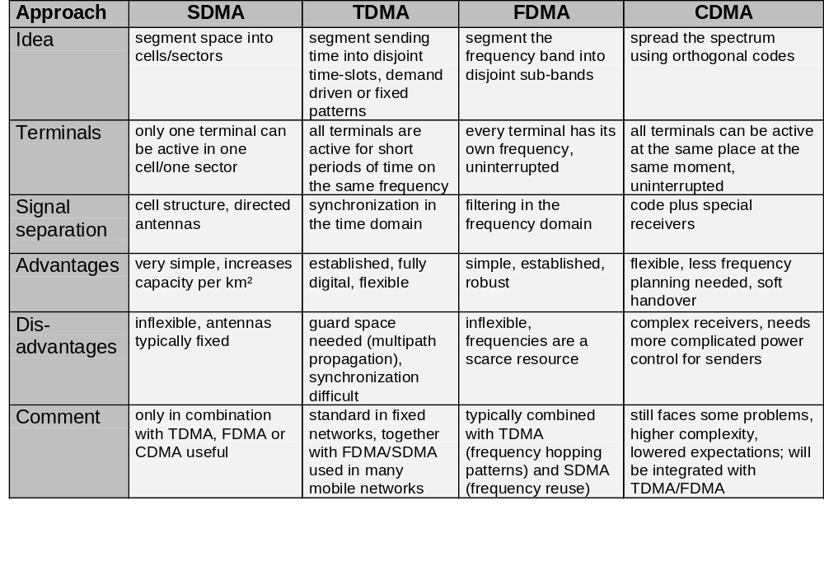
Comparison SDMA/TDMA/FDMA/CDMA

