Slide 1

One Interface,
Infinite Agents
Using Copilot with Omnigent
Anas Khan
Software Engineer, Microsoft · Independent Omnigent contributor
25 min + Q&A
@anxkhn · #DevDays · #DevDaysMumbai · #mumtechup
1
Notes:
Open with the promise: Copilot fixes a bug, the browser views the live session, and Codex reviews a fork with full history. Keep this brief so the live demo starts at 07:00.

Slide 2
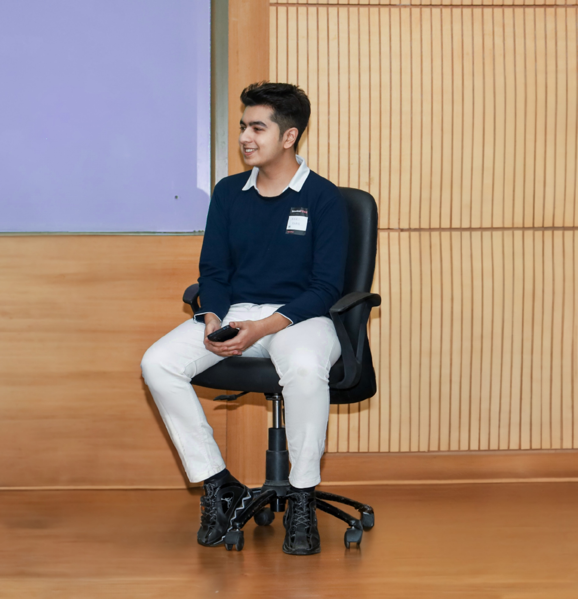
02
Speaker
About Anas
Software Engineer at Microsoft
ANAS KHAN
Backend
systems and
applied AI
Google DeepMind GSoC contributor
Independent Omnigent contributor
22
6
on the Copilot SDK harness
merged PRs
Views are personal. No corporate endorsement implied.
@anxkhn · #DevDays · #DevDaysMumbai · #mumtechup
2
Notes:
Introduce yourself warmly: Software Engineer at Microsoft, Google DeepMind GSoC contributor, independent Omnigent contributor. State 22 merged PRs, six on the Copilot SDK harness. These views are your own.

Slide 3
03
The economic context
Why developers juggle tools
SUBSIDIZED PLANS
THE MANUAL FRICTION
Flat rate pricing
01
Quotas exhaust, prompting developers to rotate tools
Frontier coding subscriptions bundle
massive token allowances and higher
hourly rate limits.
Calling raw API endpoints per token
gets expensive during large tasks.
02
Manual tool switching loses the preceding investigation
03
Rebuilding files and test traces takes 15-20 minutes
04
Copying the prompt passes a headline without evidence
Developers rotate tools for valid economic reasons, but manual handoffs lose the work trace.
@anxkhn · #DevDays · #DevDaysMumbai · #mumtechup
3
Notes:
Explain developer economics: frontier labs heavily subsidize flat-rate coding subscriptions (Copilot, Claude Code, Codex) with high rate limits, while raw API keys get expensive. When developers hit hourly quotas or need another model's strengths, they switch tools. Copying the last prompt passes a headline while leaving the investigation behind.

Slide 4
04
Architecture map
Demystifying the stack
MODEL / LLM
proposes text and tool calls
HARNESS
connects the model to files, tools, tests, and Git (e.g. OpenCode)
AGENT
model + harness + goal, loop, and state
META-HARNESS
coordinates multiple harnesses, sessions, and hosts (e.g. Omnigent)
Model proposes. Harness acts. Agent pursues. Meta-harness coordinates.
OpenCode is a single harness with multi-model dispatch · A meta-harness operates across separate harnesses
@anxkhn · #DevDays · #DevDaysMumbai · #mumtechup
4
Notes:
Define all four layers in plain language: model, harness, agent, and meta-harness. Address OpenCode: OpenCode and Copilot are single harnesses with multi-model dispatch, lacking an agent-to-agent protocol to coordinate with external harnesses. Omnigent coordinates separate harnesses and persists session lineage. T3 Code is an agent harness control surface for operating local coding agents through web, desktop, and mobile clients.

Slide 5
05
Core system
Meet Omnigent
Server-backed work record
1
Keep agent work addressable,
even when the client changes.
Multiple clients
2
Explicit session forks
3
An open source meta-harness for work that spans tools and agents.
Shared policy and usage
4
Apache-2.0 · alpha · shared record, not identical harness behavior
Source: Omnigent deployment overview · repository
@anxkhn · #DevDays · #DevDaysMumbai · #mumtechup
5
Notes:
Introduce Omnigent as an open source way to keep agent work addressable across clients and make forks explicit. Its server-backed record includes normalized session items, usage, policy, and lineage. Apache-2.0 and alpha. Sources: https://omnigent.ai/docs/deploy/overview.

Slide 6
06
Integration taxonomy
How harnesses connect
DIRECT PYTHON SDK
Copilot
NATIVE SDK
Claude Code
github-copilot-sdk embedded in runner process.
Bundled CLI daemon over local IPC.
claude-sdk via claude_agent_sdk.
Directly drives Anthropic agent loop.
NATIVE CLI BRIDGES
Codex · Cursor · OpenCode · Pi
ACP OVER STDIO
Devin · Grok · Gemini · Qwen · Goose
Native daemons and terminal PTY wrappers
supporting Kimi, Kiro, Antigravity.
Agent Client Protocol over child stdio pipes.
Generic ACP adapter connects any CLI tool.
Omnigent unifies direct SDKs, native CLIs, and open ACP agents into one protocol.
Source: Omnigent harness architecture · docs/build/harnesses
@anxkhn · #DevDays · #DevDaysMumbai · #mumtechup
6
Notes:
Explain the four integration styles: Direct Python SDK (Copilot), Native SDK (Claude Code), Native CLI bridge (Codex, Cursor, OpenCode, Pi, Antigravity, Kimi, Kiro), and Agent Client Protocol (ACP) over stdio (Devin, Grok Build, Gemini, Qwen, Goose). Detail the ACP stack: stdio JSON-RPC transport, capability negotiation, and generic adapter.

Slide 7
07
Session branching
Forks preserve complete history
SAME SESSION ATTACH
SESSION FORK
DATABASE
Single session entity in Postgres
DATABASE
Clones full conversation DAG in Postgres
CLIENTS
Terminal & browser connect via WSS
HISTORY
Inherits all prior prompts, diffs & tools
EXECUTION
Existing runner owns active process
EXECUTION
Select host and workspace
PURPOSE
Steering and observing same run
PURPOSE
Specialization, review, quota rotation
Forks preserve complete conversational history in Postgres while rebinding execution to the workspace.
Source: Omnigent collaboration docs
@anxkhn · #DevDays · #DevDaysMumbai · #mumtechup
7
Notes:
Forks preserve complete history: a session fork clones the entire conversation DAG in Postgres, so the receiving agent inherits all prior prompts, file diffs, tool calls, and test outputs. Four reasons to fork: harness capabilities, model specialization, independent review, and rate-limit rotation.

Slide 8
08
Token & cache dynamics
Cache cold starts across forks
WARM CACHE (SAME MODEL)
COLD CACHE (FORKED MODEL)
~90% Cache Hit
0% Cache Hit (Turn 1)
FORK TO NEW MODEL
Input tokens match exact prompt prefix
and model tokenizer.
Metered at discounted cached rates.
Provider KV caches do not cross models.
Turn 1 requires full re-tokenization
at standard input token rates.
Conversation history transfers in the database, but prompt cache resets at the model boundary.
Source: Provider prompt caching documentation
@anxkhn · #DevDays · #DevDaysMumbai · #mumtechup
8
Notes:
Explain cache cold starts across forks: prompt caches and KV caches are model-checkpoint and tokenizer specific. When forking from Copilot to Codex, history is duplicated in Postgres, but prompt cache hits reset to zero on turn one, requiring full input re-tokenization.

Slide 9
09
The adapter
Copilot enters through the SDK
OMNIGENT RUNNER
github-copilot-sdk
SDK-MANAGED CLI
BACKEND
COPILOT SERVICE
tool
usage
compaction
interrupt
policy
Not a separately configured Copilot CLI
Defaults to mai-code-1.1-flash · 22 merged PRs
Source: Omnigent copilot_executor.py · PRs #1486, #1505, #1511
@anxkhn · #DevDays · #DevDaysMumbai · #mumtechup
9
Notes:
Omnigent's canonical copilot harness uses Python's github-copilot-sdk inside a per-conversation harness process. It is not a direct wrapper around a separately installed Copilot CLI. The SDK manages its bundled CLI backing process. Default model is mai-code-1.1-flash. There are 22 merged contributions, including six Copilot harness PRs.

Slide 10
10
Demo contract
Watch the boundary, not the bug
1
2
3
4
Copilot
fixes
Browser inspects
same session
Usage records
evidence
Codex reviews
the fork
Track the session ID, active harness, host, workspace, and test evidence.
@anxkhn · #DevDays · #DevDaysMumbai · #mumtechup
10
Notes:
The demo bug is deliberately small. Ask the room to track the active harness, session ID, host and workspace selection, and evidence verified by each agent. Questions are reserved for the last five minutes. Move directly into the demo at 07:00.

Slide 11
11
Live workflow
Live demo
$ omnigent run --harness copilot
FIX
SAME SESSION
USAGE
REVIEW FORK
Switching to the prepared terminal and browser
@anxkhn · #DevDays · #DevDaysMumbai · #mumtechup
11
Notes:
Follow DEVDAYS_FINAL_TALK_PLAN.md. Run from 07:00 to 12:45. Do not troubleshoot for more than 12 seconds. End on the Codex verdict and visible session lineage. Do not add another Copilot provider turn.

Slide 12
12
Boundary ledger
What crossed the boundary?
✓ AVAILABLE TO CODEX
△ NOT PROMISED
Persisted conversation history
Hidden reasoning tokens
Explicit commands and tool outputs
Provider prompt cache
Workspace files on bound host
Files on unbound machines
Session lineage parentage
Same tool permissions
Recorded usage telemetry
Combined billing accounts
Source: Omnigent collaboration docs · prepared demo evidence
@anxkhn · #DevDays · #DevDaysMumbai · #mumtechup
12
Notes:
Return to the opening question: what moved and what did not? The full conversation history was duplicated in the database, while files were accessed because the fork was bound to the workspace host. Usage is operational evidence, not billing reconciliation.

Slide 13
13
Security architecture
Wire security and payload encryption
ENCRYPTED REASONING
encrypted_content
BENEFITS
• Cryptographically proves reasoning integrity
• Preserves multi-turn context without plaintext leaks
• Protects proprietary model scratchpads
Frontier chain-of-thought tokens arrive sealed.
Omnigent preserves these encrypted payloads in the
session DAG for upstream cryptographic verification.
HOW IT WORKS UNDER THE HOOD
1. Model emits sealed reasoning payload (encrypted_content)
2. Omnigent stores opaque blob untouched in Postgres DAG
TRADE-OFFS
• Opaque in client UI (renders 'Thinking…' indicator)
• Cannot inspect raw chain-of-thought tokens locally
3. Subsequent turns pass blob back to verify reasoning state
Sealed payloads preserve cryptographic verification without exposing internal scratchpads.
Source: Omnigent security architecture & reasoning specs
@anxkhn · #DevDays · #DevDaysMumbai · #mumtechup
13
Notes:
Explain encrypted reasoning payloads: frontier reasoning models emit sealed chain-of-thought tokens as encrypted_content. Omnigent preserves these encrypted blobs in the session DAG for upstream cryptographic verification without exposing raw scratchpads. Detail pros and trade-offs.

Slide 14
14
Portable work record
Evidence the next agent can check
GOAL
Fix cart total calculation
CONSTRAINT
Change src/cart.js only
FILE CHANGED
src/cart.js
DIFF
subtotal - discount + shipping
COMMAND
node --test
OBSERVED RESULT
1 pass · 0 fail
UNRESOLVED RISK
Invalid discounts are not covered
Claims the next agent can independently verify.
@anxkhn · #DevDays · #DevDaysMumbai · #mumtechup
14
Notes:
This is the reusable artifact. It is a structured work record that travels with the session. The next agent receives claims it can verify: files, diff, command, and observed result.

Slide 15
15
Execution safety
Know where it runs and what contains it
TERMINAL · BROWSER
SESSION RECORD
RUNNER HOST
server-backed
workspace · credentials · network
fork branch
PROMPT
POLICY
SANDBOX
"Do not edit"
allow · ask · deny
filesystem · process · network
guides behavior
decides on observed actions
enforces an OS boundary
MULTI-HOST RUNNERS
CONTEXTUAL POLICY
KERNEL SANDBOXING
Local laptop, remote SSH server, or cloud box
Dynamic data protection and live spend caps
Docker, Bubblewrap, seccomp, and Kubernetes
Sources: Omnigent policies · Omnibox · collaboration docs
@anxkhn · #DevDays · #DevDaysMumbai · #mumtechup
15
Notes:
Explain Omnigent's execution architecture: multi-host execution across local machines, SSH servers, and Docker/Kubernetes sandboxes. Three layers of safety: prompts guide intent, policies gate tool calls in software, and sandboxes enforce kernel boundaries.

Slide 16
16
Operational rules
Use the smallest workflow that works
1
Keep Copilot primary when it handles the task.
2
Fork to another harness for a specific role.
3
Bind the target host and workspace explicitly.
4
Verify with tests after branching.
5
Stop once the job is verified.
Usage records provide operational telemetry, separate from the provider invoice.
Omnigent labels itself alpha.
Omnigent: Apache-2.0 · alpha
@anxkhn · #DevDays · #DevDaysMumbai · #mumtechup
16
Notes:
Keep Copilot primary when it fits. Fork to another harness only for a named role. Bind the correct host and workspace. Verify after the fork. Stop when solved. Omnigent labels itself alpha.

Slide 17
17
Closing synthesis
Keep the evidence portable
EMPOWERING DEVELOPERS WITH META-HARNESSES
SUBSIDIZED ACCESS
ZERO RE-LEARNING
COLLABORATIVE VIEWS
Flat-rate coding plans give developers
frontier reasoning models without
runaway per-token API bills.
Maintain all context in a single session
instead of re-learning ten disparate
CLI harnesses, prompt tools, and configs.
Invite teammates into live runs,
comment directly on code diffs, and
inspect transparent session DAG lineage.
When work must move, carry evidence, not confidence.
@anxkhn · #DevDays · #DevDaysMumbai · #mumtechup
17
Notes:
Empowering developers through meta-harnesses: how meta-harnesses let developers, especially young and student engineers, use subsidized frontier plans, keep all context in one session without re-learning tools, and share reproducible, collaborative workflows. End with: carry evidence, not confidence.

Slide 18
Questions?
LinkedIn · anxkhn · X · @anxkhn
Notes:
Open Q&A for five minutes. Repeat every audience question into the microphone. Discuss Copilot SDK, session forks, ACP protocol, or security boundaries. Keep the notes URL visible.

