Slide 1
SHOP-O-GREEN
MUMBAI/INDIA
Team Members:
Ritesh Panjwani
Bhaskar Gurram
Vinayak Jaiswal
Kanvi Parekh

Slide 2
Problem Statement
With the increasing options in brand selection for a single kind of product and tertiary sector taking turn for the better, which in turn adds to the carbon footprint, consumers often go for less sustainable products than the more sustainable contemporaries. To create an awareness regarding the ideal choice of product among the consumer is the need of the hour.

Slide 3
Solution for the problem
The project aims at developing an Android application based chiefly on barcode scanning for monitoring the purchasing habits of the user and maintaining a ‘Climate-Welfare-Centric’ database that is integrated with the application.

Slide 4
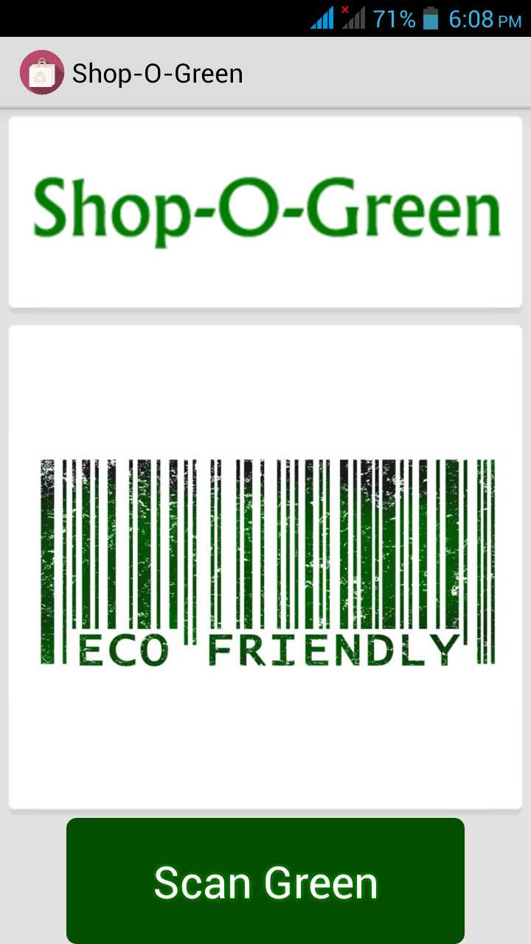
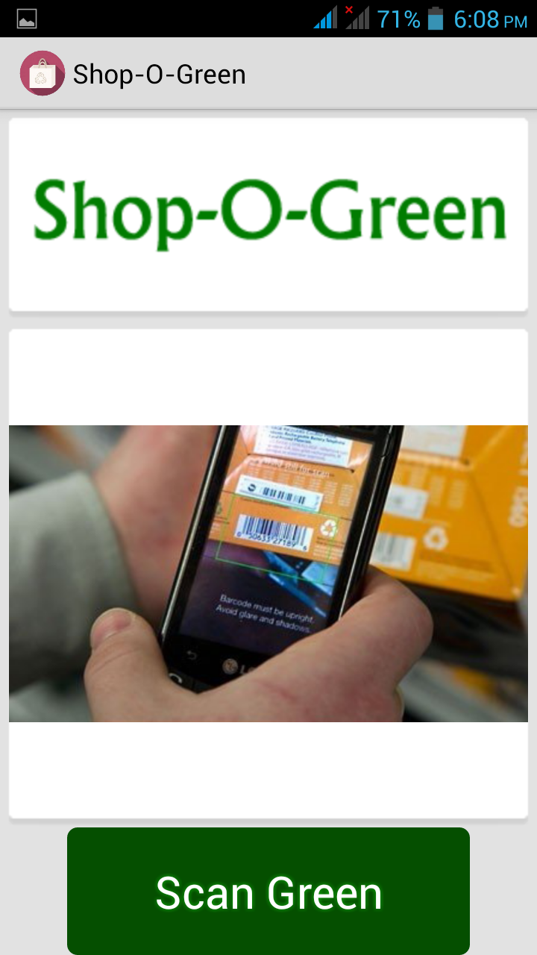
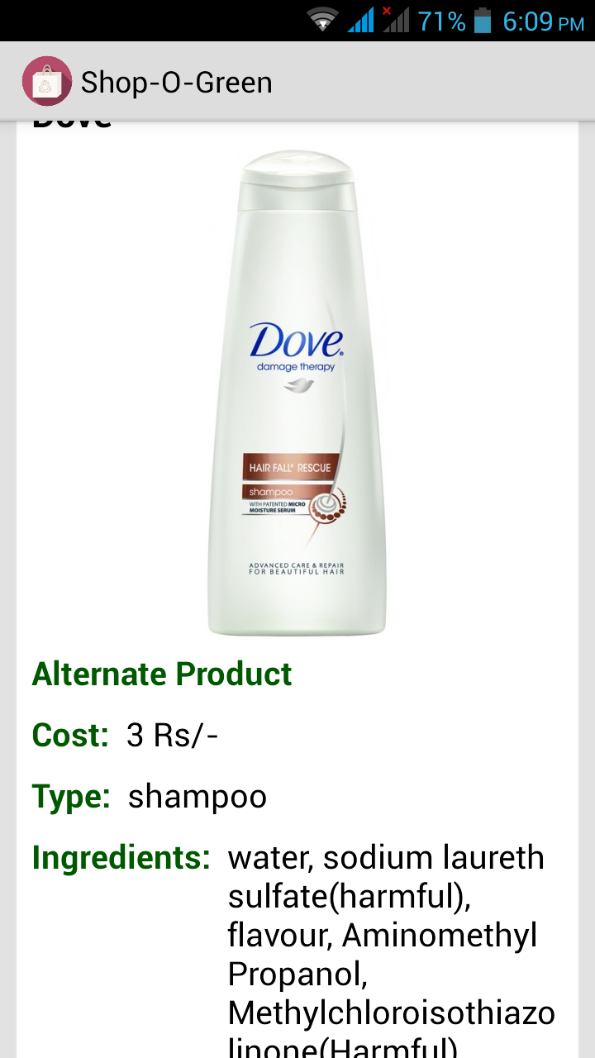
Screenshots of the app

Slide 5
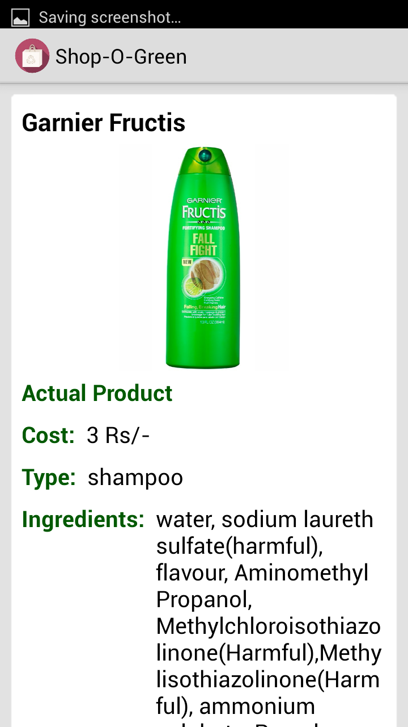
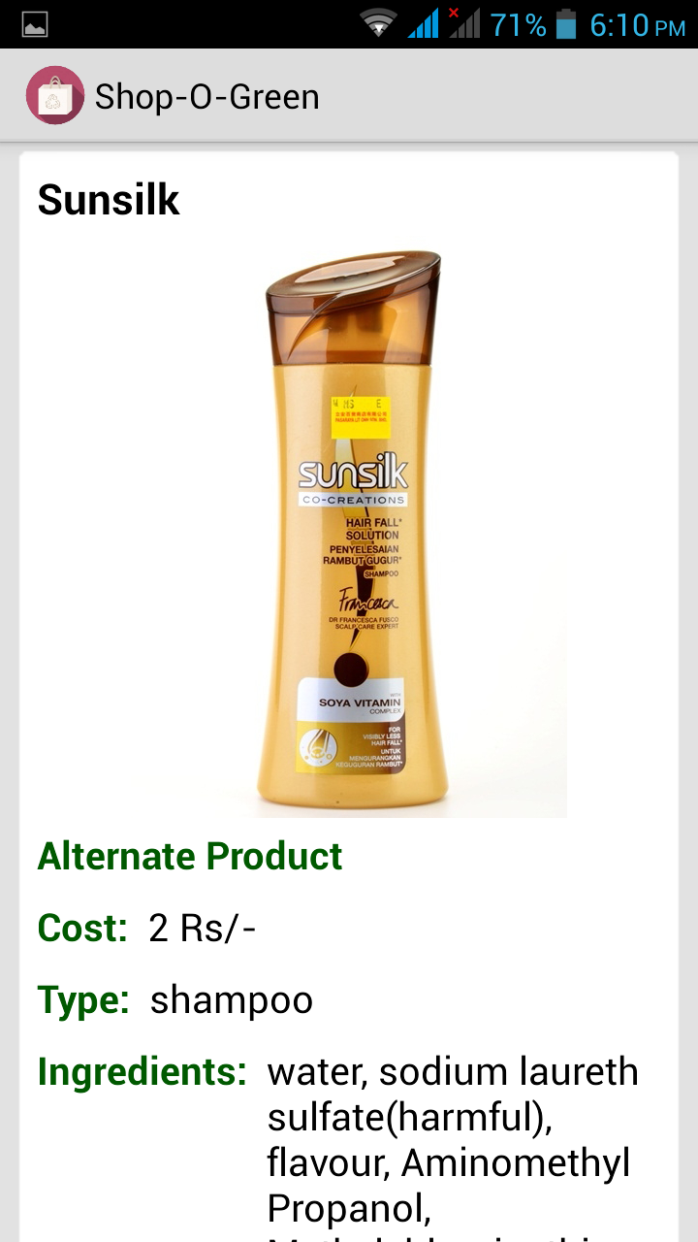
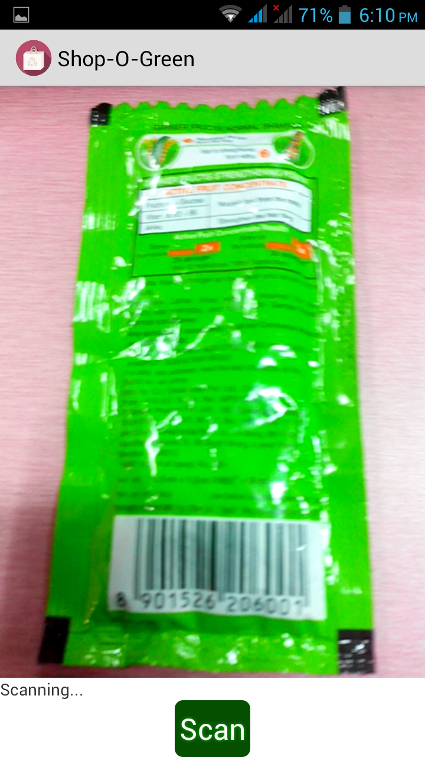
Screenshots of the app

Slide 6
Progress so far
The application successfully implements barcode scanning and lists the product name, key ingredients including the harmful ones, lists the environment harming quotient and lists more sustainable products along with their respective details. The database of products has been developed for shampoos, detergents, deodorant and it has to be expanded and maintained from time-to-time.

Slide 7
Future Prospects
In view of expanding this application, we can work in coalition with various organizations to expand the database of various products and keep updating it from time-to-time.

Slide 8
Twitter Handles
riteshppanjwani
bhaskargurram
codervinayak
kanvi.parekh

