Slide 1

Watthours.com Mumbai,India
Team Members
Hetal Motwani
Krapi Shah
Prajakta Kulkarni
Sarup Dalwani

Slide 2
Problem Statement
We are working on creating a platform to make public awareness and also to encourage people to put their right foot forward towards saving the earth. This is a small step towards saving our Earth.
Public Awareness
How might we increase overall understanding of the science and facts of climate change, to gain a critical mass of public awareness and support for strong action on climate change?
Personal Impact
How might we help individuals and families understand their personal impact and carbon footprint, shift to climate-friendly behaviours and reduce carbon-intensive consumption? NGO-- Save the Children

Slide 3
Solution:
Solution for this problem:
We must try to involve people towards our aim to save the environment.
As today most of us firstly look forward to our own benefits we try to provide them incentives like discount coupons, free recharge, etc. on any step taken forward.

Slide 4
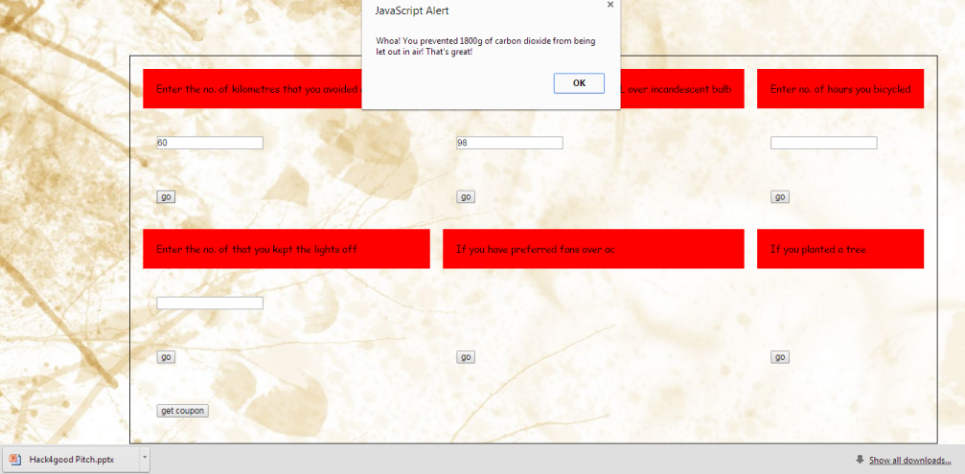

Slide 5
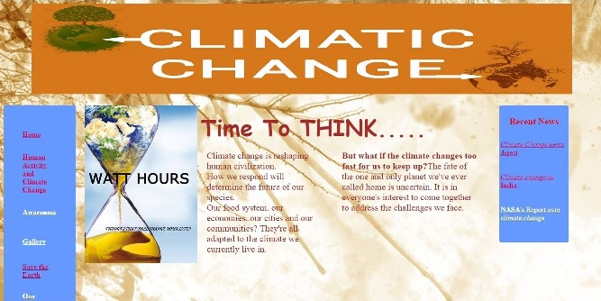
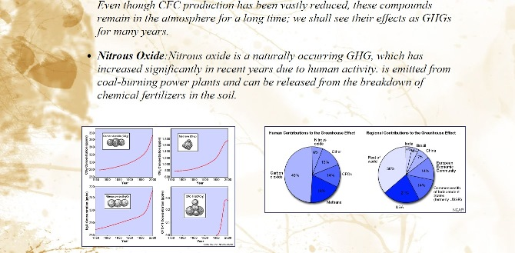

Slide 6
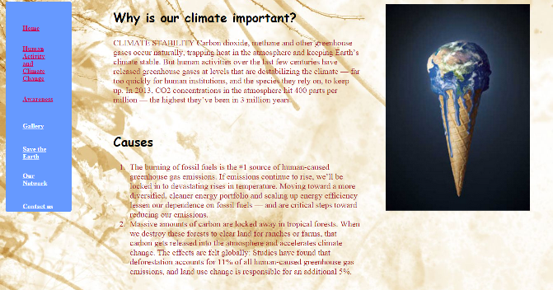
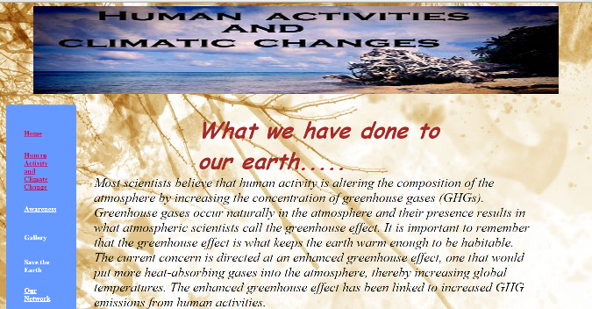

Slide 7
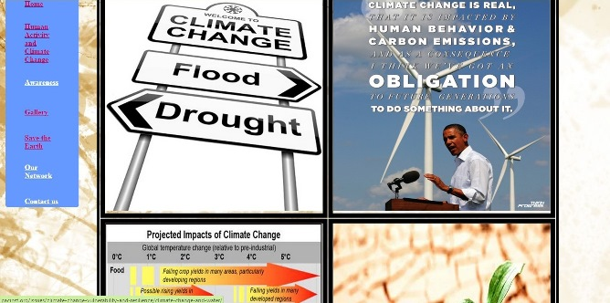
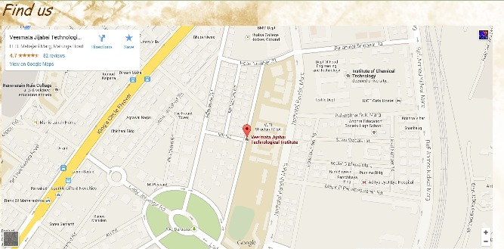

Slide 8
What We Have Done..
We have created a website showing the impacts of our actions on the today’s world. This helps in creating public awareness regarding the same.
Also we have tried to include our idea giving incentives as and when a user adds his achievement in helping save the planet.

Slide 9
How We Can Continue…
We can link with varied NGOs to take the idea of carbon credits on a higher platform.
The gallery images will be updated depending on the positive or negative steps taken by us.
Also we can have various apps that can help us verify about the steps taken to reduce carbon footprints.
Have a user account that keeps a tab of the activities the user is doing. Depending on it we can give them badges, points ,etc and appropriate rewards depending on that.
We can create a timer which will help the people to understand the catastrophic effects of the climatic changes and the steps that need to be taken RIGHT away to save the earth from this catastrophe.
Further, we can link the site to an auto mailing process that will give the users various incentives, thus boosting their morale.
Also, the achievements can be posted on the users Facebook wall or other social networking sites.

