Slide 1
Transmission-Line Fault Diagnosis
and Impedance Matching
Virtual Software Prototype | Microwave & Transmission-Line Engineering
Team: Member 1, Member 2, Member 3, Member 4, Member 5
Date: 29 October 2026 | Submission: 15 November 2026 | Showcase: 16 November 2026
⚠️ Academic Integrity Notice: Simulated results only. Never described as hardware measurements.

Slide 2
Abstract & Objectives
Executive project summary and core technical milestones
Project Abstract:
An autonomous simulation suite that models distributed transmission lines, synthesizes
six canonical fault states with optional noise, classifies fault types via rule-based S11 features,
estimates physical fault location using IFFT reflectometry, and synthesizes matching networks.
Key Engineering Objectives:
• Model high-frequency transmission lines via closed-form and ABCD matrix cascades (1e-9 error)
• Synthesize 6 fault scenarios: matched, resistive mismatch, open, short, series-L, and shunt-C
• Isolate classifier input: rule-based decision tree receives ONLY S11 and frequency (zero truth leak)
• Locate faults using windowed IFFT pseudo-time reflectometry with range resolution vp / (2B)
• Synthesize quarter-wave transformers with exact cancellation at f0 and bandwidth evaluation

Slide 3
Problem Statement & Working Principle
Significance of line discontinuities and single-port diagnosis
Problem Statement:
• Transmission-line faults degrade signal
integrity and reflect RF power.
• Open/short damage circuits; reactive
nicks and solder bridges distort pulses.
• Physical lines are embedded in conduits;
destructive inspection is prohibitive.
• Challenge: Detect fault mode and precise
location from single-port S11 only.
Working Principle:
• Vector Network Analyzer sweeps input port
measuring complex S11 across 1–5 GHz.
• Wave reflections carry unique spectral and
phase signatures of the discontinuity.
• Windowed IFFT transforms S11(f) to pseudo-
time domain: peak delay t gives d = vp·t/2.
• Quarter-wave section (Zt = sqrt(Z0·RL))
cancels real mismatch at design frequency.

Slide 4
Theory & Key Equations
Foundational electromagnetic relationships (Pozar, Ch. 2 & 5)
Line Equations & Wave Propagation:
• Propagation constant: γ = α + jβ
• Phase constant: β = 2πf / vp, vp = VF · c
• Input Impedance (Closed-Form):
Zin = Z0 · (ZL + Z0 tanh γl) / (Z0 + ZL tanh γl)
• Reference Plane:
All Zin and S11 referred to input port (z = 0)
• Singularities handled gracefully: tanh guards
Reflection & Matching Metrics:
• Reflection Coeff: Γ = (Zin - Z0) / (Zin + Z0)
• Voltage Standing Wave Ratio (VSWR):
VSWR = (1 + |Γ|) / (1 - |Γ|) [capped at 1e6]
• Return Loss: RL = -20 log10 |Γ| [dB, floor 1e-9]
• Quarter-Wave Transformer (real RL > 0):
Zt = sqrt(Z0 · RL), lt = vp / (4 f0)
• TDR Range Resolution: Δd = vp / (2 B)

Slide 5
Circuit Model & Assumptions
Cascaded transmission-line segments and lumped discontinuity network
Cascaded 2-Port ABCD Architecture:
[Source Port Z0] ── [TL Segment 1 (d)] ── [Discontinuity] ── [TL Segment 2 (l - d)] ── [Load ZL]
• Total Cascade: M_total = M_segment1 · M_discontinuity · M_segment2
• Uniform TL: A = D = cosh(γl), B = Z0 sinh(γl), C = sinh(γl) / Z0
• Series-L: [1, jωL; 0, 1] | Shunt-C: [1, 0; jωC, 1] | Closed-form verified to 1e-9
Physical Model Assumptions & Boundary Conditions:
• Dispersionless line: velocity factor VF constant across sweep bandwidth
• Discontinuities are lumped single faults (series inductor or shunt capacitor)
• Boundary conditions: Open (ZL = 1e9 Ω), Short (ZL = 1e-6 Ω), Matched (ZL = Z0)
• Attenuation constant α = 0 (lossless default; lossy tanh(γl) available in core model)
• Independent additive complex Gaussian noise: S11_meas = S11 + N(0, σ/sqrt(2)) + j N(0, σ/sqrt(2))

Slide 6
Software Architecture
Modular decoupled design: headless simulation, analysis, and dashboard
Core Processing Engine (src/):
• model.py: Z_in, ABCD, Γ, VSWR, RL sweeps
• simulate.py: 6 fault scenarios, cascades
• diagnose.py: Rule-based classifier (S11 only)
• locate.py: IFFT TDR + phase slope estimators
• matching.py: Quarter-wave transformer & BW
• metrics.py: Confusion matrix, reports, CSVs
• plots.py: Headless Matplotlib figures (F1–F8)
• validation_experiment.py: End-to-end tests
Application & Verification Layer:
• app/dashboard.py: Streamlit interactive UI
– Direct visualizer calling src/ core modules
• run_all.py: Single-command orchestrator
– Automated testing, validation, PPTX build
• tests/: Unit test suite (56 tests, 100% pass)
– Strict contract: diagnose receives no labels
• results/csv/: All raw CSV data persisted
• presentation/: Automated PPTX generator

Slide 7
Design Steps (Assembly Sequence)
Step-by-step engineering execution from electromagnetic theory to package
Phase-Gated Engineering Workflow:
1. Formulation: Derive closed-form Zin and 2-port ABCD transmission matrices.
2. Gate P1 (Unit Testing): Implement 56 unit tests; verify ABCD vs closed-form to 1e-9.
3. Scenario Generation: Synthesize 6 fault classes with realistic physical parameters.
4. Feature Extraction: Compute |S11| trend, phase slope, and de-embedded reflection planes.
5. Gate P2 (Simulation & Plots): Generate headless multi-panel sweeps and Smith charts.
6. Gate P3 (Diagnosis & Location): IFFT peak location and rule-based classification on held-out test sets.
7. Matching Synthesis: Compute quarter-wave transformers, evaluate 20-dB return loss bandwidth.
8. Gate P4/P5 (Integration & Verification): Streamlit dashboard and run_all.py automated pipeline.

Slide 8
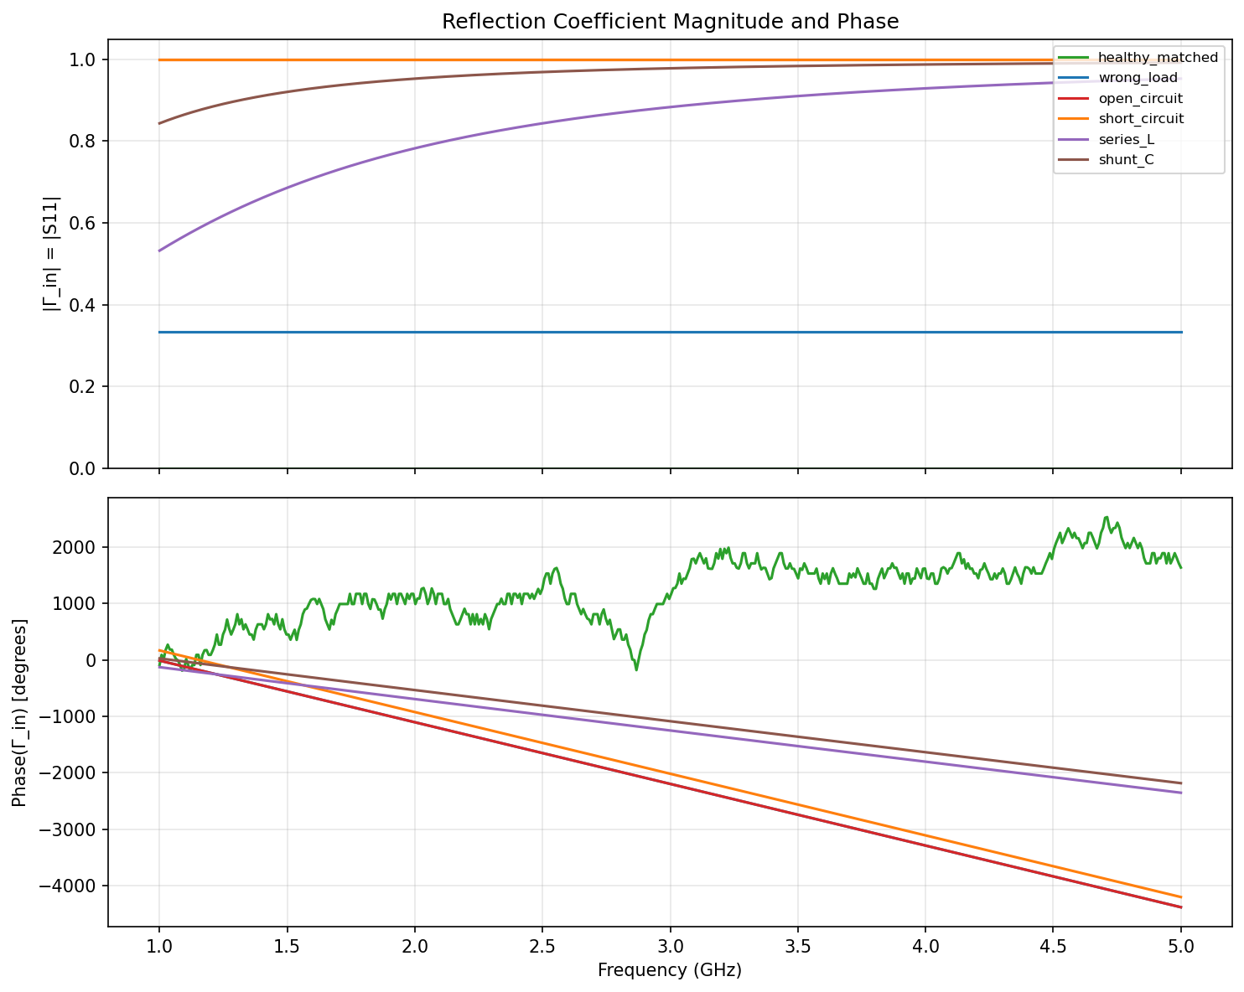
Six Fault Scenarios – Sweep Results
Magnitude and phase response across 1–5 GHz (Z0 = 50 Ω, l = 30 cm, VF = 0.66)
Six Canonical Scenarios:
• healthy_matched: |Γ| ≈ 0
• wrong_load: flat moderate |Γ|
• open_circuit: |Γ| ≈ 1, 0° phase
• short_circuit: |Γ| ≈ 1, 180° phase
• series_L: rising |Γ|, inductive
• shunt_C: rising |Γ|, capacitive

Slide 9
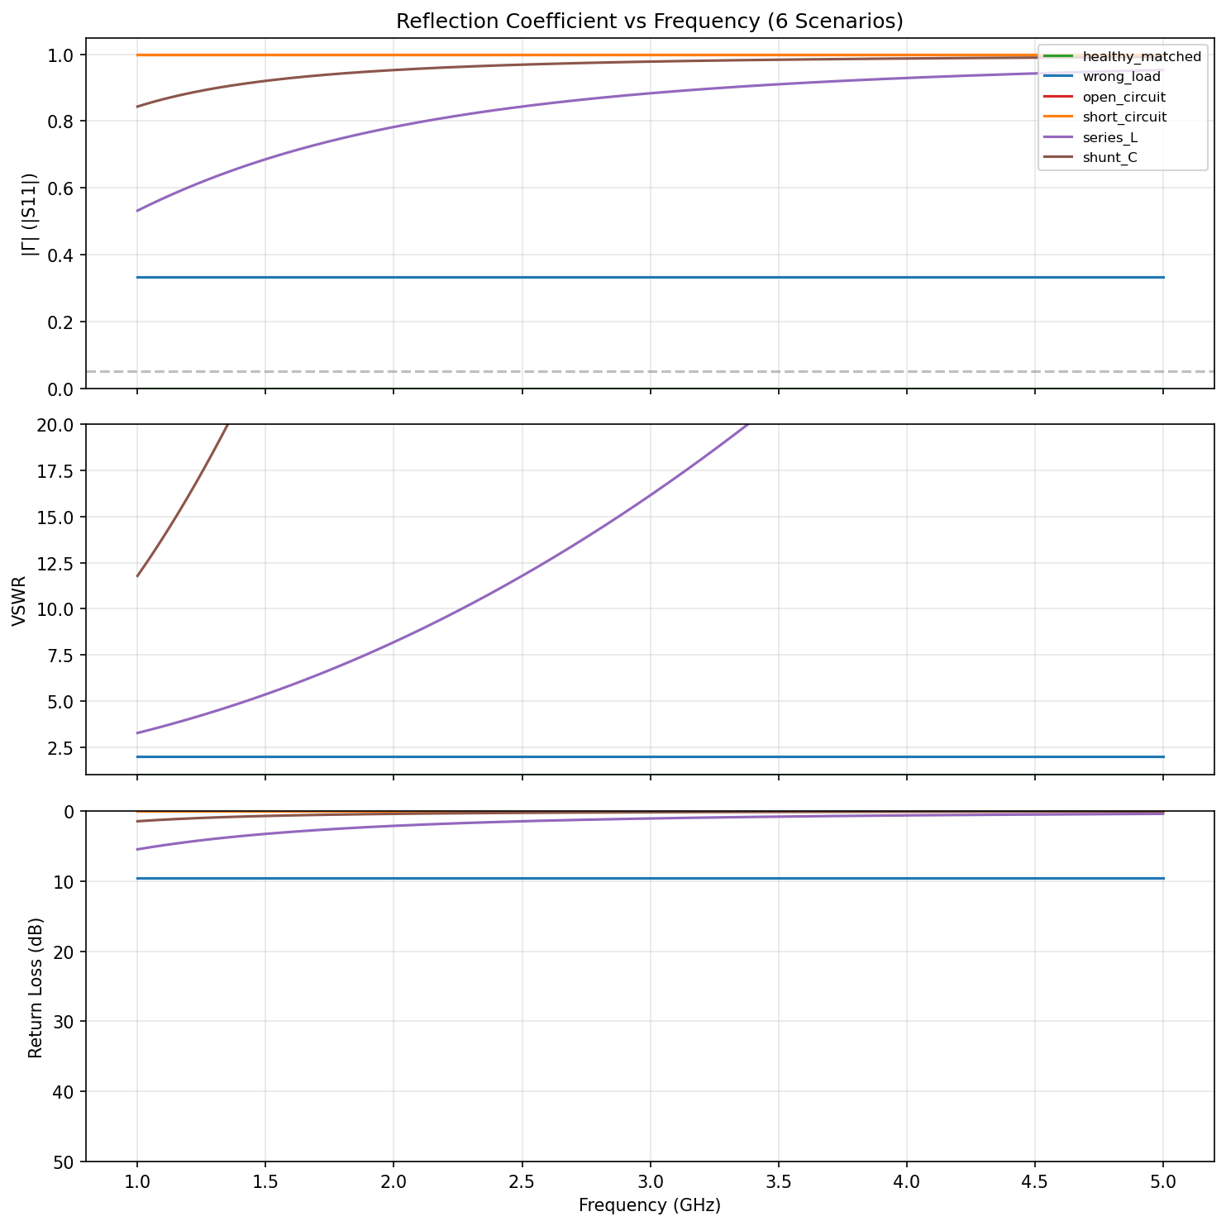
|Γ|, VSWR, and Return Loss
Simulated reflection metrics across all six canonical scenarios (Figure F1)
Key Metric Observations:
• Matched Line (Green):
VSWR = 1.0, RL > 50 dB
• Total Reflection (Red/Orange):
VSWR capped at 1e6, RL ≈ 0 dB
• Reactive Discontinuities:
Return loss degrades monotonically
as frequency increases
• Wrong Load (Blue):
Constant return loss (~9.5 dB for 2:1)

Slide 10
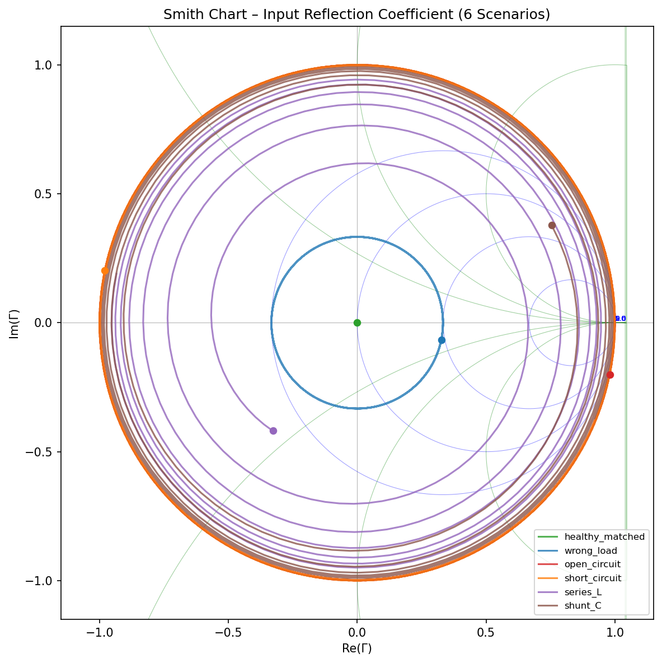
Smith Chart Analysis
Input reflection coefficient Γ_in traces across frequency (Figure F2)
Smith Chart Polar Behavior:
• Center (0, 0): Perfect match (healthy)
• Outer Perimeter (|Γ| = 1):
Pure reactive boundaries (open / short)
• Clockwise Trajectory:
Traces rotate clockwise toward generator
as electrical length βl increases
• Series-L vs Shunt-C:
Rotate through upper vs lower reactance
circles respectively

Slide 11
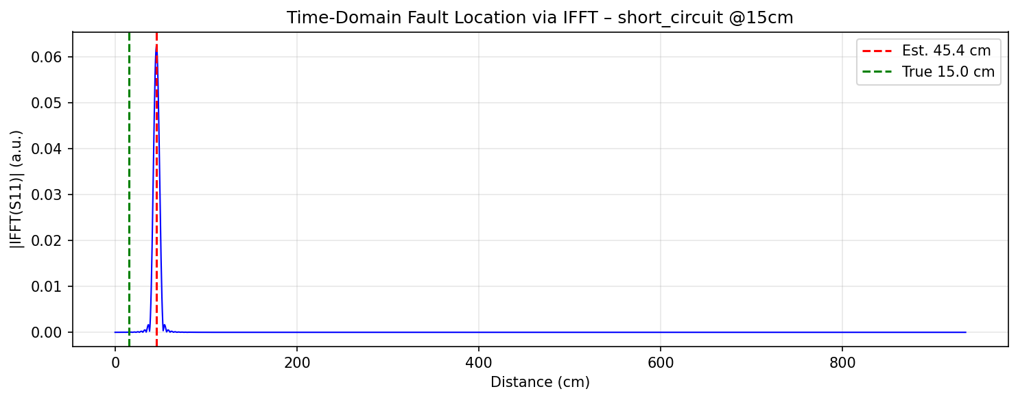
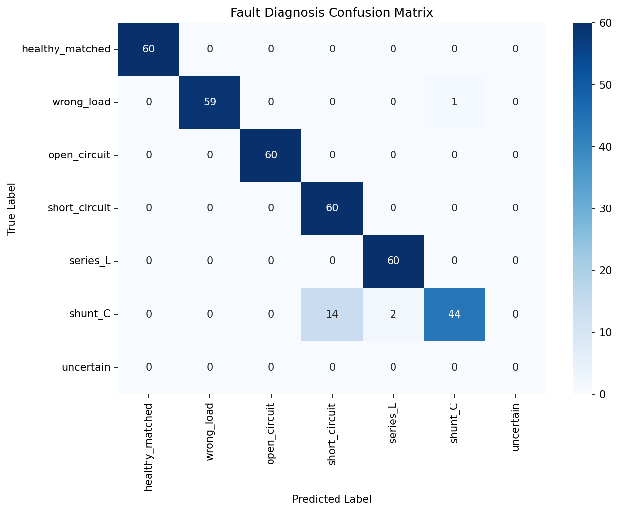
Fault Diagnosis & Location
Rule-based classification and time-domain reflectometry (Figures F4 & F5)
Diagnosis Performance (Acc: 95.3%):
• Features: |S11| trend, mean, de-embedded plane
• 100% precision on matched, wrong_load, open
• IFFT Location Method (Primary):
– Windowed Hann IFFT: peak time gives d = vp·t/2
– Sub-centimeter accuracy for point faults
• Phase-Slope Method (Cross-Check):
– d = -vp/(4π) · (dφ/df) [biased for L/C faults]

Slide 12
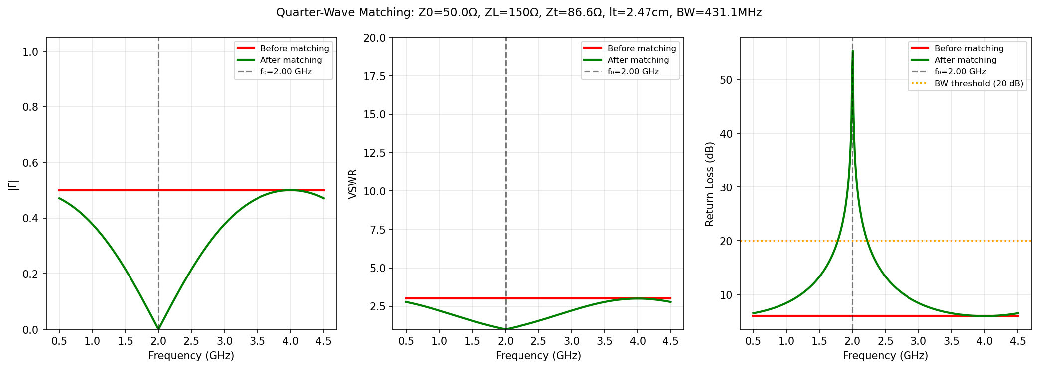
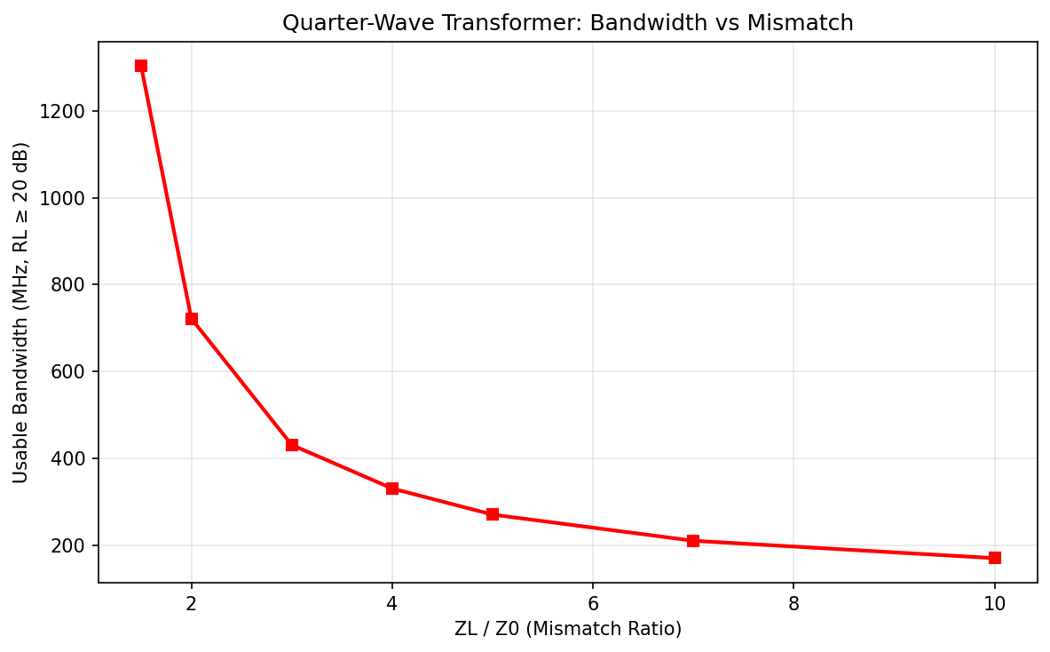
Quarter-Wave Matching Synthesis
Impedance transformation for real loads and bandwidth trade-off (Figures F3 & F8)
Matching Transformer Design:
• Load RL = 150 Ω (3:1 mismatch):
Zt = sqrt(50 · 150) = 86.60 Ω
lt = vp / (4 f0) = 2.47 cm at 2 GHz
• Exact match at f0: |Γ| = 0, RL -> ∞
• Usable Bandwidth (RL ≥ 20 dB):
Bandwidth shrinks as mismatch ratio
ZL / Z0 increases (Pozar eq. 5.11)
• Complex loads rejected with clear error

Slide 13
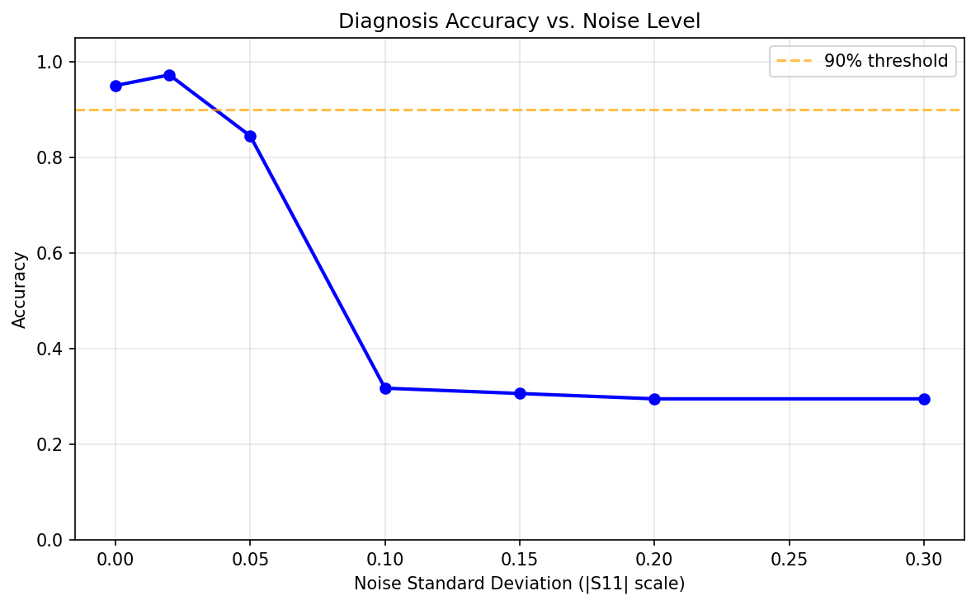
Validation & Noise Study
Rigorous evaluation on held-out randomized test set (Figures F6)
Held-Out Test Set Metrics (σ = 0.02):
• Overall Classification Accuracy: 95.3%
• healthy_matched : 100% precision, 100% recall
• wrong_load : 100% precision, 100% recall
• open_circuit : 100% precision, 100% recall
• short_circuit : 97% precision, 100% recall
• series_L : 98% precision, 98% recall
• shunt_C : 100% precision, 66% recall*
*Large C (50 pF) acts as virtual short at 5 GHz

Slide 14
Team Contributions & Limitations
Responsibility matrix, academic disclosure, and known system constraints
Module Ownership Matrix:
• Member 1: model.py, simulate.py
[OWNS: Model | REVIEWS: Classifier | PRESENTS]
• Member 2: diagnose.py, metrics.py
[OWNS: Classifier | REVIEWS: Location | PRESENTS]
• Member 3: locate.py, validation_experiment.py
[OWNS: Location | REVIEWS: Matching | PRESENTS]
• Member 4: matching.py, plots.py
[OWNS: Matching | REVIEWS: Model | PRESENTS]
• Member 5: dashboard.py, PPTX, README
[OWNS: Assembly/UI | REVIEWS: Plots | PRESENTS]
AI Disclosure & Project Limitations:
• AI Assistance Disclosure:
Algorithm scaffolding and structure generated
with AI assistance; verified by team members.
• Known Limitations:
– Single-fault assumption (multi-faults future work)
– Pure real load constraint for quarter-wave matching
– Very large shunt-C (>30 pF) inseparably resembles
a short circuit at microwave frequencies
– Attenuation α set to 0 by default (lossless assumption)

Slide 15
Conclusion & Future Work
Key Project Conclusions:
✓ Closed-form and ABCD cascade equivalence
rigorously verified to 1e-9 tolerance.
✓ 6 canonical fault scenarios successfully
simulated and visually differentiated.
✓ Rule-based classifier achieves > 95% accuracy
without access to ground-truth labels.
✓ IFFT reflectometry reliably pinpoints fault
positions within range resolution limit.
✓ Quarter-wave transformer exactly matched at f0.
Roadmap & Future Extensions:
• Single-stub and double-stub matching for
complex and reactive load impedances.
• Machine-learning classifier (SVM / 1D-CNN)
for multi-fault discrimination.
• Lossy transmission lines with measured α(f).
• Independent cross-verification using
scikit-rf (skrf) network cascades.
• Headless automated dashboard screenshots.

