Slide 1
RE-Station
CXA Open Category 2019
By: Technoobs
Terence Chan, Nanyang Junior College Year 1
Loh Kar Wei, Singapore Polytechnic Year 1

Slide 2
Main Idea
To make it more convenient to share reused goods
RE-Station will act as the middle-man for people to declutter their homes and list out unused items for others to claim and use
This discourages people from buying a whole new product when they can just claim one from our lockers and it will work the same

Slide 3
RE-Station Website
Uses Bootstrap, HTML, CSS, Javascript and Firebase
Users can choose to sign up a new account or login with their google accounts to start collecting milestone points and list items on the website
Users are able to view all the listings listed and “Claim” them from the lockers
Users will be provided the locker location, number and 6 digit OTP too to open up the locker
Users can also create a new listing which will then update the database and a pin provided to them
Users will have to use the pin to open the locker and place their item in before it is validated

Slide 4
Additional Website Features
Learn More Page
For users to learn more on the current climate change issue, the 3Rs and how our project will help us in fighting climate changing by Reusing and Reducing
User review system
Users are able to leave a review (1 to 5 out of 5 in total) to gauge their overall experience with the other party’s item
The average of all ratings is calculated and displayed on the “My Listings” page

Slide 5
Milestone Points & Rewards
Upon successfully listing a new item or claiming one, users are awarded with Milestone Points
Upon reaching a specific number of milestone points, User’s milestone level will increase and vouchers will be rewarded to them for redemption
The vouchers awarded in this Milestone system can be sponsored from Enterprises looking to do some charity and support our reusing drive
Users can head over to the “My Rewards” page to view their vouchers available for redemption

Slide 6
Phone Compatibility
Users are also able to view this web app on their phones hence making the entire RE-Station system much more accessible and convenient

Slide 7
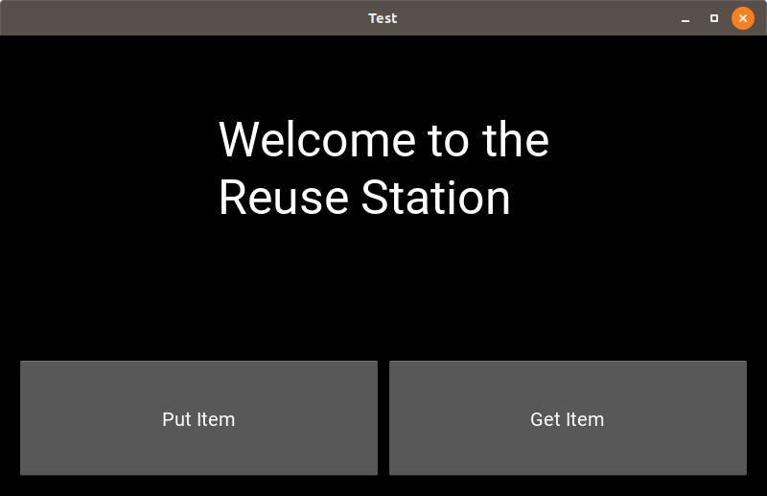
Locker
Is where you can place/ get used objects
In 1 station, there are supposed to be multiple lockers, but due to time/ technical constraints, we only have 1 locker
People can put an unwanted item at the station, after keying in its name, details, and providing a necessary photo (Can be taken with on board camera)
Has Image Recognition software to check the object before hand (Prevent Abuse)

Slide 8
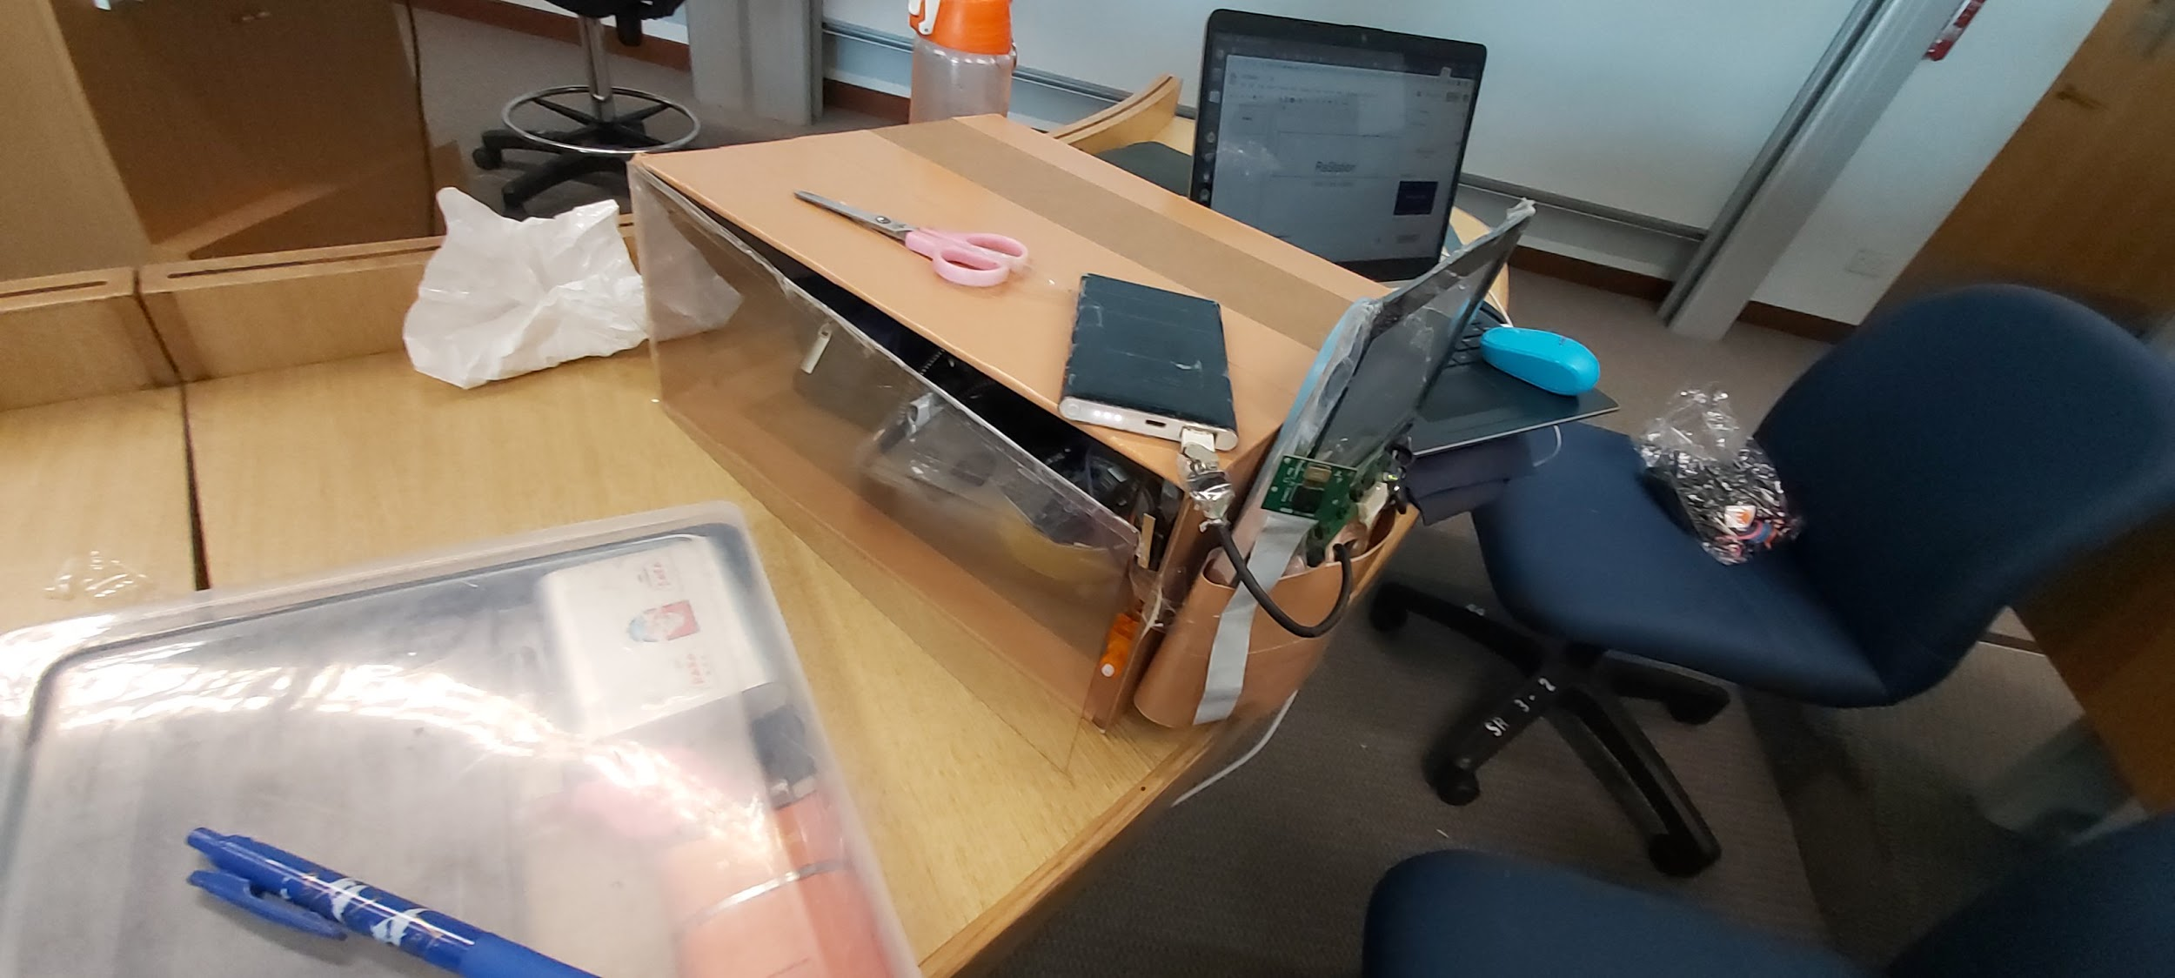
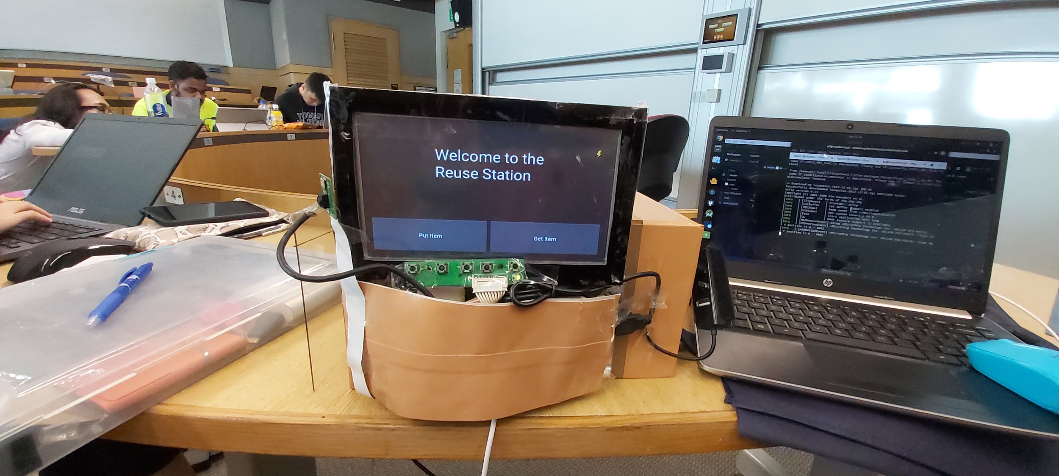

Slide 9
More Technical Details about the Locker
Raspberry Pi with 7 inch resistive Touch Screen
Raspberry Pi Camera
Arduino
Servo (To lock the door)
Ultrasonic Sensor (To check if an item is properly placed in the Locker)
Door switch

Slide 10
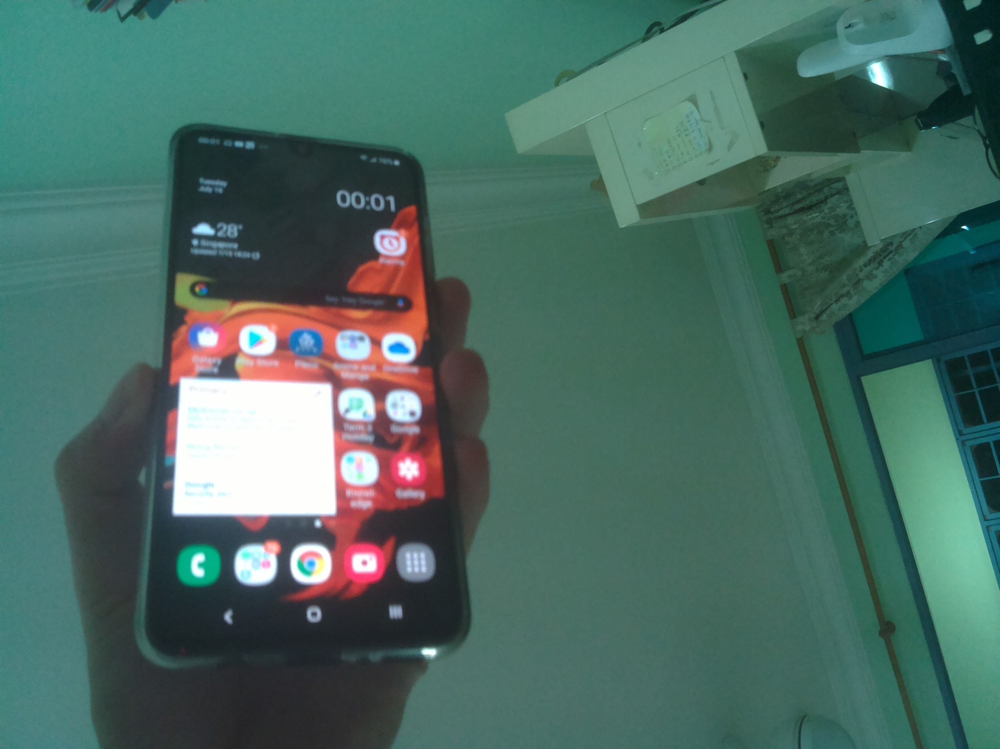
Procedure
Person selects whether they want to put or retrieve an item
Input details about an item
Take a photo of the item with the on board camera
Uses a Pretrained Image Recognition model (Inception) to check item.
Only allows suitable items
Unlocks the locker with the servo
When the user placed an item
(Check item is placed with the ultrasonic sensor)
User closes the locker before locking
Uses a switch to know if the locker is closed

Slide 11
Retrieving Item
Select the Option to retrieve an item and enter the locker number
If already claimed, enter the secret pin needed to claim this object
The person can remove the object from the locker

