Slide 1

BloodHound-Kube
Kubernetes Attack Path Analysis with BloodHound
Don Cowan | https://github.com/HackinAhab/bloodhound-kube

Slide 2

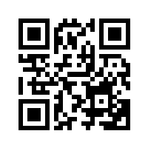
~# whoami
pentester | homelab nerd | semi-professional debugger of skill issues
Don Cowan
@HackinAhab
https://ahab.dev/card
2

Slide 3
Kubernetes relationship problems
• A Kubernetes cluster is not just one permission system, it is many relationships stacked together.
• RBAC, service accounts, workloads, secrets, and namespaces interact in non-obvious ways.
• A single permission often looks harmless until it is chained with workload behavior.
•kubectl and raw YAML don’t show multi-step reachability at scale.
•Penetration tests need fast answers to “what can this principal become?”
3

Slide 4
What is BloodHound-Kube?
1
2
3
4
Collect
Parse
Output
Explore
Gather Kubernetes objects via API
Build nodes, edges, and properties
Generate BloodHound OpenGraph JSON
Import and investigate paths
# collect and parse using current kubeconfig/context
./bloodhound-kube collect --scope all --cluster demo --parsed-output demo.json
# optional: redact Secret data values while preserving key names
./bloodhound-kube collect --redacted --zip --output demo.jsonl
4

Slide 5
Demo time!
1
Build the binary.
# baseline check
go build -trimpath -ldflags "-s -w" -o bhk .
2
Run collection against the demo contexts.
# collect + parse
Upload or import the OpenGraph data.
./bloodhound-kube collect --cluster live-demo --redacted --parsed-output live-demo.json
3
# upload graph data
4
Run prepared Kubernetes path queries.
./bloodhound-kube upload --upload-file live-demo.json --token-id $BLOODHOUND_TOKEN_ID --token-key $BLOODHOUND_TOKEN_KEY
5
Explain paths
5

Slide 6
Demo Video
6
Notes:
In case of the demo gods striking me down

Slide 7
How to Interpret the Graph
What the graph can tell you
What still requires tester validation
•Which objects are connected by relationships.
•Which paths are the most straightforward.
•Which misconfiguration is most relevant to the path.
•Which relationship is likely to lead to an objective.
•Whether the path is exploitable in the specific environment.
•Whether compensating controls block the chain.
•Whether captured credentials are valid and in scope.
•Whether the path creates meaningful business impact.
7

Slide 8
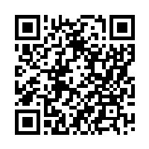
Questions?
1
Kubernetes authorization is a graph problem.
BloodHound-Kube turns cluster state into OpenGraph data.
2
Better visibility leads to better, faster, more accurate testing.
3
github.com/HackinAhab/bloodhound-kube
Open source | Contributions and feedback welcome
8

Slide 9
PlaceHolder
Keep the live demo narrow: one environment, one path, one clear conclusion.
06
BLOODHOUND-KUBE

