Slide 1









VORTEXA
3.0
12 HRS HACKATHON
POWERED BY A.I.R.S
DOMAIN & NO : 3, B-03
PROBLEM STATEMENT TITLE : MILESTONEVAULT: ADVERSARIAL SMART-CONTRACT ESCROW
TEAM NAME : TORVALDS
SEALSTONE
TEAM ID : XQR1520246
Escrow that can't be tricked
TEAM LEADER : Omkar Rane
TEAM MEMBERS : Omkar Rane, Pranay Patil
Notes:
0:00 (20 s). We are Sealstone, our answer to B-03 MilestoneVault. One sentence: escrow that can't be tricked by ambiguous agreements, swapped deliverables, or malicious contracts. Everything you will see today is a working product you can test.

Slide 2




PROBLEM STATEMENT
Milestone escrow breaks in three ways, and most projects fix only one.
1
Ambiguous agreements
2
Swapped deliverables
3
Buggy money code
Agreements are written in prose. Vague terms hide disputes before any money moves.
Approval isn't tied to a specific file, so what was reviewed can differ from what gets paid.
A double release, a missing check or a re-entrant call can drain funds that can't be recovered.
"to the mentor's satisfaction"
≠
3.000 ETH
"paid from the remaining funds"
reviewed
delivered
taken from a naive escrow in one attack
AI may propose a checklist, but a person must confirm it, ambiguities must be resolved, and AI output must never be written to the contract directly.
THE BRIEF SAYS
Notes:
0:20 (40 s). Three failures. One: agreements are prose, so 'to the mentor's satisfaction' is a future dispute. Two: approval is not bound to a file, so what is reviewed can differ from what is paid. Three: money code is unforgiving; our Attack Lab shows a naive escrow losing 3 ETH of other people's money to one re-entrancy attack. The booklet adds the rule that shapes our design: AI proposes, a person confirms, and AI never writes to the contract.

Slide 3
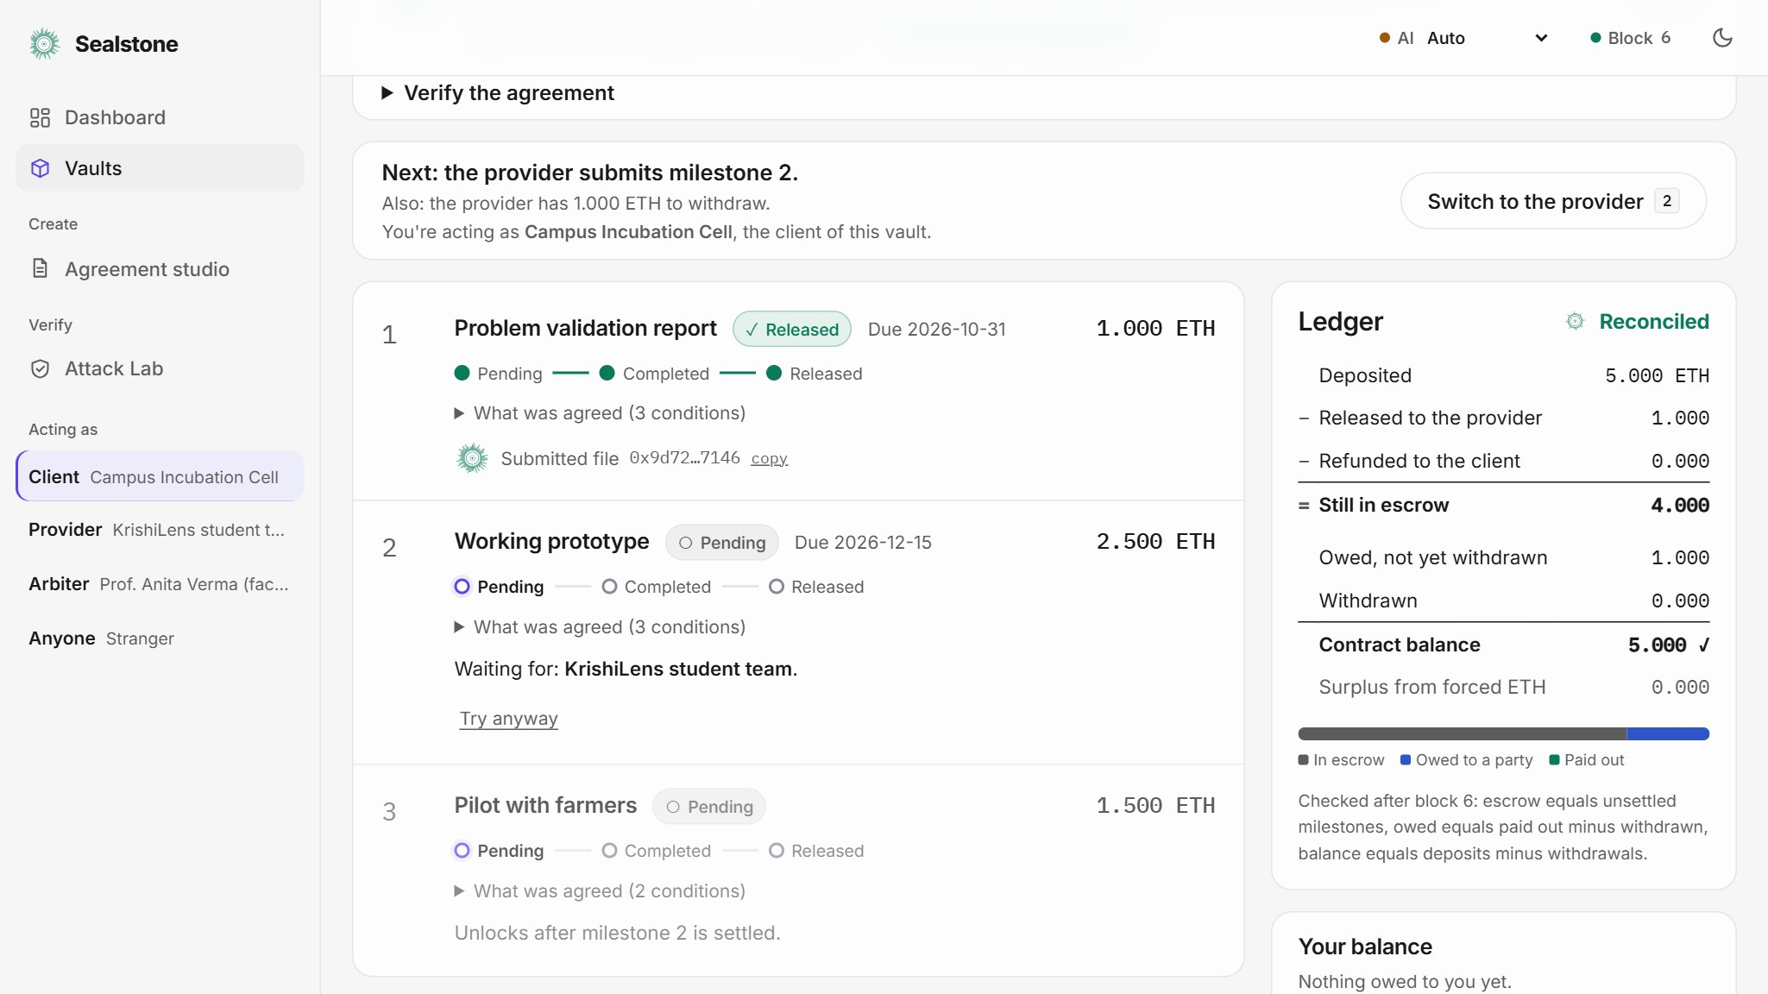
IDEA TITLE / PROPOSED SOLUTION
Sealstone: three layers of integrity, so nobody can trick the payment.
AGREEMENT INTEGRITY
sealstone.local/vault
1
AI proposes and flags unclear terms. Rules re-check, a person resolves every flag, and both sides sign the hash.
2
DELIVERABLE INTEGRITY
The provider commits the file's SHA-256. The client can approve only that exact file.
3
FUND INTEGRITY
Role-gated states, pull payments and a re-entrancy guard. A live ledger reconciles after every action.
Every milestone, and a ledger that reconciles
AI informs. Rules decide.
Every money-moving decision is made in Solidity. AI output never reaches the contract.
Notes:
1:00 (60 s). Our idea closes all three failures. Layer one is the agreement: the AI proposes and flags ambiguity, a deterministic validator re-checks everything, a person resolves each flag, and the keccak hash of the confirmed terms is stored on-chain and signed by both sides. Layer two is the file: approval is bound to its SHA-256. Layer three is the money: a role-gated state machine with pull payments and a live reconciliation panel. The principle: AI informs, rules decide.

Slide 4
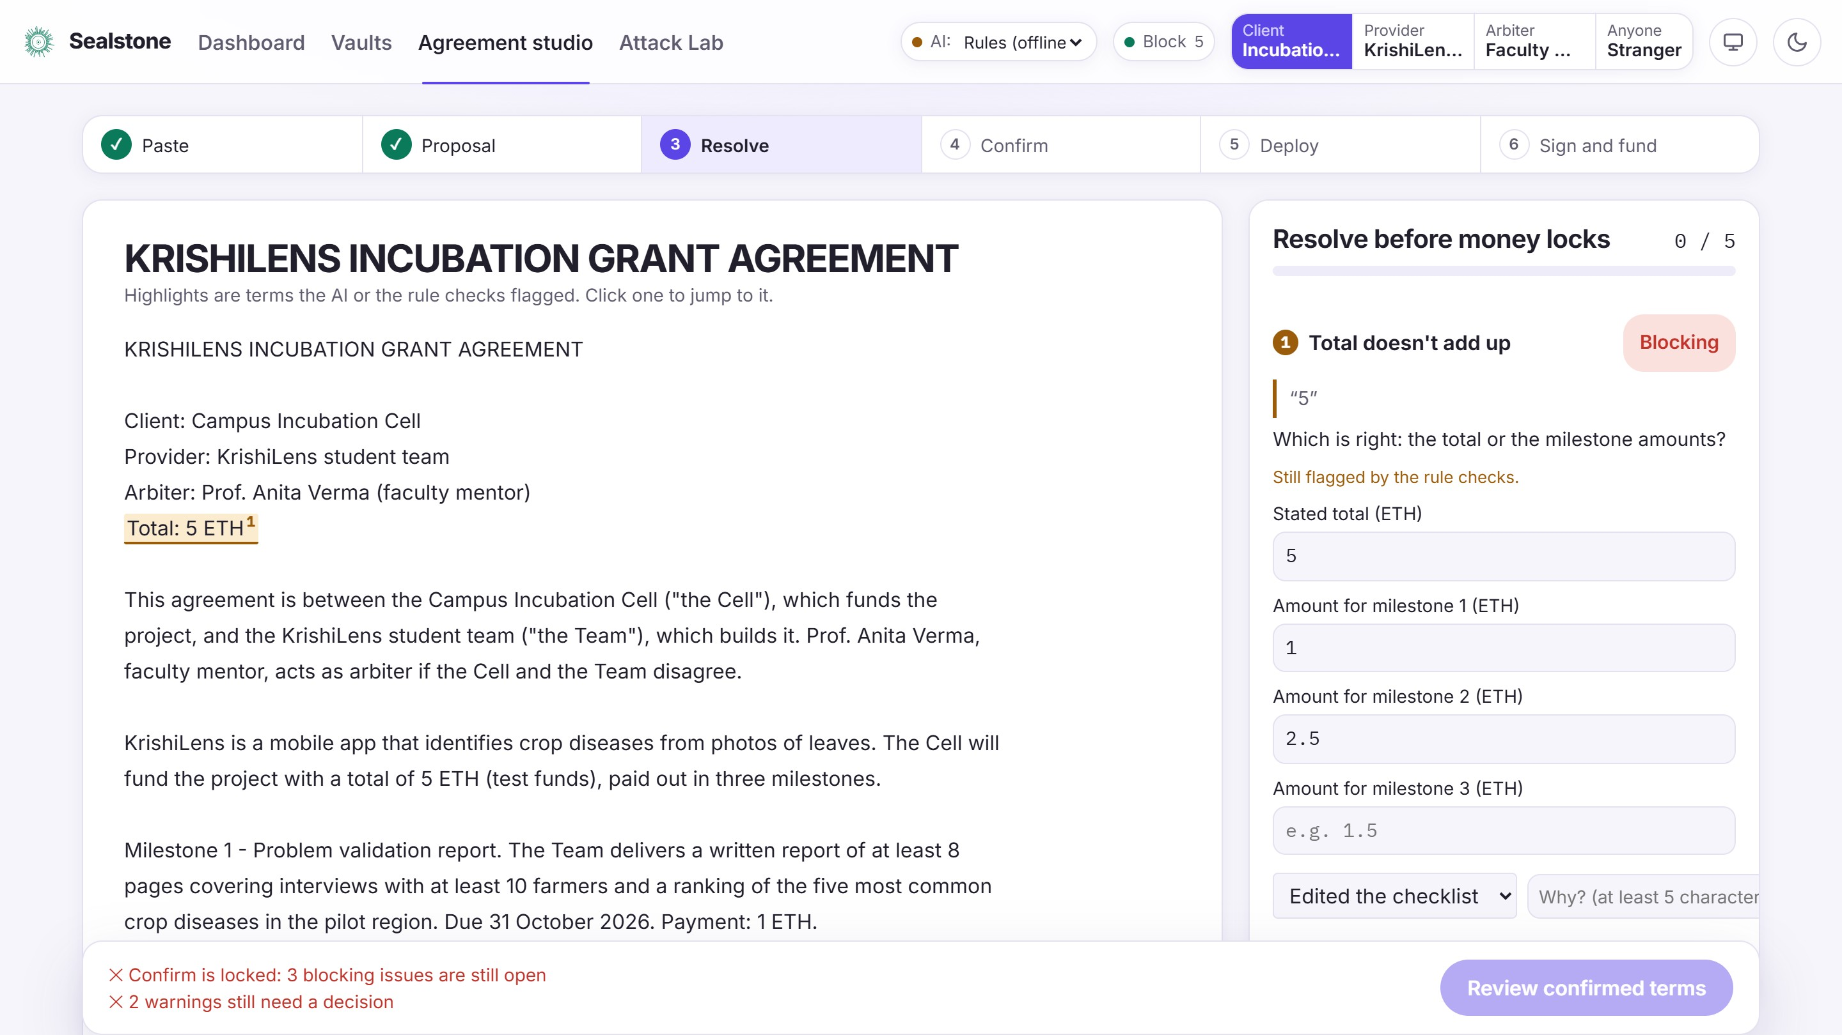
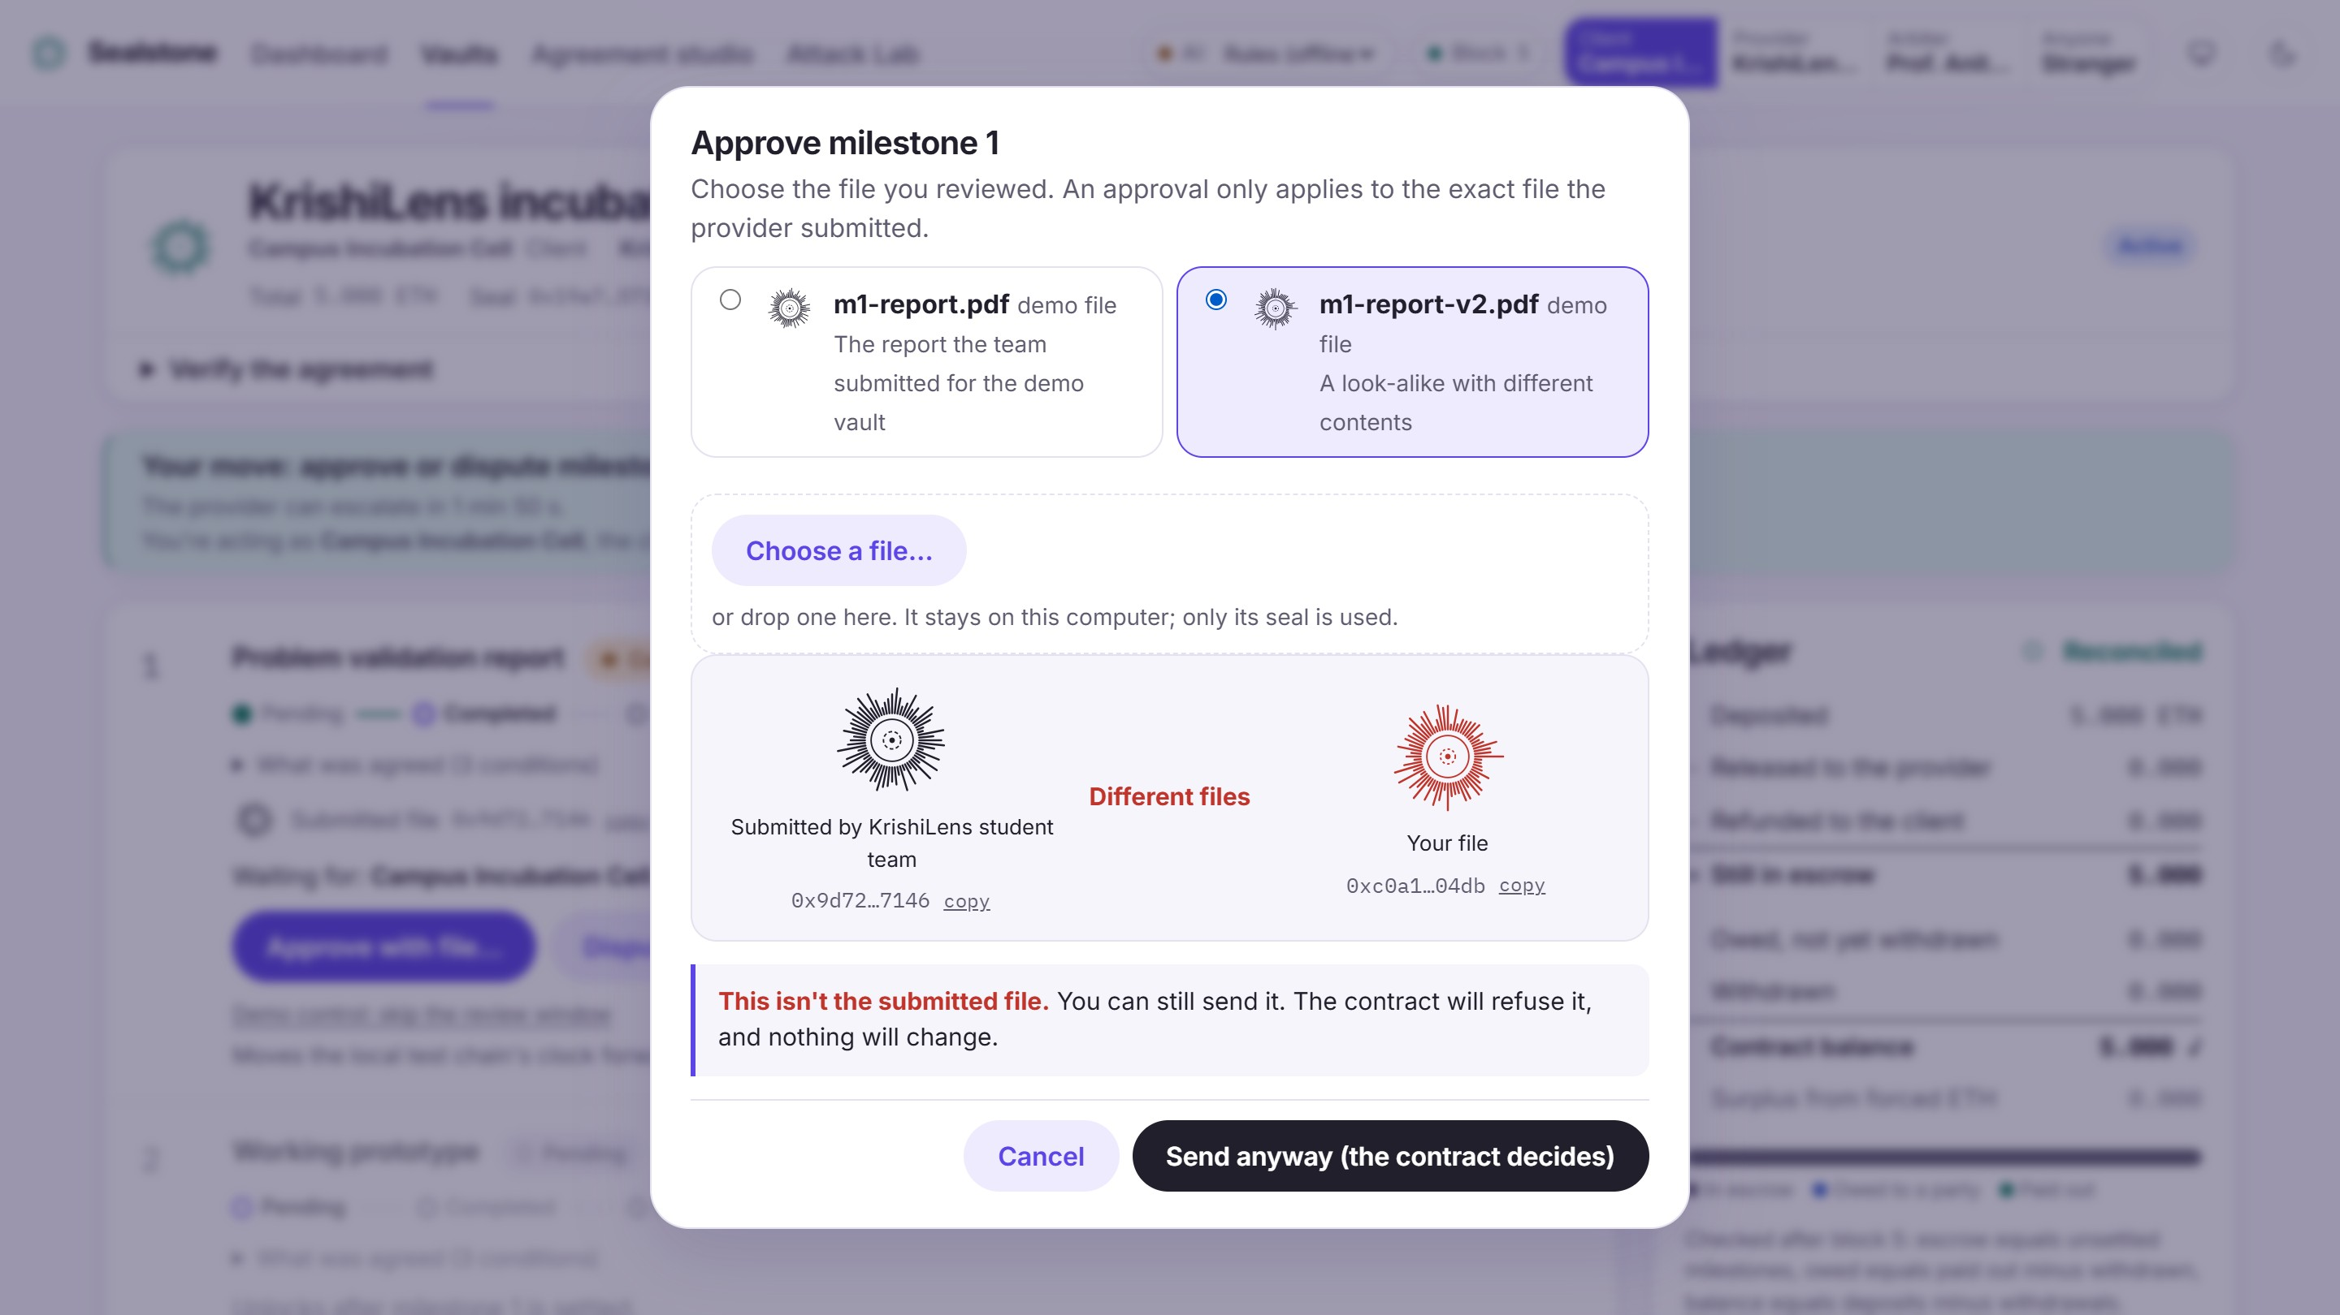
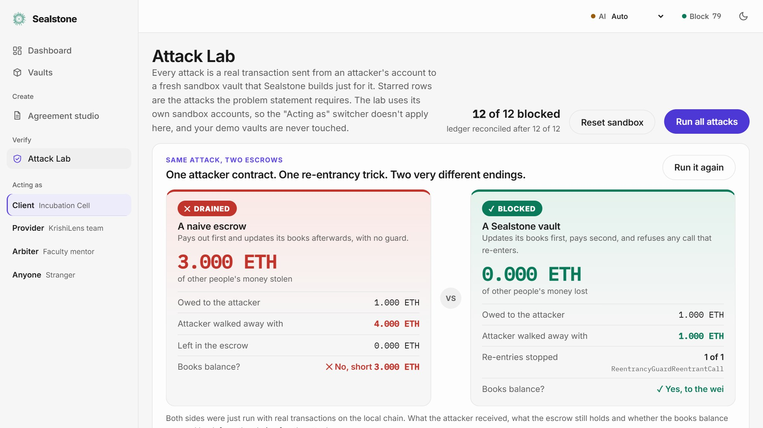
PRODUCT IN ACTION
A working product, not a mock-up: judges can try every step live.
1
2
3
4
sealstone.local/agreement
sealstone.local/dashboard
sealstone.local/vault
sealstone.local/attack-lab
DASHBOARD SCREENSHOT
Placeholder: the final dashboard capture goes here
AI proposes and flags
One dashboard, every vault
A swapped file is refused
12 real attacks, one click
Unclear terms are highlighted. Confirm stays locked until each is resolved.
What's locked, owed and waiting, with the ledger reconciled.
Two different seals. The contract reverts and funds don't move.
Each is blocked, and the ledger reconciles after every one.
LIVE DEMO PATH about 5 minutes
1
2
3
4
5
6
Extract
Resolve flags
Confirm + sign
Submit file
Swap it: refused
Run 12 attacks
Notes:
2:00 (40 s). This is the live path we will walk if you invite us to. Pasting an agreement shows the AI's flags; the dashboard shows every vault with its ledger reconciled; the swapped-file approval is refused with two visibly different seals; the Attack Lab fires twelve real transactions at the contract. Everything runs on a local chain, with Wi-Fi off if you like.

Slide 5
TECHNICAL APPROACH 1/3
From a paragraph to a protected payment: AI proposes, rules decide, people confirm.
OFF-CHAIN AI proposes, rules and people decide
1
Agreement text
2
AI proposes
3
Rules re-check
4
A person resolves
5
Confirmed checklist
pasted prose, any format
milestones and ambiguities (Ollama, Gemini or rules)
wei arithmetic, parties, quotes found in the text
edit, remove or acknowledge every flag
the only version that can be deployed
AI BOUNDARY: only the confirmed, hashed version crosses
ON-CHAIN Solidity decides
10
Pull and reconcile
9
Approve exact hash
8
Deliver
7
Fund exactly
6
Seal on-chain
withdraw, then the ledger checks itself
or dispute: the arbiter decides
the provider commits the file's SHA-256
the client deposits the exact total
keccak256 hash stored, both parties sign
COLOUR KEY
AI-proposed
Rules
Person
On-chain
Every refusal is a named error, and a refused call changes nothing.
Notes:
2:40 (50 s). Left to right, then back along the bottom. The AI proposes a checklist and ambiguities; a deterministic validator re-checks arithmetic and parties and verifies every quote exists in the text; a person resolves each flag; only the confirmed, hashed checklist crosses the AI boundary to the chain. On-chain, both parties sign the hash, the client funds the exact total, the provider commits the file's SHA-256, the client approves that exact hash or disputes, and money moves by pull payment while the ledger reconciles.

Slide 6
TECHNICAL APPROACH 2/3
One state machine per milestone. Anything not on the map reverts with a named error.
markComplete(i, hash)
approve(i, hash)
Provider
Client, the hash must match
PENDING
COMPLETED
RELEASED
work not yet submitted
awaiting the client
final: pays the provider
dispute(i) | escalate(i)
resolve(Release)
Client, or Provider after the window
Arbiter
Check order in every function
role, agreement state, index, then milestone state. The first rule that fails names the error.
DISPUTED
REFUNDED
the arbiter decides
final: credits the client
resolve(Refund)
Arbiter
Final states never change.
A second release, an unauthorized refund or a skipped step reverts with a named error.
Notes:
3:30 (40 s). One state machine per milestone. The provider marks it complete with the file's hash. From Completed, only the client can approve with the same hash, which credits the provider, or dispute; the provider can escalate only after the review window. Only the arbiter can settle a dispute, either releasing to the provider or refunding the client. Released and Refunded are final. Anything else, such as a second release, reverts with a specific error and changes nothing.

Slide 7
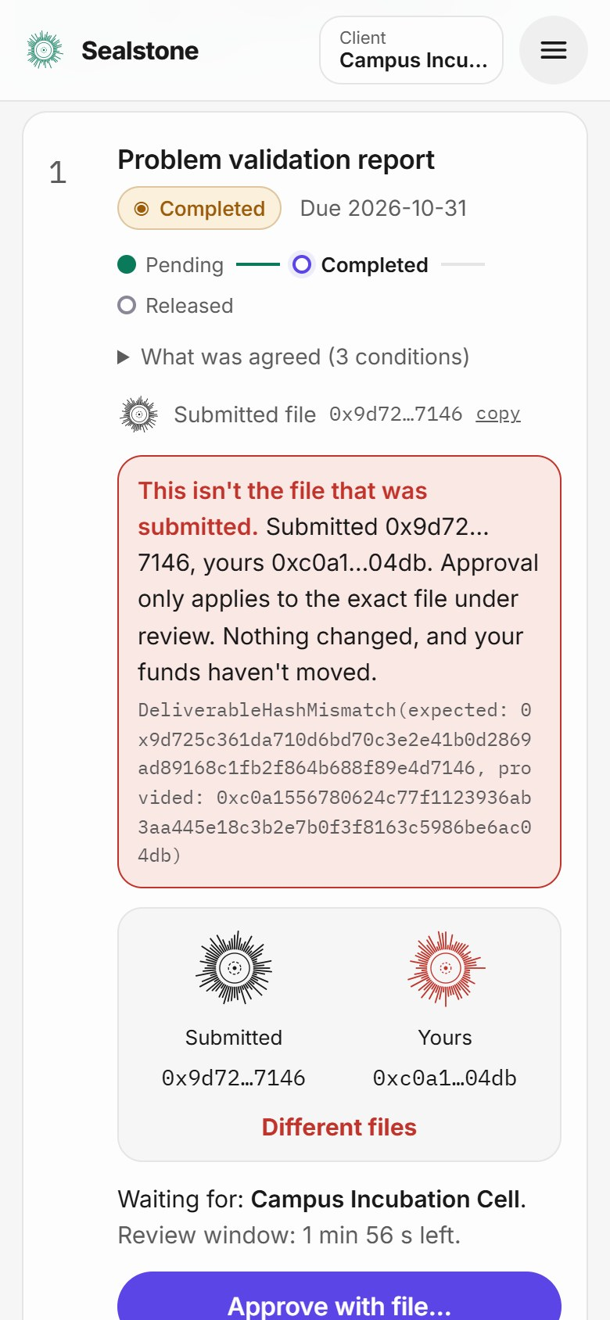
TECHNICAL APPROACH 3/3
Three small parts, and the AI service can never touch the chain.
WEB APP
AI SERVICE
LOCAL CHAIN
Agreement studio
Vault dashboard
Attack Lab
React, TypeScript, ethers v6
extract, validate, gate
Ollama, Gemini or built-in rules
✕
MilestoneVault.sol
OpenZeppelin guard
Attack contracts, test only
Solidity 0.8.24, Hardhat
HTTP
never
connects
SHARED PACKAGE
One implementation of hashing, validator and gate
JSON-RPC: sign, fund, approve, withdraw
Local fallback.
With Wi-Fi off it still works: rules extractor, local chain, bundled fonts. No paid API, GPU or cloud.
Notes:
4:10 (30 s). Three parts. The web app, which also works on a phone, talks to the chain directly over JSON-RPC. The AI service extracts, validates and gates, and it has no route, key or RPC connection to the chain: it only stores confirmed JSON. One shared package implements hashing, the validator and the gate, so the browser, server and deploy scripts agree byte for byte. Everything is local, so the full demo works with Wi-Fi off.

Slide 8
FEASIBILITY AND VIABILITY
Built, tested and reproducible in 12 hours, with no paid service.
BOOKLET RULE
EVIDENCE
138
100%
✓
Working MVP, testable live
npm run dev: studio, vault, Attack Lab
✓
Reproducible live testing
demo:reset, a seeded vault, 383 tests
contract tests passing
line coverage of the escrow
✓
AI used meaningfully
extracts milestones, flags ambiguity
1,000
12/12
✓
Checkable rules decide
validator and Solidity; AI never overrides
fuzz steps, 8 invariants
real attacks blocked
✓
Fictional data only
invented agreements, test ETH, local chain
✓
Local fallback
rules extractor and local chain, Wi-Fi off
$ npm run dev
$ npm run test:contracts
$ npm run demo:reset
Notes:
4:40 (35 s). Feasibility is evidenced, not claimed. The booklet's Common Rules map to concrete proof: a working product judges can run, reproducible resets, meaningful AI with deterministic rules deciding, fictional data, and a local fallback. The numbers are from our own runs: 138 contract tests, 383 tests overall, 100% line coverage, a 1,000-step randomized invariant fuzz, and twelve real attacks all blocked.

Slide 9
IMPACT AND BENEFITS
Fewer disputes, no swapped files, and no hidden intermediary to trust.
Other users' money left in the contract
1
Freelancers and clients
Pay only for the exact file you approved. Disputes go to a named referee.
2
Grant programmes
One dashboard shows what's locked, owed and waiting across every agreement.
3
Auditors and finance
The ledger reconciles after every action, and the rules are tests anyone can run.
One re-entrancy attack, payout by payout. In the Attack Lab's contrast run the attacker takes 4 ETH and 3 ETH of other users' money is lost.
WHAT'S NEXT
Factory for many agreements
A committee as arbiter
Pilot on a public testnet
Notes:
5:15 (35 s). The impact is visible in one picture. The same re-entrancy attack drains a naive escrow of 3 ETH of other people's money, and cannot touch ours. That translates into three groups of people: freelancers and clients who pay only for the exact file they approved, grant programmes that see everything locked and owed in one dashboard, and auditors who can reproduce every guarantee as a test. Next steps are a factory for many agreements, a committee arbiter, and a public-testnet pilot.

Slide 10
DIFFERENTIATOR
Most escrow demos secure the money. Sealstone also secures the agreement and the file.
AGREEMENT INTEGRITY
DELIVERABLE INTEGRITY
FUND INTEGRITY
ADVERSARIAL PROOF
Vague terms can't reach the contract
Approval is bound to the exact file
Forced-in money can't break the books
You fire the attacks yourself
"to the mentor's satisfaction"
≠
0.300 ETH
12 / 12
↓
surplus, never withdrawable
real transactions, all blocked
A live demo, set by a person
DeliverableHashMismatch
✓ books still reconcile
Run all attacks
LIVE PROOF
LIVE PROOF
LIVE PROOF
LIVE PROOF
agreement studio, Extract
rejects approval of a swapped deliverable
attack: Force ETH in with selfdestruct
Attack Lab, Run all attacks
Don't take our word for it. Pick a role in the demo vault, or press Run all attacks.
AI never moves money
Works with Wi-Fi off
Honest limits: one contract per agreement, a trusted arbiter, and a hash proves identity, not quality.
Notes:
5:50 (30 s). Each of these is something you can check live, not a claim. One: a vague phrase like 'to the mentor's satisfaction' cannot reach the contract until a person resolves it. Two: approval is bound to the exact file, so a look-alike is refused with a named error, DeliverableHashMismatch. Three: if someone force-sends ETH into the vault, it is counted as surplus, nobody can withdraw it, and the books still reconcile. Four: you can fire twelve real attacks at the contract yourself and read the result. The AI never moves money, the demo works with Wi-Fi off, and we state our limits: one contract per agreement, a trusted arbiter, and a hash proves identity, not quality. Don't take our word for it: pick a role, or press Run all attacks.

Slide 11










SEALSTONE escrow that can't be tricked
Team TORVALDS · XQR1520246 · Omkar Rane (leader), Pranay Patil
THANK YOU!
Game’s
Still On
VORTEXA 3.0
AIRS
Notes:
6:20. Thank you. Everything we showed is running on this laptop, offline. We would love you to try to break it: pick a role in the demo vault, or press Run all in the Attack Lab. Team TORVALDS, team ID XQR1520246: Omkar Rane and Pranay Patil.

