Slide 1
Clustering Project
Chad Hackney
Data Science, Ada Cohort
Zillow Project, The Sequel
15 Apr 2019

Slide 2
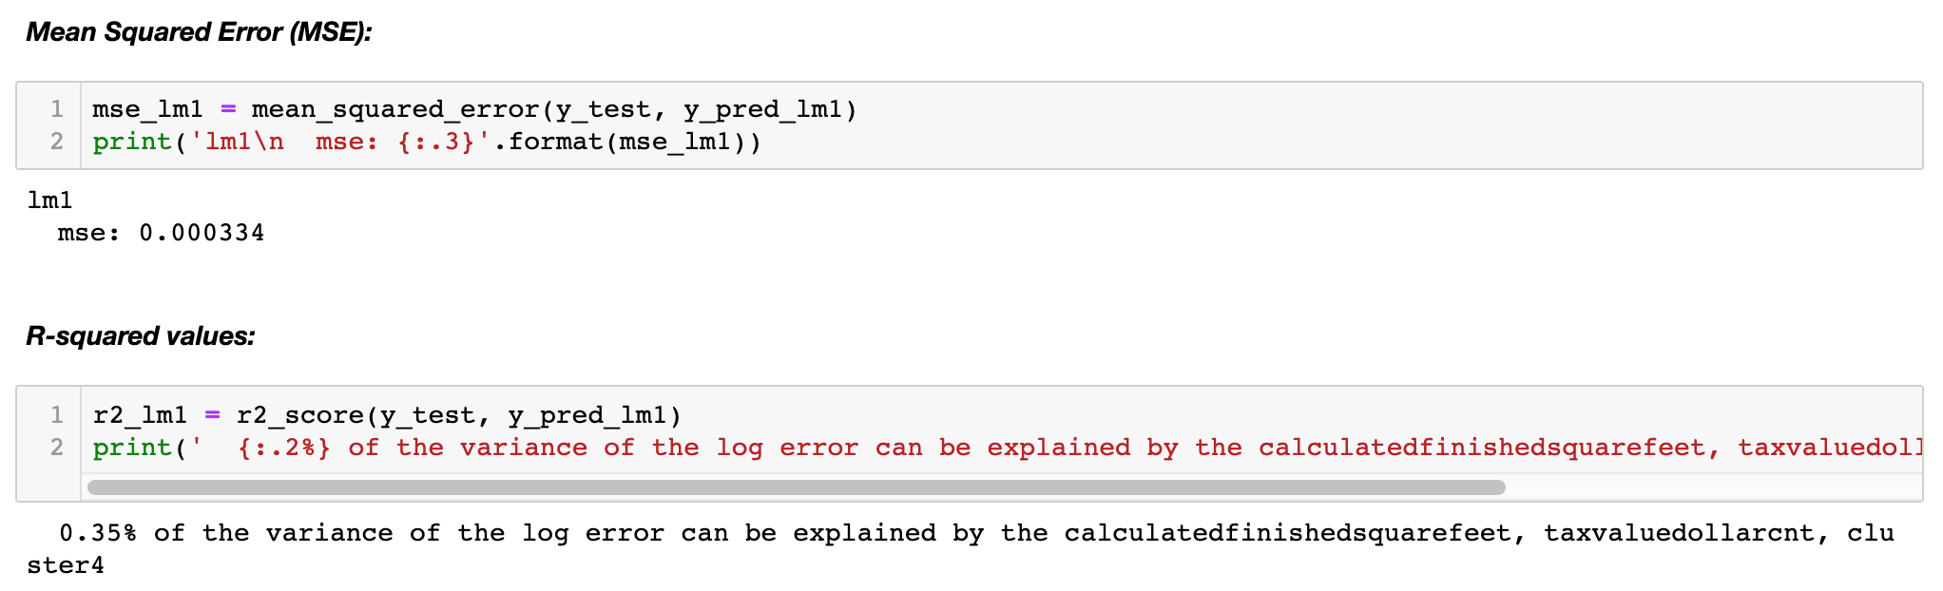
Zillow data set w/ clustering
Essentially no additional insights from previous Zillow project;
Possibly due to user error, i.e. insufficient experience playing with clusters and modeling and their interactions;
Will experiment more to better discover how clusters and modeling play together.

Slide 3
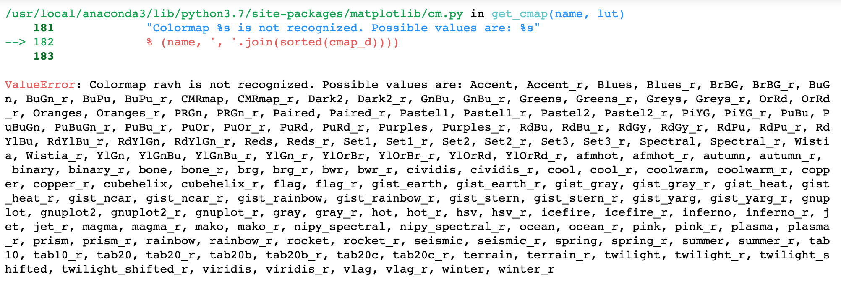
Observations
Accidental discovery regarding color schemes in Seaborn:
Incorrect color input generates an error with massive list of color options
Experimentation ensues…

Slide 4
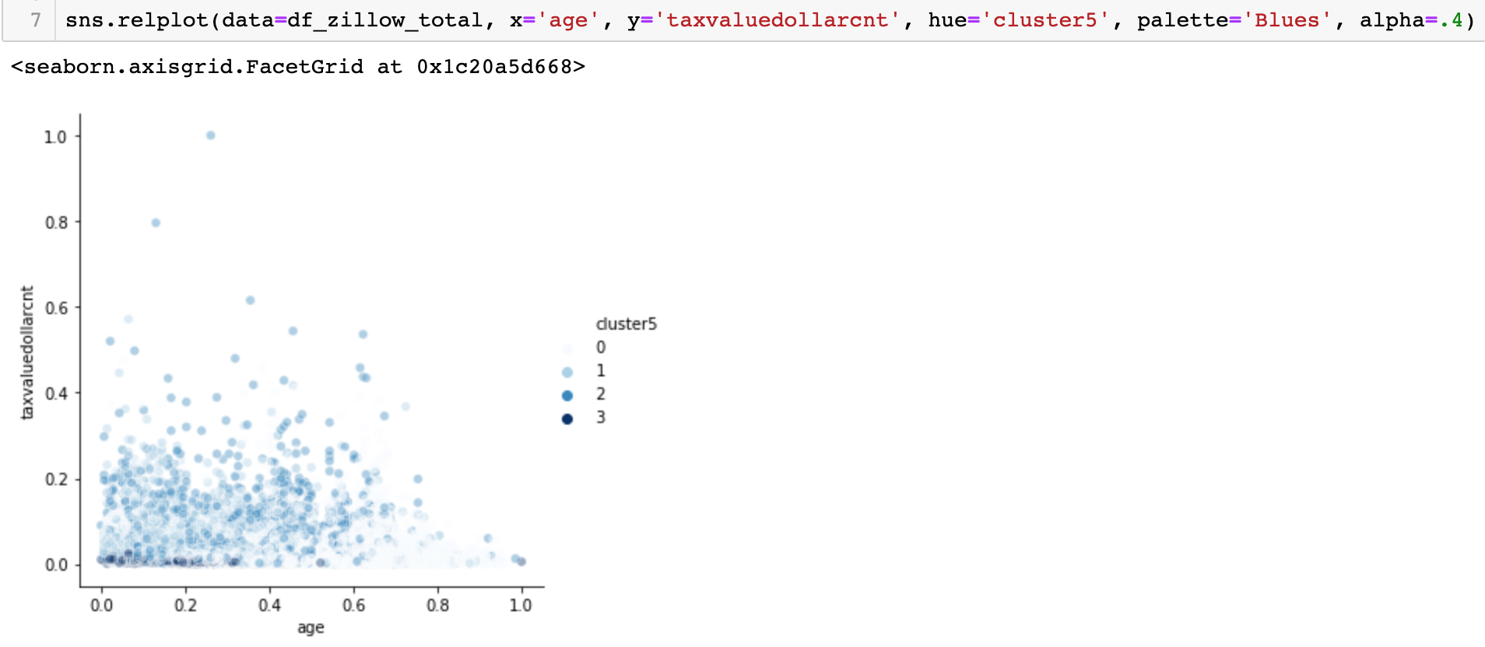
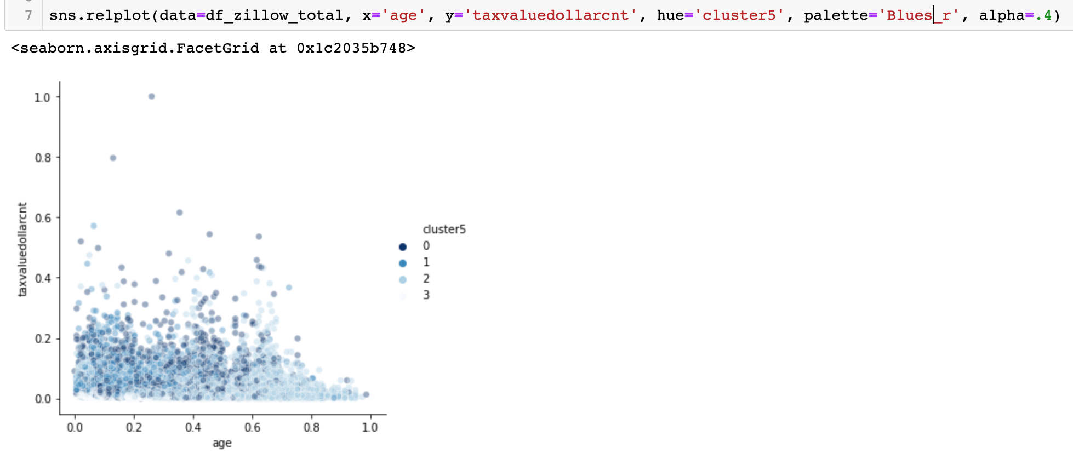
Reverse color palette

Slide 5
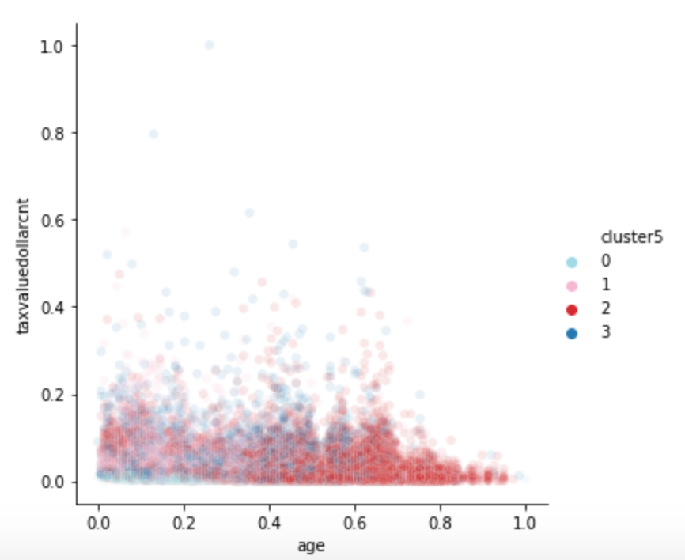
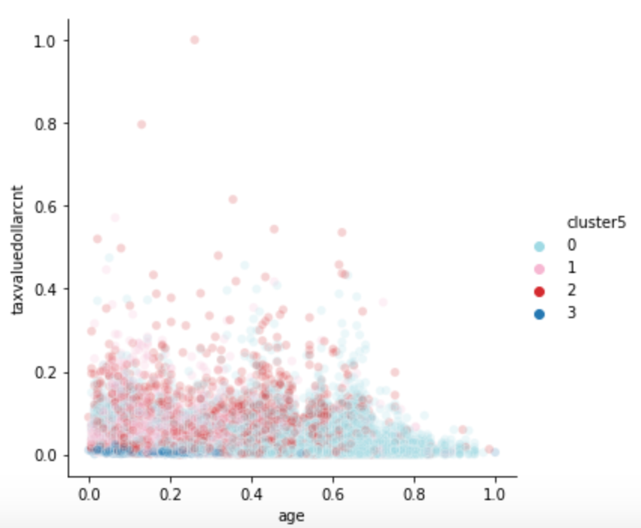
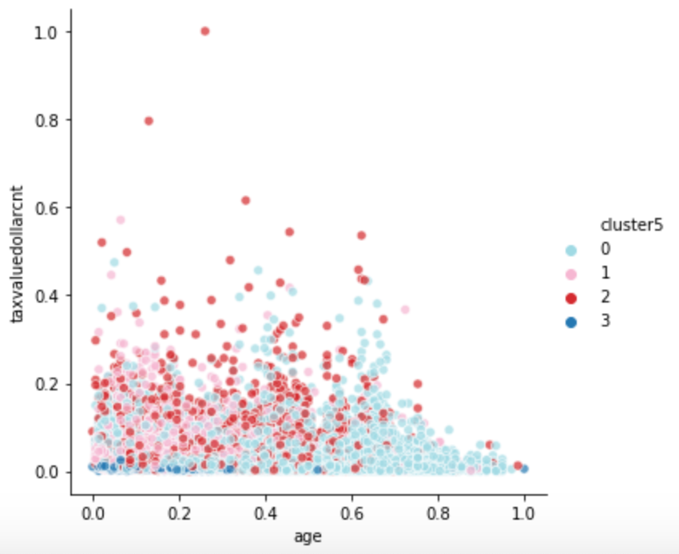
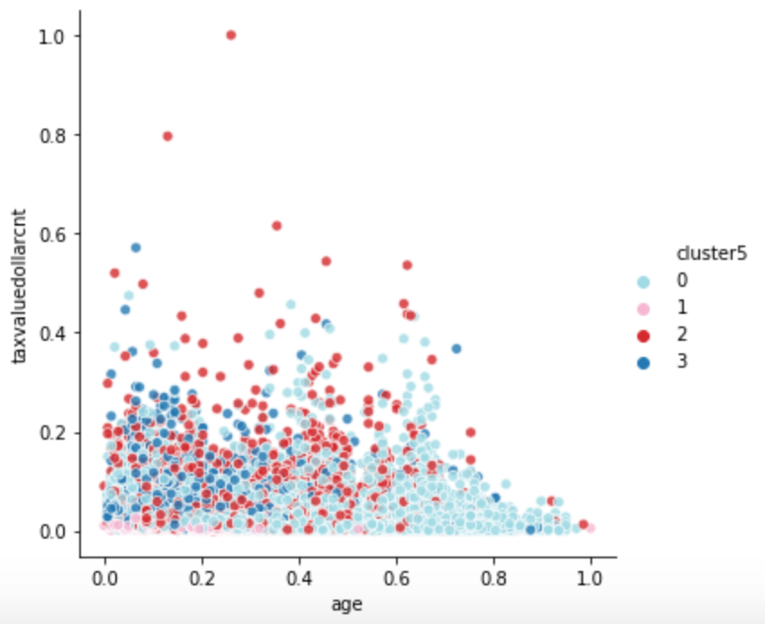
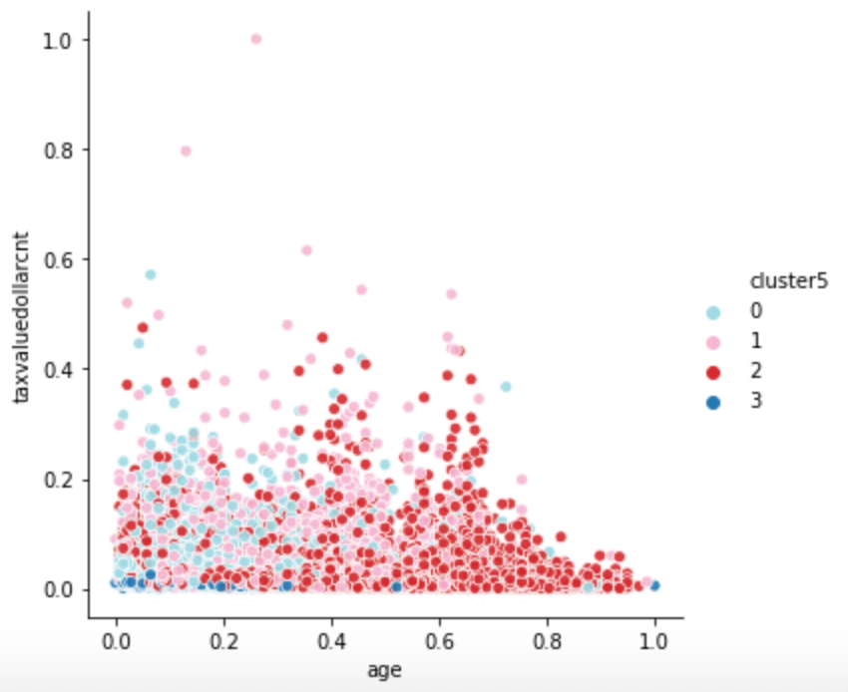
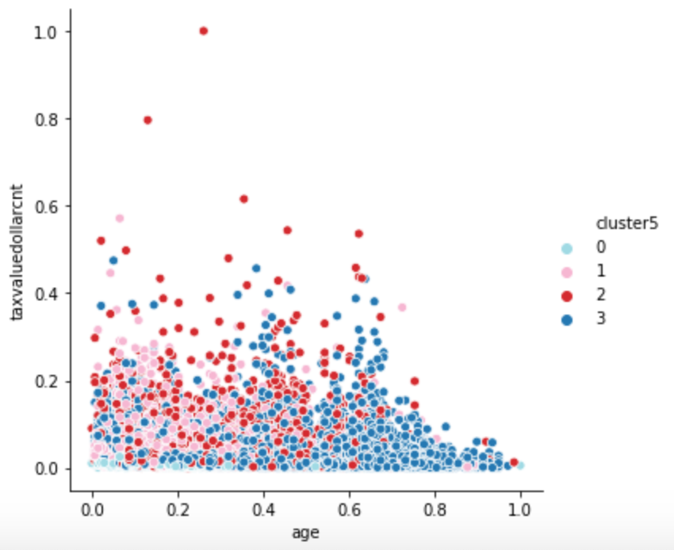
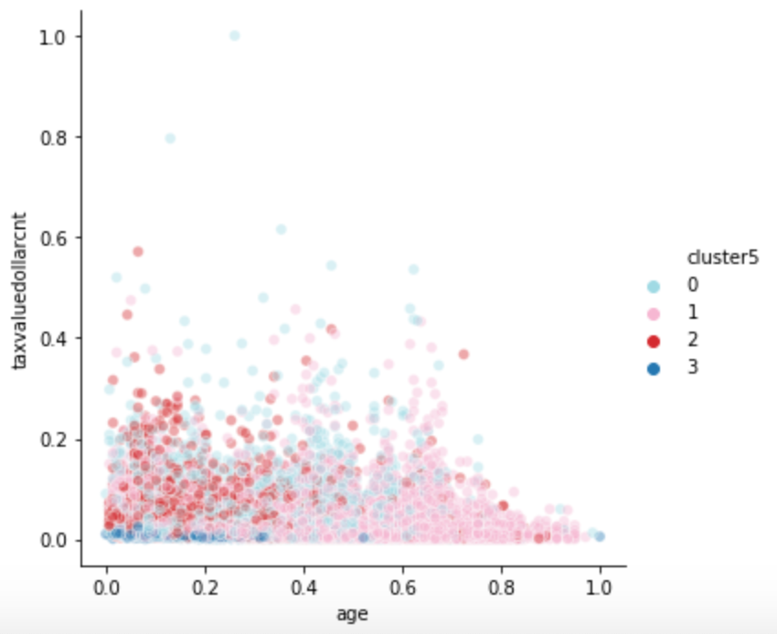
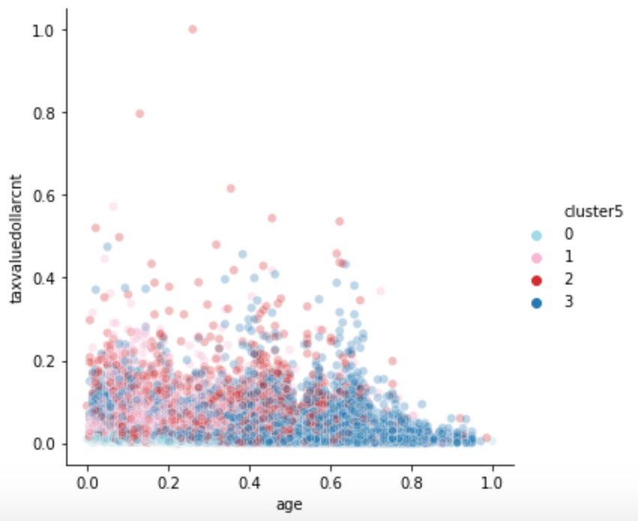
Alpha settings, .1 up to 1.0

