Slide 1
Inr/usd exchange rate prediction
SML Project Group: Harshit Gautam (202208) Shubham (2022488)

Slide 2
Introduction:
In this project, we explore different machine learning techniques to forecast the INR/USD exchange rate. Our dataset comprises historical exchange rate data, and we aim to build models that accurately predict future exchange rates. We employ three distinct methodologies: Linear Regression, Long Short-Term Memory (LSTM) networks, and a combination of Bagging, Boosting, and ARIMA. Let's delve into each approach and analyze their performance.

Slide 3
Different Models used :
1. Linear Regression
2. Ridge Regression
3. LSTM Networks (Neural Networks)
4. ARIMA (Autoregressive Integrated Moving Average)

Slide 4
Dataset overview
Date is in format: 13-05-2024
We have used Close Price for the models to train and also predicted close price only.
Date | Open | High | Low | Close | Adj Close | Volume
######## | 45.709 | 45.728 | 45.615 | 45.71 | 45.71 | 0
######## | 45.709 | 45.719 | 45.56 | 45.629 | 45.629 | 0
######## | 45.632 | 45.656 | 45.475 | 45.55 | 45.55 | 0
######## | 45.548 | 45.613 | 45.519 | 45.548 | 45.548 | 0

Slide 5
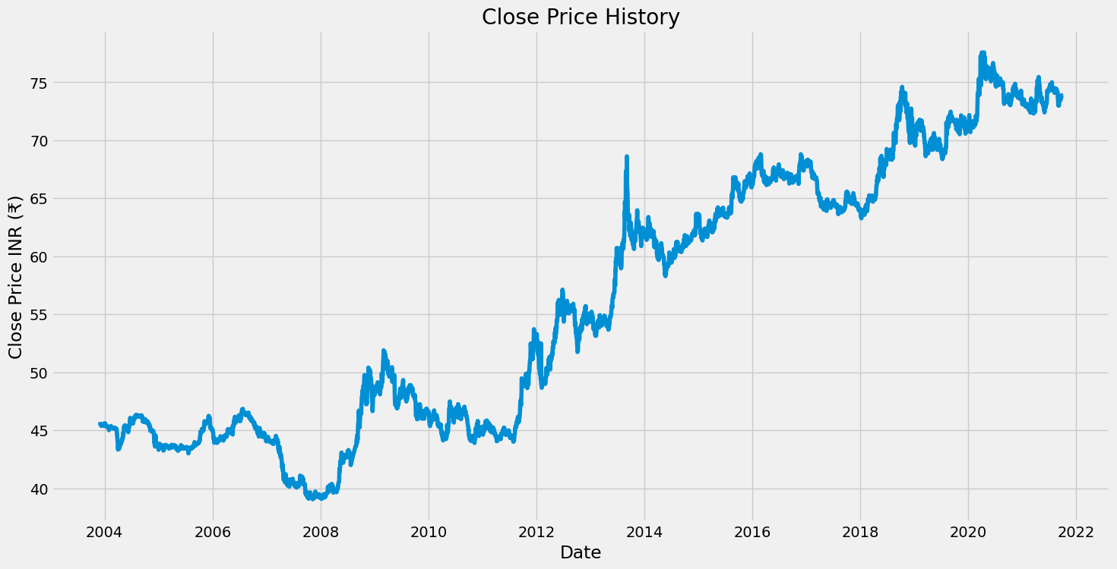
Close Price graph

Slide 6
1. Linear regression
We initiate with Linear Regression, a fundamental yet robust method for prediction tasks. After preprocessing the data and visualizing its trends, we train a Linear Regression model. The model demonstrates its predictive capacity, but its simplicity may limit its accuracy, especially in capturing non-linear relationships.

Slide 7
Pre processing
Data Loading: Initially, we load the dataset containing historical INR/USD exchange rate data from a CSV file.
Data Cleaning: We perform data cleaning by removing any missing values (NaN) from the dataset using the dropna() function.
Data Type Conversion: The 'Date' column is converted to datetime format using the astype() function to facilitate time-based analysis.
Visualization: Before training the model, we visualize the historical close price trends to gain insights into the data's behavior over time. This visualization aids in identifying patterns and trends, essential for model training.

Slide 8
Model Training and Prediction:
Feature Selection: For the Linear Regression model, we consider only the 'Close' price as the feature. This feature is extracted and stored in the 'df' DataFrame.
Data Scaling: To normalize the data and bring all features to the same scale, we employ Min-Max scaling using the MinMaxScaler from sklearn. This step ensures that no single feature dominates the learning process due to its larger scale.
Data Segmentation: We split the dataset into training and testing sets. Approximately 80% of the data is used for training (train_data_len), while the remaining 20% is reserved for testing.
Model Training: The Linear Regression model is instantiated and trained using the training data. We fit the model to the training features (x_train) and target labels (y_train) using the fit() function.
Prediction: Once trained, the model is used to predict the close prices for the test data (x_test). These predictions are then inverse-transformed to obtain the predicted close prices in the original scale using the inverse_transform() function.

Slide 9
Accuracy Evaluation:
R-squared Score: To evaluate the accuracy of our Linear Regression model, we calculate the R-squared (R2) score. R2 score measures the proportion of the variance in the dependent variable (close prices) that is predictable from the independent variable (dates). A higher R2 score indicates a better fit of the model to the data.
Print Accuracy: The R2 score is printed to the console as a percentage to provide a quantitative assessment of the model's predictive performance. Accuracy of this model : 98.4763748097207%

Slide 10
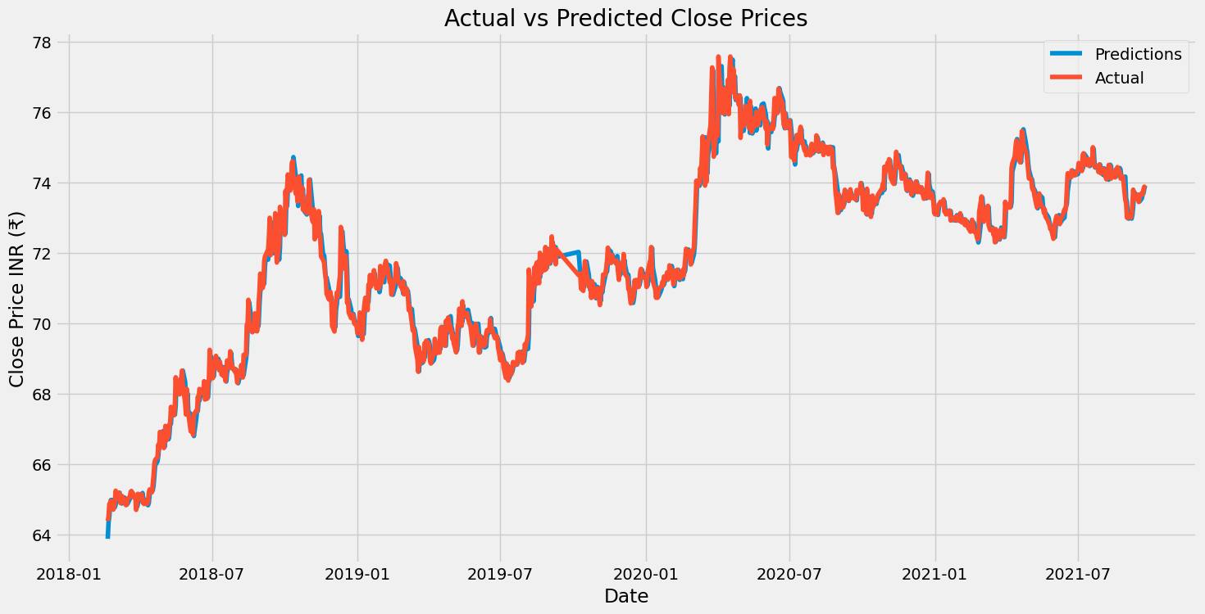
Predictions

Slide 11
2. Ridge regression
Ridge Regression is an extension of linear regression used to mitigate multicollinearity and overfitting. It introduces a regularization term to the cost function, penalizing large coefficients. This regularization helps stabilize the model and improves generalization, making it suitable for datasets with many features or correlated predictors. In our project, Ridge Regression is employed as a predictive tool for forecasting the INR/USD exchange rate based on historical data. Through preprocessing, training, and accuracy evaluation, we aim to showcase its efficacy in producing robust predictions while addressing common regression challenges.

Slide 12
Preprocessing:
Data Loading: Similar to Linear Regression, we start by loading the dataset containing historical INR/USD exchange rate data from a CSV file.
Data Cleaning: We perform data cleaning by removing any missing values (NaN) from the dataset using the dropna() function.
Data Type Conversion: The 'Date' column is converted to datetime format using the astype() function to facilitate time-based analysis.
Visualization: Before training the model, we visualize the historical close price trends to gain insights into the data's behavior over time. This visualization aids in identifying patterns and trends, essential for model training.

Slide 13
Model Training and Prediction:
Feature Selection: For the Ridge Regression model, we consider only the 'Close' price as the feature. This feature is extracted and stored in the 'df' DataFrame.
Data Scaling: To normalize the data and bring all features to the same scale, we employ Min-Max scaling using the MinMaxScaler from sklearn, similar to Linear Regression.
Data Segmentation: We split the dataset into training and testing sets. Approximately 80% of the data is used for training (train_size), while the remaining 20% is reserved for testing.
Model Training: The Ridge Regression model is instantiated and trained using the training data. We fit the model to the training features (x_train) and target labels (y_train) using the fit() function.
Prediction: Once trained, the model is used to predict the close prices for the test data (x_test). These predictions are then inverse-transformed to obtain the predicted close prices in the original scale using the inverse_transform() function.

Slide 14
Accuracy Evaluation:
Root Mean Squared Error (RMSE): To evaluate the accuracy of our Ridge Regression model, we calculate the Root Mean Squared Error (RMSE) on both training and testing sets. RMSE represents the square root of the mean of the squared differences between actual and predicted values. A lower RMSE indicates better predictive performance.
RMSE (Root Mean Squared Error):
Train RMSE: 0.2751970441502295
Test RMSE: 0.3494645100654175
R-squared Score: The R2 score measures the proportion of the variance in the dependent variable (close prices) that is predictable from the independent variable (dates). A higher R2 score indicates a better fit of the model to the data. It is the primary metric used for evaluating the model's accuracy.
Print R2 Score: The R2 score is printed to the console as a percentage to provide a quantitative assessment of the model's predictive performance.
Accuracy : 97.65254905583818%

Slide 15
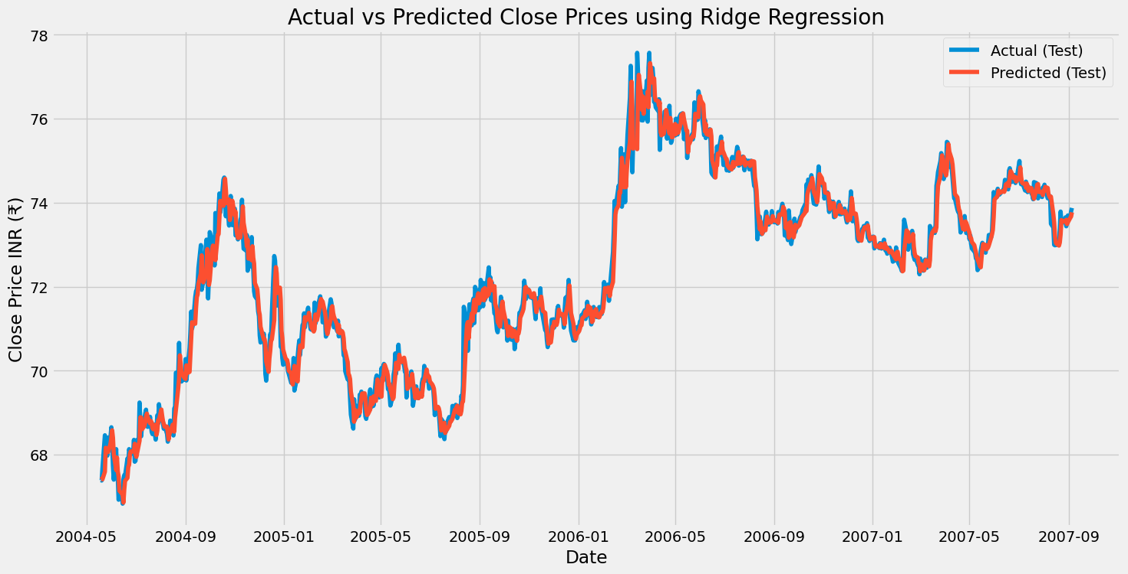
Predictions

Slide 16
3. LSTM (Long Short-Term Memory)
Moving to more complex models, we implement LSTM networks. LSTMs are well-suited for sequential data like time series, capable of capturing intricate patterns over time. By leveraging this architecture, we enhance our prediction capabilities. The visualization showcases how LSTM outperforms Linear Regression in capturing nuanced trends and predicting future exchange rates accurately.

Slide 17
Preprocessing:
Data Loading: We start by loading the dataset containing historical INR/USD exchange rate data from a CSV file.
Data Cleaning: Similar to the Linear Regression approach, we perform data cleaning by removing any missing values (NaN) from the dataset using the dropna() function.
Data Type Conversion: The 'Date' column is converted to datetime format using the astype() function to facilitate time-based analysis.
Visualization: Before training the model, we visualize the historical close price trends to gain insights into the data's behavior over time. This step helps identify patterns and trends essential for model training.
Feature Selection and Scaling: For LSTM, we consider only the 'Close' price as the feature. We scale the data using Min-Max scaling to bring all features to the same scale, using the MinMaxScaler from sklearn. This normalization step is crucial for LSTM models.

Slide 18
Model Training and Prediction:
Data Segmentation and Time Window: LSTM models require a sequence of data for training. We segment the dataset into smaller sequences, where each sequence consists of a window of past close prices. In the provided code, a time window of 60 days is used (x_train and y_train).
Reshaping Data: The input data (x_train) needs to be reshaped into a 3D array to be compatible with the LSTM input shape. This reshaping involves adding an additional dimension to represent the number of time steps and features.
LSTM Model Architecture: We construct an LSTM model using Keras Sequential API. The model architecture typically includes one or more LSTM layers followed by one or more Dense layers for output. In the provided code, two LSTM layers with 50 units each are used, followed by a Dense output layer.
Model Compilation and Training: The model is compiled with a suitable loss function (mean squared error) and optimizer (Adam). We then train the model using the training data (x_train and y_train) for a specified number of epochs.
Prediction: After training, the model is used to predict the close prices for the test data (x_test). These predictions are inverse-transformed to obtain the predicted close prices in the original scale using the inverse_transform() function.

Slide 19
Accuracy Evaluation:
Mean Squared Error (MSE): We calculate the Mean Squared Error (MSE) between the actual close prices and the predicted close prices on the test data. MSE measures the average squared difference between the predicted values and the actual values, providing a measure of model performance.
R-squared Score: Additionally, we compute the R-squared (R2) score to evaluate the proportion of the variance in the dependent variable (close prices) that is predictable from the independent variable (dates). A higher R2 score indicates a better fit of the model to the data.
Print MSE and R2 Score: Both the MSE and R2 score are printed to the console to provide comprehensive quantitative assessments of the model's predictive performance. Accuracy : 97.26204883635826 %

Slide 20
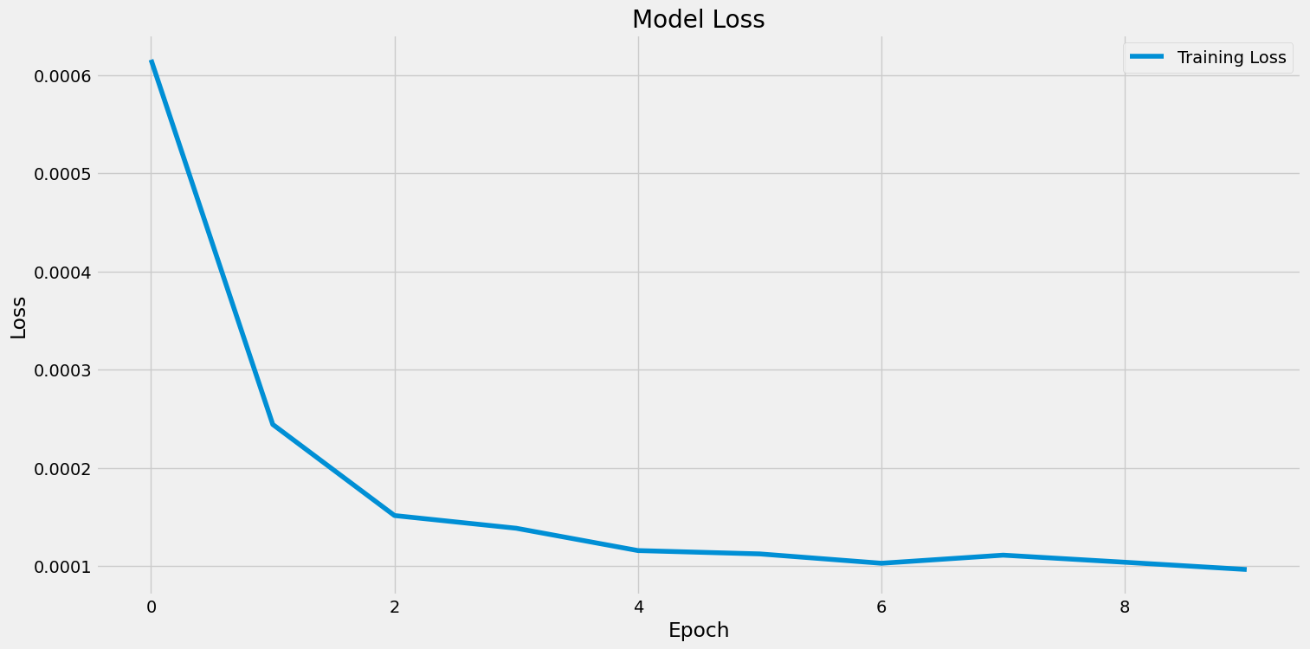
MSE v/s epochs plot

Slide 21
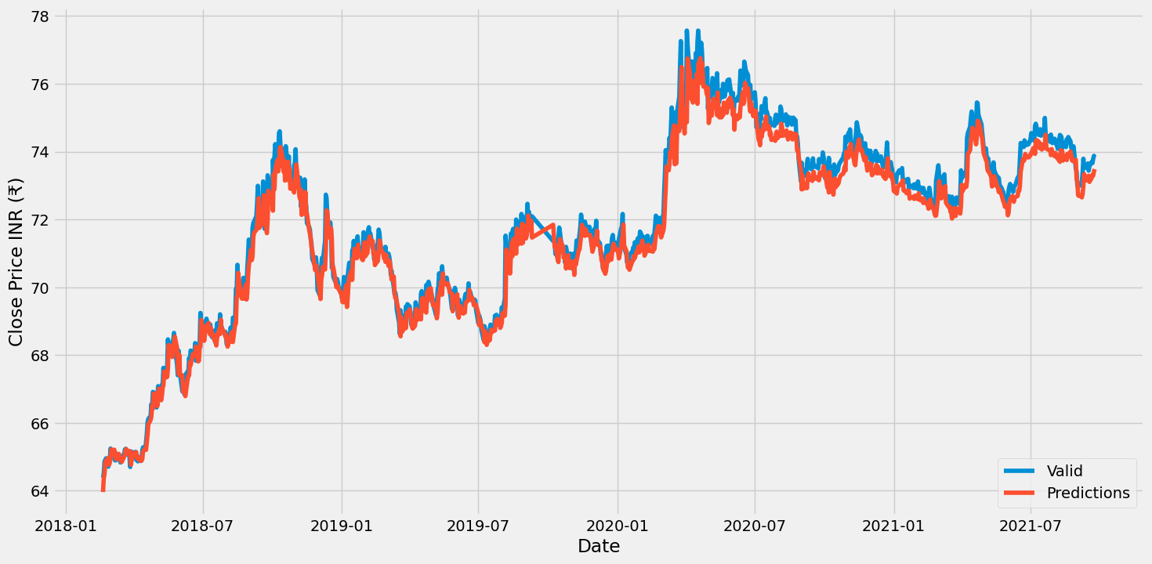
Predictions

Slide 22
4. Ensemble Learning with ARIMA:
Next, we explore ensemble learning techniques, specifically Bagging and Boosting, in conjunction with ARIMA. These methods amalgamate the strengths of individual models to produce a more robust prediction. By combining bagging and boosting forecasts and integrating them with ARIMA, we achieve improved accuracy and confidence in our predictions.

Slide 23
Preprocessing:
Data Loading: Load the dataset containing historical INR/USD exchange rate data from a CSV file.
Data Preprocessing: Perform any necessary data preprocessing steps, such as converting the 'Date' column to datetime format and handling missing values.
Data Transformation: If the data is not stationary, perform differencing or other transformations to make it stationary. This step is crucial for ARIMA modeling.
Train-Test Split: Split the dataset into training and testing sets. Typically, a portion of the data is reserved for training the model, and the remaining portion is used for testing.

Slide 24
Model Training and Prediction:
Parameter Selection: Determine the appropriate parameters (p, d, q) for the ARIMA model. These parameters represent the number of autoregressive terms, differences, and moving average terms, respectively.
Model Fitting: Fit the ARIMA model to the training data using the determined parameters. This involves estimating the model coefficients based on the training data.
Forecasting: Use the trained ARIMA model to forecast future values of the INR/USD exchange rate. Generate predictions for the testing set and optionally for future time periods beyond the available data.
Prediction Visualization: Visualize the forecasted values alongside the actual data to assess the model's performance visually.

Slide 25
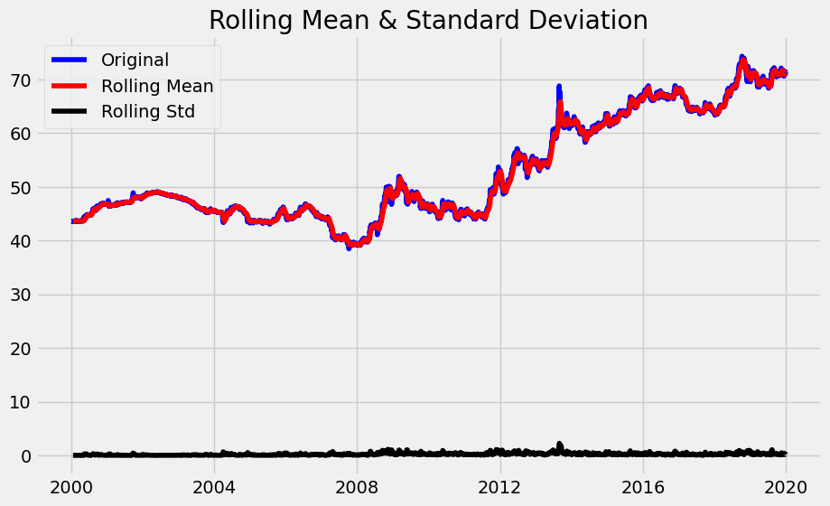
Rolling mean and std deviation

Slide 26
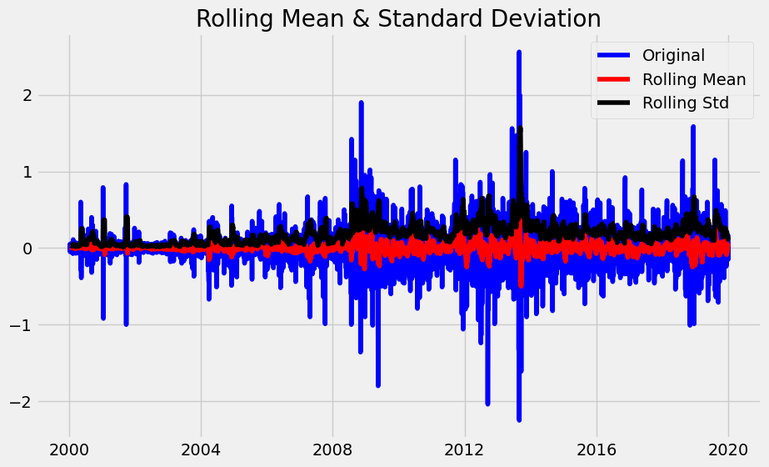

Slide 27
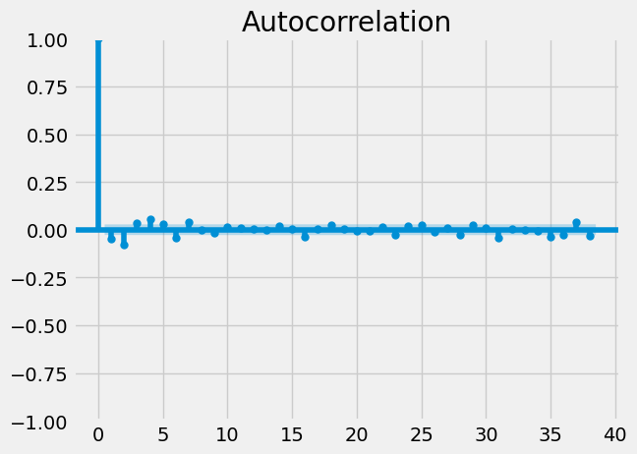
autocorrelation

Slide 28
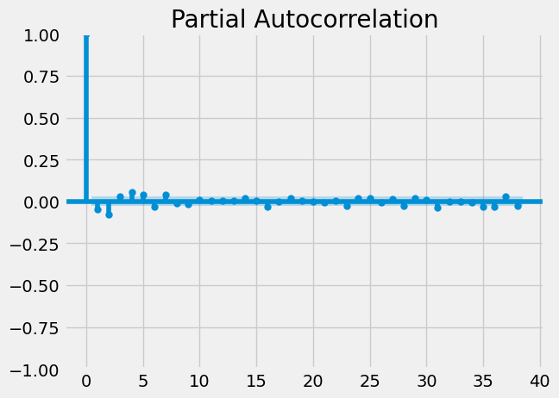
Partial autocorrelation

Slide 29
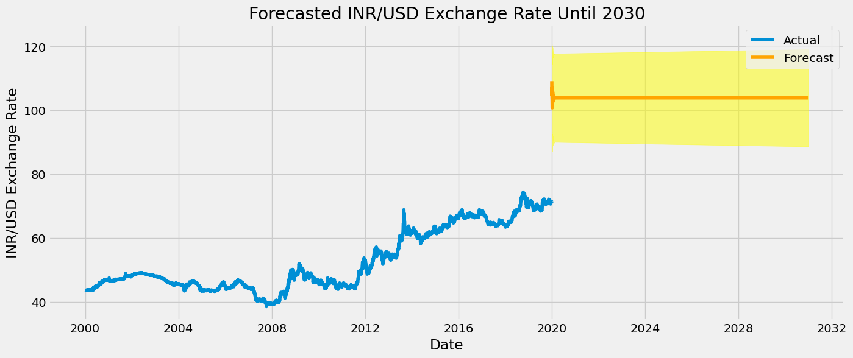
Forecasting till 2030

Slide 30
Comparing accuracy
On comparing accuracies of all the models we get Linear Regression model with highest accuracy : 98.4763748097207%

