Slide 1
JavaScript
Forms and JSON

Slide 2
Forms
Forms are a way to allow for user input, and then for gathering that input and sending it from the client to the server (i.e., from your browser to the machine where the code lives)
A form is simply another HTML tag: <form></form>. Nothing scary!
It has some unique attributes, such as configuring where the form submits to.
Forms don’t always have to look like a boring form! A search box could be a form. A status post on Facebook could be a form.

Slide 3
Let’s see an example
Here’s a form!
<form> </form>
Here’s a form!
Huh?
The <form> tag by itself doesn’t render anything visible! Without <input> elements, a form is meaningless.

Slide 4


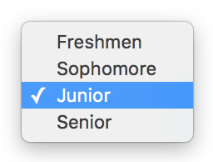

Form input
There are many types of input a form can have. Some popular ones include:
Text input | Name: <input type="text" name="name">
Radio buttons | <input type="radio" name="gender" value="male">Male <input type="radio" name="gender" value="female" checked>Female
Select/Drop-down | <select name="grade"> <option value="freshmen">Freshmen</option> <option value="sophomore">Sophomore</option> <option value="junior" selected>Junior</option> <option value="senior">Senior</option> </select>

Slide 5
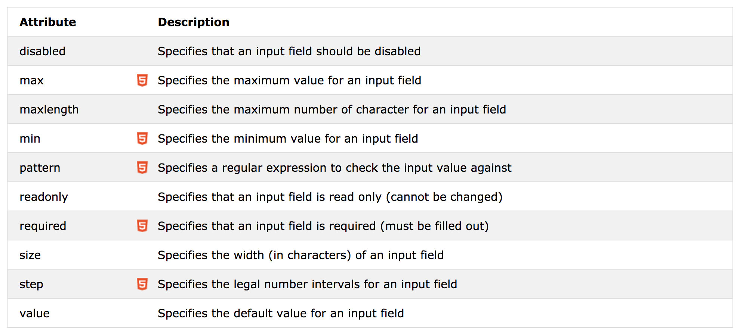
Input restrictions
Notes:
Image from https://www.w3schools.com/html/html_form_input_types.asp
Note that you shouldn’t rely on only this for input validation! There are ways to circumvent these checks, but it’s a good way to catch non-malicious bad input.

Slide 6
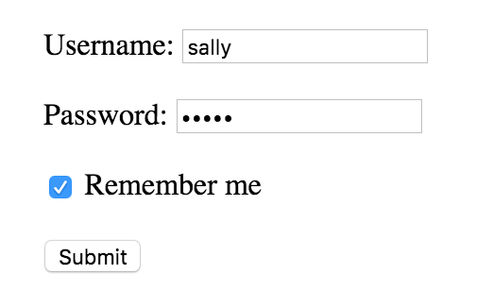
Let’s see another example
<form action="/login" method="POST"> Username: <input type="text" name="username"> <br/><br/> Password: <input type="password" name="pswd"> <br/><br/> <input type="checkbox" name="rememberMe" checked> Remember me <br/><br/> <input type="submit" value="Submit"> </form>
Notes:
The action attribute defines the action to be performed when the form is submitted. Here, since it’s an endpoint (i.e., a URL), the form data is sent to that endpoint on the server when the user clicks on the submit button.
The method attribute defines which HTTP method to use.

Slide 7
Where does JavaScript come in?
Sometimes, you might not want the form to be submitted to the server immediately. Instead, you might want to use JavaScript to capture the submission and perform other actions before submitting the data to the server.
Why might you want to do this?
Better user experience; using the form action will refresh the page when the form is submitted
Better form validation experience; with JavaScript, you can call attention to errors in more interesting ways
Maybe you need to clean up or format the data a certain way before submitting it

Slide 8
How do we do that?
HTML
<form id="my-form"> <input type="text" name="input”/> <input type="submit” value=”Submit”> </form>
JavaScript
window.onload = function() { function processForm(e) { if (e.preventDefault) e.preventDefault(); var data = document.getElementById("input").value; /* do what you want with the data and submit */ // return false to prevent default form behavior return false; } var form = document.getElementById(“my-form”); form.addEventListener("submit", processForm); }
Notes:
Example from here: http://stackoverflow.com/questions/5384712/capture-a-form-submit-in-javascript
We’ve attached an event listener on the submit button.
Now, when the user clicks on the submit button, it calls the processForm function that we’ve defined.
Inside that function, we can do whatever we want -- of course, it would be a good idea to make sure the form data still gets submitted. How? We’ll cover that in tomorrow’s lecture.
Note that we end the processForm function with “return false” to prevent it from doing the form submit action.

Slide 9
Let’s zoom in on form submission
In tomorrow’s lecture, we’re going to learn how to submit form data to the server in JavaScript using AJAX.
The data that we send over -- and that we receive back from the server -- can be formatted in several different ways. The two most popular formats are JSON and XML. We’ll be using JSON in this bootcamp.
Why do we need data formats? Imagine giving someone a paragraph of text, with no punctuation. It’s going to be very difficult to parse.
Data formats standardize how to parse data.

Slide 10
That’s it for basic forms!
Any questions?

Slide 11
JSON
Stands for JavaScript Object Notation
Is a syntax for storing and exchanging data
Follows these rules:
Data is in name/value pairs
Data is separated by commas
Curly braces hold objects
Square brackets hold arrays
Notes:
Source: https://www.w3schools.com/js/js_json_syntax.asp

Slide 12
Let’s see an example
{“name”: “Jane Doe”}
{“name”: “Jane Doe”, “skills”: [“archery”, “ballet”]}
{“name”: “Jane Doe”, “skills”: [{“name”: “archery”}, {“name”: “ballet”}]}
To construct, you can just write it as is: var temp = {“name”: myName}; // where myName is a variable Or you can construct it by setting key/values: var temp = {}; temp[“name”] = myName; // where myName is a variable
You can nest { } and [ ] as many times as you like! ...Although it’s not a great idea to do it too many times
Notes:
{} denotes an object; in essence, an entity. It’s not an object in the sense of a Java object; there’s no class definition or instantiation or anything.

Slide 13
Working with JSON
var data = {“name”: “Jane Doe”, “skills”: [{“name”: “archery”}, {“name”: “ballet”}]}
console.log(data[“name”]); // Jane Doe
console.log(data.name); // Jane Doe
console.log(data[“skills”]); // [{“name”: “archery”}, {“name”: “ballet”}]
console.log(data[“skills”][0]); // {“name”: “archery”}
console.log(data[“skills”][0][“name”]); // archery
console.log(data[“skills”][0][“name”]); // archery
data[“skills”][0][“name”] = “skiing”;
console.log(data[“skills”][0][“name”]); // skiing

Slide 14
Pop quiz
Who can tell me what console.log will print out?
var data = { “order”: “ice cream”, “toppings”: [“sprinkles”, “toffee bits”, “chocolate syrup”], “flavor”: { “name”: “matcha green tea”, “numScoops”: 1 } }; console.log(data[“toppings”][2]);
Notes:
Answer: chocolate syrup
Indentation doesn’t matter, but it makes it easier to read

Slide 15
That’s it for JSON!
Any questions?

Slide 16
Reference
https://www.w3schools.com/html/html_forms.asp
https://www.w3schools.com/js/js_validation.asp
https://www.w3schools.com/js/js_json_intro.asp

