Slide 1
Git and SVN
Version control systems

Slide 2
Solo versus group work
All is fine and dandy when you are the only person working on a coding project. But if you were working on that coding project with other people, how would you consolidate all the changes everyone’s made?
One option is to email each other the changes you have made. But...

Slide 3

What happens when you don’t have a VCS
Notes:
You end up with a million copies of your code

Slide 4
Version control system (VCS)
A version control system is a code management tool that helps you track and manage code changes. It allows you to easily roll back to a previous version of the code, or merge new changes into existing code.
SVN and Git are two of the most popular VCSs.
Github is a public online VCS that uses Git. Companies generally each have their own VCS server.

Slide 5
Keywords
Repository (repo)/codebase - the code in its entirety, regardless of where it’s stored
Local/working copy/working directory - the copy of the code that lives on your computer; this is the copy you make changes to
Master/remote - the official copy of the code that lives on the VCS server
Check in/push - sending your changes to the master
Check out/pull - getting a copy of the master code for the first time, or updating your local with any changes checked in to the master since the last time you pulled
Commit - a group of similar changes (feature or bug fix) that you bundle into single push to master

Slide 6
Any questions about version control?

Slide 7
Subversion (SVN)
SVN is the most intuitive way of thinking about VCSs.
You check-out from the master, make your changes, test your changes, then check-in your changes back into the master.
Then your partner runs svn update to update their local with your changes.
Notes:
svn workflow image from: http://www.ranorex.com/blog/wp-content/uploads/2012/02/Ranorex-With-SVN-546x364.png

Slide 8
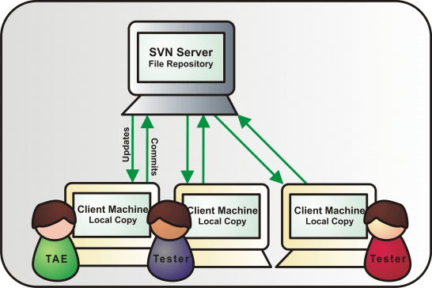
SVN workflow
Notes:
Image taken from: http://www.ranorex.com/blog/wp-content/uploads/2012/02/Ranorex-With-SVN-546x364.png

Slide 9
Common SVN commands
svn checkout [url] - get a copy of the code located at url
svn status/svn st - lists the files you’ve made changes to locally
svn diff [file] - show the changes you’ve made in file
svn add [file] - add a new file you’ve created locally to SVN
svn commit -m “this is my bug fix” - push the changes you’ve made locally to master, passing in a message describing the change
svn log - show the history of commits
svn update/svn up - pull in and update your local with changes from master that you don’t have

Slide 10
Git
Git introduces the concept of a local repository, where you have version control for your local changes
Why it is a good idea to have version control on your local changes: You have been working pretty hard on several features over the past week, but suddenly, the customer doesn’t want one of the features anymore and now you have to remove all of the code relating to it.
In SVN, you would have to manually go through each file, find the code related to the unwanted feature, and then delete it.
In Git, you can simply delete the commit of the unwanted feature, assuming you were committing after each feature. Now you can push the rest of the commits to master.

Slide 11
Git
Git’s main selling point is their encouragement of and easy use of branching.
Branches allow the developer to create and work on multiple copies of the code. However, these multiple copies aren’t literally stored as multiple copies of code -- Git only keeps track of the diff each branch has with master, and applies/un-applies them as you switch between branches*!
* simplified explanation

Slide 12
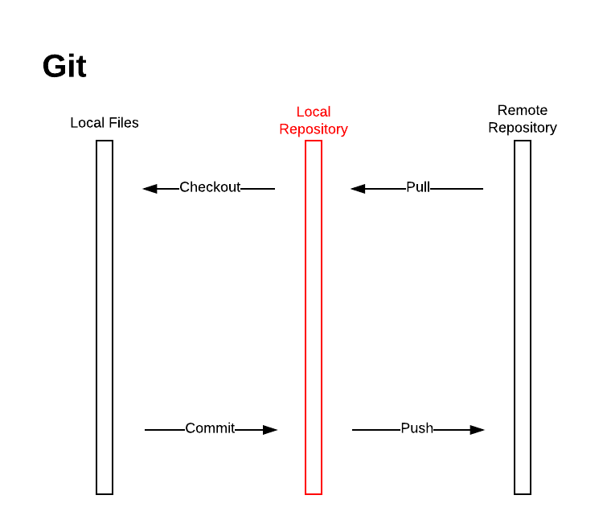
Commit
Commit
Commit
Git workflow
Notes:
Image taken from: http://blog.walty8.com/wp-content/uploads/2016/06/SVN-Git-Git-Actions.png

Slide 13
Common Git commands
git clone [url] - get a copy of the code located at url
git pull - pull in and update your local repo with any changes from master that you don’t have
git status - lists the files you’ve made changes to in your local
git diff [file] - show the changes you’ve made in file
git add/rm [file] - add or remove file to/from the staging area
git commit -m “this is my bug fix” - commit the staged file changes to your local repo, passing in a message describing the change
git log - show the history of commits
git push - push all the committed changes to master

Slide 14
That’s it for SVN and Git!
Any questions?

Slide 15
References
https://git-scm.com/book/en/v1/Git-Branching-What-a-Branch-Is
http://blog.walty8.com/comparison-of-git-and-svn/
https://git.wiki.kernel.org/index.php/GitSvnComparison
https://www.git-tower.com/learn/
https://www.atlassian.com/git/tutorials/comparing-workflows

