Slide 1
MySQL
Persisting data to a database

Slide 2
What is a database?
A database is a structured collection of data that is organized so that it can easily be accessed, managed, and updated.
Databases use schemas to define what the data being stored looks like. This includes the type of data, what relation the data have to each other, as well as any constraints on the data.
There are many different types of databases, so don’t expect to be able to interact with all of them in the same way!
Notes:
Source: http://searchsqlserver.techtarget.com/definition/database

Slide 3
What is MySQL?
It’s the most popular open source SQL database management system.
SQL stands for structured query language
It’s a relational database, meaning it stores data in tables and uses the notion of rows and columns.
Username | Manager
tester1 | manager2
tester2 | manager2
tester3 | manager2
First Name | Last Name | Age
John | Doe | 42
Notes:
Source: https://dev.mysql.com/doc/refman/5.7/en/what-is-mysql.html

Slide 4
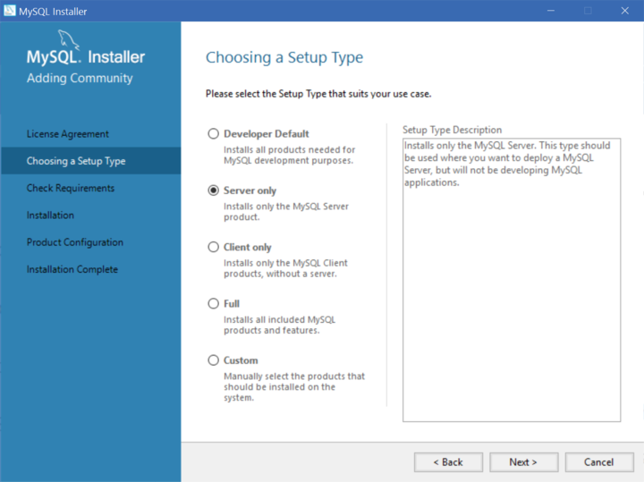
Installing MySQL (1 / 3) FOR PC
Go to http://dev.mysql.com/downloads/mysql/, select Microsoft Windows for the operating system, and download the basic 32-bit ZIP Archive version of MySQL.
Open the ZIP file and follow the installation wizard to install.
When it asks you for a setup type, select “Server only”.

Slide 5
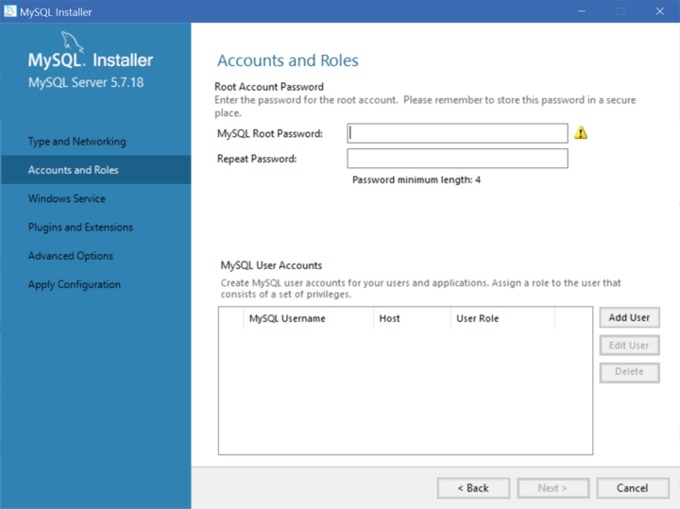
Installing MySQL (2 / 3) FOR PC
When you get to Accounts and Roles, set a simple password (we will be getting rid of it shortly).

Slide 6
Installing MySQL (3 / 3) FOR PC
Once the installation is complete, open the MySQL Command Line Client.
When it prompts you for the password, enter the password you set in the installation wizard.
Inside MySQL (as signified by the > in front of your terminal prompt), run SET PASSWORD FOR root@localhost=PASSWORD('');
Close the MySQL Command Line Client window.
Now you should be able to start up MySQL without a password; simply hit enter after you open the MySQL Command Line Client again.
If everything is working, you may now throw away the temporary password.

Slide 7
Installing MySQL FOR MAC
Go to http://dev.mysql.com/downloads/mysql/, select MAC OS X for the operating system and download the DMG version of MySQL
Open the DMG file and follow the installation wizard to install. It will give you a temporary password at some point, save this password somewhere. You’ll need it in a second and then never again.
Once the installation is complete, open up System Preferences and start the MySQL server.
Now start up MySQL in your terminal by running mysql -u root -p,and when it prompts you for the password, enter your temporary password
Inside MySQL (as signified by the > in front of your terminal prompt), run SET PASSWORD FOR root@localhost=PASSWORD('');
Now you should be able to start up MySQL without a password, simply by running mysql -u root
If that still doesn’t work, make sure /usr/local/bin/mysql is in your path.
If everything is working, you may now throw away that temporary password.

Slide 8
Basic commands
The way you interact with a MySQL server is through SQL commands.
To be very clear: MySQL is a database manager, SQL is the language to interact with it.
SQL commands are actually pretty human readable. Queries generally follow a SELECT some attributes FROM some table WHERE some case holds true pattern.
Some keywords will be in all caps, which doesn’t matter -- it just improves readability
Most commands end with a ;
Follow along while we go through some basic commands!

Slide 9
Creating a database and table
> SHOW DATABASES; # lists all databases
> CREATE DATABASE test; # create a database named test
> USE test; # make test the active database
> CREATE TABLE test_table (
id INTEGER NOT NULL AUTO_INCREMENT,
user VARCHAR(15) NOT NULL,
PRIMARY KEY (id),
UNIQUE (user)
);
> SHOW TABLES; # show the tables in the database
> DESC test_table; # describe the test_table
Notes:
For the create, we are
Creating a table named test_table
test_table has 2 fields (or columns): id and user
id is of type integer, it cannot be null, and each time a new record is added to the table, the value of id is the current highest value of id + 1.
user is a string (varchar) of max length 15, and cannot be null
id is the primary key, meaning that no two records can have the same value for id, and that id the field to uniquely identify a record
user is unique, meaning that no two records can have the same value for user

Slide 10
Insert/Update/Delete/Query a record
# Add a new record with user = “johnDoe” into test_table. id will be
# set automatically; since this is the first record in the table, id = 1.
> INSERT INTO test_table (user) VALUES(“johnDoe”);
# Display everything currently in test_table
> SELECT * FROM test_table;
# Add a new record with user = “janeDoe” into test_table. id will be # automatically set to 2.
> INSERT INTO test_table (user) VALUES(“janeDoe”);
> SELECT * FROM test_table;
# The record with user = “johnDoe” now has user = “noDoe” since it has id = 1.
> UPDATE test_table SET user = “noDoe” WHERE id = 1;
# Will display the noDoe record
> SELECT user FROM test_table WHERE id = 1;

Slide 11
Insert/Update/Delete/Query a record
# Display everything currently in test_table, but formatted more legibly
> SELECT * FROM test_table\G
# Delete the record where id = 1
> DELETE FROM test_table WHERE id = 1;
> SELECT * FROM test_table;
# Delete the test_table table
> DROP TABLE test_table;
> SHOW TABLES;
# Delete the test database
> DROP DATABASE test;
> SHOW DATABASES;

Slide 12
That’s it for MySQL!
Any questions?

Slide 13
Reference
http://www.w3schools.com/sql (read all the tutorials but skip joins)

