Slide 1
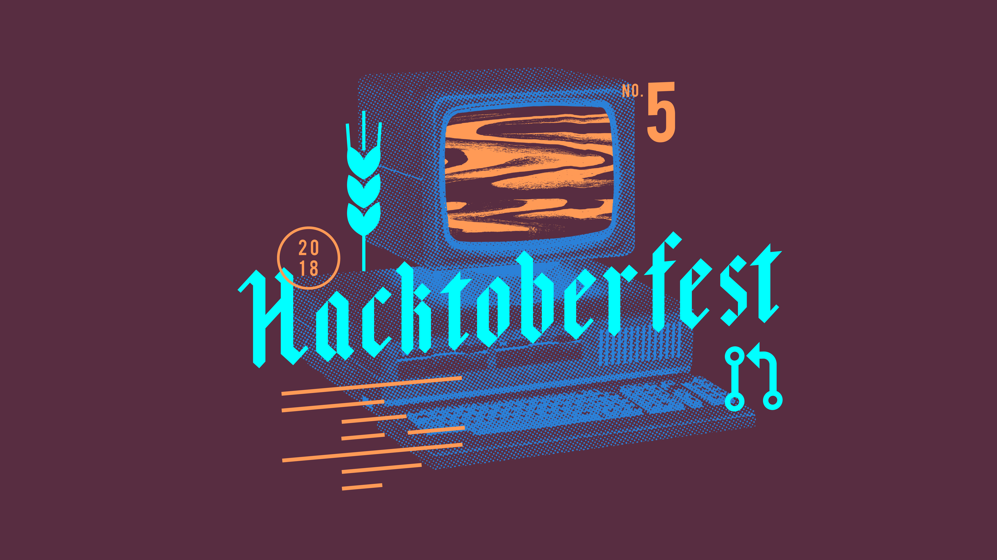
My first pull request
Tobias Schaffner

Slide 2
Agenda
Register at Github
Install git
Fork the project
Add your changes changes
Create the pull request

Slide 3
Register at Github
https://github.com/
You can use this account to register for Hacktoberfest afterwards:
https://hacktoberfest.digitalocean.com/

Slide 4
Install git
Windows:
https://gitforwindows.org/
Debian based Linux:
sudo apt-get install git
Mac (Homebrew):
brew install git

Slide 5

Fork the project
Go to the project and create a fork:
https://github.com/HacktoberfestMunich/MyFirstPR
New shell or git-bash:
git clone https://github.com/<YourName>/MyFirstPR.git
Change into the repository
cd MyFirstPR

Slide 6
Add your changes
Create a new branch:
git checkout -b my_changes
Add your name to the README.md at the right section and commit your changes:
git commit -a
Push your changes:
git push --set-upstream origin my_changes

Slide 7
Create the pull request
Go to your repository:
git clone https://github.com/<YourName>/MyFirstPR.git
Create a pull request with the branch you created as origin and the master of the original repository as target.
Check your progress at:
https://hacktoberfest.digitalocean.com/

Slide 8
Questions?

