Slide 1


Intro
Tobias Schaffner
sponsored by

Slide 2
Agenda
Intro
Presentations
Meet and eat (about 9 PM)
Hackathon / First pull request

Slide 3
WIFI
SSID: PixelGroup_Schulung
Pass: Hacktoberfest2018!

Slide 4
Presentations
Find all the presentations here:
https://github.com/HacktoberfestMunich/Presentations/

Slide 5

Overview

Slide 6
Sponsor
Chief executive
Helmut Süßmuth

Slide 7

Sponsor
CEO PIXEL Group
Simon Ashdown

Slide 8
Why is open source great?
Empirically better quality software (Wheeler, 2015)
Modern software development techniques
Peer reviewing
Great opportunity to learn
Equal opportunities

Slide 9
OpenSource becomes mainstream
GitHub number of active contributers (10 or more contributions) per company 2017:
1 Microsoft 4,550
2 Google 2,267
3 Red Hat 2,027
4 IBM 1,813
5 Intel 1,314
6 Amazon 881
7 SAP 747
8 ThoughtWorks 739
9 Alibaba 694
10 GitHub 676

Slide 10
Munich Meetup
Learn something about OpenSource
Meet other people interested in OpenSource
Promote a project
See what other people in the OpenSource scene are working on
Have a great evening with beer and pizza

Slide 11
Workshop
Listen to the project presentations
Have some pizza together and join a project that you are interested in
Spend some time together working on the project

Slide 12
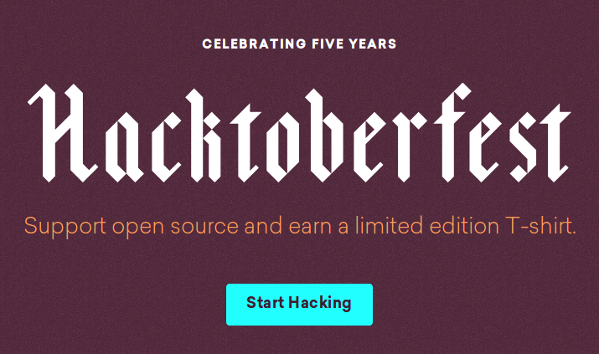
Hacktoberfest rules
https://hacktoberfest.digitalocean.com/

Slide 13
Hacktoberfest rules
Register
Open 5 pull requests
(Does not necessarily to be code)
Get shirt
Open one pull request in a Microsoft project to get another special shirt
https://open.microsoft.com/2018/09/30/join-hacktoberfest-2018-celebration-microsoft/

Slide 14
Questions?

