Slide 1

Valetudo
Tobias Schaffner

Slide 2
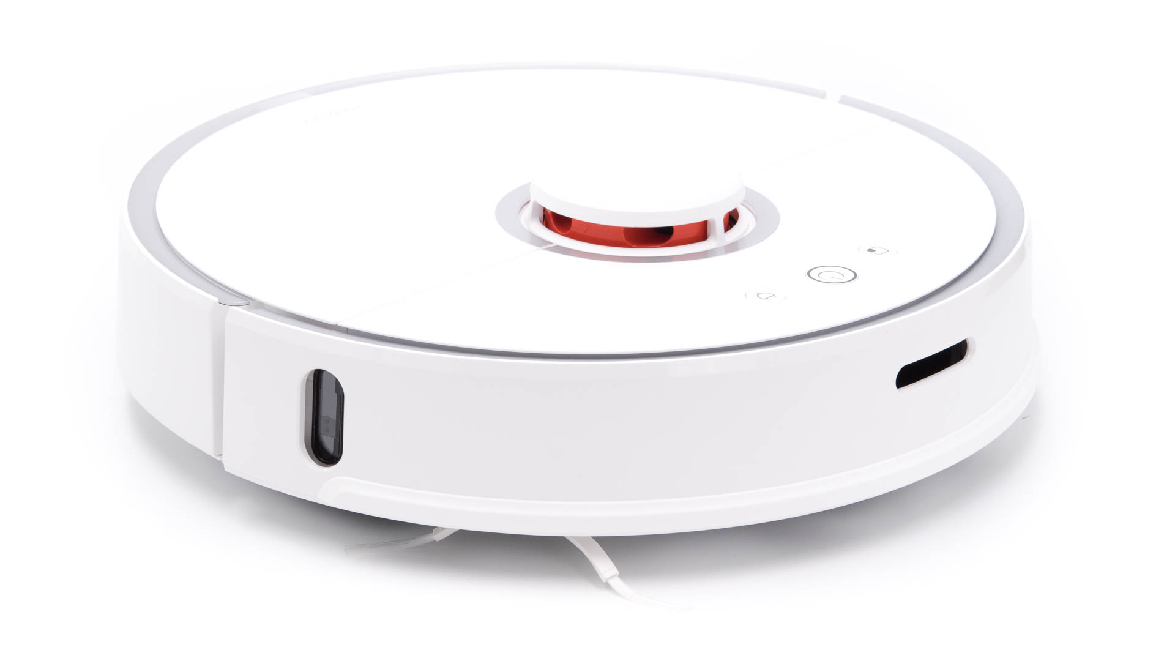
Xiaomi Roborock S50

Slide 3
Sends everything to the cloud
SSID
MAC address
Map of your flat

Slide 4
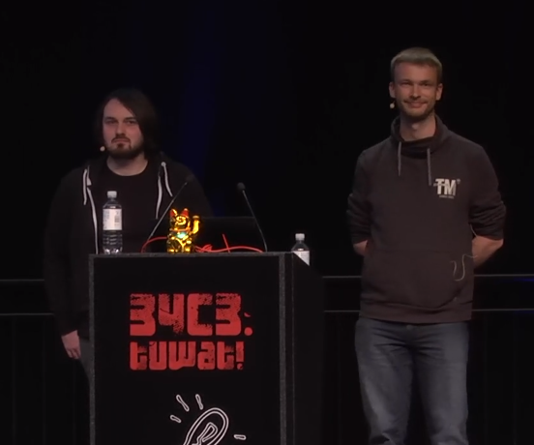
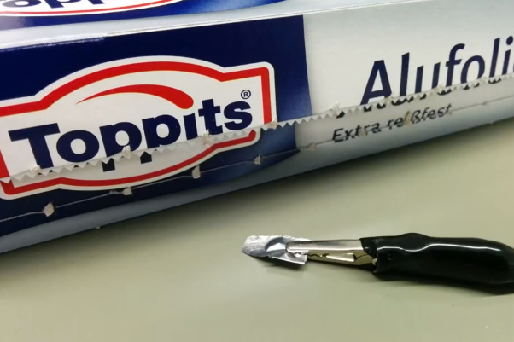
Hacked
Dennis Giese
Daniel Wegemer
https://media.ccc.de/v/34c3-9147-unleash_your_smart-home_devices_vacuum_cleaning_robot_hacking

Slide 5
Dustcloud
Cloud alternative
Running on Raspberry Pi

Slide 6
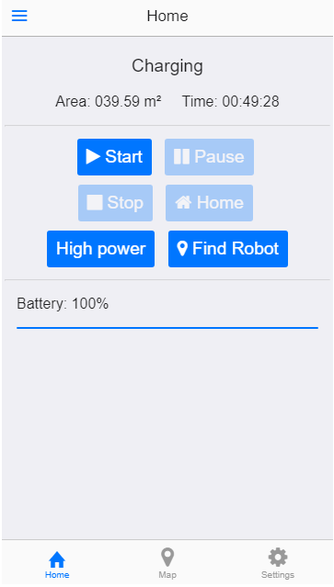
Valetudo
https://github.com/Hypfer/Valetudo
Webinterface directly
running on the robot
Javascript
Remote API

Slide 7
Access
For flashing use the instructions in the repository
Webinterface: http://rockrobo
SSH: ssh root@rockrobo using the private key in the folder of this presentation

Slide 8
Questions?

