Slide 1
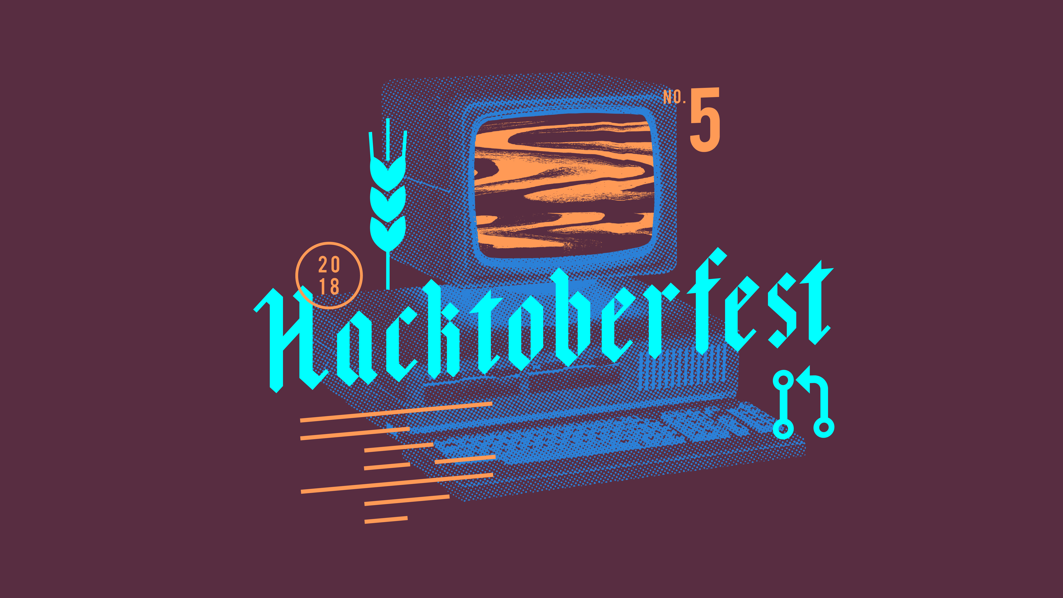
Mort + OpenCV | Go | Python
Pablo Aguiar (@scorphus)

Slide 2
Who’s Pablo Aguiar (@scorphus)
Computer Scientist from Brazil
FOSS contributor for 10+ years
Previously at Globo.com
Mentor at HackIllinois
Currently working on a side project
And looking for the next gig!
Coffee geek :-)

Slide 3


Mort + OpenCV → face and features
Mort: storage and image processing server written in Go
OpenCV: Open Source Computer Vision Library
Challenge:
  Add face recognition and feature detection to Mort with OpenCV

Slide 4
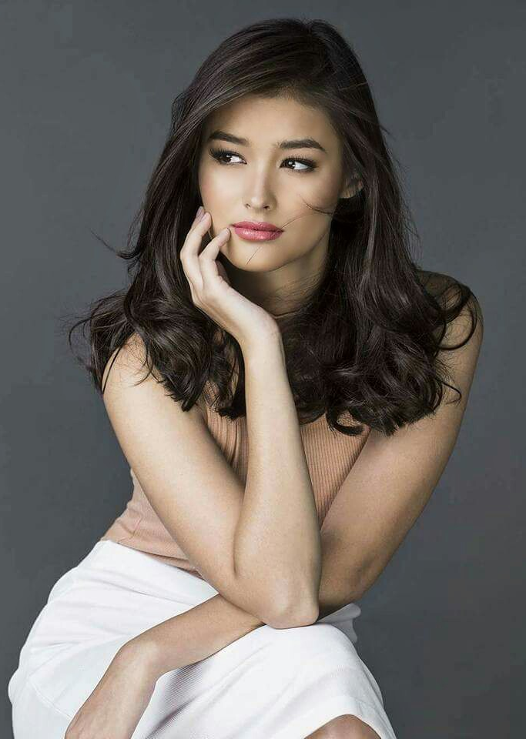
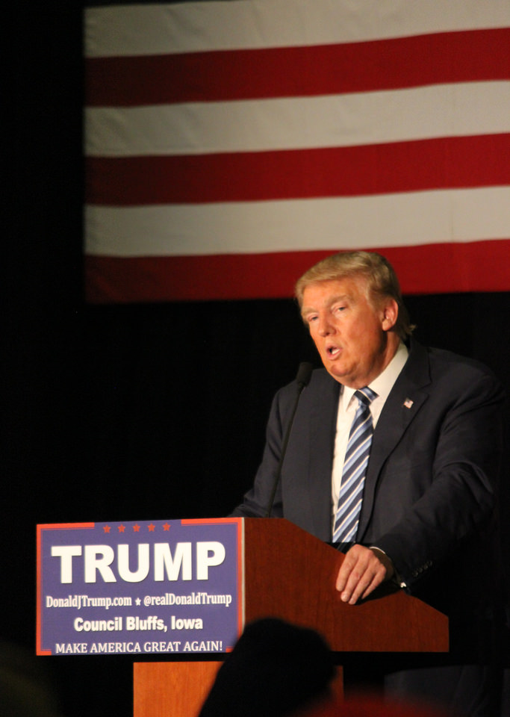
Mort + OpenCV → face and features

Slide 5
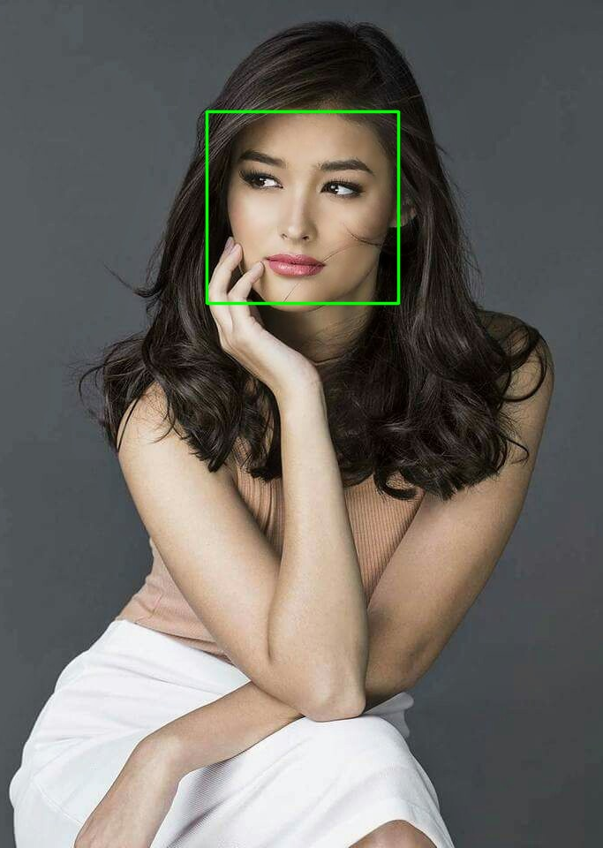

Mort + OpenCV → face and features

Slide 6
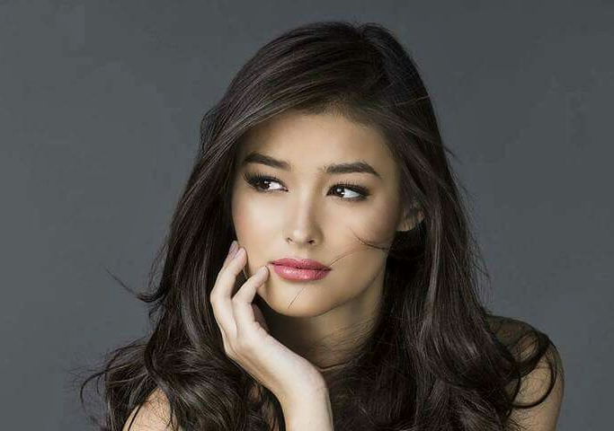
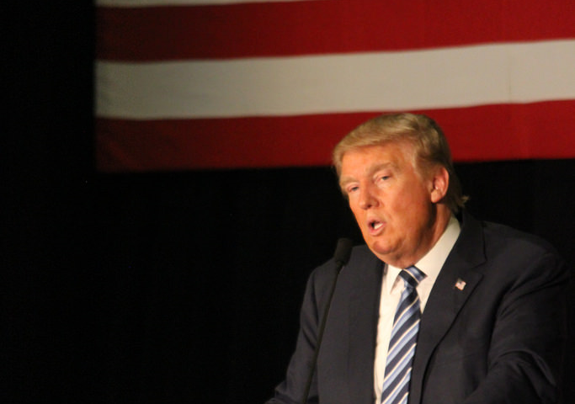
Mort + OpenCV → face and features

Slide 7
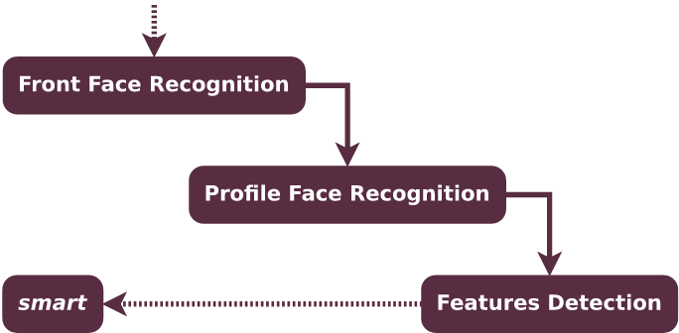
Mort + OpenCV → face and features

Slide 8

Python
Python: a programming language that lets you work quickly and integrate systems more effectively
Challenges:
  Solve bugs
  Improve docs
  Increase test coverage

Slide 9
Go
Go: an open source programming language that makes it easy to build simple, reliable, and efficient software
Challenges:
  Solve bugs
  Improve docs
  Add examples

Slide 10
I’m here to help|mentor|share|code
Python
Go
Git
Docker
Ansible
Fish
Bash
Coffee :-D

Slide 11
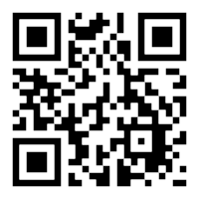
bit.ly/mort-py-go

Slide 12
Let’s have some FUN!!! \o/
Questions?

