Slide 1

Lantern
Tobias Schaffner

Slide 2
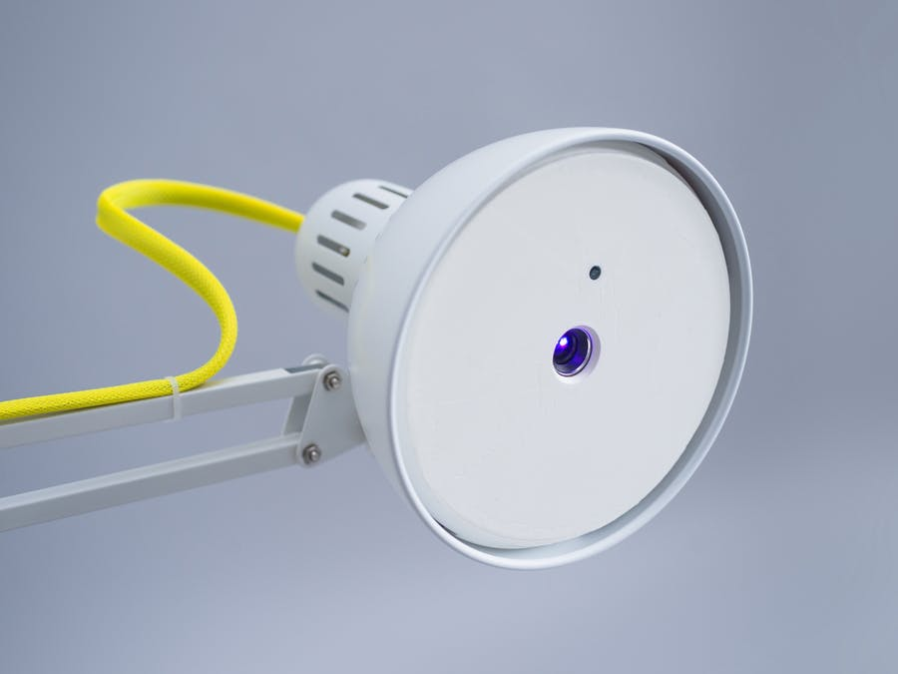
Lantern
A mixed reality device running
android things

Slide 3
Hardware
https://www.hackster.io/nord-projects/android-things-lantern-9f0c28
IKEA Tertial Lamp
Raspberry PI running Android Things
Rasperry PI Camera module
UO Smart Beam Laser projector
Acceleromter

Slide 4
Software
https://github.com/nordprojects/lantern
Based on Android
Java/Kotlin
Channel concept (configurable app fragments)

Slide 5
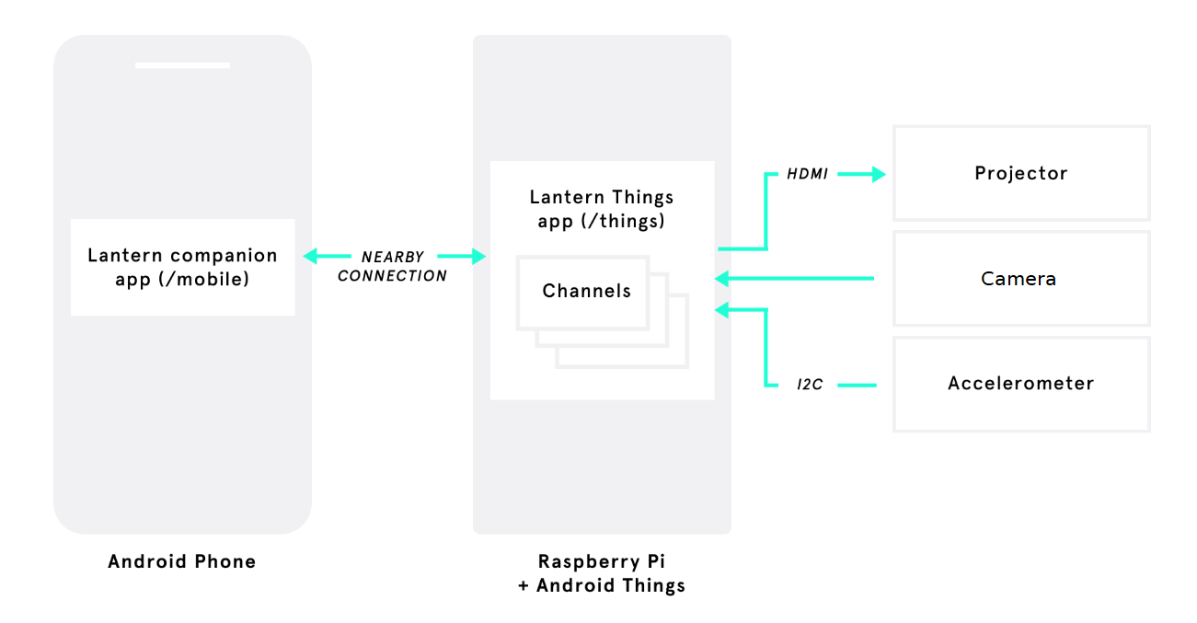
Lantern

Slide 6
Idea
Input with camera
Output with projector
Processing of input pictures something like OpenCV or Tensorflow opens countless possibilities

Slide 7
Getting started
Stick to the documentation on
https://github.com/nordprojects/lantern
Please use your own phone for the companion app
Connect with adb to the provided IP

Slide 8
Questions?

