Slide 1
Land Registry using Blockchain
Vidyavardhini’s College of Engineering & Technology
K.T. Marg, Vartak College Campus, Vasai Rd, Vasai-Virar, Maharashtra 401202
Department of Computer Science and Engineering [Data Science]
Group No: 06
Prathamesh Thakare 61
Tejas Wani 65
Pritish Dhumal 11
Prof. Sumeet Shingi
Date: 02/11/2023

Slide 2
Contents
Introduction
Problem Statement
Literature Survey
Proposed System
Architecture/Framework/Block diagram/Algorithm/Process Design
Details of Hardware/Software used
Output
Result Analysis
Conclusion
References
Thank you

Slide 3
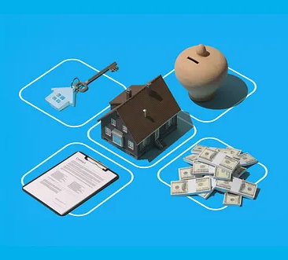
Introduction
“Land Registry Using Blockchain" revolutionizes land management with secure, transparent, and efficient processes. This innovative project overcomes traditional land registry challenges, offering a modern solution for recording ownership and transactions.

Slide 4
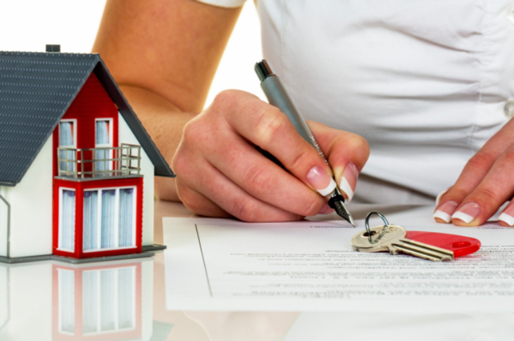
Problem Statement
Traditional land registration systems worldwide face issues like fraud, opaque records, paperwork, and bureaucracy, leading to disputes and inefficiencies. Our project leverages blockchain to combat fraud, improve transparency, and streamline land registration and transactions.

Slide 5
Literature Survey
Sr. No | Paper Title | Advantages | Disadvantages
1 | Land Registration System Using Blockchain | It offers the potential to address several critical challenges in the current paper-based land registration system, including fraud prevention, enhanced security, transparency, and efficiency. | The legal and regulatory framework for such a system may need to be developed, which can be a complex and time-consuming process
2 | Securing Land Registration using Blockchain | It presents a compelling solution to address the vulnerabilities in the current land registration process. | Implementing a blockchain-based land registry may face challenges in terms of initial infrastructure and technology adoption costs.
3 | Blockchain-Based Land Registration System: A Conceptual Framework | It addresses the issues of data fraud, security, and system reliability. | Resistance from traditional land management authorities and adaptation to the new technology could be obstacles.
4 | Land Registration System Using Block-chain. | It replaces the manual documentation with smart contracts. | Resistance from existing stakeholders, such as brokers and government agencies, may hinder adoption.
5 | Digital Land Registry System Using Blockchain | It revolutionize land registration systems by eliminating intermediaries, improving transaction speed, and enhancing security | Transitioning from a centralized system to a blockchain-based one requires adaptation, regulatory adjustments, and overcoming resistance from existing stakeholders.

Slide 6
Proposed system
Our proposed system leverages blockchain technology to revolutionize land registration by introducing a secure, transparent, and efficient process. Key features include decentralized ledger, smart contracts, ownership verification, transparency, efficiency, and cost savings. The system enhances security, reduces fraud, and ensures compliance while promoting adoption and ongoing maintenance.
Our proposed system is a transformative shift in land management and ownership documentation. It effectively addresses the persistent issues of fraudulent land transfers, opacity in ownership records, excessive paperwork, and bureaucratic red tape. By harnessing the capabilities of blockchain technology, we mitigate fraudulent activities, enhance transparency, and simplify land registration and transaction processes. This results in a modern, efficient, and secure solution for land ownership management.

Slide 7
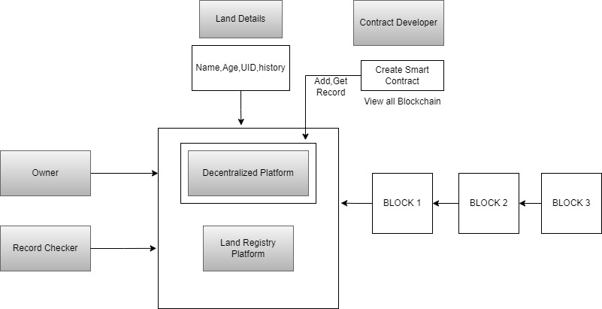
Architecture/Framework/Block diagram/Algorithm/Process Design

Slide 8
Details of Hardware/Software used
Hardware details:
Processor: A multi-core processor, such as an Intel Core i7 or AMD Ryzen, is recommended for smoother development and testing.
Memory (RAM): At least 8GB of RAM is recommended, especially for larger projects and testing.
Storage: You'll need storage for your development environment, IDE, and project files. An SSD (Solid State Drive) is preferred for faster load times.
Software details:
Remix Ethereum IDE: For initial contract development and testing.
Truffle: For advanced development, testing, and deployment.
Solidity programming language: For writing the smart contract.
Ethers.js: For smart contract interaction.
Front-end technologies (HTML, CSS, JavaScript, and frameworks) for the user interface.

Slide 9
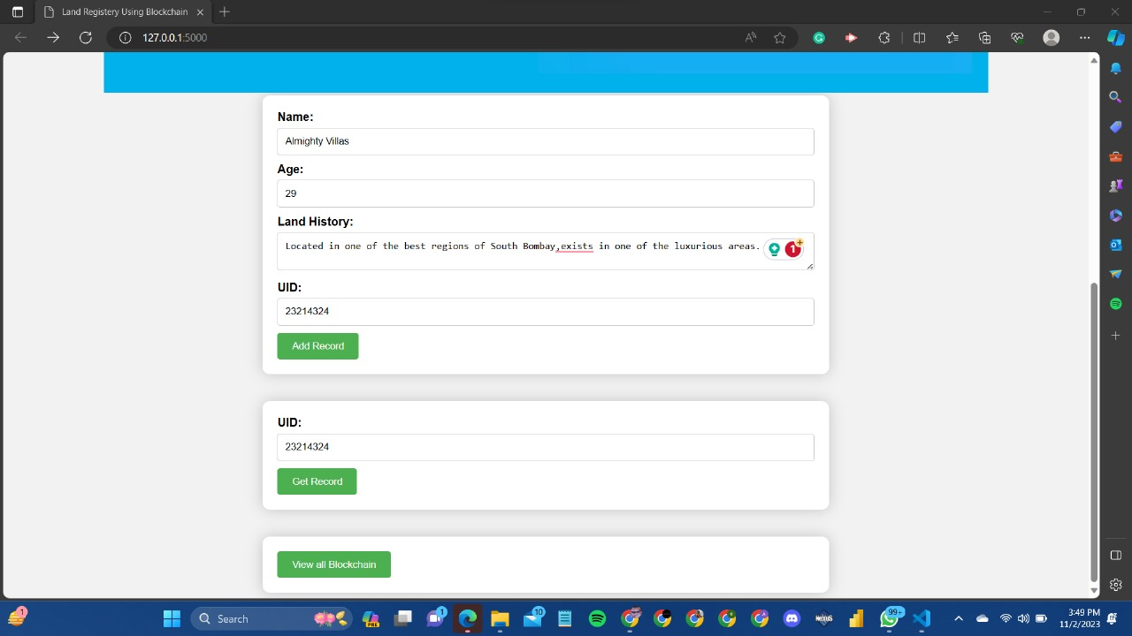
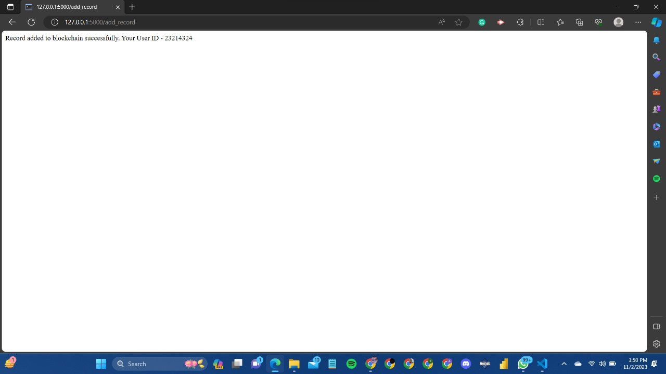
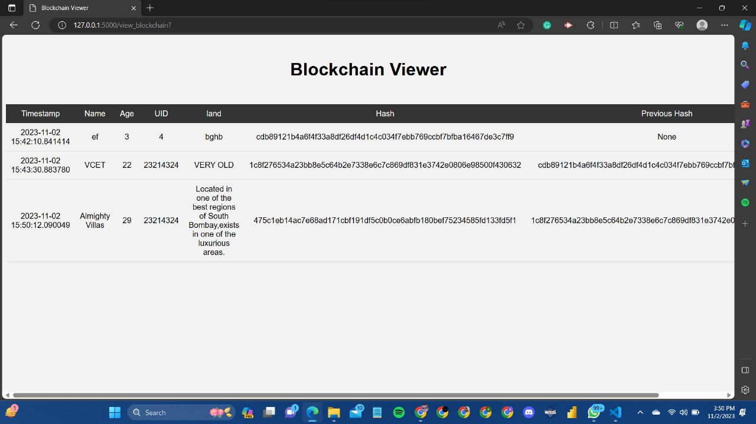
Output

Slide 10
Result Analysis
Transparency and Trust: The system provided a high level of transparency and trust, reducing fraud and disputes.
Security: The project effectively mitigated fraudulent activities and ensured secure land records.
Legal Compliance: The system fully complied with local and national land registration regulations.
Data Integrity: Data on the blockchain remained accurate and unchanged, serving legal and financial purposes.
Maintenance and Updates: Ongoing maintenance and updates adapted to changing requirements and emerging technologies.
Cost Savings: Significant cost savings were achieved by minimizing paperwork and disputes.

Slide 11
Conclusion
In conclusion, the proposed system represents a groundbreaking approach to address the longstanding challenges associated with land management and ownership documentation. By incorporating blockchain technology, this initiative has the potential to revolutionize how land ownership records are recorded and managed. With a renewed emphasis on security, transparency, and efficiency, the project is poised to streamline land registration and transaction procedures, ultimately benefiting landowners, authorities, and the entire real estate industry. The potential for enhanced security and efficiency in land management and transactions is a beacon for a future where blockchain technology is an integral part of the land registry process.

Slide 12
References
[1] Archana Sahai, Rajiv Pandey, Smart Contract Definition for Land Registry in Blockchain, 9th IEEE International Conference on Communication Systems and Network Technologies, 2020
[2] Rijwan Khan, Shadab Ansari, Sneha Jain, Saksham Sachdeva, Blockchain based land registry system using Ethereum Blockchain, Journal of Xi'an University of Architecture & Technology.
[3] Hartmut MÜLLER and Markus SEIFERT, Blockchain, a Feasible Technology for Land Administration? , FIG Working Week 2019 Geospatial information for a smarter life environmental
resilience Hanoi, Vietnam, April 22–26, 2019
[4] Meghali Nandi, Rajat Kanti Bhattacharjee, Amrit Jha, Ferdous A. Barbhuiya, A secured land registration framework on Blockchain, 2020 Third ISEA Conference on Security and Privacy
2020
[5] Krishnapriya S, Greeshma Sarath, Securing Land Registration using Blockchain, Third International Conference on Computing and Network Communication (CoCoNet’19)
[6] Arif Furkan Mendi, Kadir Kaan Sakakl, Alper Cabuk, And Blockchain Based Land Registration System Proposal for Turkey,
2020.
[7]Ali, Adnan Nadeem, Ali Alzahrani, Salman Jan, A Transparent and Trusted Property Registration System on Permissioned Blockchain, 2020.
[8] R.C. Suganthe, N. Shanthi, R.S. Latha, K. Gowtham, S. Deepakkumar, R. Elango, Blockchain enabled Digitization of Land Registration, 2021 International Conference on Computer Communication and Informatics (ICCI – 2021), Jan. 27-29,2021.
[9] Swapnil Soner, Ratnesh Litoriya, Prateek Pandey, Exploring Blockchain and Smart Contract Technology for Reliable and Secure Land Registration and Record Management, 2021.
[10] Ameya Thosar, Mayur Harne, Ashutosh Sarode, Dr. Parminder Kaur, Land Registry Management Using Blockchain, 2021.

Slide 13
Thank you

