Slide 1
Topics concerning BibTeX / biblatex / biber
Terminology BibTeX / bibLaTeX / biber
Citation and bibliography styles
Sharelatex with bibLaTeX and biber
Executing BibTeX / bibLaTeX / biber
Creation of .bib – files with „hacks“.

Slide 2
BibTeX / bibLateX and biber (terminology)
BibTeX was created in 1985 – with enhancements until 1988 and in 2010.
BibLateX was created to separate the formating from BibTeX
Biber replaces BibTeX as a backend for BibLaTeX.
Bibtex and biber are external programs that process bibliography information and act (roughly) as the interface between your .bib file and your LaTeX document.
Natbib and biblatex are LaTeX packages that format citations and bibliographies; natbib works only with bibtex, while biblatex (at the moment) works with both bibtex and biber. Source: https://tex.stackexchange.com/questions/25701/bibtex-vs-biber-and-biblatex-vs-natbib/25702#25702

Slide 3
Styles with Biblatex and biber
With Biblatex the bibliographic and the citation style can be set separately:
Biblatex bibliography styles: https://de.sharelatex.com/learn/Biblatex_bibliography_styles http://www.ctan.org/tex-archive/macros/latex/exptl/biblatex-contrib
Biblatex citation styles: Biblatex provides several standard citations styles, if no citation style is set LaTEX uses the one that matches the bibliography style. https://de.sharelatex.com/learn/Biblatex_citation_styles (source of information)

Slide 4
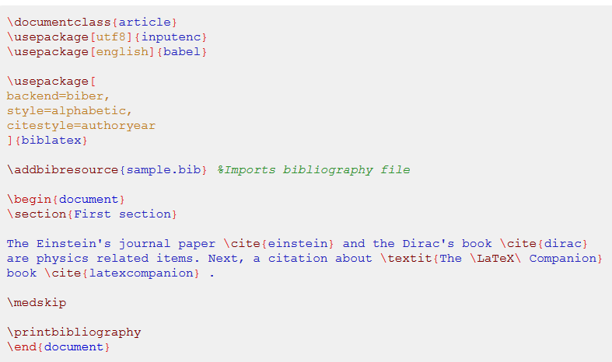
Source: https://de.sharelatex.com/learn/Biblatex_citation_styles

Slide 5

Sharelatex @ GWDG
ShareLaTeX is a Tex Live Installation on a GWDG Server. Evey user with GWDG Account can use ShareLaTeX alone or as a group software.
The GWDG offers ShareLaTeX as a beta service until the end of 2017 for all users at https://sharelatex.gwdg.de
https://info.gwdg.de/docs/doku.php?id=de:services:email_collaboration:sharelatex
Example:
https://sharelatex.gwdg.de/project/59540519823c6c72002e01dd

Slide 6
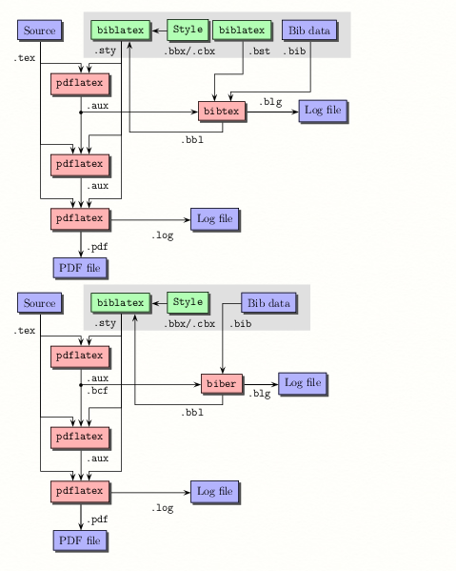
Processing BibTex
BibTeX needs an .aux file – so you have to run LaTeX before BibTeX is able to do its work.
a .bst file (the style file) is needed, that specifies the general reference-list style and formats individual entries.
.bib file(s) are the database of all reference-list entries of the user.
BibTeX uses only cited entries of the .bib file which are specified by the .aux file and creates as output a .bbl file containing these entries together with the formatting commands specified by the .bst file. LaTeX will use the .bbl file, to produce the reference list.
Source of information: https://web.archive.org/web/20110927042356/http://www.tex.ac.uk/tex-archive/bibliography/bibtex/base/bibtex.web
ShareLaTeX: The server generates the output files as PDFs.
Source: https://tex.stackexchange.com/questions/25701/bibtex-vs-biber-and-biblatex-vs-natbib/25702#25702

Slide 7
The syntax of .bib-files (book)
A data set consists of a publication type, a BibTeX key and tags.
@book{GBV-774840722,
author = {Demtröder, Wolfgang},
title = {Laser spectroscopy : Basic principles},
publisher = {Springer},
year = {2014},
volume = {1},
series = {Laser spectroscopy ; 1},
address = {Berlin [u.a.]},
edition = {5. ed.},
pages = {XVIII, 496 S.},
}

Slide 8
The syntax of .bib-files (article)
A data set consists of a publication type, a BibTeX key and tags.
@article{hell1994breaking,
title={Breaking the diffraction resolution limit by stimulated emission: stimulated-emission-depletion fluorescence microscopy},
author={Hell, Stefan W and Wichmann, Jan},
journal={Optics letters},
volume={19},
number={11},
pages={780--782},
year={1994},
publisher={Optical Society of America}
}

Slide 9
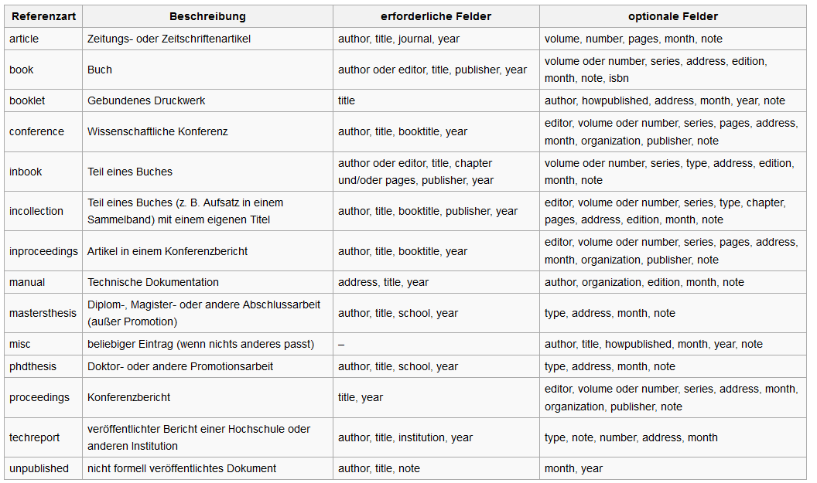
https://de.wikipedia.org/wiki/BibTeX
Entry Types

Slide 10
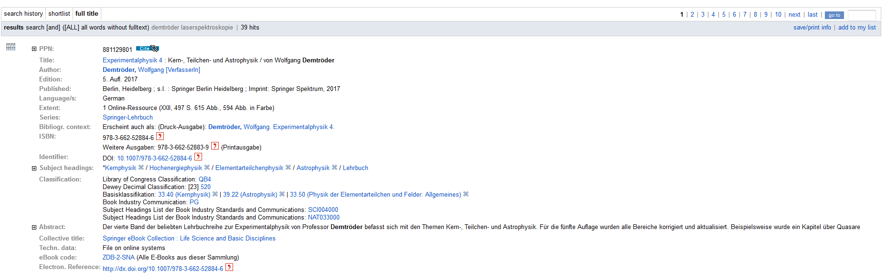
Hack 1: Export of .bib files from a library catalogue
Unfortunately the catalogue of SUB Göttingen GUK does not offer a BibTeX - Export.
Export from GVK: https://gso.gbv.de is possible

Slide 11
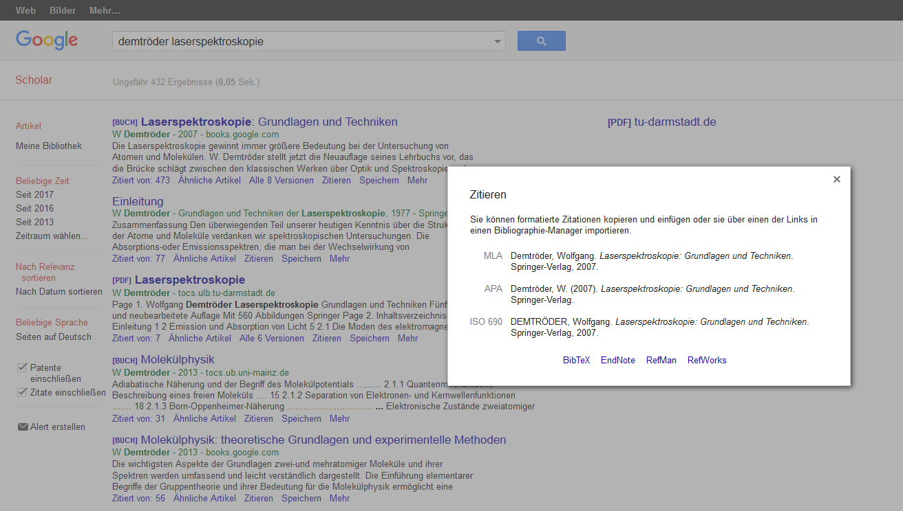
Hack 2 : Google Scholar offers BibTeX export

Slide 12
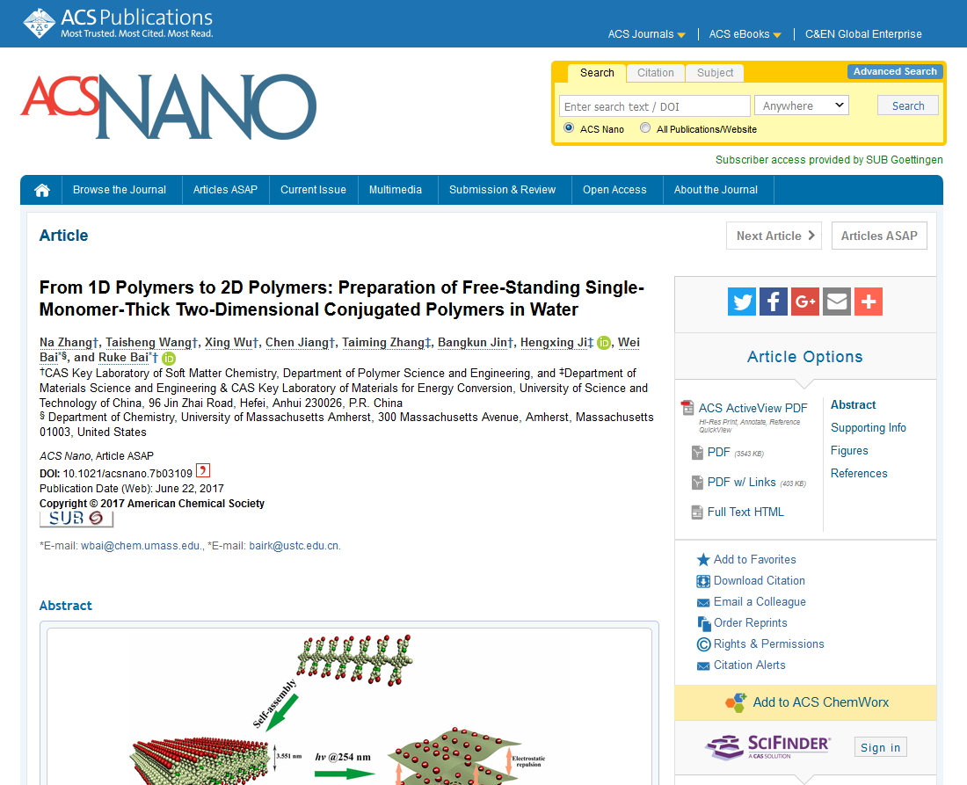
Hack 3 : Export from the publishers

Slide 13
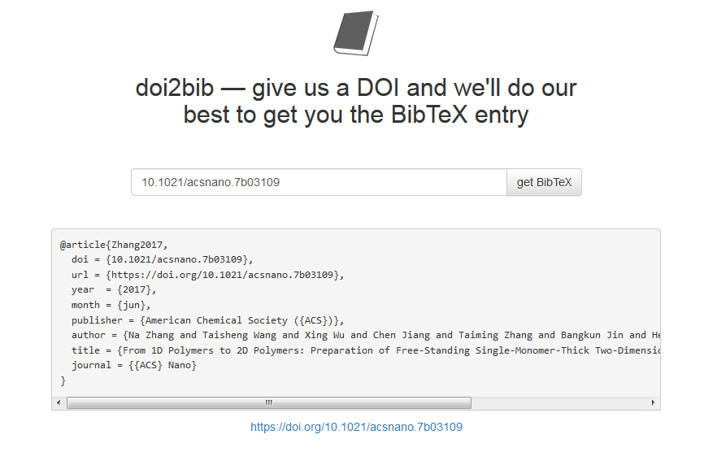
Hack 4 : doi2bib: www.doi2bib.org

Slide 14





Hack 5 : Export from other reference management tools

Slide 15
Hack 6 : JabRef
BibTeX / BibLaTeX can also be used directly with the reference management tool JabRef.
JabRef is installed locally on your PC and needs JAVA Runtime Environment.
Import of Bibtex by DOIs is possible
Different scientific data bases can be searched like arXiv, CiteseerX, Google Scholar, Medline, GVK, IEEEXplore, and Springer
In older versions a plugin for GVK had be be installed manually. http://www.gbv.de/wikis/cls/Jabref-GVK-Plugin

Slide 16
Librarian‘ s Hack 7
If you know the Pica Production Number PPN (can be extracted from the citation link of a book), you may enter it into this URL:
http://unapi.gbv.de/?id=gvk:ppn:73241511X&format=bibtex

Slide 17
Helpful Links
Wissenschaftliche Arbeiten schreiben mit LaTeX : Leitfaden für Einsteiger: https://opac.sub.uni-goettingen.de/DB=1/XMLPRS=N/PPN?PPN=870458442
BibLaTeX – Sophisticated Bibliographies in LaTeX: https://www.ctan.org/pkg/biblatex?lang=de
biber: https://sourceforge.net/projects/biblatex-biber/files/biblatex-biber/ ;
ShareLaTeX der GWDG: https://info.gwdg.de/docs/doku.php?id=de:services:email_collaboration:sharelatex
Using bibliographies in ShareLaTeX: https://de.sharelatex.com/learn/Using_bibliographies_in_ShareLaTeX
Hacky Hour
July 4th 2017

