Slide 1


Slide 2
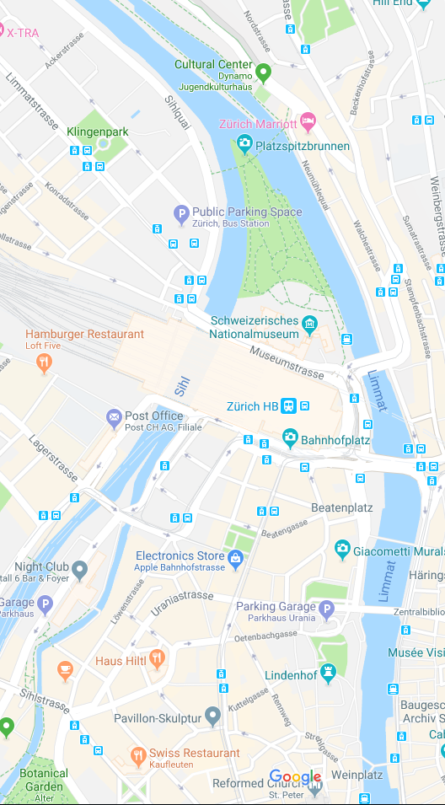
Share my location

Slide 3
Stop sharing location

