Slide 1
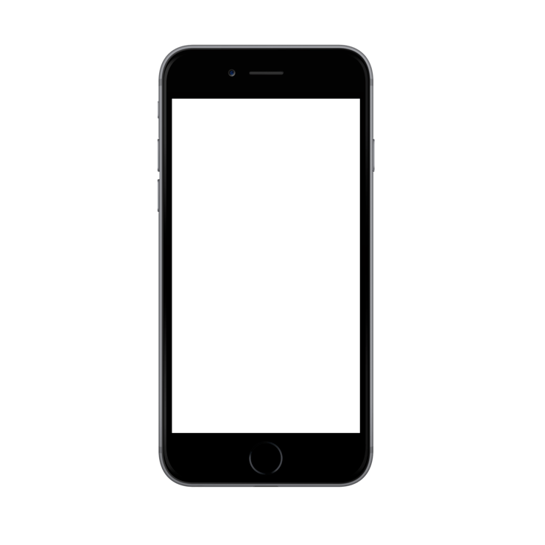
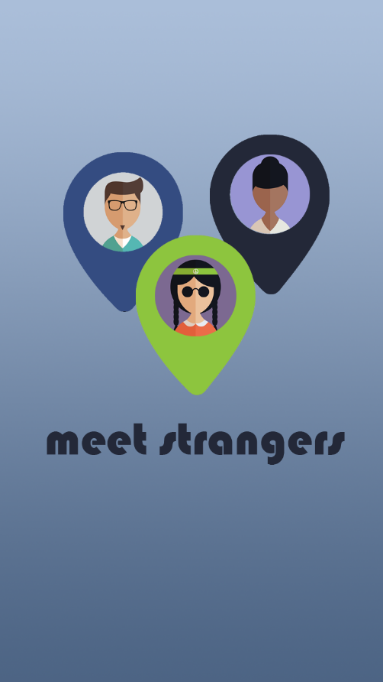

Slide 2
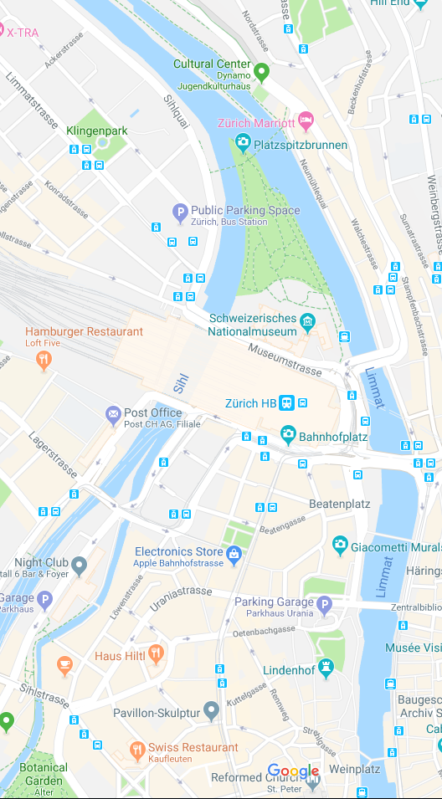
Share my location

Slide 3
Your location
Strangers
Stop sharing
Stop sharing location

