Slide 1



Slide 2
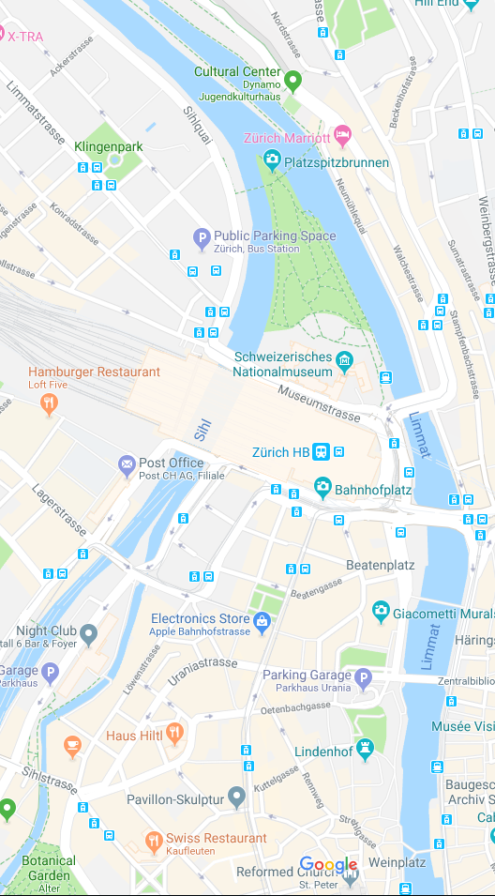


Slide 3



You
Strangers

Slide 4
You
Strangers

Slide 5


