Slide 1



Slide 2
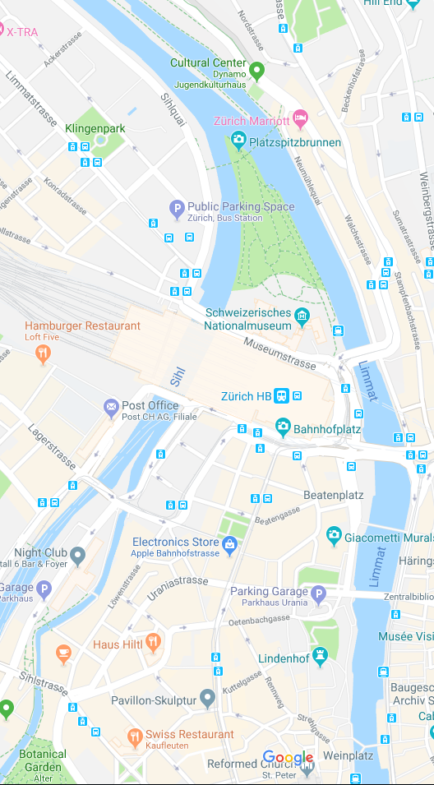



Slide 3


You
Strangers

Slide 4
You
Strangers

Slide 5


