Slide 1
J2EE与中间件技术
——安全

Slide 2
Java SE Security Implementation Mechanisms
Java Authentication and Authorization Service (JAAS)
  JAAS is a set of APIs that enable services to authenticate and enforce access controls upon users.
Java Generic Security Services (Java GSS-API)
Java Cryptography Extension (JCE)
Java Secure Sockets Extension (JSSE)
Simple Authentication and Security Layer (SASL)

Slide 3
Java EE Security Implementation Mechanisms
Java EE security services are provided by the component container and can be implemented using declarative or programmatic techniques.

Slide 4
开发安全的应用
Java EE, web, and web services applications are made up of components that can be deployed into different containers. These components are used to build a multitier enterprise application. Security for components is provided by their containers.
A container provides two kinds of security: declarative and programmatic security.

Slide 5
Declarative security
Declarative security expresses an application component’s security requirements by using either deployment descriptors or annotations.
Deployment descriptors are external to an application, and include information that specifies how security roles and access requirements are mapped into environment-specific security roles, users, and policies.

Slide 6
Programmatic security
Programmatic security is embedded in an application and is used to make security decisions.
Programmatic security is useful when declarative security alone is not sufficient to express the security model of an application.

Slide 7

A Simple Security Example
Step 1: Initial Request
  In the first step of this example, the web client requests the main application URL.
  Since the client has not yet authenticated itself to the application environment, the server responsible for delivering the web portion of the application (hereafter referred to as web server) detects this and invokes the appropriate authentication mechanism for this resource.

Slide 8
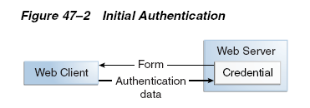
Step 2: Initial Authentication
  The web server returns a form that the web client uses to collect authentication data (for example, user name and password) from the user. The web client forwards the authentication data to the web server.

Slide 9
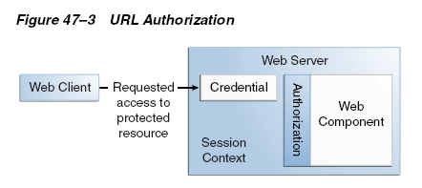
Step 3: URL Authorization
  The credential is used for future determinations of whether the user is authorized to access restricted resources it may request.

Slide 10
    The web server consults the security policy (derived from the deployment descriptor) associated with the web resource to determine the security roles that are permitted access to the resource.
    The web container then tests the user’s credential against each role to determine if it can map the user to the role.

Slide 11
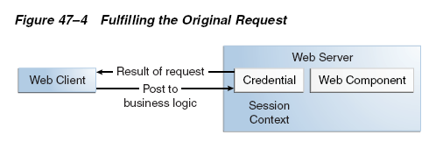
Step 4: Fulfilling the Original Request
  If the user is authorized, the web server returns the result of the original URL request.

Slide 12
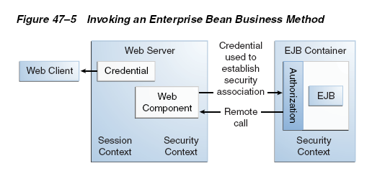
Step 5: Invoking Enterprise Bean Business Methods
  The web page performs the remote method call to the enterprise bean.

Slide 13
  The EJB container is responsible for enforcing access control on the enterprise bean method. It consults the security policy (derived from the deployment descriptor) associated with the enterprise bean to determine the security roles that are permitted access to the method.
  If the call is authorized, the container dispatches control to the enterprise bean method. The result of the bean’s execution of the call is returned to the web page, and ultimately to the user by the web server and the web client.

Slide 14
Characteristics of Application Security
安全性包括：
  认证和授权
    用户和组
    角色和策略
  审计和日志记录
  防火墙
  数据保密和安全套接字

Slide 15
认证和授权
认证（Authentication）：用户向系统证明“我是谁”
授权（Authorization）：应用服务器授予某个用户访问哪些资源的权限，“我能访问什么样的服务”

Slide 16
用户和组
用户：应用程序终端用户的账户名（ID）
组：命名的用户集合，可以包含0个或多个用户；通常用于表示具有类似系统资源访问权限的应用程序用户；如：
  “雇员”组：企业的所有用户
  “管理人员”组： “雇员”组的子集，可以访问敏感的工资数据

Slide 17
角色和策略
角色(role)：一种抽象的逻辑用户分组；代表相同资源访问权限的用户组或者特定用户；
  在部署时，角色被映射为授权的用户或组
策略：回答“特定角色能够访问什么样的服务”的问题
应用服务器：使用角色和策略为请求者访问资源提供授权，如
  具有客户服务角色的成员在8:00 AM到5:00 PM间访问web应用程序

Slide 18
其他
审计和日志记录：
  收集、存储和分发整个系统中安全事件信息
  查看执行的活动；
  帮助检测和调查应用程序环境中的潜在弱点
防火墙
  禁止任何不需要的协议或客户类型访问应用程序

Slide 19
数据保密和安全套接字层
安全套接字层（Secure Sockets Layer, SSL）：通过在网络传输之前对数据加密，保证数据的机密性
SSL结合了几种加密技术：数字证书、标准加密（对称密钥加密）、公钥加密

Slide 20
Wildfly示例：创建用户和角色
文件，或数据库
文件
  users.properties文件，格式是：USERNAME=PASSWORD
    Griffith=11111111
  roles.properties文件，格式是：USERNAME=ROLENAME
    Griffith=webuser

Slide 21
Wildfly 配置
修改standalone.xml，在<subsystem xmlns="urn:jboss:domain:security:2.0">中增加<security-domains>：
<security-domain name="MyDomain" cache-type="default">
  <authentication>
    <login-module code=“UsersRoles” flag=“required”>
      <module-option name=“usersProperties” value=“users.properties”/>
      <module-option name=“rolesProperties” value=“roles.properties”/>
    </login-module>
  </authentication>
</security-domain>

Slide 22
如果安全信息来自数据库表，则类似：
<security-domain name=“MyDomain">
<authentication>
  <login-module code="Database" flag="required">
    <module-option name="dsJndiName" value=" java:jboss/datasources/MyDataSource"/>
    <module-option name="principalsQuery" value=“SELECT password FROM physio WHERE username=?"/>
    <module-option name="rolesQuery"> value="SELECT role, 'Roles' FROM role WHERE username=?"/> </module-option>
    <module-option name="hashAlgorithm">SHA-256</module-option>
    <module-option name="hashEncoding">base64</module-option>
  </login-module>
</authentication>
</security-domain>

Slide 23
Tomcat示例：创建用户和角色
文件，或数据库
文件
  修改<tomcat>/conf/tomcat-users.xml文件
  增加
    <role rolename="webuser"/>
    <user username="Griffith" password="11111111" roles="webuser"/>

Slide 24
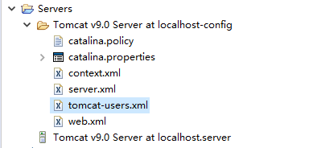
注：Eclipse+Tomcat
自动还原配置文件问题
在Eclipse中修改tomcat-users.xml文件，就不会出现这个问题

Slide 25
Securing Web Applications
how to set up security for the deployed application by using annotations or deployment descriptors.

Slide 26
1.Specifying Security Constraints
A security constraint is used to define the access privileges to a collection of resources using their URL mapping.

Slide 27
Annotations
If your web application uses a servlet, you can express the security constraint information by using annotations.
  @HttpConstraint and @HttpMethodConstraint
  annotations within the @ServletSecurity annotation to specify a security constraint.

Slide 28
示例
……
@WebServlet(name = "PayrollServlet", urlPatterns = {"/payroll"})
@ServletSecurity(
@HttpConstraint(transportGuarantee = TransportGuarantee.CONFIDENTIAL, rolesAllowed = {"DEPT-ADMIN", "DIRECTOR"}))
public class GreetingServlet extends HttpServlet {
  ……
}

Slide 29
Deployment Descriptor
If your web application does not use a servlet, you must specify a security-constraint element in the deployment descriptor file.

Slide 30
security-constraint Element
The following subelements can be part of a security-constraint.
  Web resource collection (web-resource-collection)
    A list of URL patterns and HTTP operations that describe a set of resources to be protected.
  Authorization constraint (auth-constraint)
    Specifies whether authentication is to be used and names the roles authorized to perform the constrained requests.
  User data constraint (user-data-constraint)
    A user data constraint can be used to require that a protected transport-layer connection, such as HTTPS, be used for all constrained URL patterns and HTTP methods specified in the security constraint.

Slide 31
Web.xml示例
……
<security-constraint>
<web-resource-collection>
<web-resource-name>Protected Resources</web-resource-name>
<url-pattern>/*</url-pattern>
</web-resource-collection>
<auth-constraint>
<role-name>*</role-name>
</auth-constraint>
<user-data-constraint>
<transport-guarantee>NONE</transport-guarantee>
</user-data-constraint>
</security-constraint>
……

Slide 32
2. Specifying Authentication Mechanisms
Basic authentication
Form-based authentication
Digest authentication
Client authentication
Mutual authentication

Slide 33
HTTP Basic Authentication
Specifying HTTP basic authentication requires that the server request a username and password from the web client and verify that the user name and password are valid by comparing them against a database of authorized users in the specified or default realm.
Basic authentication is the default when you do not specify an authentication mechanism.

Slide 34
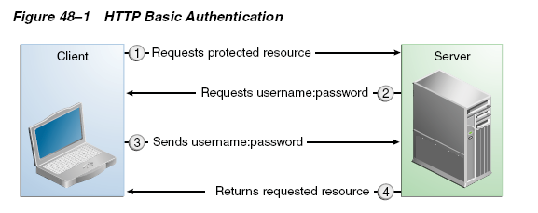
HTTP Basic Authentication
When basic authentication is used, the following actions occur.
  1. A client requests access to a protected resource.
  2. The web server returns a dialog box that requests the user name and password.
  3. The client submits the user name and password to the server.
  4. The server authenticates the user in the specified realm and, if successful, returns the requested resource.

Slide 35
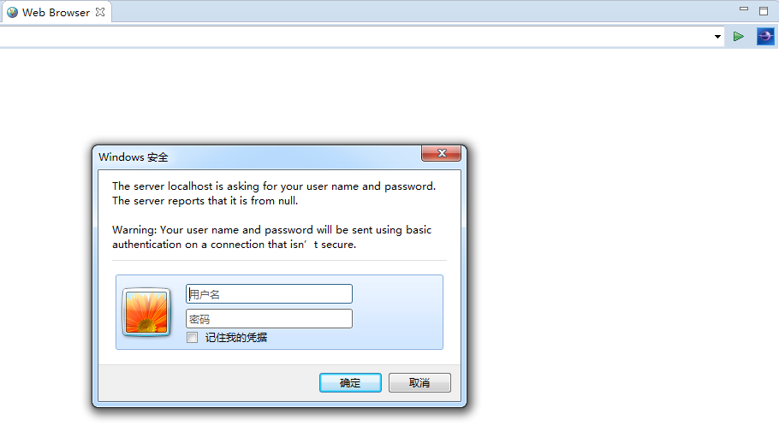
基于浏览器的认证

Slide 36
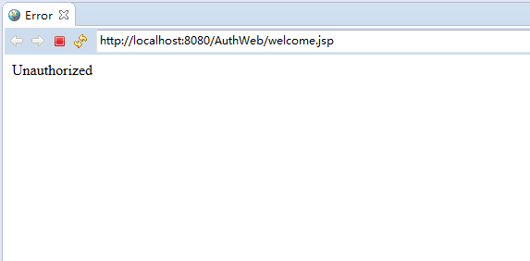
取消

Slide 37
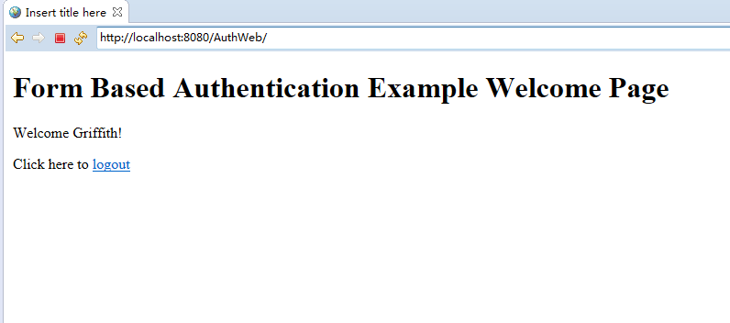
输入UN/PW—welcome.jsp

Slide 38
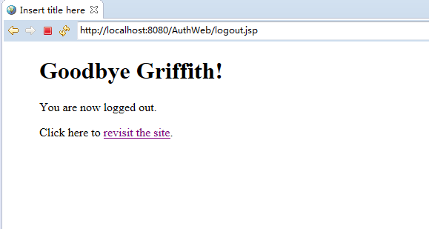
LOGOUT—logout.jsp

Slide 39
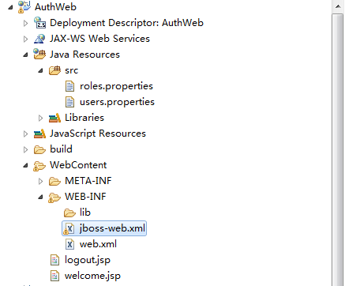
Wildfly

Slide 40
Jboss-web.xml(Wildfly)
……
<jboss-web>
<security-domain>MyDomain</security-domain>
</jboss-web>
……

Slide 41
Web.xml
……
<welcome-file-list>
<welcome-file>welcome.jsp</welcome-file>
</welcome-file-list>
<security-constraint>
<web-resource-collection>
<web-resource-name>Success</web-resource-name>
<url-pattern>/welcome.jsp</url-pattern>
<http-method>GET</http-method>
<http-method>POST</http-method>
</web-resource-collection>
<auth-constraint>
<role-name>webuser</role-name>
</auth-constraint>
</security-constraint>
<login-config>
<auth-method>BASIC</auth-method>
</login-config>
<security-role>
<role-name>webuser</role-name>
</security-role>
……

Slide 42
web.xml
To specify an authentication mechanism for your web application, declare a login-config element in the application deployment descriptor.
The sub-element auth-method configures the authentication mechanism for the web application.
  The element content must be either BASIC,DIGEST, FORM, CLIENT-CERT, or a vendor-specific authentication scheme.

Slide 43
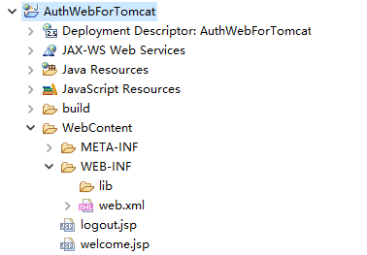
Tomcat

Slide 44
welcome.jsp
<html>
  <head>
    <title>Form Based Authentication Example Welcome Page</title>
  </head>
  <body>
  <h1> Form Based Authentication Example Welcome Page </h1>
  <p> Welcome <%= request.getRemoteUser() %>!
  <p> Click here to <a href="logout.jsp">logout</a>.
  </body>
</html>

Slide 45
logout.jsp
<html>
  <head>
    <title>Form Based Authentication Logout Page</title>
  </head>
  <blockquote>
    <h1> Goodbye <%= request.getRemoteUser() %>! </h1>
    <% session.invalidate(); %>
    <p> You are now logged out.
    <p> Click here to <a href=<%= "\""+request.getContextPath()+"\""%>>revisit the site</a>.
  </blockquote>
  </body>
</html>

Slide 46
logout.jsp
采用Basic认证，不关闭浏览器就不会清除session
  session.invalidate()无效

Slide 47
基于表单的认证——FORM
访问需要认证的页面，则返回登录表单：login.jsp
当用户通过适当的认证后，调出欢迎页面：welcome.jsp
  注销用户，进入退出页面：logout.jsp
登录失败，调用失败页面：login_failure.jsp

Slide 48
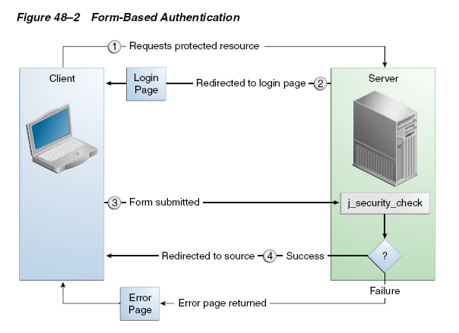


Slide 49
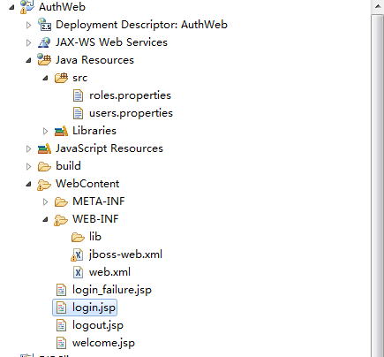

Slide 50
Web.xml
……
<login-config>
<auth-method>FORM</auth-method>
<form-login-config>
<form-login-page>/login.jsp</form-login-page>
<form-error-page>/login_failure.jsp</form-error-page>
</form-login-config>
</login-config>
……

Slide 51
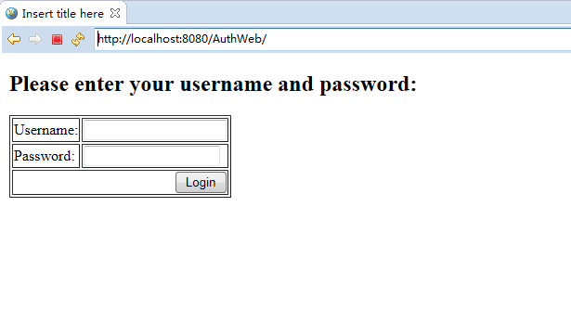
login.jsp

Slide 52
login.jsp
……
<h2>Please enter your username and password:</h2>
<p><form method="POST" name="Login" action="j_security_check">
  <table border=1>
    <tr><td>Username:</td>
    <td><input type="text" name="j_username"></td>
    </tr><tr><td>Password:</td>
    <td><input type="password" name="j_password"></td>
    </tr><tr><td colspan=2 align=right><input type="submit" value="Login" name="Submit"></td></tr>
  </table>
</form>
……

Slide 53
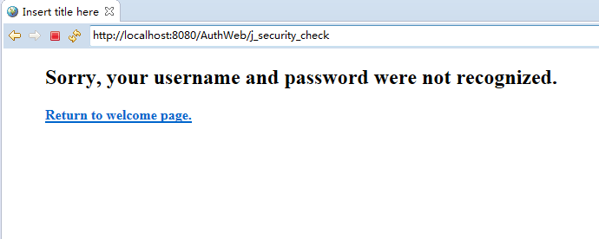
login_failure.jsp

Slide 54
login_failure.jsp
<html>
  <head>
    <title>Form Based Authentication Login Failure</title>
  </head>
  <blockquote>
    <h2>Sorry, your username and password were not recognized.</h2>
    <p><b>
    <a href="welcome.jsp">Return to welcome page.</a>
    </b>
  </blockquote>
  </body>
</html>

Slide 55
基于SSL证书的认证
在客户端和服务器之间加密传输
以Wildfly为例

Slide 56
生成证书
使用JDK keytool生成server.keystore文件
  进入命令行窗口
  keytool -genkey -alias tc-ssl -keyalg RSA -keystore d:\server.keystore -validity 3650
  按照提示要求输入私钥信息，password如123456
  将kerstore文件复制到%JBOSS_HOME%/standalone/configuration/

Slide 57
配置WildFly Security Realm
修改standalone.xml文件中的<management>下的<security-realm name=“ManagementRealm”>，增加<server-identities>
  指定生成的证书，配置权限级别为后台ManagementRealm
……
<security-realm name="ManagementRealm">
<server-identities> <ssl> <keystore path="server.keystore" relative-to="jboss.server.config.dir" keystore-password="123456" alias="tc-ssl" />
</ssl>
</server-identities>
……

Slide 58
Configure Undertow Subsystem for SSL
修改standalone.xml文件中的<subsystem xmlns=“urn:jboss:domain:undertow:4.0”>下的<server name=“default-server”> ，修改<https-listener>
  使监听HTTPS配置生效，使用名为https的绑定，安全级别为ManagementRealm
……
<https-listener name= "https" socket-binding="https" security-realm="ManagementRealm"/>
……

Slide 59
Web.xml
……
<security-constraint>
……
<user-data-constraint>
<transport-guarantee>CONFIDENTIAL</transport-guarantee>
</user-data-constraint>
</security-constraint>
……

Slide 60
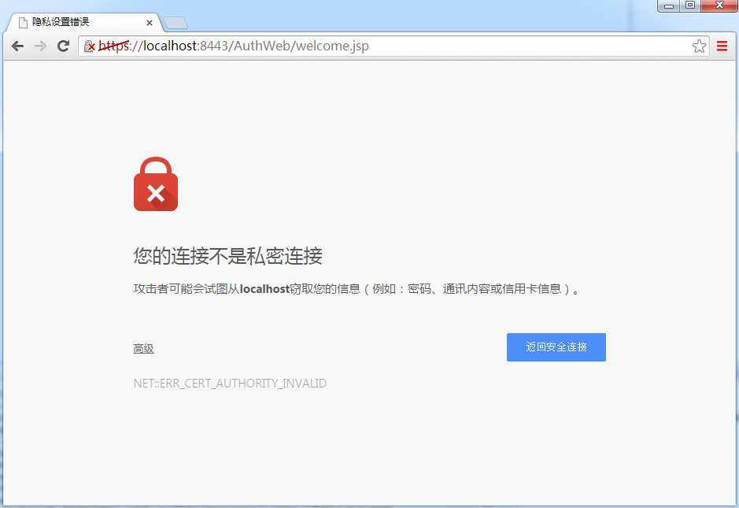

Slide 61
声明性安全
声明性安全
  使用表单/浏览器/客户证书
  把安全配置情况存储在部署描述文件中
    角色、访问控制、身份认证要求
    Web.xml
    Jboss-web.xml
  优先选择的模式

Slide 62
EJB安全--Annotation
The role of DEPT-ADMIN is authorized for methods that review employee payroll data,
and the role of DIRECTOR is authorized for methods that change employee payroll data.
The enterprise bean would be annotated as shown in the following code:
...
@DeclareRoles({"DEPT-ADMIN", "DIRECTOR"})
@Stateless
public class PayrollBean implements Payroll {
  @Resource SessionContext ctx;
  @RolesAllowed("DEPT-ADMIN")
  public void reviewEmployeeInfo(EmplInfo info) {
    oldInfo = ... read from database;
    // ...
  }
  @RolesAllowed("DIRECTOR")
  public void updateEmployeeInfo(EmplInfo info) {
    newInfo = ... update database;
    // ...
  }
...
}

Slide 63
编程性安全
细粒度的编程安全性
Servlet 3.1 provides the authenticate, login, and logout methods of the HttpServletRequest interface.
  getAuthType();
  getRemoteUser();
  getUserPrincipal();
  isuserInRole();

