Slide 1
J2EE与中间件技术
——Java EE概述

Slide 2
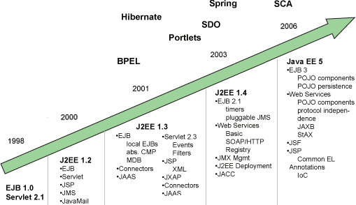
Java EE

Slide 3
Java EE
http://www.oracle.com/technetwork/java/javaee/overview/index.html
Java Platform, Enterprise Edition (Java EE)
The Java EE 8 Tutorial
  1. Overview

Slide 4
Enterprise applications
Developers today increasingly recognize the need for distributed, transactional, and portable applications that leverage the speed, security, and reliability of server-side technology.
Enterprise applications provide the business logic for an enterprise.
  They are centrally managed and often interact with other enterprise software.
  In the world of information technology, enterprise applications must be designed, built, and produced for less money, with greater speed, and with fewer resources.

Slide 5
Overview(1)
The aim of the Java Platform, Enterprise Edition (Java EE) platform is to provide developers a powerful set of APIs while reducing development time, reducing application complexity, and improving application performance.

Slide 6
Overview(2)
The Java EE platform uses a simplified programming model
  more annotations and less XML configuration
  Dependency injection can be applied to all resources a component needs, effectively hiding the creation and lookup of resources from application code

Slide 7
Java EE Application Model(1)
The Java EE application model begins with the Java programming language and the Java virtual machine.
The proven portability, security, and developer productivity they provide forms the basis of the application model.
The Java EE application model defines an architecture for implementing services as multitier applications that deliver the scalability, accessibility, and manageability needed by enterprise-level applications.

Slide 8
Java EE Application Model(2)
This model partitions the work needed to implement a multitier service into the following parts
  The business and presentation logic to be implemented by the developer
  The standard system services provided by the Java EE platform

Slide 9
Distributed Multitiered Applications
Security
Java EE Components
  Java EE Clients
  Web Clients
  Application Clients
  Applets
  The JavaBeans Component Architecture
  Java EE Server Communications
Web Components
Business Components
Enterprise Information System Tier

Slide 10
The Java EE platform uses a distributed multitiered application model for enterprise applications.
Application logic is divided into components according to function, and the application components that make up a Java EE application are installed on various machines, depending on the tier in the multitiered Java EE environment to which the application component belongs.

Slide 11
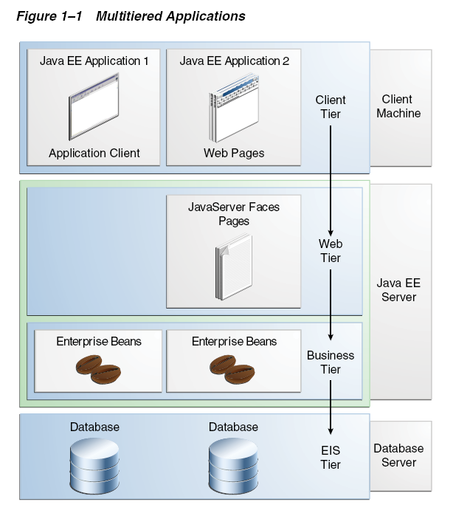
Multitiered Applications

Slide 12
Multitiered Applications
Client-tier components run on the client machine.
Web-tier components run on the Java EE server.
Business-tier components run on the Java EE server.
Enterprise information system (EIS)-tier software runs on the EIS server.

Slide 13
Security(1)
Although other enterprise application models require platform-specific security measures in each application, the Java EE security environment enables security constraints to be defined at deployment time.
The Java EE platform provides standard declarative access control rules that are defined by the developer and interpreted when the application is deployed on the server.

Slide 14
Security(2)
Java EE also provides standard login mechanisms so that application developers do not have to implement these mechanisms in their applications.
  e.g. RBAC
The same application works in a variety of security environments without changing the source code.

Slide 15
Java EE Components(1)
Java EE applications are made up of components. A Java EE component is a self-contained functional software unit that is assembled into a Java EE application with its related classes and files and that communicates with other components.

Slide 16
Java EE Components(2)
Java EE components are written in the Java programming language and are compiled in the same way as any program in the language.
The difference between Java EE components and “standard” Java classes is that Java EE components are assembled into a Java EE application, are verified to be well formed and in compliance with the Java EE specification, and are deployed to production, where they are run and managed by the Java EE server.

Slide 17
Java EE Components(3)
The Java EE specification defines the following Java EE components:
  Application clients and applets are components that run on the client.
  Java Servlet, JavaServer Faces, and JavaServer Pages (JSP) technology components are web components that run on the server.
  EJB components (enterprise beans) are business components that run on the server.

Slide 18
Java EE Components: Java EE Clients
Application clients and applets are components that run on the client.
A Java EE client can be a web client or an application client.

Slide 19
Java EE Components: Web Client(1)
Web client
  dynamic web pages containing various types of markup language (HTML, XML, and so on), which are generated by web components running in the web tier;
  a web browser, which renders the pages received from the server.

Slide 20
Java EE Components: Web Client(2)
Web client
  A web client is sometimes called a thin client.
    Thin clients usually do not query databases, execute complex business rules, or connect to legacy applications.
  When you use a thin client, such heavyweight operations are off-loaded to enterprise beans executing on the Java EE server, where they can leverage the security, speed, services, and reliability of Java EE server-side technologies.

Slide 21
Java EE Components: Application Client
Application client
  provides a way for users to handle tasks that require a richer user interface than can be provided by a markup language
  typically has a graphical user interface (GUI) created from the Swing or the Abstract Window Toolkit (AWT) API
  Application clients directly access enterprise beans running in the business tier

Slide 22
Java EE Components: JavaBeans Component
The JavaBeans Component Architecture
  The server and client tiers might also include components based on the JavaBeans component architecture (JavaBeans components) to manage the data flow between an application client or applet and components running on the Java EE server, or between server components and a database.
  JavaBeans components are not considered Java EE components by the Java EE specification.

Slide 23
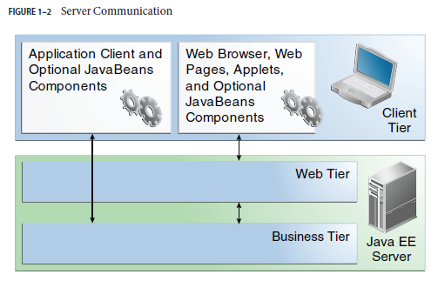
Java EE Server Communications

Slide 24
Java EE Components: Web Components
Java EE web components are either servlets or web pages created using JavaServer Faces technology and/or JSP technology (JSP pages).
might include a JavaBeans component to manage the user input and send that input to enterprise beans running in the business tier for processing

Slide 25
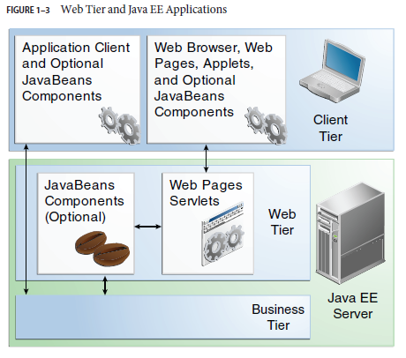
Web Tier and Java EE Applications

Slide 26
Java EE Components: Business Components
Enterprise JavaBeans (EJB) components (enterprise beans) are business components that run on the server.
Business code, which is logic that solves or meets the needs of a particular business domain such as banking, retail, or finance, is handled by enterprise beans running in either the business tier or the web tier.

Slide 27
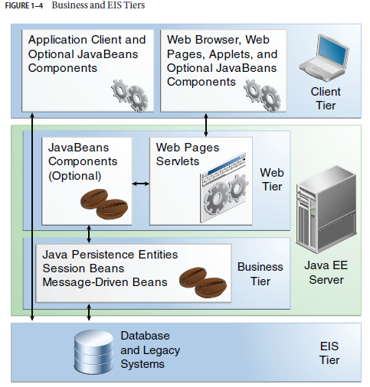
Business and EIS Tiers

Slide 28
Enterprise Information System Tier
The enterprise information system tier handles EIS software and includes enterprise infrastructure systems such as enterprise resource planning (ERP), mainframe transaction processing, database systems, and other legacy information systems.

Slide 29
Java EE Containers
Container Services
Container Types

Slide 30
Java EE Containers
Normally, thin-client multitiered applications are hard to write because they involve many lines of intricate code to handle transaction and state management, multithreading, resource pooling, and other complex low-level details.
The component-based and platform-independent Java EE architecture makes Java EE applications easy to write because business logic is organized into reusable components. The Java EE server provides underlying services in the form of a container for every component type.

Slide 31
Container Services
Containers are the interface between a component and the low-level platform-specific functionality that supports the component.
Before it can be executed, a web, enterprise bean, or application client component must be assembled into a Java EE module and deployed into its container.
The assembly process involves specifying container settings for each component in the Java EE application and for the Java EE application itself. Container settings customize the underlying support provided by the Java EE server, including services such as security, transaction management, Java Naming and Directory Interface (JNDI) lookups, and remote connectivity.

Slide 32
Configurable Services
The Java EE security model lets you configure a web component or enterprise bean so that system resources are accessed only by authorized users.
The Java EE transaction model lets you specify relationships among methods that make up a single transaction so that all methods in one transaction are treated as a single unit.
JNDI lookup services provide a unified interface to multiple naming and directory services in the enterprise so that application components can access these services.
The Java EE remote connectivity model manages low-level communications between clients and enterprise beans. After an enterprise bean is created, a client invokes methods on it as if it were in the same virtual machine.

Slide 33
Nonconfigurable Services
The container also manages nonconfigurable services, such as enterprise bean and servlet lifecycles, database connection resource pooling, data persistence, and access to the Java EE platform APIs.

Slide 34
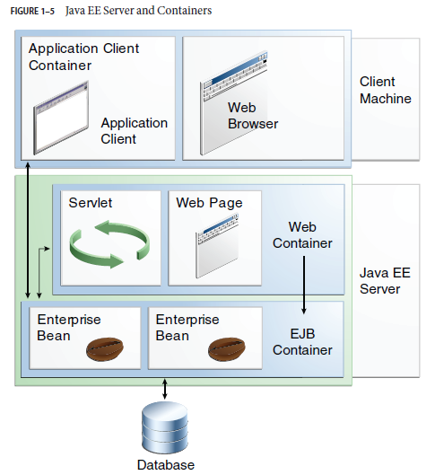
Server and Containers

Slide 35
Container Types(1)
Java EE server: The runtime portion of a Java EE product. A Java EE server provides EJB and web containers.
  Enterprise JavaBeans (EJB) container: Manages the execution of enterprise beans for Java EE applications. Enterprise beans and their container run on the Java EE server.
  Web container: Manages the execution of web pages, servlets, and some EJB components for Java EE applications. Web components and their container run on the Java EE server.

Slide 36
Container Types(2)
Application client container: Manages the execution of application client components. Application clients and their container run on the client.
Applet container: Manages the execution of applets. Consists of a web browser and Java Plug-in running on the client together.

Slide 37
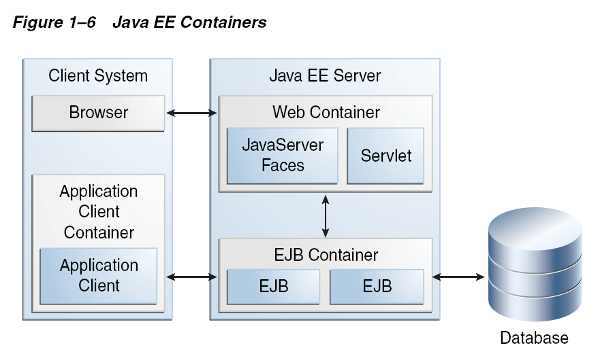
Java EE Containers
Figure 1–6 shows the relationships among the Java EE containers.

Slide 38
Web Services Support
Web services are web-based enterprise applications that use open, XML-based standards and transport protocols to exchange data with calling clients.
The Java EE platform provides the XML APIs and tools you need to quickly design, develop, test, and deploy web services and clients that fully interoperate with other web services and clients running on Java-based or non-Java-based platforms.

Slide 39
Web Services
Extensible Markup Language (XML) is a cross-platform, extensible, text-based standard for representing data.
Client requests and web service responses are transmitted as Simple Object Access Protocol (SOAP) messages over HTTP to enable a completely interoperable exchange between clients and web services, all running on different platforms and at various locations on the Internet.
The Web Services Description Language (WSDL) is a standardized XML format for describing network services.

Slide 40
Java EE Application Assembly and Deployment
A Java EE application is packaged into one or more standard units for deployment to any Java EE platform-compliant system. Each unit contains:
  A functional component or components (such as an enterprise bean, web page, servlet, or applet)
  An optional deployment descriptor that describes its content

Slide 41
Packaging
Packaging Applications
Packaging Enterprise Beans
Packaging Web Archives
Packaging Resource Adapter Archives

Slide 42
Packaging Applications
A Java EE application is delivered in either a Java Archive (JAR) file, a Web Archive (WAR) file, or an Enterprise Archive (EAR) file.
A WAR or EAR file is a standard JAR (.jar) file with a .war or .ear extension.

Slide 43
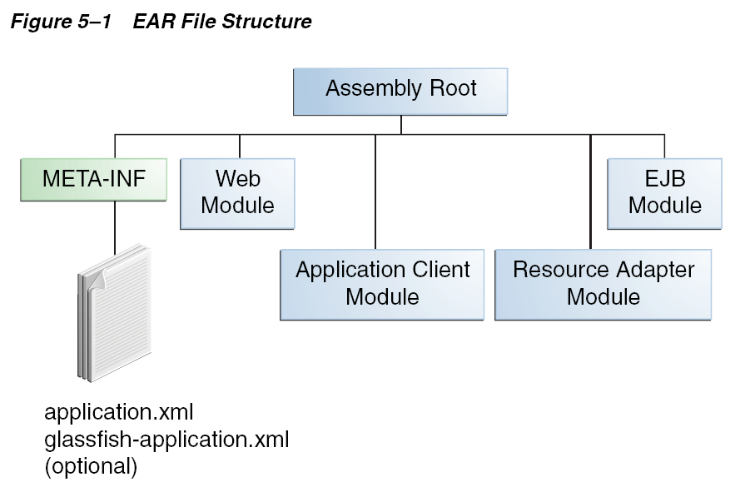
EAR file

Slide 44
Deployment Descriptors
There are two types of deployment descriptors: Java EE and runtime.
  A Java EE deployment descriptor is defined by a Java EE specification and can be used to configure deployment settings on any Java EE-compliant implementation.
  A runtime deployment descriptor is used to configure Java EE implementation-specific parameters.

Slide 45
Java EE module
The four types of Java EE modules
  EJB modules, which contain class files for enterprise beans and an EJB deployment descriptor. *.jar
  Web modules, which contain servlet class files, web files, supporting class files, GIF and HTML files, and a web application deployment descriptor. *.war
  Application client modules, which contain class files and an application client deployment descriptor. *.jar
  Resource adapter modules, which contain all Java interfaces, classes, native libraries, and other documentation, along with the resource adapter deployment descriptor. *.rar

Slide 46
Development Roles
The Java EE product provider
  designs and makes available for purchase the Java EE platform APIs, and other features defined in the Java EE specification.
  typically application server vendors who implement the Java EE platform according to the Java EE Platform specification.
The tool provider
  creates development, assembly, and packaging tools used by component providers, assemblers, and deployers.
Application Component Provider
  creates web components, enterprise beans, applets, or application clients for use in Java EE applications.
Application Assembler
  receives application modules from component providers and assembles them into a Java EE application EAR file.
Application Deployer and Administrator
  configures and deploys the Java EE application, administers the computing and networking infrastructure where Java EE applications run, and oversees the runtime environment.

Slide 47
Java EE 8 APIs
Enterprise JavaBeans Technology
Java Servlet Technology
JavaServer Faces Technology
JavaServer Pages Technology
JavaServer Pages Standard Tag Library
Java Persistence API
Java Transaction API
Java API for RESTful Web Services
Managed Beans
Contexts and Dependency Injection for Java EE
Dependency Injection for Java
Bean Validation
Java Message Service API
Java EE Connector Architecture
JavaMail API
Java Authorization Contract for Containers
Java Authentication Service Provider Interface for Containers
Java EE Security API
Java API for WebSocket
Java API for JSON Processing
Java API for JSON Binding
Concurrency Utilities for Java EE
Batch Applications for the Java Platform

Slide 48
Enterprise JavaBeans Technology
There are two kinds of enterprise beans: session beans and message-driven beans.
  A session bean represents a transient conversation with a client. When the client finishes executing, the session bean and its data are gone.
  A message-driven bean combines features of a session bean and a message listener, allowing a business component to receive messages asynchronously. Commonly, these are JavaMessage Service (JMS) messages.
Enterprise JavaBeans 3.2
Spring框架

Slide 49
Java Servlet Technology
Java servlet technology lets you define HTTP-specific servlet classes.
A servlet class extends the capabilities of servers that host applications that are accessed by way of a request-response programming model.
Although servlets can respond to any type of request, they are commonly used to extend the applications hosted by web servers.
Servlet 4.0

Slide 50
JavaServer Faces
JavaServer Faces technology is a user interface framework for building web applications. The main components of JavaServer Faces technology are as follows:
  A GUI component framework.
  A flexible model for rendering components in different kinds of HTML or different markup languages and technologies. A Renderer object generates the markup to render the component and converts the data stored in a model object to types that can be represented in a view.
  A standard RenderKit for generating HTML/4.01 markup.
JavaServer Faces 2.3 and Expression Language 3.0

Slide 51
JavaServer Pages Technology
JavaServer Pages (JSP) technology lets you put snippets of servlet code directly into a text-based document.
A JSP page is a text-based document that contains two types of text:
  static data (which can be expressed in any text-based format such as HTML, WML, and XML)
  and JSP elements, which determine how the page constructs dynamic content
JavaServer Pages 2.3

Slide 52
JavaServer Pages Standard Tag Library
The JavaServer Pages Standard Tag Library (JSTL) encapsulates core functionality common to many JSP applications.
  JSTL has iterator and conditional tags for handling flow control,
  tags for manipulating XML documents,
  internationalization tags,
  tags for accessing databases using SQL,
  and commonly used functions.
JSTL 1.2

Slide 53
Java Persistence API(JPA)
Persistence uses an object-relational mapping approach to bridge the gap between an object oriented model and a relational database.
The Java Persistence API can also be used in Java SE applications
Java Persistence consists of three areas:
  The Java Persistence API
  The query language
  Object/relational mapping metadata
Java Persistence API 2.1
Hibernate框架

Slide 54
JavaTransaction API
The Java Transaction API (JTA) provides a standard interface for demarcating transactions.
The Java EE architecture provides a default auto commit to handle transaction commits and rollbacks. An auto commit means that any other applications that are viewing data will see the updated data after each database read or write operation.
However, if your application performs two separate database access operations that depend on each other, you will want to use the JTA API to demarcate where the entire transaction, including both operations, begins, rolls back, and commits.
Java Transaction API 1.2

Slide 55
JAX-RS
Java API for RESTful Web Services (JAX-RS)
  The Java API for RESTful Web Services (JAX-RS) defines APIs for the development of Web services built according to the Representational State Transfer (REST) architectural style.
JAX-RS 2.1

Slide 56
Managed Beans
Managed Beans, lightweight container-managed objects (POJOs) with minimal requirements, support a small set of basic services, such as resource injection, lifecycle callbacks, and interceptors.
Managed Beans 1.0

Slide 57
Contexts and Dependency Injection for the Java EE
Platform
Contexts and Dependency Injection (CDI) for the Java EE platform defines a set of contextual services, provided by Java EE containers, that make it easy for developers to use enterprise beans along with JavaServer Faces technology in web applications.
Designed for use with stateful objects, CDI also has many broader uses, allowing developers a great deal of flexibility to integrate different kinds of components in a loosely coupled but type-safe way.
CDI 2.0

Slide 58
Dependency Injection for Java
Dependency Injection for Java defines a standard set of annotations (and one interface) for use on injectable classes.
Dependency Injection for Java 1.0

Slide 59
Bean Validation
The Bean Validation specification defines a metadata model and API for validating data in JavaBeans components.
Instead of distributing validation of data over several layers, such as the browser and the server side, you can define the validation constraints in one place and share them across the different layers.
Bean Validation 2.0
  使用注解的方式对Java Bean 进行约束验证的规范

Slide 60
Java Message Service API
The JavaMessage Service (JMS) API is a messaging standard that allows Java EE application components to create, send, receive, and read messages.
It enables distributed communication that is loosely coupled, reliable, and asynchronous.
JMS 2.0

Slide 61
Java EE Connector Architecture
The Java EE Connector architecture is used by tools vendors and system integrators to create resource adapters that support access to enterprise information systems that can be plugged in to any Java EE product.
Java EE Connector Architecture 1.7

Slide 62
JavaMail API
Java EE applications use the JavaMail API to send email notifications.
The JavaMail API has two parts:
  an application-level interface used by the application components to send mail
  a service provider interface.
The Java EE platform includes JavaMail with a service provider that allows application components to send Internet mail.
JavaMail 1.5

Slide 63
JACC and JASPIC
Java Authorization Contract for Containers (JACC)
  The JACC specification defines a contract between a Java EE application server and an authorization policy provider.
  JACC 1.5
Java Authentication Service Provider Interface for Containers (JASPIC)
  JASPIC specification defines a service provider interface (SPI) by which authentication providers that implement message authentication mechanisms may be integrated in client or server message processing containers or runtimes.
  JASPIC 1.1
  整合第三方验证服务

Slide 64
Java EE Security API
The purpose of the Java EE Security API specification is to modernize and simplify the security APIs by simultaneously establishing common approaches and mechanisms and removing the more complex APIs from the developer view where possible.
Java EE Security API 1.0

Slide 65
Java API for WebSocket
WebSocket is an application protocol that provides full-duplex communications between two peers over TCP.
The Java API for WebSocket enables Java EE applications to create endpoints using annotations that specify the configuration parameters of the endpoint and designate its lifecycle callback methods.
Java API for WebSocket 1.0

Slide 66
Java API for JSON Processing
JSON is a text-based data exchange format derived from JavaScript that is used in web services and other connected applications.
The Java API for JSON Processing (JSON-P) enables Java EE applications to parse, transform, and query JSON data using the object model or the streaming model.
JSON-P 1.1

Slide 67
Java API for JSON Binding
The Java API for JSON Binding (JSON-B) provides a binding layer for converting Java objects to and from JSON messages.
new to the Java EE 8 platform
JSON-B 1.0

Slide 68
Concurrency Utilities for Java EE
The Concurrency Utilities for Java EE is a standard API for providing asynchronous capabilities to Java EE application components through the following types of objects:
  managed executor service, managed scheduled executor service, managed thread factory, and context service.
Concurrency Utilities for Java EE 1.0

Slide 69
Batch Applications for the Java Platform
Batch jobs are tasks that can be executed without user interaction.
The Batch Applications for the Java Platform specification is a batch framework that provides support for creating and running batch jobs in Java applications.
  The batch framework consists of a batch runtime, a job specification language based on XML, a Java API to interact with the batch runtime, and a Java API to implement batch artifacts.
Batch Applications for the Java Platform 1.0

Slide 70
Java EE 8 APIs in the Java Platform, Standard Edition 8
Java Database Connectivity API
Java Naming and Directory Interface API
JavaBeans Activation Framework
Java API for XML Processing
Java Architecture for XML Binding
Java API for XML Web Services
SOAP with Attachments API for Java
Java Authentication and Authorization Service
Common Annotations for the Java Platform

Slide 71
Java Database Connectivity API
The JavaDatabase Connectivity (JDBC) API lets you invoke SQL commands from Java programming language methods.
  You use the JDBC API in an enterprise bean when you have a session bean access the database.
  You can also use the JDBC API from a servlet or a JSP page to access the database directly without going through an enterprise bean.
The JDBC API has two parts:
  an application-level interface used by the application components to access a database,
  and a service provider interface to attach a JDBC driver to the Java EE platform.
JDBC 4.1

Slide 72
Java Naming and Directory Interface
The Java Naming and Directory Interface (JNDI) provides naming and directory functionality, enabling applications to access multiple naming and directory services, including
  existing naming and directory services such as LDAP, NDS,DNS, and NIS.
It provides applications with methods for performing standard directory operations, such as
  associating attributes with objects and searching for objects using their attributes.
Using JNDI, a Java EE application can store and retrieve any type of named Java object

Slide 73
JavaBeans Activation Framework
The JavaBeans Activation Framework (JAF) is used by JavaMail API. (JavaMail利用JAF处理MIME编码的邮件附件)
JAF provides standard services to determine the type of an arbitrary piece of data, encapsulate access to it, discover the operations available on it, and create the appropriate JavaBeans component to perform those operations.

Slide 74
Java API for XML Processing(JAXP)
  supports the processing of XML documents using Document Object Model (DOM), Simple API for XML (SAX), and Extensible Stylesheet Language Transformations (XSLT).
Java Architecture for XML Binding (JAXB)
  provides a convenient way to bind an XML schema to a representation in Java language programs.

Slide 75
SOAP with Attachments API for Java(SAAJ)
  enables the production and consumption of messages that conform to the SOAP 1.1 and 1.2 specifications and SOAP with Attachments note.
Java API for XML Web Services (JAX-WS)
  provides support for web services that use the JAXB API for binding XML data to Java objects.

Slide 76
Java Authentication and Authorization Service
The Java Authentication and Authorization Service (JAAS) provides a way for a Java EE application to authenticate and authorize a specific user or group of users to run it.

Slide 77
Common Annotations for the Java Platform
Annotations enable a declarative style of programming in the Java platform.
Common Annotations for the Java Platform 1.2

Slide 78
开发工具
Eclipse:可扩展的免费开放源代码IDE
NetBeans:开放源码的Java集成开发环境
IntelliJ IDEA
… …

Slide 79

Web服务器和应用服务器
Web服务器：Tomcat, Jetty
EJB容器： Jboss/Wildfly
应用服务器：IBM Websphere, Oracle WebLogic,

Slide 80
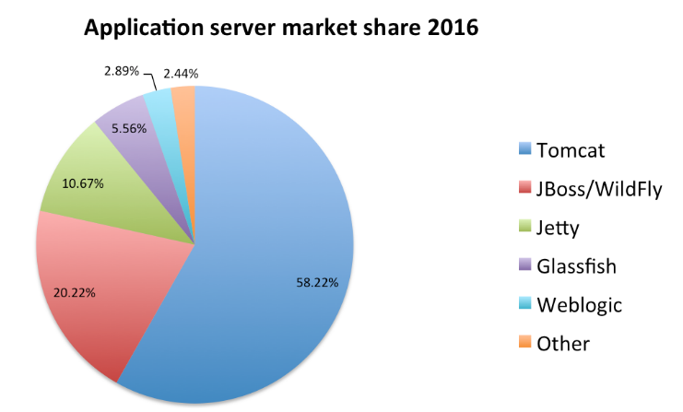
https://dzone.com/articles/most-popular-java-ee-servers-2016-edition

Slide 81
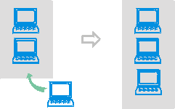
应用服务器
稳定可靠的性能：
  企业的电子商务系统面向全球，提供7天*24小时不间断的服务，系统在大负荷量下和长时间运转下的稳定性至关重要
  当系统处理能力不够时，可以通过简单的增加硬件来解决：

Slide 82
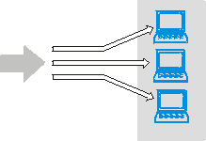
应用服务器
  动态调整不同主机间的负载可以最大的利用系统资源，同时提高单机的稳定性：
    负载均衡：将用户发来的请求，恰当地分配给各个应用服务器，无需对应用进行任何修改---可扩展性

Slide 83
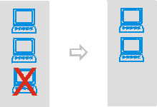
应用服务器
  当系统中的某台机器出现故障时，它的工作可由其它机器来承担，不会影响系统整体的运行，即无单点故障：
    高可靠性：错误容忍和错误恢复

Slide 84
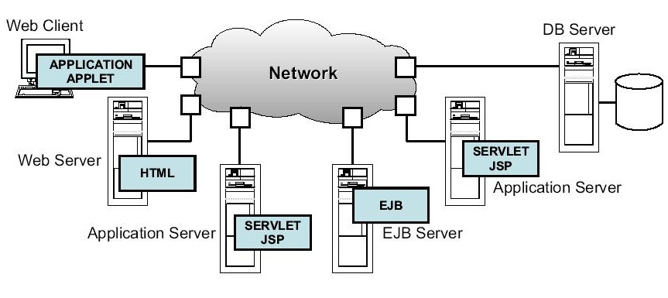
Java EE应用

Slide 85
书面作业（1）
1、你使用Java技术开发过哪些项目（包括课程作业）？
2、你开发过哪些web项目（不限于Java技术，可包括问题1的项目），使用了哪些技术？

