Slide 1
COURSEMANIA
Project By:
Hassan Zahra
Hadi Makki

Slide 2
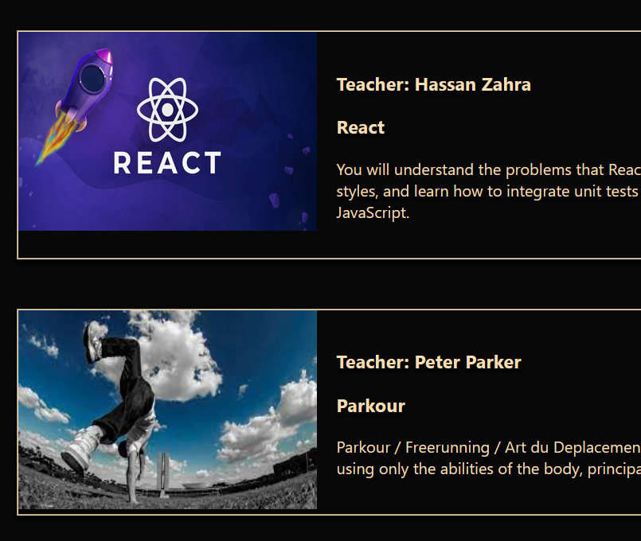
SUMMARY
CourseMania is a website in which teachers upload their courses and students can view and choose the course they desire. It is basically a course management system.

Slide 3
USER’S AUTHORITY
Admin
Login.
Access to all Courses for all Teachers.
To be Added later:
Access to list of all Students Registered.
Access to list of all Teachers Registered.
Students
Register and Login.
View Courses by different teachers.
Can choose a specific course and see it in his private page
Can download pdf courses.
Teachers
Register and Login.
Can view only his/her courses.
Can add , edit, and delete courses.
To be Added later:
Can view students who chose his/her courses.

Slide 4
USE CASE DIAGRAM
Login
Admin
Login/Register
Add/Edit/Delete Courses
Teacher
View All Courses
View own Courses only
View Courses for each Teacher
Student
Choose Courses
Download Courses

Slide 5
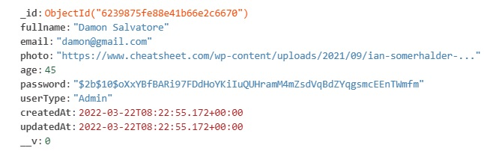
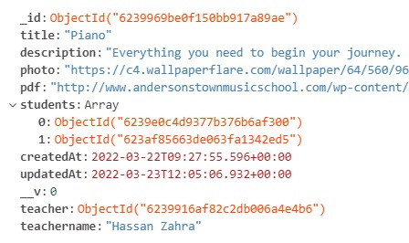
UML Diagram
User Schema
Course Schema

Slide 6
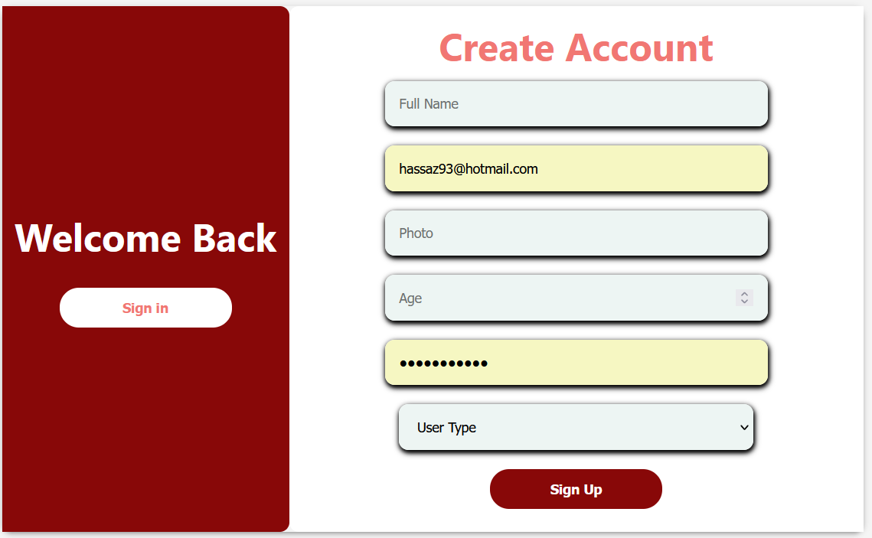
DISCUSSING THE PROJECT

