Slide 1
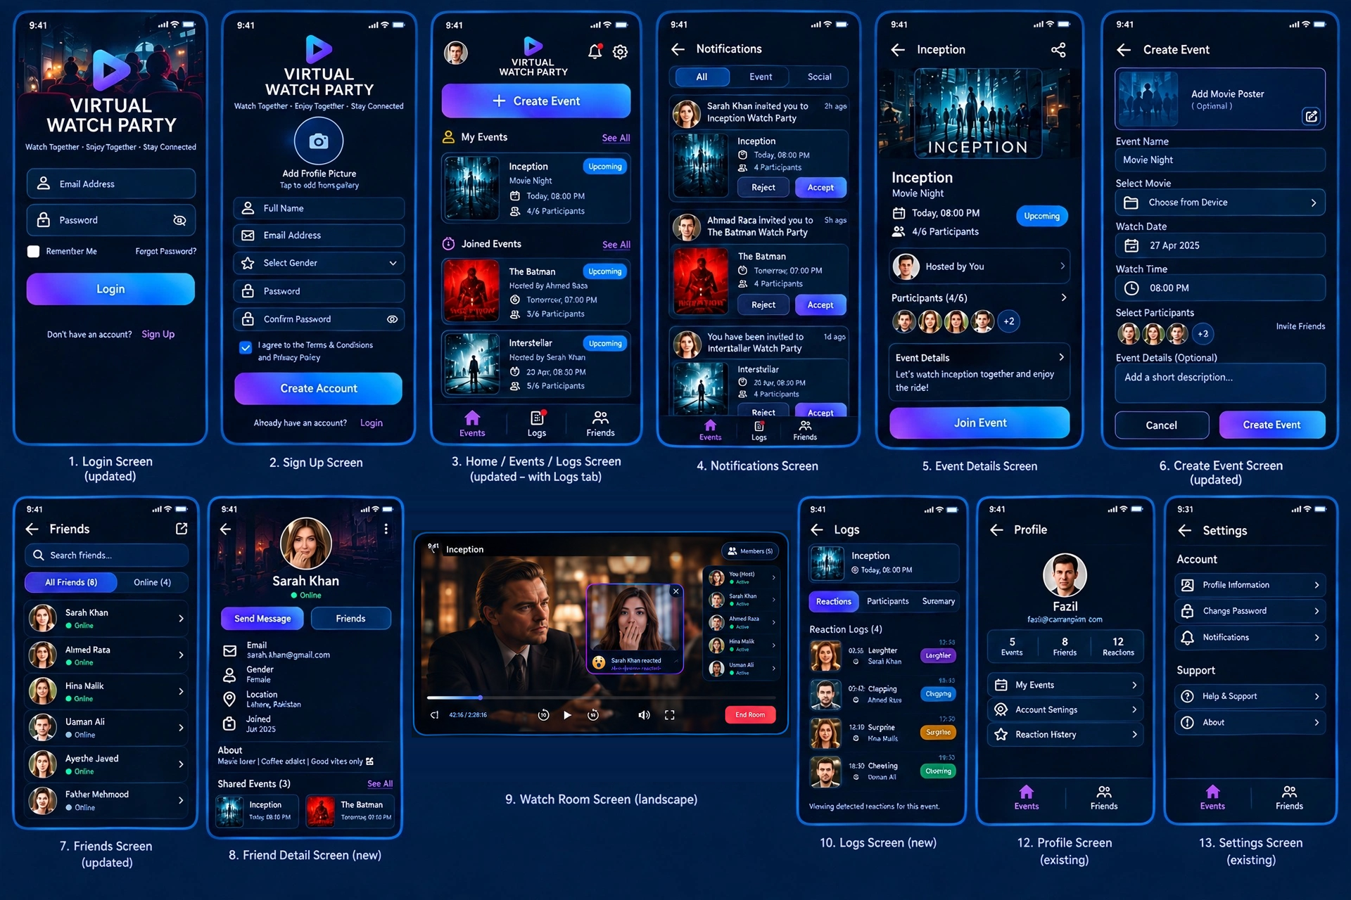
Virtual Watch Party
App UI Screens – Overview
Watch Together • Enjoy Together • Stay Connected
12 screens covering login, events, notifications, friends, the live watch room, logs, profile and settings. Each following slide shows one screen with a short description.

Slide 2
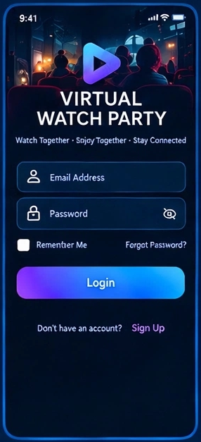
01
Login Screen
Updated
Users sign in with their email address and password, with options to show/hide the password, remember the login and recover a forgotten password. New users can jump to Sign Up from the link at the bottom.
Notes:
Users sign in with their email address and password, with options to show/hide the password, remember the login and recover a forgotten password. New users can jump to Sign Up from the link at the bottom.

Slide 3
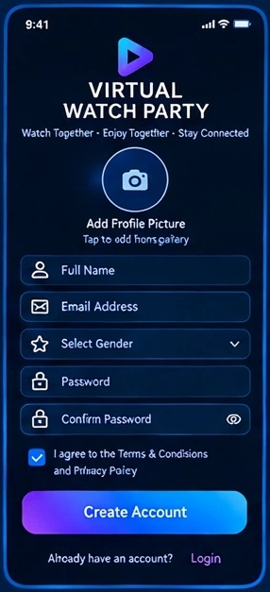
02
Sign Up Screen
New users create an account by adding a profile picture, full name, email, gender and password. Terms & Conditions must be accepted before the Create Account button completes registration.
Notes:
New users create an account by adding a profile picture, full name, email, gender and password. Terms & Conditions must be accepted before the Create Account button completes registration.

Slide 4
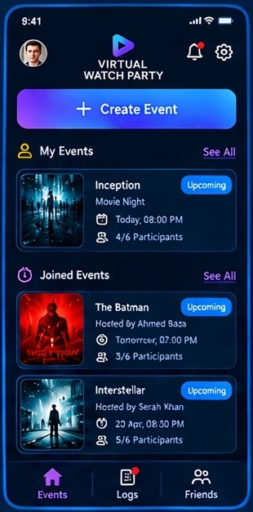
03
Home / Events / Logs Screen
Updated – with Logs tab
The main hub shows a Create Event button, the events the user is hosting (My Events) and the events they were invited to (Joined Events). The bottom bar switches between Events, Logs and Friends; notifications and settings sit at the top.
Notes:
The main hub shows a Create Event button, the events the user is hosting (My Events) and the events they were invited to (Joined Events). The bottom bar switches between Events, Logs and Friends; notifications and settings sit at the top.

Slide 5
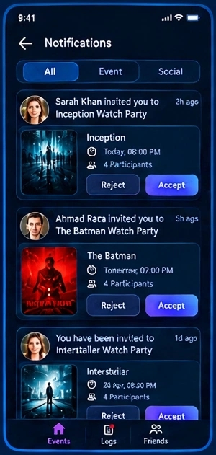
04
Notifications Screen
Lists all invitations and alerts, filterable by All, Event and Social. Each invite shows the movie, time and participant count, with Accept and Reject buttons.
Notes:
Lists all invitations and alerts, filterable by All, Event and Social. Each invite shows the movie, time and participant count, with Accept and Reject buttons.

Slide 6
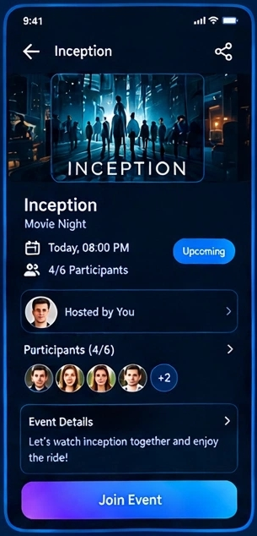
05
Event Details Screen
Shows the movie poster, event name, date, time, host and participant list (4/6) along with the event description. The Join Event button lets the user enter the watch party.
Notes:
Shows the movie poster, event name, date, time, host and participant list (4/6) along with the event description. The Join Event button lets the user enter the watch party.

Slide 7
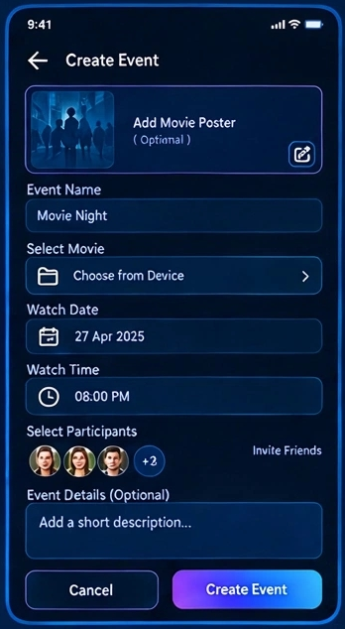
06
Create Event Screen
Updated
Hosts set up a party by adding an optional poster, event name, movie (chosen from device), date, time and participants. A short description can be added before tapping Create Event.
Notes:
Hosts set up a party by adding an optional poster, event name, movie (chosen from device), date, time and participants. A short description can be added before tapping Create Event.

Slide 8
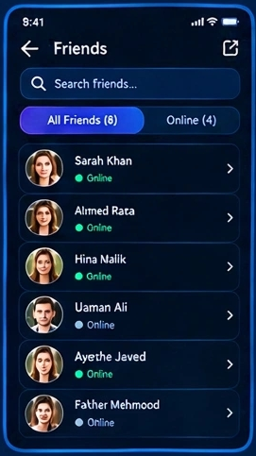
07
Friends Screen
Updated
Displays the friends list with online/offline status and a search bar. Tabs filter between All Friends and Online friends; tapping a friend opens their profile.
Notes:
Displays the friends list with online/offline status and a search bar. Tabs filter between All Friends and Online friends; tapping a friend opens their profile.

Slide 9
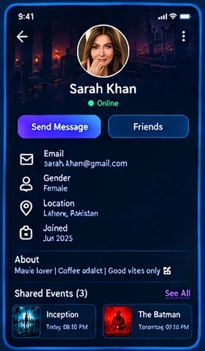
08
Friend Detail Screen
New
Shows a friend’s profile with photo, online status, email, gender, location, join date and bio. Users can send a message and see the events they share with that friend.
Notes:
Shows a friend’s profile with photo, online status, email, gender, location, join date and bio. Users can send a message and see the events they share with that friend.

Slide 10
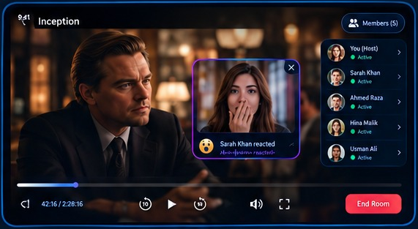
09
Watch Room Screen
Landscape
The live viewing room where everyone watches the movie in sync, with playback controls, seek bar, volume and fullscreen. A members panel shows who is active, live reaction pop-ups appear over the video, and the host can end the room.
Notes:
The live viewing room where everyone watches the movie in sync, with playback controls, seek bar, volume and fullscreen. A members panel shows who is active, live reaction pop-ups appear over the video, and the host can end the room.

Slide 11
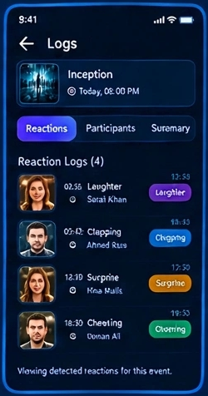
10
Logs Screen
New
Records what happened during an event, organised into Reactions, Participants and Summary tabs. The reaction log lists timestamped reactions such as laughter, clapping, surprise and cheering per person.
Notes:
Records what happened during an event, organised into Reactions, Participants and Summary tabs. The reaction log lists timestamped reactions such as laughter, clapping, surprise and cheering per person.

Slide 12
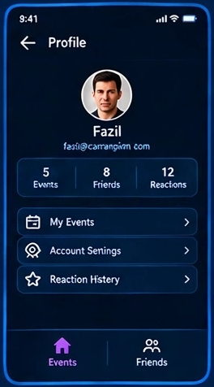
11
Profile Screen
Existing
Shows the user’s photo, name and email with quick stats for events, friends and reactions. Shortcuts lead to My Events, Account Settings and Reaction History.
Notes:
Shows the user’s photo, name and email with quick stats for events, friends and reactions. Shortcuts lead to My Events, Account Settings and Reaction History.

Slide 13
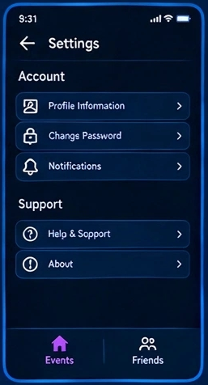
12
Settings Screen
Existing
Lets the user manage Account options (profile information, change password, notifications) and Support options (help & support, about). The bottom bar keeps navigation consistent.
Notes:
Lets the user manage Account options (profile information, change password, notifications) and Support options (help & support, about). The bottom bar keeps navigation consistent.

