Slide 1
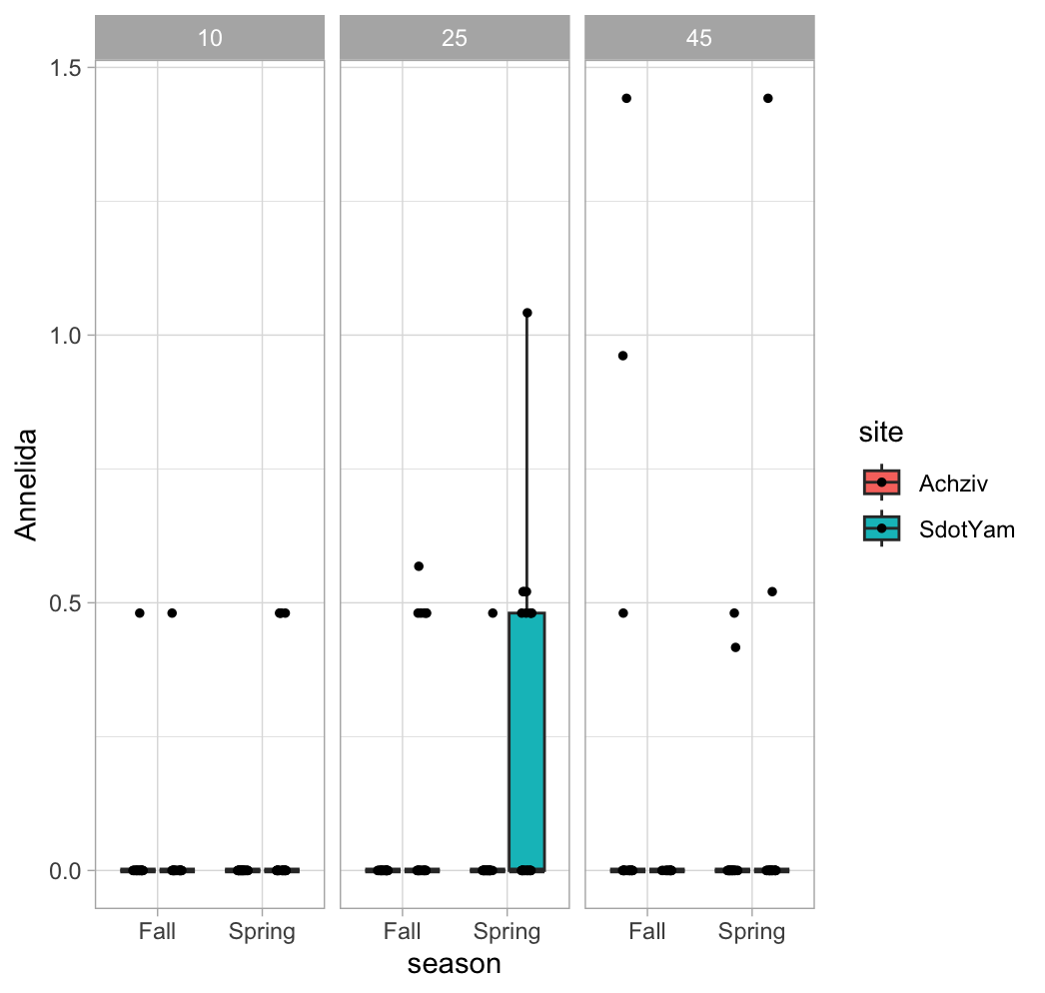
Depth: 10 m
Depth: 25 m
Depth: 45 m

