Slide 1
Human-or-AI Voice Detector
BIU Big Data and AI course project — ASVspoof2019 (Logical Access)
MinIO · Apache Spark · Apache Kafka · Elasticsearch · scikit-learn · Flask
Beny Rojanski · Renana Chaba · Hadar Baum

Slide 2
Problem & dataset
• Can we tell real human speech apart from AI-generated (TTS / voice-conversion) speech?
• ASVspoof2019 Logical Access partition: bonafide vs. spoofed utterances
• ~121k labeled flac clips across train / dev / eval, speaker-disjoint splits
• PA (replay-attack) partition intentionally excluded — not AI-generated speech
1

Slide 3
Architecture
The full pipeline, end to end - object store to serving
Kaggle: ASVspoof2019 LA
download_dataset.py
MinIO
object store - raw audio
Spark
batch_feature_extraction.py
Parquet +
Elasticsearch
feature table
train_classifier.py
RF vs Gradient Boosting ->
model + EER threshold
index_embeddings.py
standardize ->
k-NN embeddings
kafka_producer.py ->
streaming_enrichment.py
near-real-time scoring
insights.py
aggregations -> charts + RESULTS.md
Flask app
/classify + /dashboard
View exact diagram in DESIGN.md
Same architecture as the Mermaid flowchart in docs/DESIGN.md, redrawn natively for the deck.
2

Slide 4
Pipeline stage 0-1 - Ingest
Kaggle corpus -> MinIO object store
• download_dataset.py pulls the ASVspoof2019 LA corpus (~121k flac files) from Kaggle via its API into data/raw/ — a one-time step, gated on a Kaggle API token.
• ingest_to_minio.py uploads every labeled utterance into MinIO, an S3-compatible object store, keyed by partition and filename.
• 32 concurrent upload threads by default — this step is I/O-bound (many small files), so threading helps a lot even though Python threads don't parallelize CPU work.
• Downstream steps (the Spark job, the streaming consumer, the Flask app) always fetch audio by key from MinIO, never the local filesystem — any worker, anywhere, can read a clip.
• Protocol metadata (speaker id, attack id, bonafide/spoof label) stays in small local text files — only the audio bytes, the actually "big" unstructured data, go into the object store.
Where this stage sits in the pipeline:
Kaggle
MinIO
Spark
Parquet + ES
train_classifier
index_embeddings
kafka -> streaming
insights.py
Flask app
3

Slide 5
Pipeline stage 2 - Transform
Spark batch feature extraction — the actual "big data" step
• batch_feature_extraction.py reads the train+dev protocol metadata and fans out across Spark executors, one task per partition of utterances.
• Each executor fetches its share of clips' audio bytes from MinIO and computes a fixed-length acoustic feature vector (20 MFCCs + spectral/pitch/energy statistics) via common.features.extract_features — the same function used everywhere else in this project.
• ~50k train+dev audio files decoded and feature-extracted in parallel across cores instead of one Python process working through them serially — this is the real "big data" step, not model training itself.
• Driver and executors are both pinned to sys.executable so Spark workers resolve the same Python/venv as the driver, instead of whatever `python` happens to be on PATH.
Where this stage sits in the pipeline:
Kaggle
MinIO
Spark
Parquet + ES
train_classifier
index_embeddings
kafka -> streaming
insights.py
Flask app
4

Slide 6
What's in the feature vector
53 numbers per clip — one shared function, one fixed shape
Group | Count | What it captures
MFCCs (20 coeffs × mean/std) | 40 | Vocal-tract spectral envelope — timbre/voice quality, the model's top group
Spectral shape (centroid/bandwidth/rolloff) | 6 | Brightness, spread, and energy roll-off of the spectrum
Signal level (zero-crossing rate, RMS energy) | 4 | Noisiness and loudness over time
Pitch (F0, 50-500Hz via librosa.yin) | 2 | Fundamental frequency mean/std, human vocal range
Duration | 1 | Clip length in seconds
Total | 53 | One fixed-length row per clip, any duration
• Mean + std of frame-level features, not raw sequences — every clip, any length, maps to the same 53-column row a tabular classifier expects.
• One function, common/features.py:extract_features(), computes this for the Spark batch job, the Kafka consumer, and the live /classify endpoint — training and inference match exactly.
• Pitch uses plain librosa.yin, not pyin — pyin's HMM smoothing measured 2-9s/clip; across 50k+ clips, yin gets a comparable signal in ~0.02s.
5

Slide 7
Pipeline stage 2 - Load
Feature table -> Parquet + Elasticsearch
• Every feature row the Spark job computes is written to two places at once, in the same run.
• Parquet (pipeline/features_train_dev.parquet) — the input train_classifier.py and index_embeddings.py train from.
• Elasticsearch's asvspoof-training-features index — the same rows, so aggregations/insights can run without re-reading Parquet.
• Elasticsearch (a NoSQL document store) goes on to hold training results, live streamed predictions, and — once standardized — dense_vector embeddings for k-NN search, all in the same cluster.
Where this stage sits in the pipeline:
Kaggle
MinIO
Spark
Parquet + ES
train_classifier
index_embeddings
kafka -> streaming
insights.py
Flask app
6

Slide 8
AI capability 1 — the accuracy paradox
Where we started: Random Forest at scikit-learn's default 0.5 threshold
92.3%
99.8%
26.6%
Dev accuracy
looked like a finished project
Spoof recall
nearly every attack caught
Bonafide recall
real human speech found
• Dev is ~90% spoof, so a model that leans to the majority class scores well on accuracy while failing the class we actually care about. Accuracy was hiding the failure, not measuring it.
• Reweighting the training loss does not fix this: the 0.5 cutoff applied at evaluation time is a separate lever.
Where this stage sits in the pipeline:
Kaggle
MinIO
Spark
Parquet + ES
train_classifier
index_embeddings
kafka -> streaming
insights.py
Flask app
7

Slide 9
How EER is calculated
A secondary ASVspoof metric
• Score every dev utterance with the model, giving each one a P(spoof) between 0 and 1.
• Sweep every possible decision threshold and, at each one, compute two error rates: the false-acceptance rate (bonafide clips wrongly called spoof) and the false-rejection rate (spoof clips wrongly called bonafide).
• As the threshold moves, one error rate goes up while the other goes down — the Equal Error Rate is the threshold where the two curves cross, i.e. where both error rates are equal.
• EER itself is that shared error rate at the crossing point; the threshold at that point is what actually gets deployed (see the model artifact in common/model.py).
• Lower EER = better separation. 0% would mean a threshold exists with zero errors of either kind; this project's deployed model scores 9.26%.
fpr, tpr, thresholds = roc_curve(y_true_spoof, y_score_spoof)
fnr = 1 - tpr
eer_idx = argmin(abs(fnr - fpr)) # where the two curves are closest
eer, threshold = (fpr[eer_idx] + fnr[eer_idx]) / 2, thresholds[eer_idx]
8

Slide 10
Fix 1 — switching the model
Same 0.5 threshold, better-calibrated probabilities
26.6%
80.2%
+54 pts
Random Forest
bonafide recall @ 0.5
Gradient Boosting
bonafide recall @ 0.5
From the model choice alone
no threshold change
Model | EER (lower is better) | ROC-AUC | Deployed
Random Forest | 9.09% | 0.969
Gradient Boosting | 9.26% | 0.970 | ✓
• A statistical tie on EER — the gap is ~3 clips in 2,548.
9

Slide 11
Fix 2 — switching the threshold
0.5 to the EER-optimal 0.689, on the deployed model
80.2%
90.7%
9.26%
Bonafide recall
at the default 0.5
Bonafide recall
at the EER threshold
Equal Error Rate
where both errors are equal
• The threshold lives inside the model artifact, so nothing downstream can drift to 0.5.
Gradient Boosting on dev | @ default 0.5 | @ EER 0.689
Bonafide recall (real speech kept) | 80.2% | 90.7%
Bonafide precision (the cost) | 69.1% | 52.8%
Spoof recall (attacks caught) | 95.9% | 90.7%
Overall accuracy | 94.3% | 90.7%
Balanced accuracy (the honest headline) | 88.0% | 90.7%
10

Slide 12
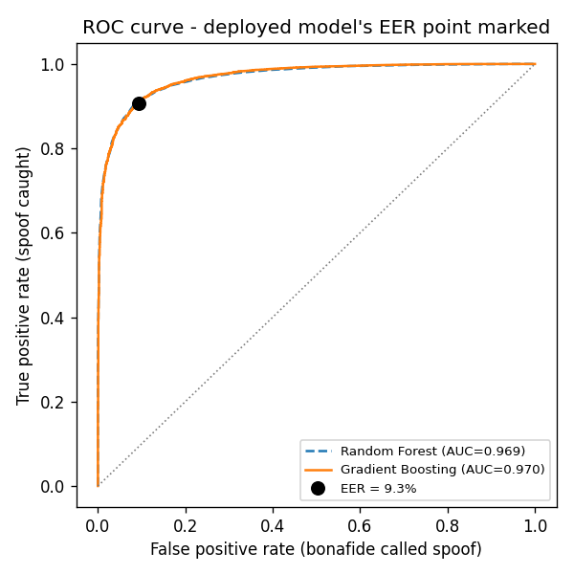
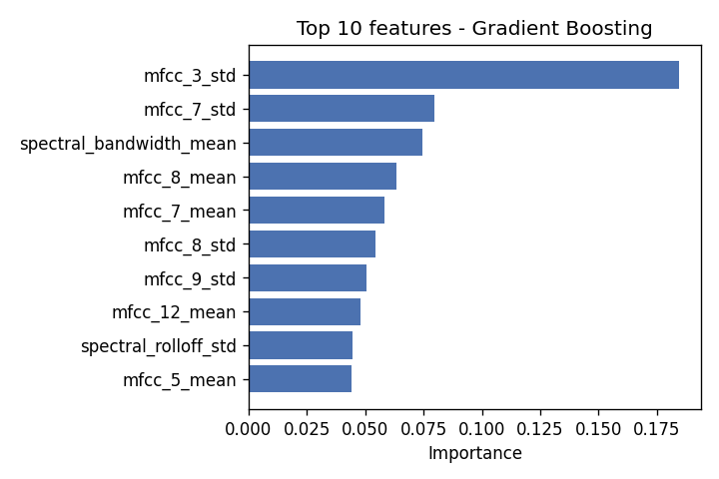
Results on dev — ROC curve & what the model learned
Both from the dev partition. Left: both candidate models, deployed model's EER point marked. Right: top acoustic features — MFCC variance dominates.
11

Slide 13
AI capability 2 — embeddings & semantic search
• The same acoustic feature vectors double as embeddings — no separate embedding model needed.
• Standardized (zero mean, unit variance) so cosine similarity isn't dominated by whichever feature happens to have the largest raw scale.
• Indexed into Elasticsearch as dense_vector fields, added to the existing index in place (a mapping update, not a reindex — the 50k+ documents were already there).
• Powers /classify's "most acoustically similar training clips" — k-NN search, playable in the browser, replacing a keyword match with genuine semantic search.
Where this stage sits in the pipeline:
Kaggle
MinIO
Spark
Parquet + ES
train_classifier
index_embeddings
kafka -> streaming
insights.py
Flask app
12

Slide 14
AI capability 3 — streaming enrichment
Kafka producer/consumer, near-real-time scoring
• Producer replays eval-set utterance events (a MinIO key, not the audio itself).
• Consumer fetches the clip, extracts features, scores it at the deployed EER threshold, and writes an enriched prediction to Elasticsearch — one document per utterance, live.
• Same feature-extraction and model code as the batch job and the web app — one implementation applied three ways, not three separate things to maintain and defend.
• A named consumer group tracks offset, so re-running resumes instead of re-scoring.
• Everything on the next three slides is scored here, on the eval partition — attacks A07–A19, synthesis systems the model never saw during training.
Where this stage sits in the pipeline:
Kaggle
MinIO
Spark
Parquet + ES
train_classifier
index_embeddings
kafka -> streaming
insights.py
Flask app
13

Slide 15
Pipeline stage 5 - Insights
insights.py — Elasticsearch aggregations -> charts + RESULTS.md
• Runs after the streaming consumer has written predictions — every number here is a live Elasticsearch aggregation query, nothing hand-typed or invented.
• Computes balanced and overall detection accuracy, per-attack-type accuracy, a confusion matrix, a confidence histogram, and class balance.
• Writes both a markdown report (docs/RESULTS.md) and the PNG charts /dashboard reuses — safe to re-run any time after a pipeline run (sample or full-scale) to regenerate real results.
• The confusion matrix, confidence histogram, and accuracy-by-attack charts on the next slides are this script's direct output, not hand-drawn. The ROC and feature-importance charts shown earlier come from train_classifier.py instead, since those need the model's own dev predictions.
Where this stage sits in the pipeline:
Kaggle
MinIO
Spark
Parquet + ES
train_classifier
index_embeddings
kafka -> streaming
insights.py
Flask app
14

Slide 16
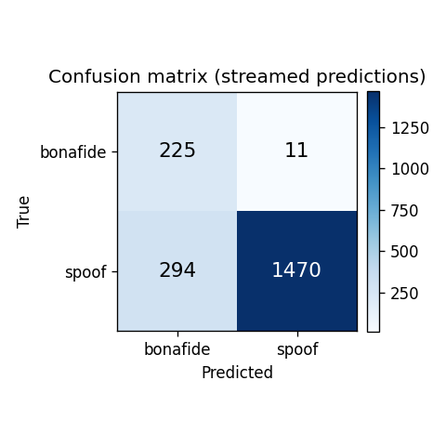
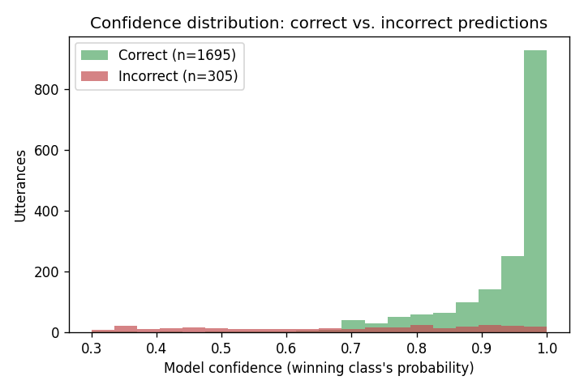
Results on streamed eval — confusion matrix & confidence
Both from the streamed eval predictions. Left: true vs. predicted counts. Right: confidence on correct vs. incorrect calls.
15

Slide 17
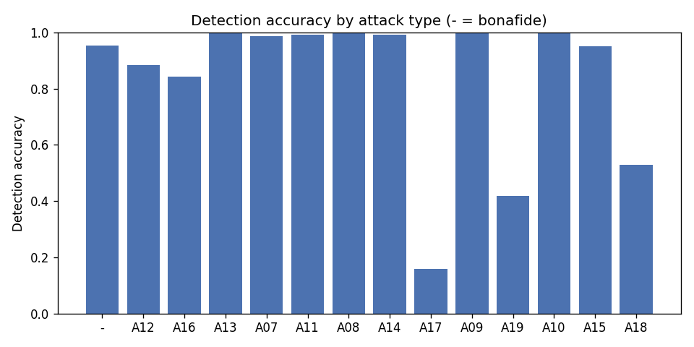
Results on streamed eval — accuracy by attack type
Near-perfect on most TTS/VC systems; A17/A18/A19 are the hard ones
89.3%
95.3%
83.3%
88.2%
Balanced accuracy
(mean of per-class recalls)
Bonafide recall
(real human speech)
Spoof recall
(AI-generated speech)
Always-spoof baseline
beats raw accuracy (84.8%)
All figures from the 2000 streamed eval predictions (attacks A07–A19, unseen during training).
16

Slide 18
Live demo
• /classify — upload a clip or record live from the microphone (captured via the Web Audio API, encoded to WAV client-side — no server changes needed for live recording).
• Returns Human / AI-generated + confidence, plus the 5 most similar training clips, each one playable right in the results, so you can hear what "similar" sounds like.
• /dashboard — live Elasticsearch aggregations: model comparison, threshold trade-off, ROC curve, confusion matrix, feature importance, confidence calibration.
▶ Open /classify
▶ Open /dashboard
Links open localhost:5000 — click while presenting from the machine running the app (see README.md).
Where this stage sits in the pipeline:
Kaggle
MinIO
Spark
Parquet + ES
train_classifier
index_embeddings
kafka -> streaming
insights.py
Flask app
17

Slide 19
Challenges & trade-offs
• Windows + Spark: worker Python resolution, a path with spaces, a pyspark 3.5.1 / Python 3.12 incompatibility, and a removed distutils — four environment bugs, none in our own logic, all diagnosed and fixed rather than worked around.
• A bug in our own code: Random Forest was reweighted twice — class_weight and sample_weight multiply in sklearn, turning 8.8:1 into 78:1.
• The EER threshold trades some spoof recall for bonafide recall — a deliberate choice, not a free win: no single threshold maximizes both on an imbalanced dataset.
• Embedding is the classifier's own feature vector, not a separate pretrained audio embedding model — keeps the semantic-search capability fully self-contained.
• Kept Python end-to-end (not Scala) since the feature-extraction library is Python-only.
• Speaker-disjoint train/dev split (not random) to avoid inflating accuracy via leakage.
18

Slide 20
Questions?
github.com/HadarBaum/asvspoof-voice-ai

