Slide 1
Route-building approach
Hadar Brayer

Slide 2
Current approach
Attractions are selected for the user in accordance to his or her interests (tags)
Given more attractions exist than time permits, attractions are chosen randomly
To minimise travel time, the city is cut into slices, each day is spent in a different slice of the city
As a function of all attractions that were chosen and the dividing of the city to slices, a route is built for each day, trying to minimise travel time
This route does not currently take into consideration similarity between different attractions, popularity etc.

Slide 3
Wishlist
The route should be built piece by piece, by taking into consideration as many characteristics of the available attractions as possible:
Opening times
Distance between attractions
Similarity of activity type or interest between different attractions
Customer’s interest domains
Availability
Etc.
Flexibility in the choice of characteristics is a desired property

Slide 4
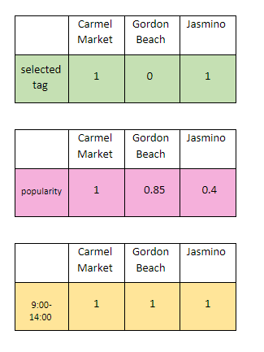
Proposed approach
Stock pre-processed data about each of the data points for each city, calculated in advance.
Data that belongs to each data point separately is stocked as vectors:
The existence of each tag
Popularity
Availability (opening hours)
Price

Slide 5
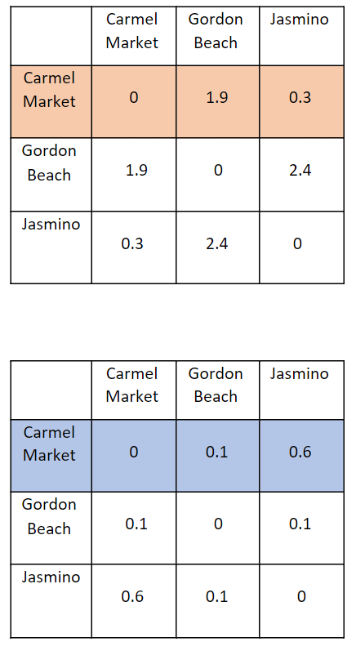
Proposed approach
Data that describes relationships between each two data points is stocked as a matrix:
Physical distance
Similarity
Physical distance
Similarity

Slide 6
Proposed approach
When building a route, the choice of the next attraction, given all the attractions that were already chosen, is done as follows:
Extract relevant vectors from matrices
Combine all vectors to create a final “note” per possible attraction
Choose the next attraction in one of the following ways:
The attraction that has the maximum note
Probabilistically, with probabilities in relation to the note of each attraction

Slide 7
Example - distance
Assume the only interesting characteristic for choosing the next attraction is its distance from the previous one
In memory, a matrix containing the distance between each two attractions in the city exists
Given the attraction that was already chosen, its distance from all other attractions can be found in the corresponding row/column
Using this vector, while excluding the attraction that was already chosen, the next attraction can be chosen such that it’s close to the previous one
1
20
15
0.3
2
0.5
0
7
8
9

Slide 8
Advantages
Flexibility in characteristics to be considered
Granularity of the characteristics to be considered
e.g., instead of distance in kilometres, consider travel time by foot, car or public transport, depending on the user
No exaggerated randomness in the choice of attractions or their order

Slide 9
Challenges
Determining how to consider each characteristic and how to combine them in order to create one meaningful final vector of notes
The amount of memory that is going to be required, specifically for large cities with many attractions
Calculation times

Slide 10
Route-Building
POC
Stock pre-processed data about each of the features for each city, calculated in advance.
Finding the next attraction according to distance, similarity, tags and popularity vectors
Using Berlin_google_tagged data
About 300 attractions

Slide 11
Tags
Preference to the attraction is given on the selected tags and also on the number of tags that the attraction answers.
Chosen tags :
"Architecture", "Culinary Experiences", "Shopping", "Art", "Urban Parks", "Museums" (total of 6 tags)
In the above example “New palace” has the lowest score
If a selected attraction meets a particular tag then the priority of the particular tag decreases but is still higher than the tags that are not selected at all.
Berlin Relaxed < Alexanderplatz < Mall of Berlin
(Shopping will have a higher priority than Architecture)
attraction | tags | score
New palace | Historic Sites, Architecture, Historic Sites, Museums | 1 - (2/6)
Mall of Berlin | Shopping | 1 - (1/6)
Alexanderplatz | Historic Sites, Popular, Architecture | 1 - (1/6)
Berlin Relaxed | Wellness and Wellbeing | 1 - (0/6)

Slide 12
Popularity
popularity is determined by "number_of_reviews"
The higher the number of reviews, the lower the score
Berlin Relaxed < New palace < Mall of Berlin < Alexanderplatz
attraction | number_of_reviews | score
New palace | 6855 | 0.97
Mall of Berlin | 40796 | 0.76
Alexanderplatz | 163891 | ~0
Berlin Relaxed | 77 | ~1

Slide 13
Similarity
In the context of similarity between attractions, the algorithm specifically addresses the similarity to the last attraction,
but still takes into account the other selected attractions as well
chosen attractions:
31 = Alexanderplatz
4 = New palace
235 = Mall of Berlin
285 = Berlin relaxed (last chosen attraction)
calculating similarity vector:
Berlin relaxed + (1/3) * Mall of Berlin + (1/9) * New palace + (1/27) * Alexanderplatz

Slide 14
Distance
The distance is calculated by Haversine distance: The angular distance between two points on the surface of a sphere (in KM)
Normalized distances
for selecting the next best attraction, we will take the distance vector of the last attraction.
Last selected attraction

Slide 15
Selecting the first attraction
selected by calculation of tags and popularity vectors
The weight of each vector can vary. Currently the weight is equal between the vectors
Alexanderplatz has the lowest result and was therefore chosen to be the first attraction
attraction | tags vector | popularity vector | final vector
New palace | 1 - (2/6) | 0.97 | 1.64
Mall of Berlin | 1 - (1/6) | 0.76 | 1.59
Alexanderplatz | 1 - (1/6) | ~0 | 0.83
Berlin Relaxed | 1 - (0/6) | ~1 | 2

Slide 16
Selecting the next best attraction
Sum of vectors and selection of the attraction with the lowest result
Extract / Calculate the vectors according to the selected attraction/s:
Distance vector
Similarity vector
Tags vector
Popularity vector

Slide 17
Selecting the next best attraction
The weight given to each vector is flexible and changeable and can lead to a different attraction selection
Extract / Calculate the vectors according to the selected attraction/s:
X2
Distance vector
X1
Similarity vector
X1
Tags vector
X3
Popularity vector
Next best attraction according to the above weights:
Brandenburg gate

Slide 18
Selecting the next best attraction
The weight given to each vector is flexible and changeable and can lead to a different attraction selection
Extract / Calculate the vectors according to the selected attraction/s:
X1
Distance vector
X1
Similarity vector
X1
Tags vector
X1
Popularity vector
Next best attraction according to the above weights:
Magicum - Berlin Magic Museum

Slide 19
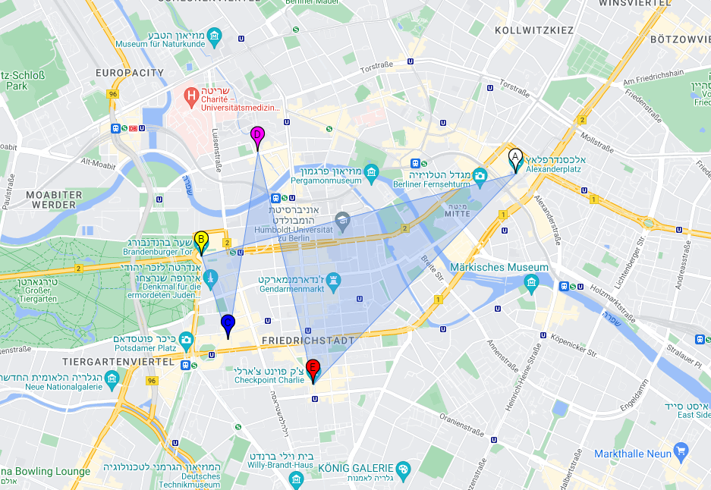
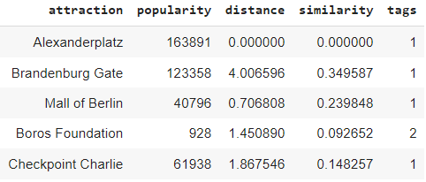
Building a route
Prioritize Popularity
Vectors weights: Popularity: 3, Distance: 2, Similarities: 1, Tags: 1
Selecting 5 attractions
A
B
C
D
E

Slide 20
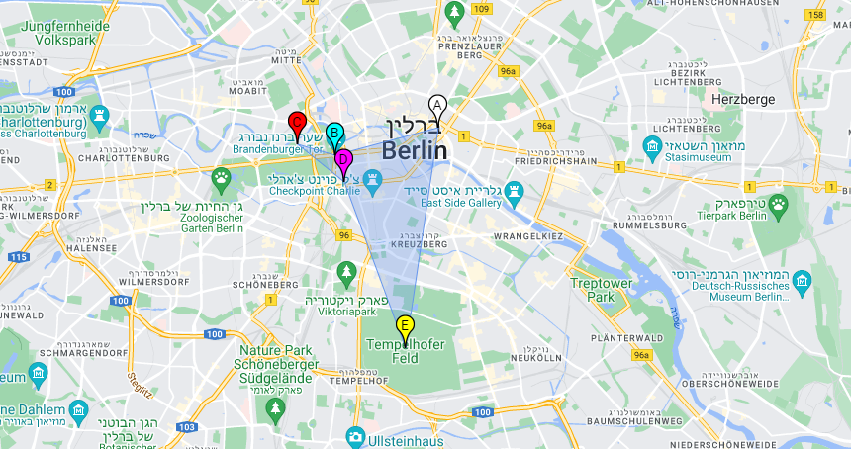
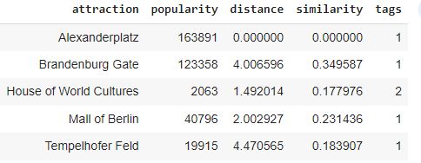
Building a route
Equally prioritize Popularity and Distance
Vectors weights: Popularity: 2, Distance: 2, Similarities: 1, Tags: 1
Selecting 5 attractions
A
B
C
D
E

Slide 21
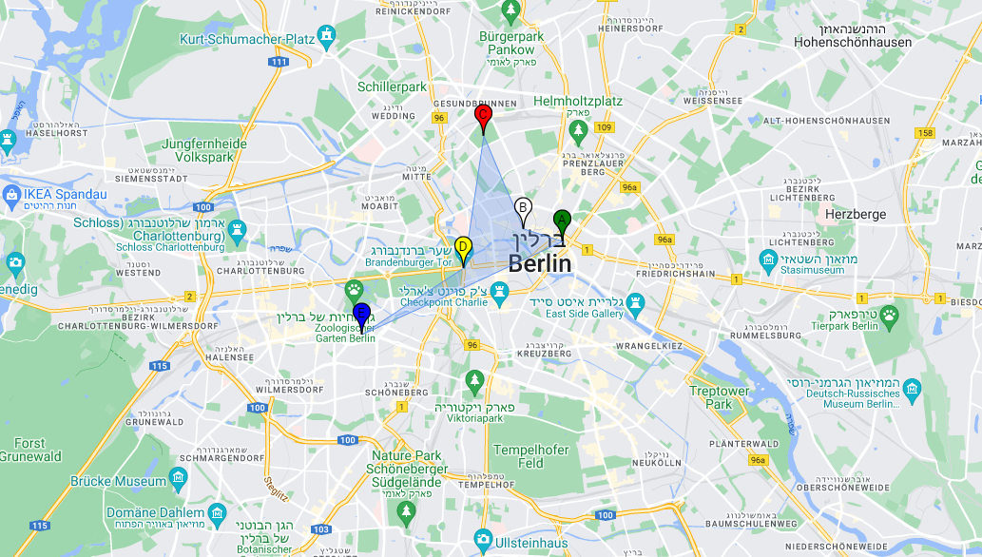
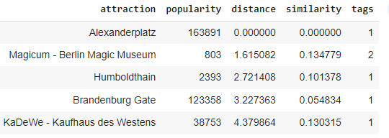
Building a route
Equally prioritize all parameters
Vectors weights: Popularity: 1, Distance: 1, Similarities: 1, Tags: 1
Selecting 5 attractions
A
B
C
D
E

Slide 22



Which Route to choose?
Rank dozens or hundreds of routs with different weights and choose the most logical algorithm
Let the user rate the importance of each Feature
Display the user several optional routes and let him choose his preferred route
Distance
Tags
Popularity

Slide 23
Flexibility in adding more features
Sum of vectors and selection of the attraction with the lowest result
Extract / Calculate the vectors according to the selected attraction/s:
Distance vector
Similarity vector
Tags vector
Popularity vector

Slide 24
Flexibility in adding more features
Sum of vectors and selection of the attraction with the lowest result
Extract / Calculate the vectors according to the selected attraction/s:
Distance vector
Similarity vector
Tags vector
Popularity vector
Availability vector

Slide 25
Flexibility in adding more features
Sum of vectors and selection of the attraction with the lowest result
Extract / Calculate the vectors according to the selected attraction/s:
Distance vector
Similarity vector
Tags vector
Popularity vector
Availability vector
Distance by public transport vector

Slide 26
Flexibility in adding more features
Sum of vectors and selection of the attraction with the lowest result
Extract / Calculate the vectors according to the selected attraction/s:
Distance vector
Similarity vector
Tags vector
Popularity vector
Availability vector
Distance by public transport vector
Age vector

Slide 27
Flexibility in adding more features
Sum of vectors and selection of the attraction with the lowest result
Extract / Calculate the vectors according to the selected attraction/s:
Distance vector
Similarity vector
Tags vector
Popularity vector
Availability vector
Distance by public transport vector
Age vector
Budget vector

Slide 28
Flexibility in user selection
As long as the data is collected and stored we can easily switch between vectors
Show distance in:
KM
MI
Show route duration by:
Walking
Public
transport

Slide 29
Flexibility in user selection
Final calculation according to the selected vectors
Extract / Calculate the vectors according to the selected attraction/s:
Distance vector
Similarity vector
Tags vector
Popularity vector
In
Availability vector
Distance by public transport vector
Out
Distance by walking vector
Age vector
Budget vector

Slide 30

Conclusions
No exaggerated randomness in the choice of attractions or their order
Flexibility in adding more features in the future
Flexibility in user selection
Easy to understand conceptually

