Slide 1
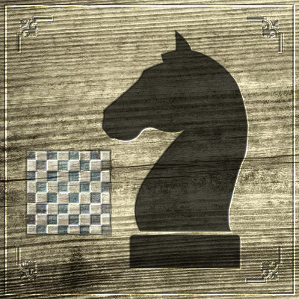
Knight’s Tour
Submitted:
Hadar Pur 308248533
Maor Shapira 305331381

Slide 2
Knight’s Tour Problem
The famous knight’s tour problem asks whether a knight can tour an entire 8 × 8 chessboard visiting each square exactly once.
A knight can move in any of 8 ways, provided that the final destination is within the board.
In each of these ways, one coordinate of the knight’s position changes by 2 units (positively or negatively), and the other coordinate changes by 1 unit (positively or negatively).
If the knight ends on a square that is one knight's move from the beginning square (so that it could tour the board again immediately, following the same path), the tour is closed, otherwise it is open.

Slide 3
There are many variations of this problem :
Whether a tour is possible with a given initial position.
Whether a tour is possible with a given initial and a given final position.
Whether there is a closed tour or re-entrant tour , that is, a tour where the last square is a knight’s move away from the first. If there is a closed tour beginning at some square, there is a closed tour beginning at any square.
We will focus on the first variation

Slide 4
A tour, or more technically, a Hamiltonian path of a general graph is a sequence of its vertices such that every vertex occurs exactly once, and vertices occurring adjacent to each other in the sequence are adjacent in the graph.
The vertices of the graphs are the squares of the chessboard, and there is an edge joining two vertices (that is, the two vertices are adjacent) if they are separated by a knight’s move.
The sequence describes the order in which the vertices are covered by the Hamiltonian path.
The knight’s tour that we had encountered earlier on is simply a Hamiltonian path in the knight’s move graph.

Slide 5
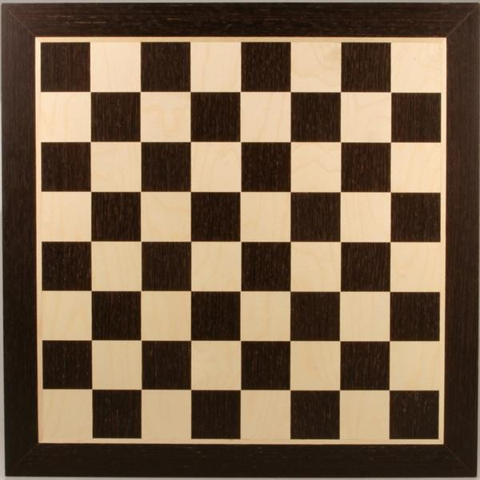

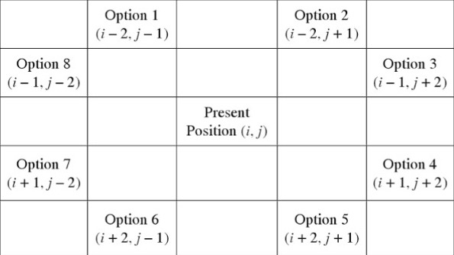
Knight Rules
Here, a knight can move in any of 8 ways, provided that the final destination is within the board.

Slide 6
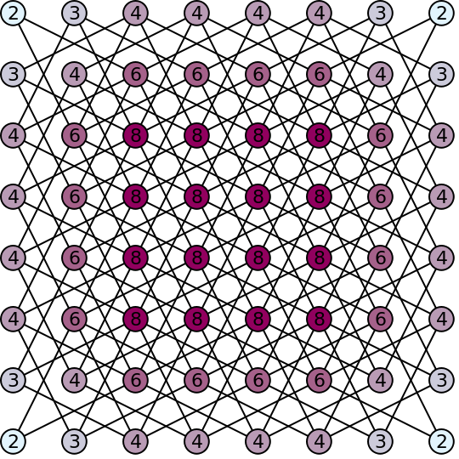
Knight's graph showing all possible paths for a knight's tour on a standard 8×8 chessboard.
The numbers on each node indicate the number of possible moves that can be made from that position.

Slide 7
Motivation to Warnsdorff’s Rule
The naive algorithm or brute force algorithm (D.F.S.) for determining whether or not a tour exists, is based on a notion of blocking vertices that have already been visited.
In a brute force algorithm there is a distinct possibility of going down a dead end, it may well happen that we choose a move that does not give rise to any correct tour.
Thus ,we retreat and try the other possible moves.
The retreating is termed backtracking.

Slide 8
The more the backtracking, in general, the more the time taken to find a tour.
Thus, the key idea to determining a tour most quickly is to minimize backtracking.
The standard approach of doing so is to impose an order of preference on the moves, that is, to decide on what order we try to perform the moves in.
The order of preference is typically generated by trying to optimize using some local heuristic.
Algorithms that use a local heuristic to make the decision at each stage form a class known as greedy algorithms .
In case a Hamiltonian path exists, the greedy algorithm gives one such Hamiltonian path, without hitting any dead ends => O(n²).

Slide 9
In the graph, vertices with a low degree are in some sense more critical as there are fewer ways of including them in paths. Vertices with a higher degree are less critical as there are plenty of ways of including them in paths.
The degree must be viewed as the number of adjacent vertices that are still free.
A vertex of lower (free) degree (which is more critical) is given preference over a vertex of higher (free) degree.
Vertices of equal degree can be given any order of preference.
This is termed the Warnsdorff’s rule.

Slide 10
Warnsdorff’s Rule
Warnsdorff's rule is a heuristic for finding a knight's tour.
The knight is moved so that it always proceeds to the square from which the knight will have the fewest onward moves.
When calculating the number of onward moves for each candidate square, we do not count moves that revisit any square already visited.
Surprisingly, the rule always gives a tour for an 8 × 8 chessboard.
While Warnsdorff’s rule does guarantee a tour from any starting point, it does not guarantee a re-entrant tour from every starting point

Slide 11
Definition of Heuristic
A heuristic technique often called simply a heuristic, is any approach to problem solving, learning, or discovery that employs a practical method not guaranteed to be optimal or perfect, but sufficient for the immediate goals.
Where finding an optimal solution is impossible or impractical, heuristic methods can be used to speed up the process of finding a satisfactory solution.

Slide 12
Iterative Complexity
n=SIZE
O(n²)
private void solvePuzzleIter(int startX, int startY) {
int[] position = initialPosition(startX, startY);
for (int i=1; i< SIZE *SIZE; i++){
position = nextMove(position);
addMoveHistory(position[0], position[1]);
}
}

Slide 13
O(1)
private int[] initialPosition(int startX, int startY){
int[] pos = new int[2];
pos[0] = startX;
pos[1] = startY;
board[pos[0]][pos[1]] = true;
return pos;
}

Slide 14
private int[] nextMove(int[] pos) {
int xPos = pos[0];
int yPos = pos[1];
int accessibility = NUM_OF_MOVES;
for (int i=0 ; i< NUM_OF_MOVES ; i++){
int newX = xPos + MOVES[i][0];
int newY = yPos + MOVES[i][1];
int newAccessibility = getAccessibilitySquares(newX, newY);
if( isEmpty(newX, newY) && newAccessibility < accessibility ){
pos[0] = newX;
pos[1] = newY;
accessibility = newAccessibility;
}
}
board[pos[0]][pos[1]] = true;
return pos;
}
NUM_OF_MOVES = O(8)=O(1)

Slide 15
O(1)
private void solvePuzzleIter(int startX, int startY) {
int[] position = initialPosition(startX, startY);
for (int i=1; i< SIZE *SIZE; i++){
position = nextMove(position);
addMoveHistory(position[0], position[1]);
}
}
n=SIZE
O(n²)
nextMove = O(1)
total
O(1)+O(n²) * O(1) = O(n²)

Slide 16
Recursive Complexity
private boolean solvePuzzleRec(boolean[][] moves, int numMoves, int x, int y) {
:
:
:
for (int i = 2; i >= -2; i += -4) {
for (int j = 1; j >= -1; j += -2) {
nextX = x + i;
nextY = y + j;
if (nextX >= 0 && nextX <= SIZE - 1 && nextY >= 0 && nextY <= SIZE - 1 && !moves[nextX][nextY]) {
moveCount = lookAheadCount(moves, nextX, nextY);
if (moveCount <= minMoveCount) {
:
:
}
}
O(2)=O(1)
O(2)=O(1)

Slide 17
lookAheadCount=O(1)
nextX = x + j;
nextY = y + i;
if (nextX >= 0 && nextX <= SIZE - 1 && nextY >= 0 && nextY <= SIZE - 1 && !moves[nextX][nextY]) {
moveCount = lookAheadCount(moves, nextX, nextY);
if (moveCount <= minMoveCount) {
minMoveCount = moveCount;
bestMoveX2 = bestMoveX;
bestMoveY2 = bestMoveY;
bestMoveX = nextX;
bestMoveY = nextY;
}
}
}
}

Slide 18
moves[bestMoveX][bestMoveY] = true;
addMoveHistory(bestMoveX, bestMoveY);
numMoves++;
if (numMoves == (SIZE * SIZE))
return true;
if (moveCount > 0 && solvePuzzleRec(moves, numMoves, bestMoveX, bestMoveY)) {
return true;
}
:
:
if (moveCount > 1 && solvePuzzleRec(moves, numMoves, bestMoveX2, bestMoveY2)) {
return true;
}
:
:
:
}
O(n²)
O(n²)

Slide 19
private int lookAheadCount(boolean[][] moves, int x, int y) {
:
:
for (int i = -2; i <= 2; i += 4) {
for (int j = -1; j <= 1; j += 2) {
nextX = x + i;
nextY = y + j;
if (nextX >= 0 && nextX <= SIZE - 1 && nextY >= 0 && nextY <= SIZE - 1 && !moves[nextX][nextY]) {
maxCount++;
}
: :
if (nextX >= 0 && nextX <= SIZE - 1 && nextY >= 0 && nextY <= SIZE - 1 && !moves[nextX][nextY]) {
maxCount++;
}
}
}
return maxCount;
}
O(2)=O(1)
O(2)=O(1)
total
O(1) * O(1)+O(n²)+ O(1) * O(1) = O(n²)

Slide 20
Compare schedules between programs
Experiment number | MultiThreading Code |  | Simple Code
Code | Recursive | Iterative | Recursive | Iterative
1 | 0 ms | 1 ms | 1 ms | 0 ms
2 | 0 ms | 1 ms | 0 ms | 1 ms
3 | 0 ms | 0 ms | 0 ms | 1 ms
4 | 0 ms | 0 ms | 0 ms | 1 ms
5 | 0 ms | 1 ms | 1 ms | 0 ms
6 | 1 ms | 1 ms | 0 ms | 0 ms
7 | 1 ms | 1 ms | 0 ms | 1 ms
8 | 0 ms | 1 ms | 1 ms | 1 ms
9 | 1 ms | 1 ms | 0 ms | 1 ms
10 | 0 ms | 0 ms | 0 ms | 0 ms

Slide 21
Conclusion
Experiment number | MultiThreading Code |  | Simple Code
Code | Recursive | Iterative | Recursive | Iterative
Average | 0.3 ms | 0.7 ms | 0.3 ms | 0.7 ms

Slide 22
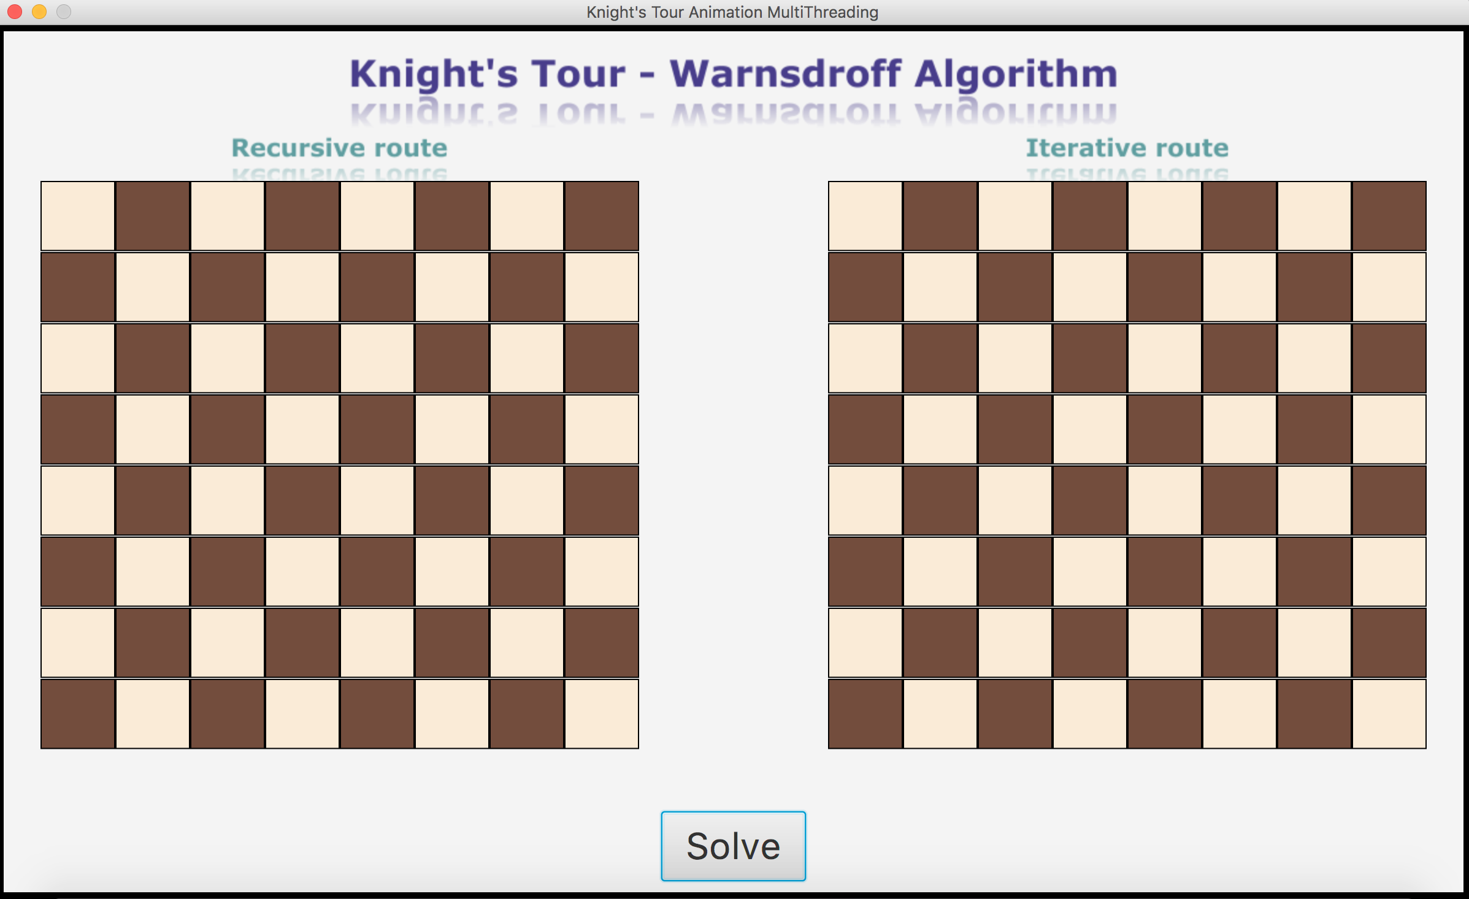
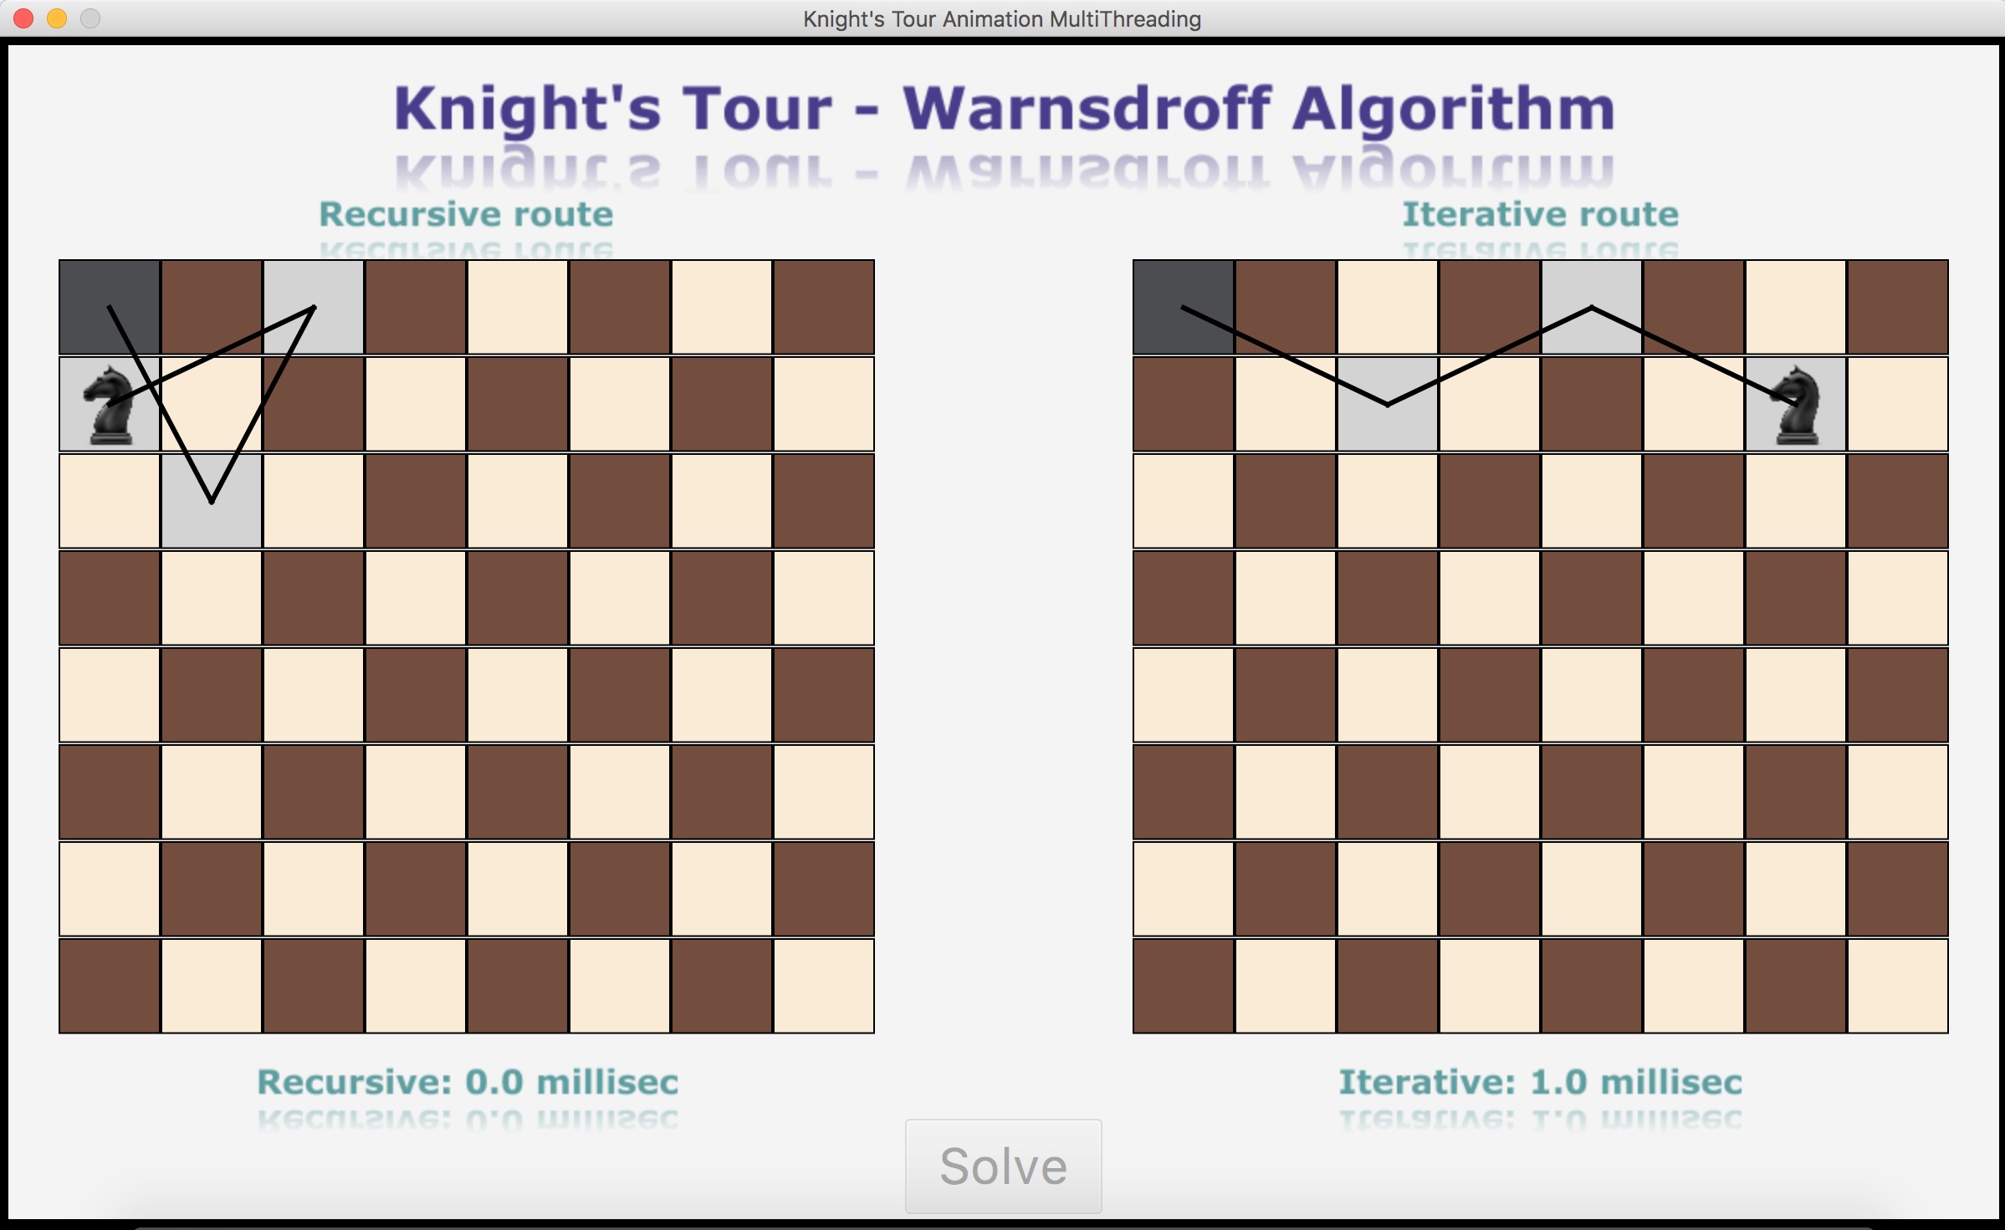
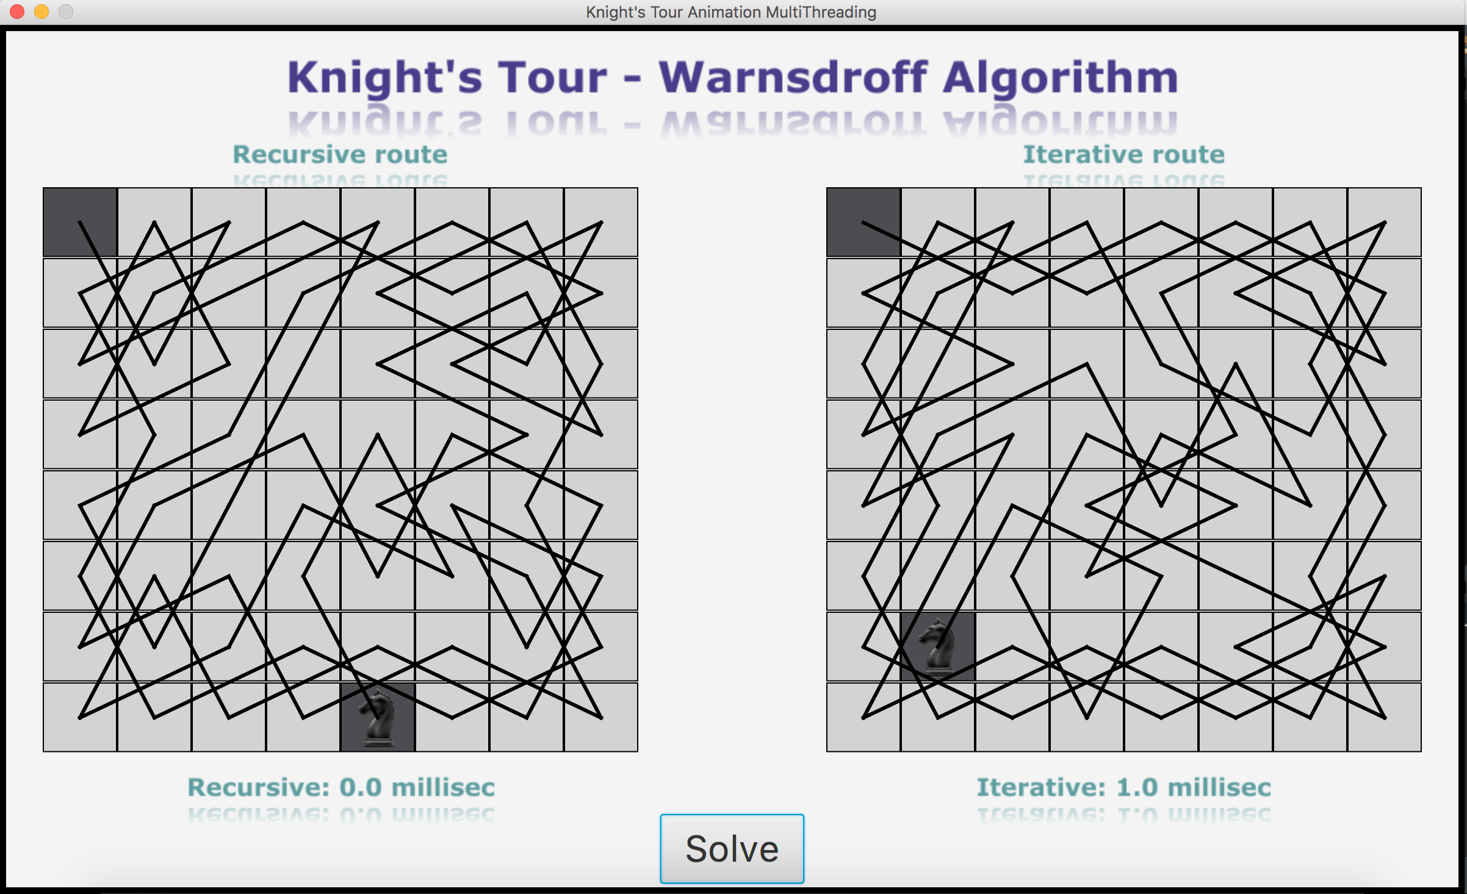
The Animation

Slide 23
Bibliography
“A simple algorithm for knight’s tours”
Author: Sam Ganzfried
“Touring Problems – A Mathematical Approach” Author: Vipul Naik

Slide 24
Thank You
Hadar Pur && Maor Shapira

