Slide 1
Theater Information System
Final Project of Course 10127 Database Systems

Slide 2
General description of the system
The “Afeka Theater “
The theater consists of three halls: “Ficus Hall”, “HaKiriya Hall” and “Mapat Hall”
The theater operates a subscription packages for its customers
There is schedule holds the information about the shows scheduled
Reservations manage

Slide 3
Requirements for the current project
Data Integrity Requirements
Reservation Management Requirements
Theater Management Requirements
Schedule Management Requirements
Customer Management Requirements
Ticket Management Requirements
Subscription Management Requirements

Slide 4
Description of 2 user types of the system
Customers
Theater staff members

Slide 5
Description of system entities
Theater
Customer
Customer Phone
Subscription Package
Subscriptions
Shows
Hall
Schedule
Seat
Reservation
Tickets in Reservation

Slide 6
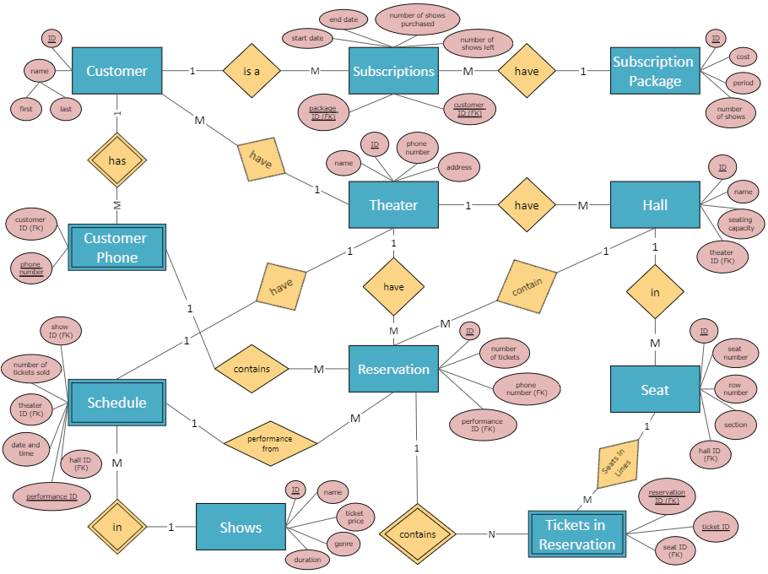
ERD

Slide 7
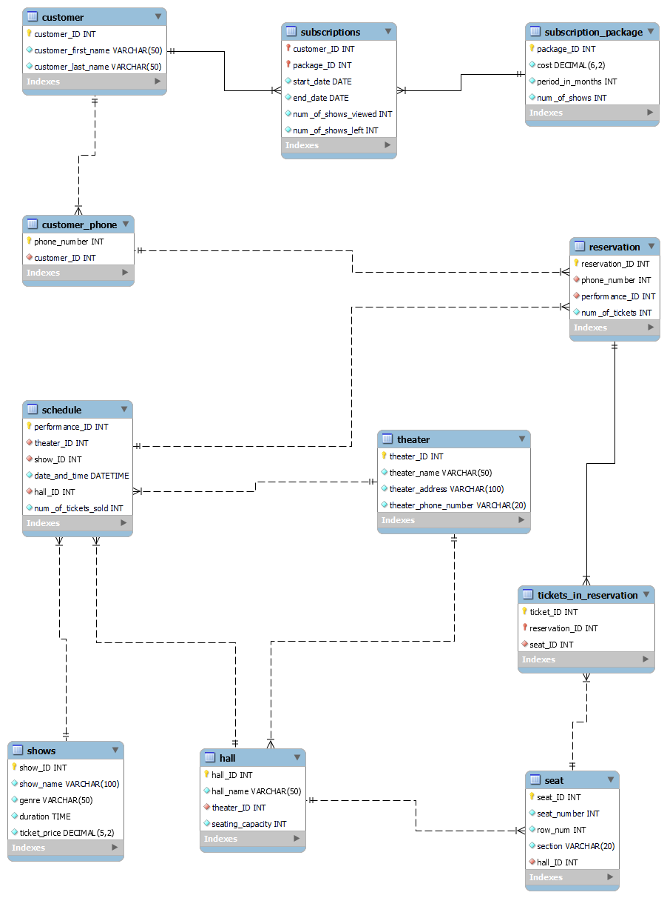
Tables

Slide 8
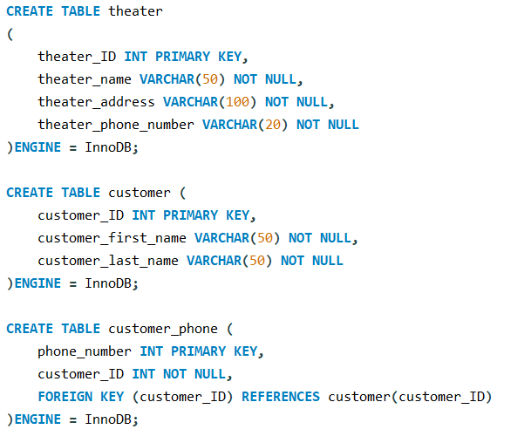
“CREATE TABLE” commands

Slide 9
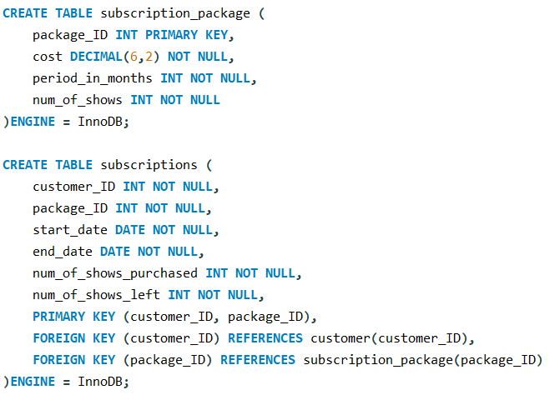
“CREATE TABLE” commands

Slide 10
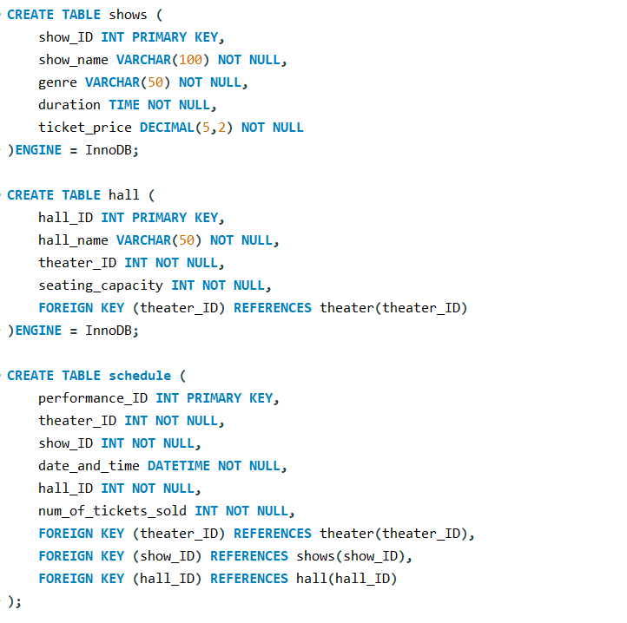
“CREATE TABLE” commands

Slide 11
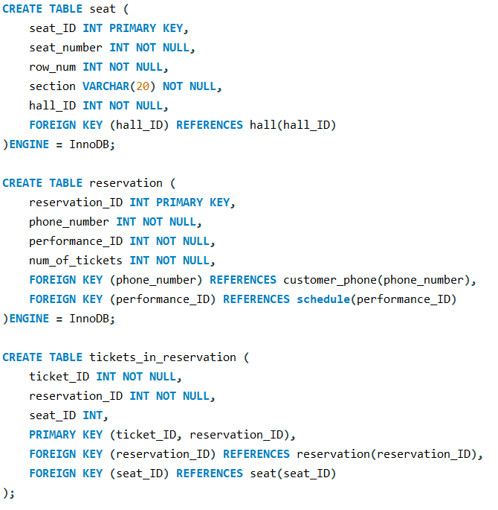
“CREATE TABLE” commands

Slide 12
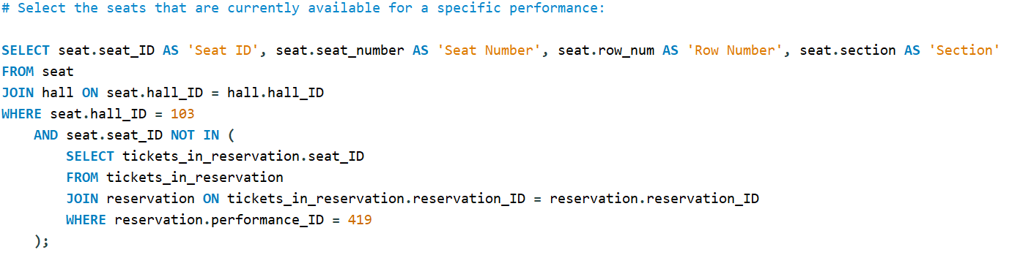
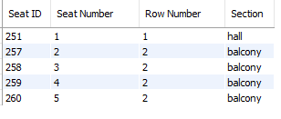
“SELECT” commands

Slide 13
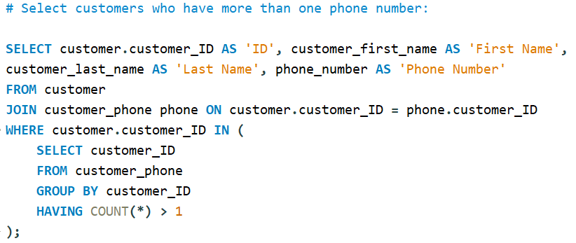
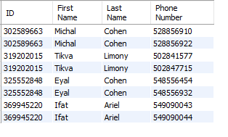
“SELECT” commands

Slide 14
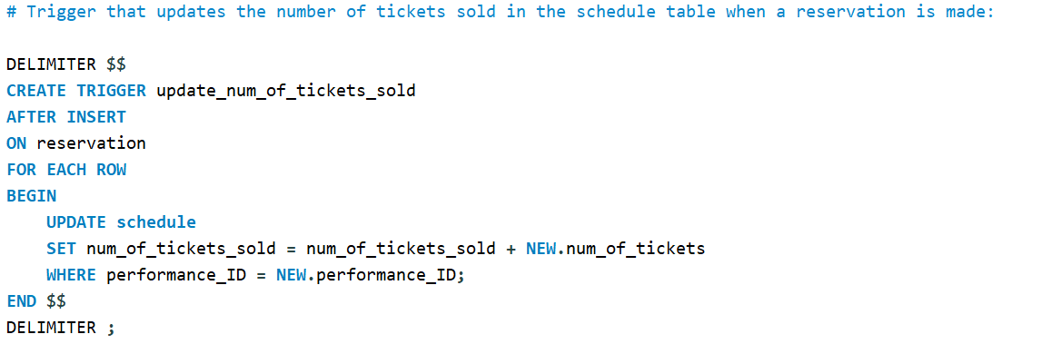
Triggers

Slide 15
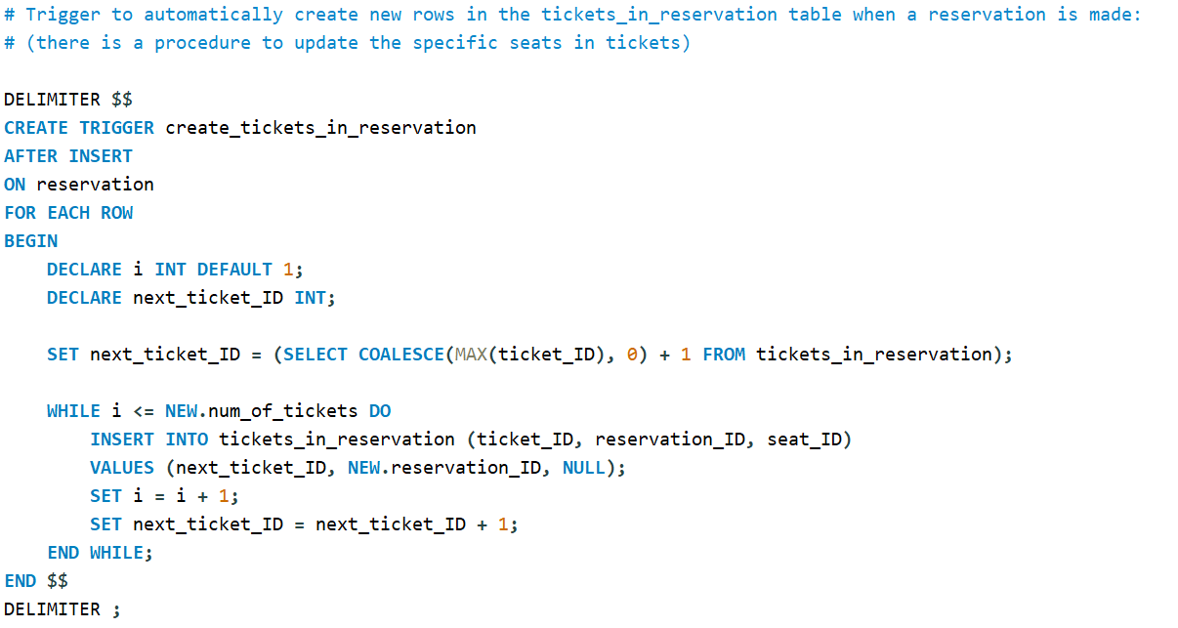
Triggers

Slide 16
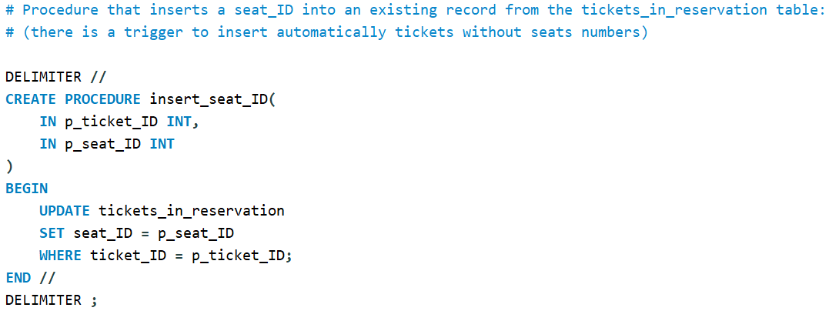
Stored Procedures

Slide 17
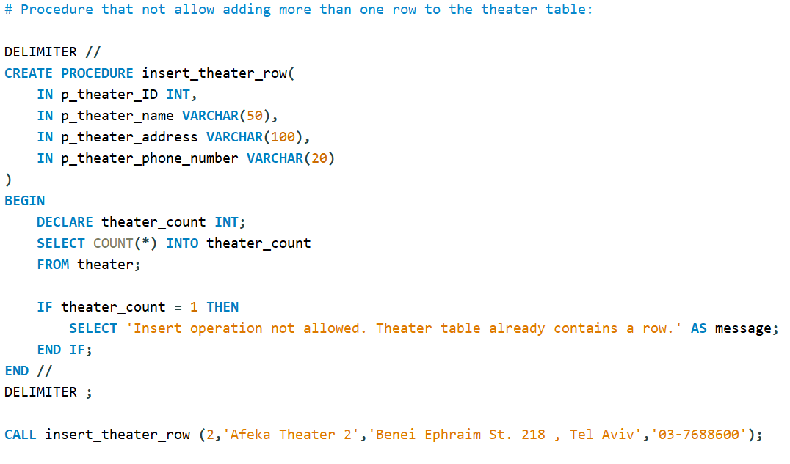
Stored Procedures

Slide 18
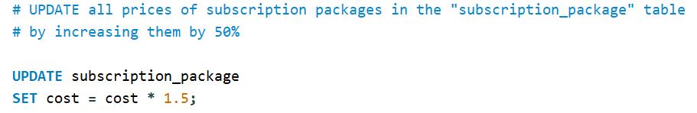
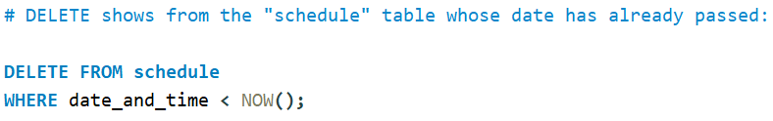
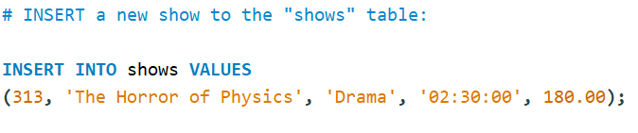
INSERT / UPDATE / DELETE commands

Slide 19

Thank you for listening!

