Slide 1
SNK revisited
Final Project in course Geometric Computer Vision (236861)
Hadassa Malka
Based on paper by Attaiki and Ovsjanikov (2024):
Shape Non-rigid Kinematics (SNK): A Zero-Shot Method for Non-Rigid Shape Matching via Unsupervised Functional Map Regularized Reconstruction

Slide 2
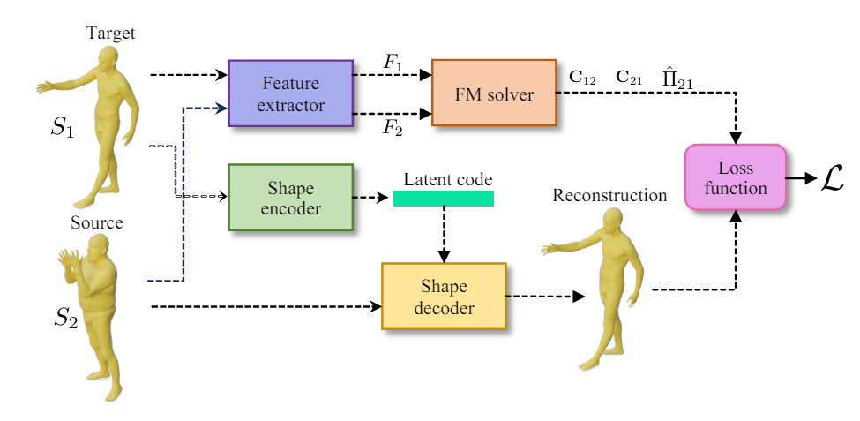
Overview
Architecture implementation based on zero-shot method for non-rigid shape correspondence presented in paper.
My implementation: https://github.com/HadassaMB/SNK_revisited.git
$$ℒ=λ_{MSE}∙ℒ_{MSE}+λ_{fmaps}∙ℒ_{fmaps}+λ_{primo}∙ℒ_{primo}$$
Notes:
L_cycle removed due to non-participation in differentiation in back-propagation

Slide 3
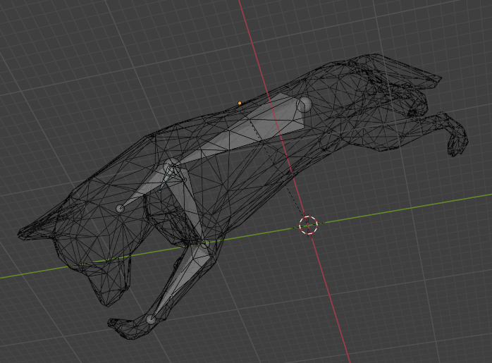
Dataset generation
Manipulation of shapes using Blender software.
Use armature to apply non-rigid deformations
Use rotate/translate for rigid transformation
Use decimate to reduce size
Use triangulate for compatibility with trimesh package
Objects saved as Wavefront .obj.
Notes:
Add armature (bones)
Rotate/Gather as wanted inside shape
Extrude new bones from nodes
Attach armature to parent
Pose mode
Move parts of objects using armature

Slide 4
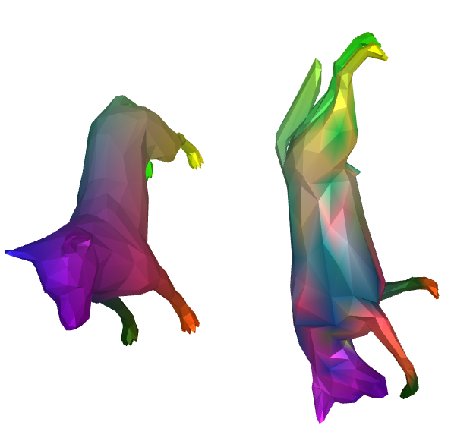
Initial correspondence – FMaps with WKS
Computation of initial shape matching using Pyfm package (investigated in HW3), using Wave Kernel Signature as descriptors.
Visualization of correspondances (colors) using meshplot package.

Slide 5

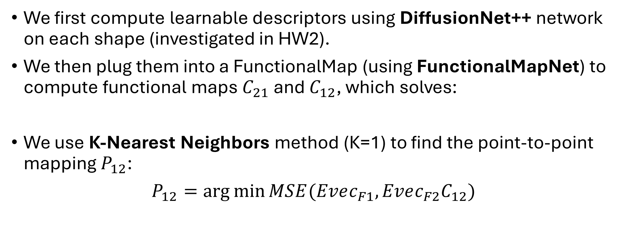
Functional mapping
We first compute learnable descriptors using DiffusionNet++ network on each shape (investigated in HW2).
We then plug them into a FunctionalMap (using FunctionalMapNet) to compute functional maps $C_{21}$ and $C_{12}$, which solves:
We use K-Nearest Neighbors method (K=1) to find the point-to-point mapping $P_{12}$:
$P_{12}=\arg{\min{MSE(Evec_{F1},Evec_{F2}C_{12})}}$

Slide 6
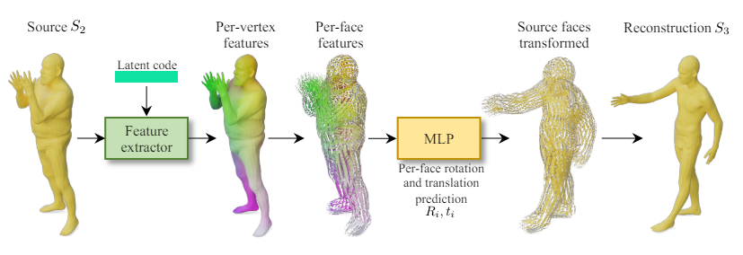
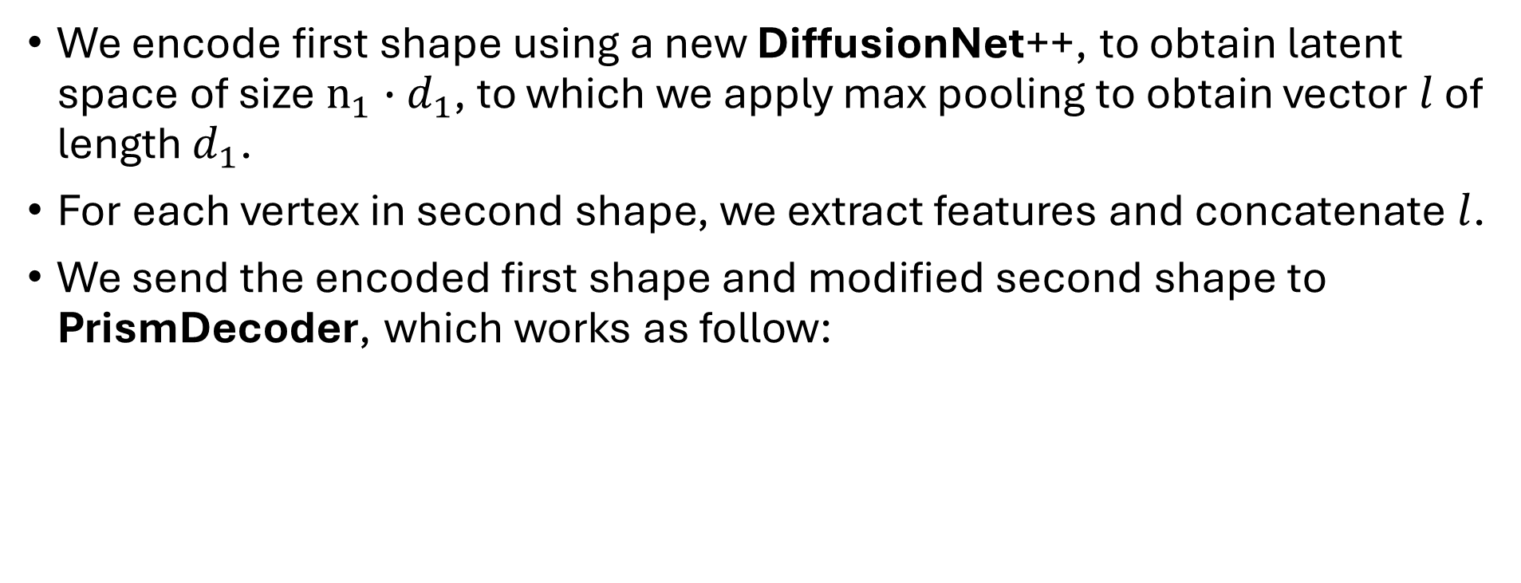
Encoder-Decoder
We encode first shape using a new DiffusionNet++, to obtain latent space of size $n_{1}∙d_{1}$, to which we apply max pooling to obtain vector $l$ of length $d_{1}$.
For each vertex in second shape, we extract features and concatenate $l$.
We send the encoded first shape and modified second shape to PrismDecoder, which works as follow:
Notes:
Need PyTorch implementation for differentiability in learning process.
KNN not differentiable – hence we removed the last part of the loss

Slide 7
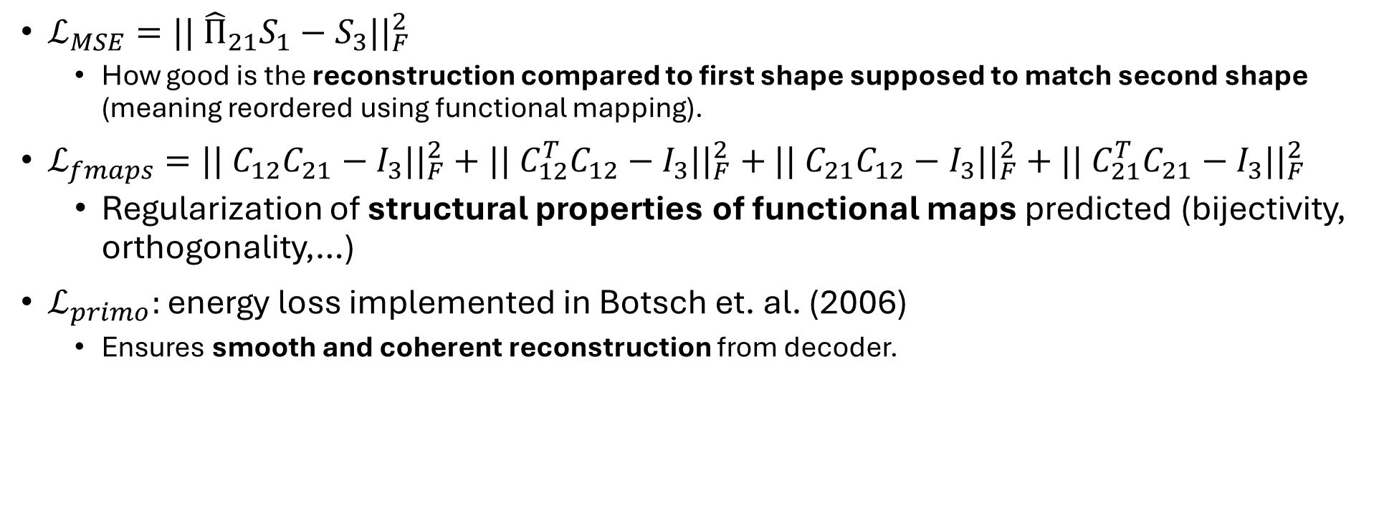
Loss functions
$ℒ_{MSE}=|| {\hat{Π}}_{21}S_{1}−S_{3}||_{F}^{2}$
How good is the reconstruction compared to first shape supposed to match second shape (meaning reordered using functional mapping).
$ℒ_{fmaps}=|| C_{12}C_{21}−I_{3}||_{F}^{2}+|| C_{12}^{T}C_{12}−I_{3}||_{F}^{2}+$ $|| C_{21}C_{12}−I_{3}||_{F}^{2}+|| C_{21}^{T}C_{21}−I_{3}||_{F}^{2}$
Regularization of structural properties of functional maps predicted (bijectivity, orthogonality,…)
$ℒ_{primo}:$ energy loss implemented in Botsch et. al. (2006)
Ensures smooth and coherent reconstruction from decoder.
$$ℒ=λ_{MSE}∙ℒ_{MSE}+λ_{fmaps}∙ℒ_{fmaps}+λ_{primo}∙ℒ_{primo}$$
Notes:
Need PyTorch implementation for differentiability in learning process.
KNN not differentiable – hence we removed the last part of the loss

Slide 8
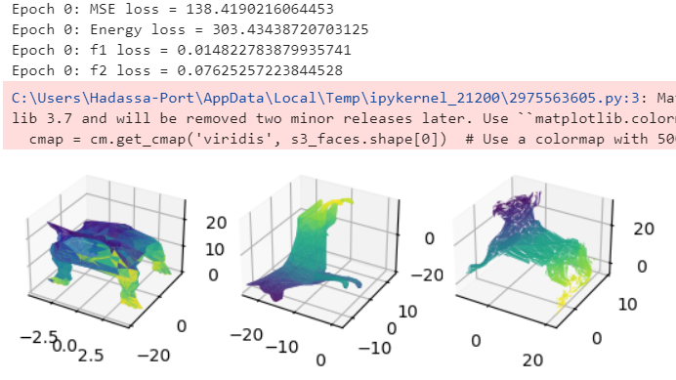
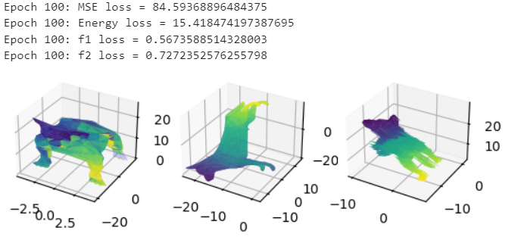
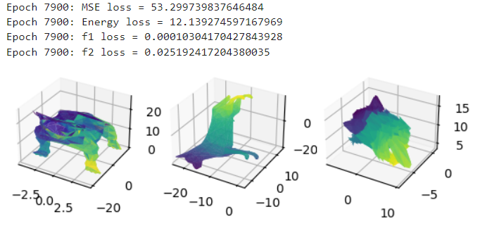

Training visualization
Poor matching obtained…
Possible reasons:
More fine-tuning of hyperparameters.
Implementation of differentiable KNN and add $ℒ_{cycle}$.
Lack of computational power – trained on 8000 iterations on CPU.

Slide 9
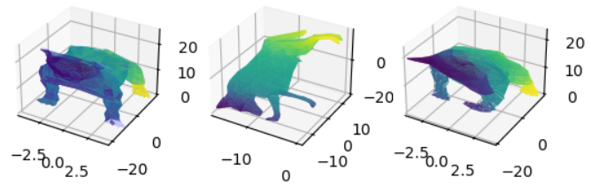
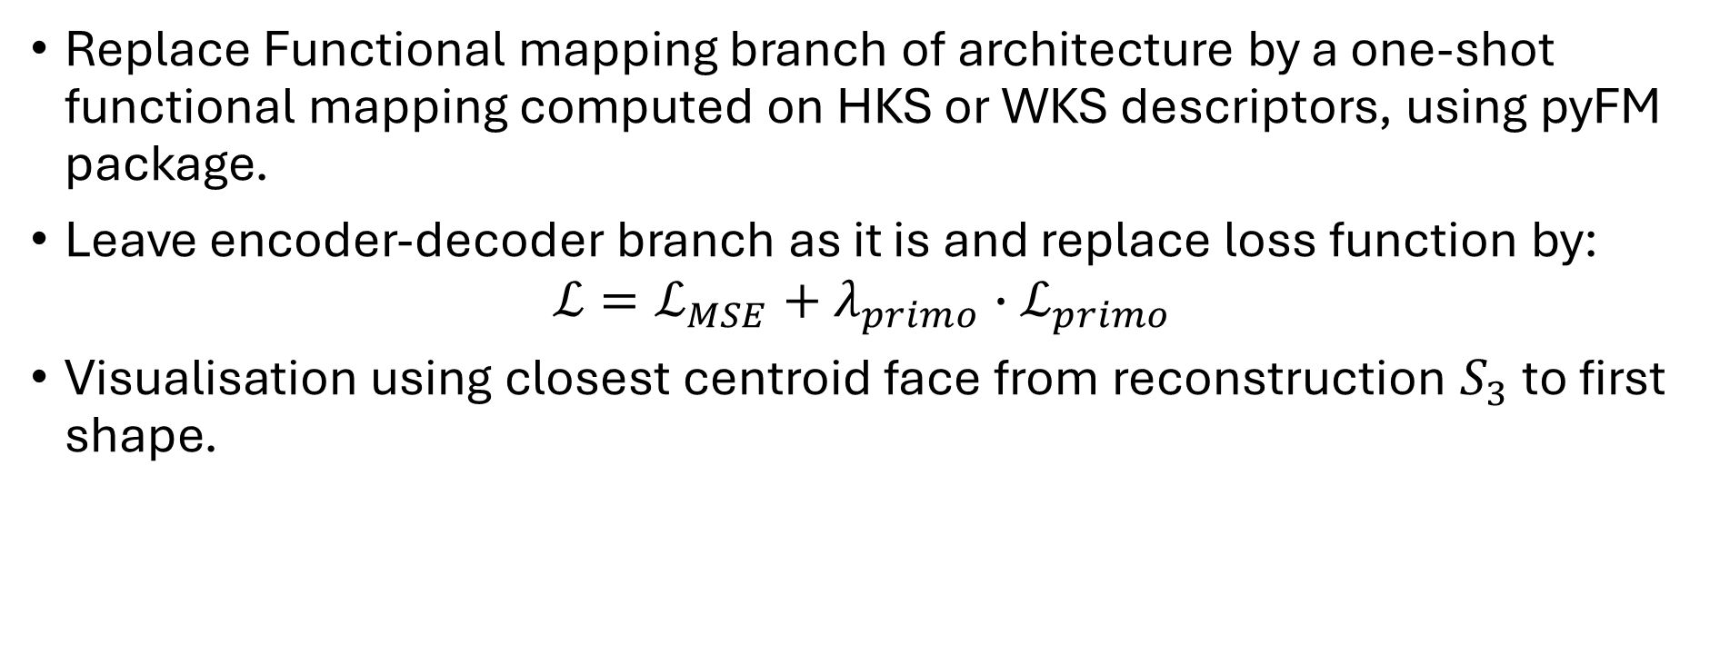
New Version
Replace Functional mapping branch of architecture by a one-shot functional mapping computed on HKS or WKS descriptors, using pyFM package.
Leave encoder-decoder branch as it is and replace loss function by:
$$ℒ=ℒ_{MSE}+λ_{primo}∙ℒ_{primo}$$
Visualisation using closest centroid face from reconstruction $S_{3}$ to first shape.
Shape 1:
Closest face matching from Shape 3
Shape 2:
Original faces with WKS descriptors
Shape 3:
Reconstruction of shape 1 following descriptors of shape 2 (from decoder)

Slide 10
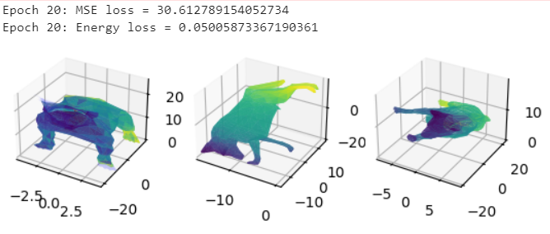
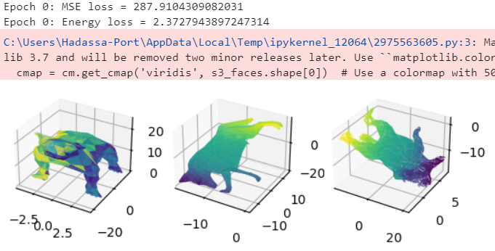
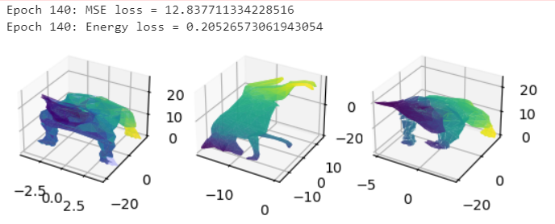
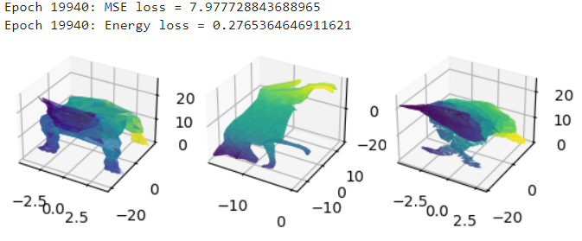
New Version - Visualization
Much better results in a few (and faster) iterations!

Slide 11
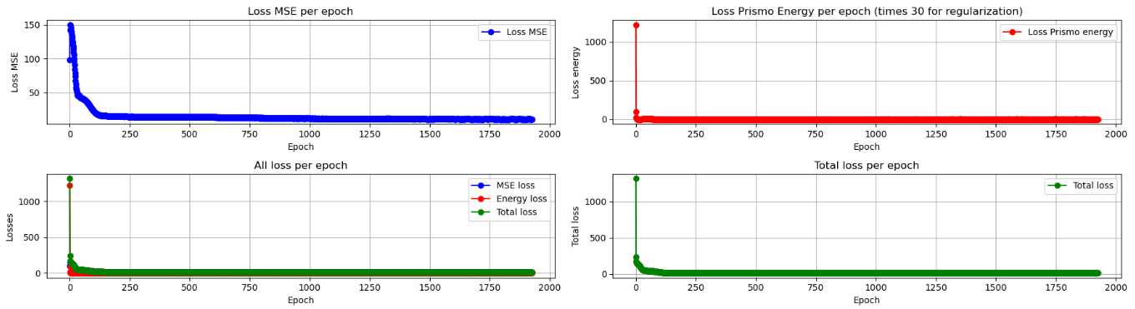
New Version – Visualization of losses
Convergence of losses:

Slide 12
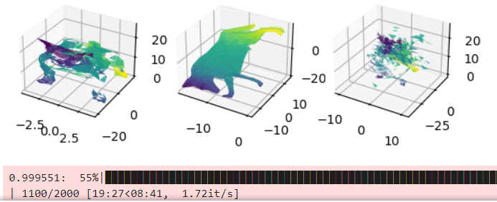
Failed experiments
I also investigated some modifications to the decoder architecture – which ended in failure:
Replace MLP with residual connections and GELU activations
Remove energy loss function

Slide 13
Contributions
Implementation of partial pipeline of architecture (not available by time of project) with adequate training process.
SNK_pipelined_CloseToPaper.ipynb
Experiments on different settings (ResNet, descriptors, hyper-parameters tuning, regularization tuning, ablation study of losses, optimizers,…).
Implementation of new, simpler but effective version of model (with adequate training process).
SNK_pipelined_new_version.ipynb
Implementation of efficient visualization methods for face matching.
Fix and modify existing modules for compatibility and filling gaps.
loss.py model_SURFMNet.py prism_decoder.py

Slide 14
References:
Attaiki and Ovsjanikov 2024: Shape Non-rigid Kinematics (SNK): A Zero-Shot Method for Non-Rigid Shape Matching via Unsupervised Functional Map Regularized Reconstruction
Sharp et. al. 2022: DiffusionNet: Discretization Agnostic Learning on Surfaces
Roufosse et. al. 2019: Unsupervised deep learning for structured shape matching
Mario Botsch et. al. 2006: PriMo: Coupled Prisms for Intuitive Surface Modeling

Slide 15
Thank you ☺

