Slide 1
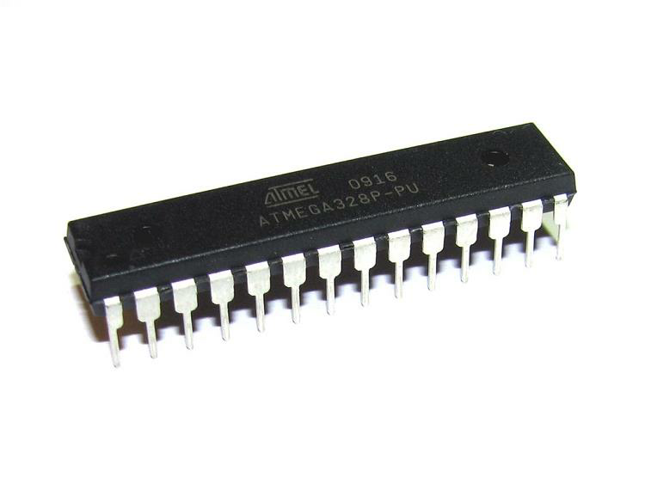

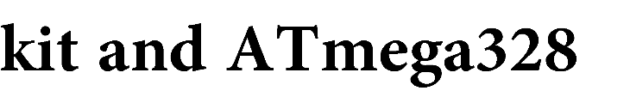

University: University Ferhat Abbas – Sétif1
Institute : science and Technology
Department : Electrotechnique
OPTION : MASTER IN AUTOMATIC CONTROL
Mini-project :
Supervisor : Dr. MOKEDDEM D.
:MESSAI Oussama
Par : MESSAI Oussama

Slide 2
- Introduction to microcontrollers
- Arduino uno kit with ATmega328p microcontroller
- Ultrasonic sensor HC-SR04
- Automatic door system with LED ( electronic circuit )
- Function mode
- The Tasks
- Arduino programming Code
- Comment or Conclusion

Slide 3
Introduction :
Microcontroller is a small computer on a single integrated circuit containing
a processor core, memory, and programmable input/output peripherals.
Program memory in the form of Ferroelectric RAM .
Microcontrollers are used in automatically controlled products and
devices, such as automobile engine control systems, implantable
medical devices, remote controls, office machines, appliances, power
tools, toys and other embedded systems.

Slide 4
Arduino uno kit with ATmega328p microcontroller :
The Arduino Uno is a microcontroller board based on the ATmega328 It
has 14 digital input/output pins (of which 6 can be used as PWM
outputs), 6 analog inputs, a 16 MHz ceramic resonator, a USB
connection, a power jack, an ICSP header, and a reset button. It
contains everything needed to support the microcontroller; simply
connect it to a computer with a USB cable or power it with a AC-to-DC
adapter or battery to get started.

Slide 5
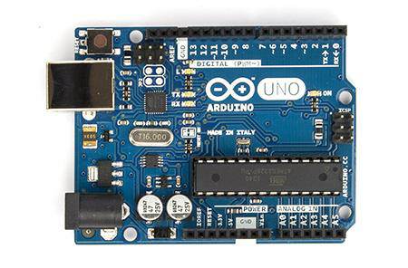
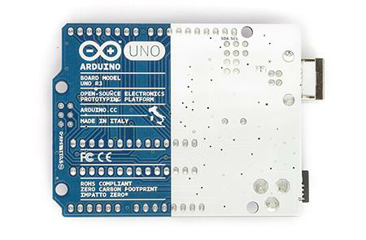
Microcontroller ATmega328
Operating Voltage 5V
Input Voltage (recommended) 7-12V
Input Voltage (limits) 6-20V
Digital I/O Pins 14 (of which 6 provide PWM output)
Analog Input Pins 6
DC Current per I/O Pin 40 mA
DC Current for 3.3V Pin 50 mA
Flash Memory 32 KB (ATmega328) of which 0.5 KB used by bootloader
SRAM 2 KB (ATmega328)
EEPROM 1 KB (ATmega328)
Clock Speed 16 MHz
Length 68.6 mm
Width 53.4 mmS

Slide 6
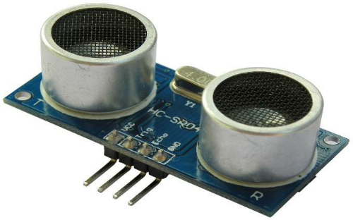
Ultrasonic Sensor :
Ultrasonic ranging module HC - SR04 provides 2cm - 400cm non-contact
measurement function, the ranging accuracy can reach to 3mm. The
moduleincludes ultrasonic transmitters, receiver and control circuit.
The basic principle of work :
(1) Using IO trigger for at least 10us high level signal,
(2) The Module automatically sends eight 40 kHz and detect whether there is a
pulse signal back.
(3) IF the signal back, through high level , time of high output IO duration is
the time from sending ultrasonic to returning
Electric Parameter :
Working Voltage DC 5 V / Working Current 15mA
Working Frequency 40Hz
Max Range 4m / Min Range 2cm
MeasuringAngle 15 degree

Slide 7
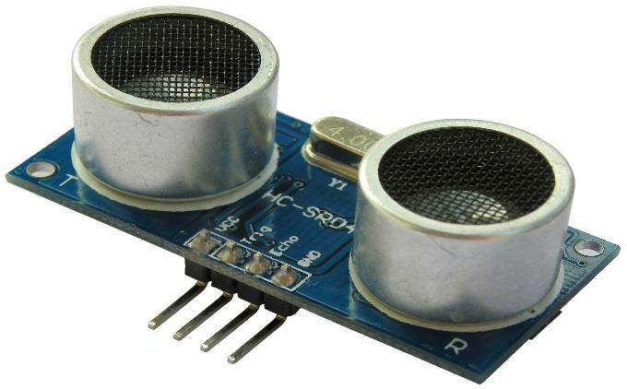
- 5V Supply
- Trigger Pulse Input
- Echo Pulse Output
- 0V Ground
Electric Parameter :
Working Voltage DC 5 V / Working Current 15mA
Working Frequency 40Hz
Max Range 4m / Min Range 2cm
MeasuringAngle 15 degree

Slide 8
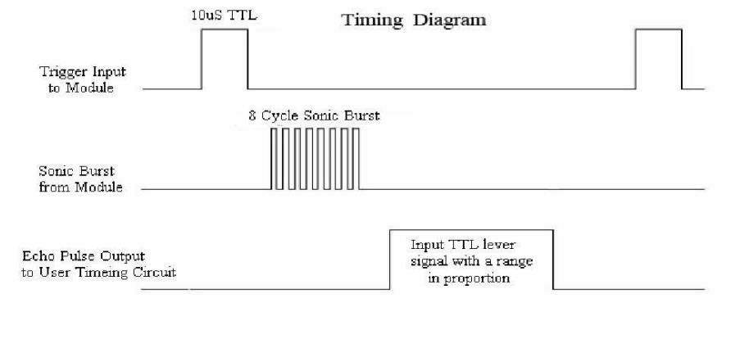
Timing diagram :
The Timing diagram is shown below. You only need to supply a
short 10uS pulse to the trigger input to start the ranging, and then the module
will send out an 8 cycle burst of ultrasound at 40 kHz and raise its echo. The Echo
is a distance object that is pulse width and the range in proportion .You can
calculate the range through the time interval between sending trigger signal and
receiving echo signal. Formula: uS / 58 = centimeters or uS / 148 =inch; or: the
range = high level time * velocity (340M/S) / 2; we suggest to use over 60ms
measurement cycle, in order to prevent trigger signal to the echo signal.

Slide 9
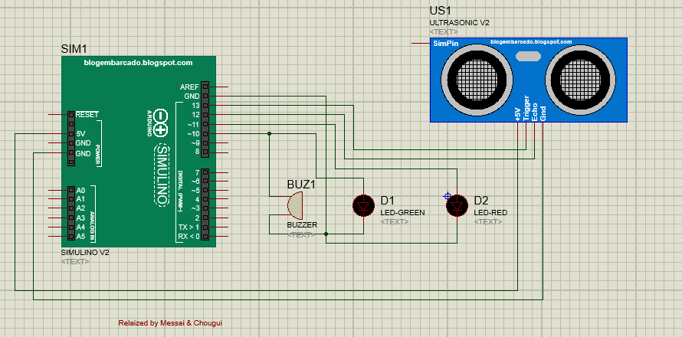
Automatic door system with LED ( electronic circuit ) : this is
the circuit of our system realized with LED instead of DC motor
The concept still the same .

Slide 10
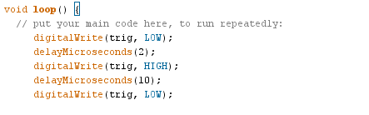

Function mode: we have three Modes in this simple system we
can divide to Cycle, Event and Mixt
Cycle : Sending periodic signal over and over from trig OUTPUT
Event : Waiting for the signal return, receiving from echo INPUT
Mixt : sending and receiving the signal , And display the
distance on LED also play a sound if obstacle was detected

Slide 11
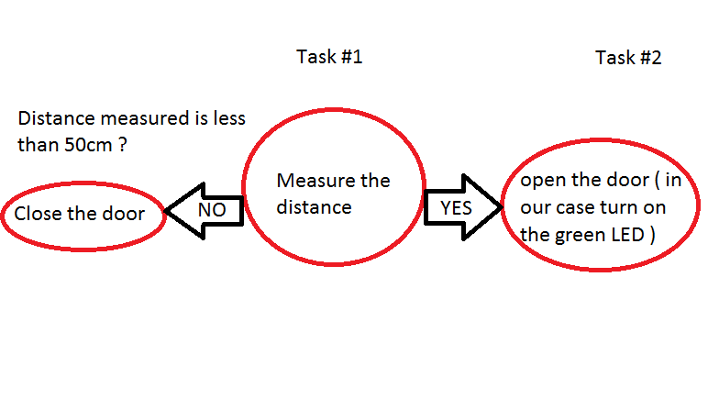
The Tasks :
First Tasks : #1 Measure the distance and display it on the Red
LED
Second tasks : #2 Detect the obstacle (human) under 50cm of
distance and open the door or power on the green LED
How it’s work ?
When the distance measured is less than 50cm means that
there is obstacle in the range of 0-50 cm from the ultrasonic
sensor ( door )
N.B : I added the buzzer parallel with the green LED

Slide 12
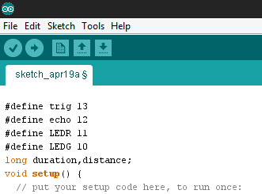
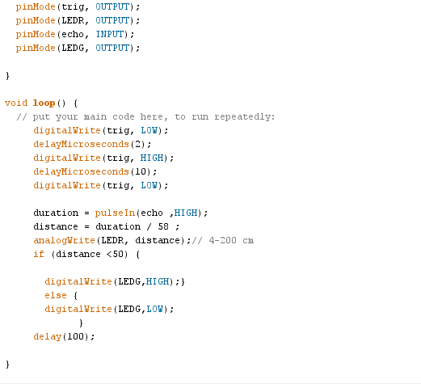
The Programme :

Slide 13
Comment : ( Conclusion )
Arduino is intended for use by both non-technical people with no previous programming experience , So any one of You can realize useful project using this Kit ☺
a lot of ideas in your head that you can make them come true in easily way with some component , even that you are not proficient electronic circuit.
Waiting For Your Projects :P ☺

Slide 14
Any Questions ? ☺
Thank You

