Slide 1
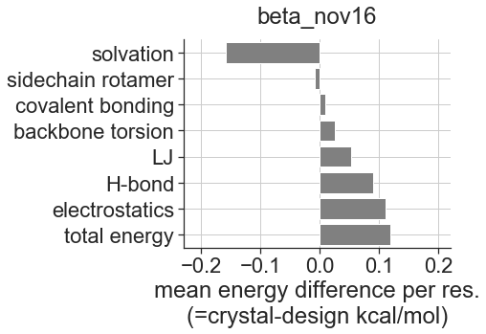
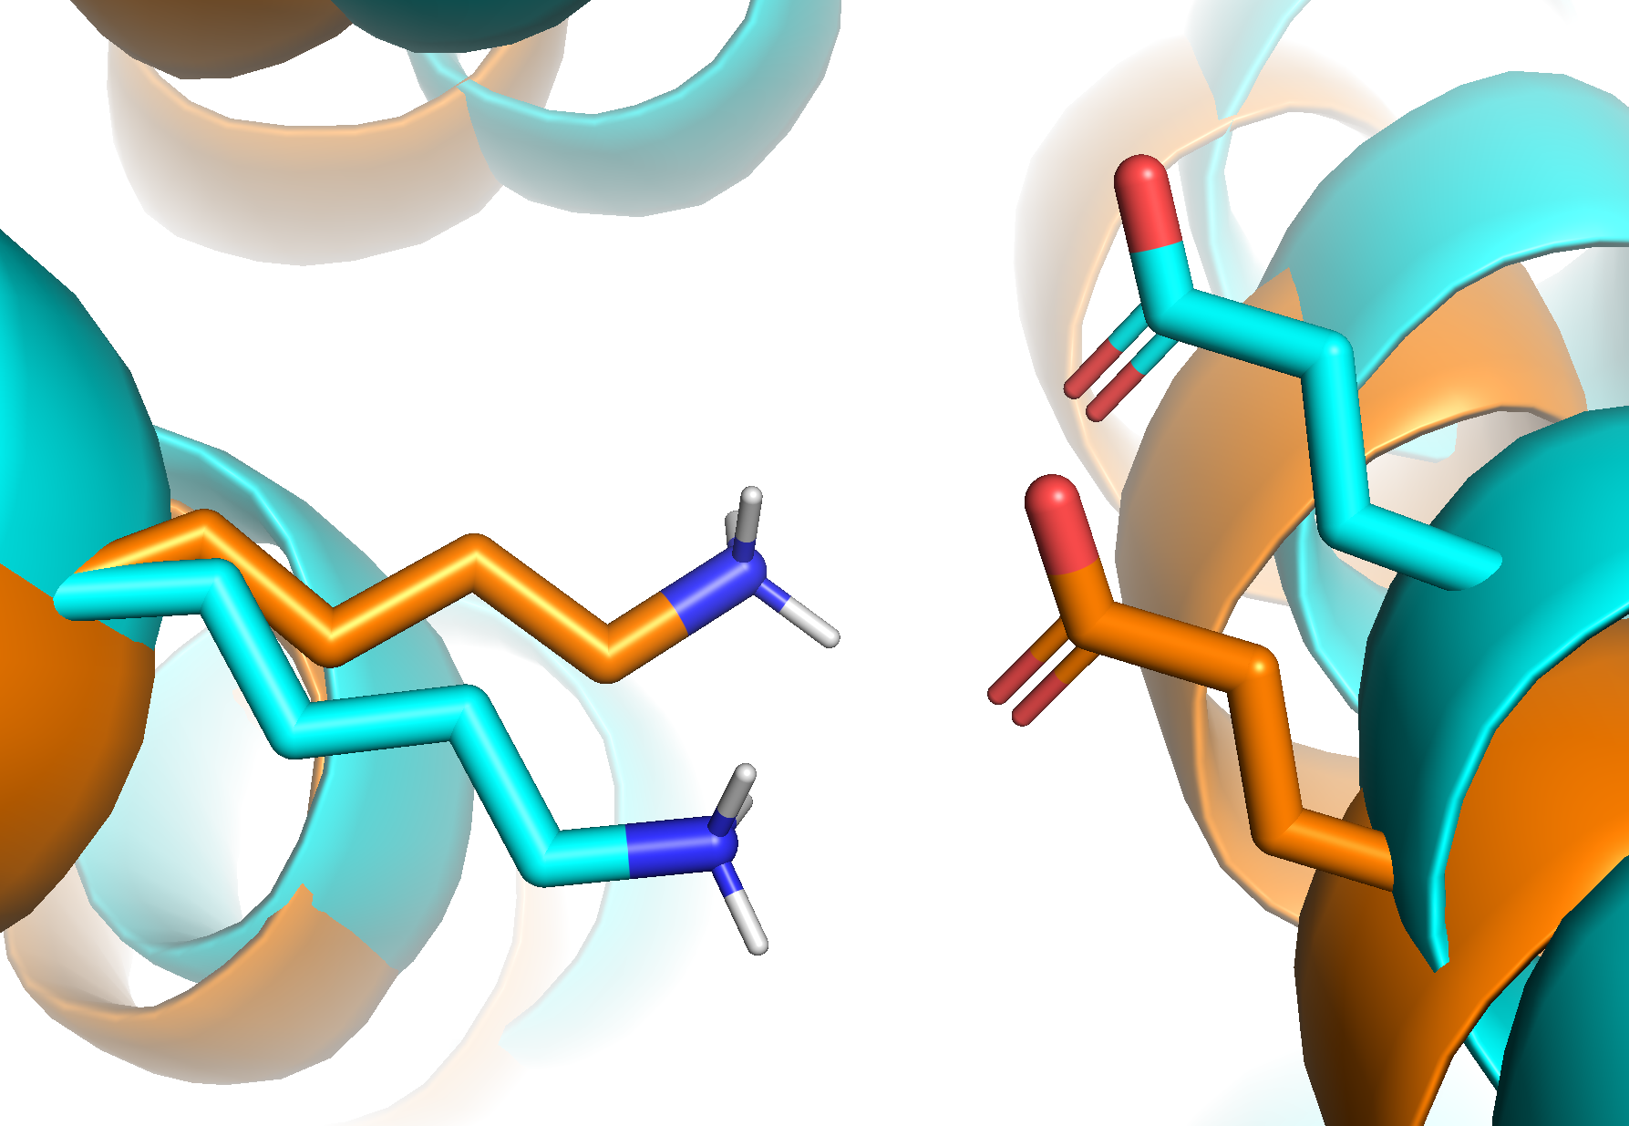
A
B
relaxed crystal
relaxed design
Δ electrostatics = 5.1 kcal/mol

