Slide 1
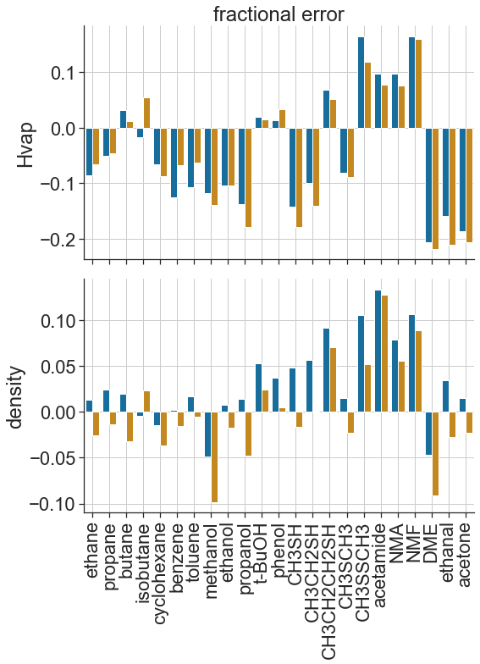
A
B
 | average fractional error
energy function | Hvap | density
beta_nov16 | 0.10 | 0.04
beta_jan22 | 0.10 | 0.04
beta_nov16
beta_jan22

