Slide 1

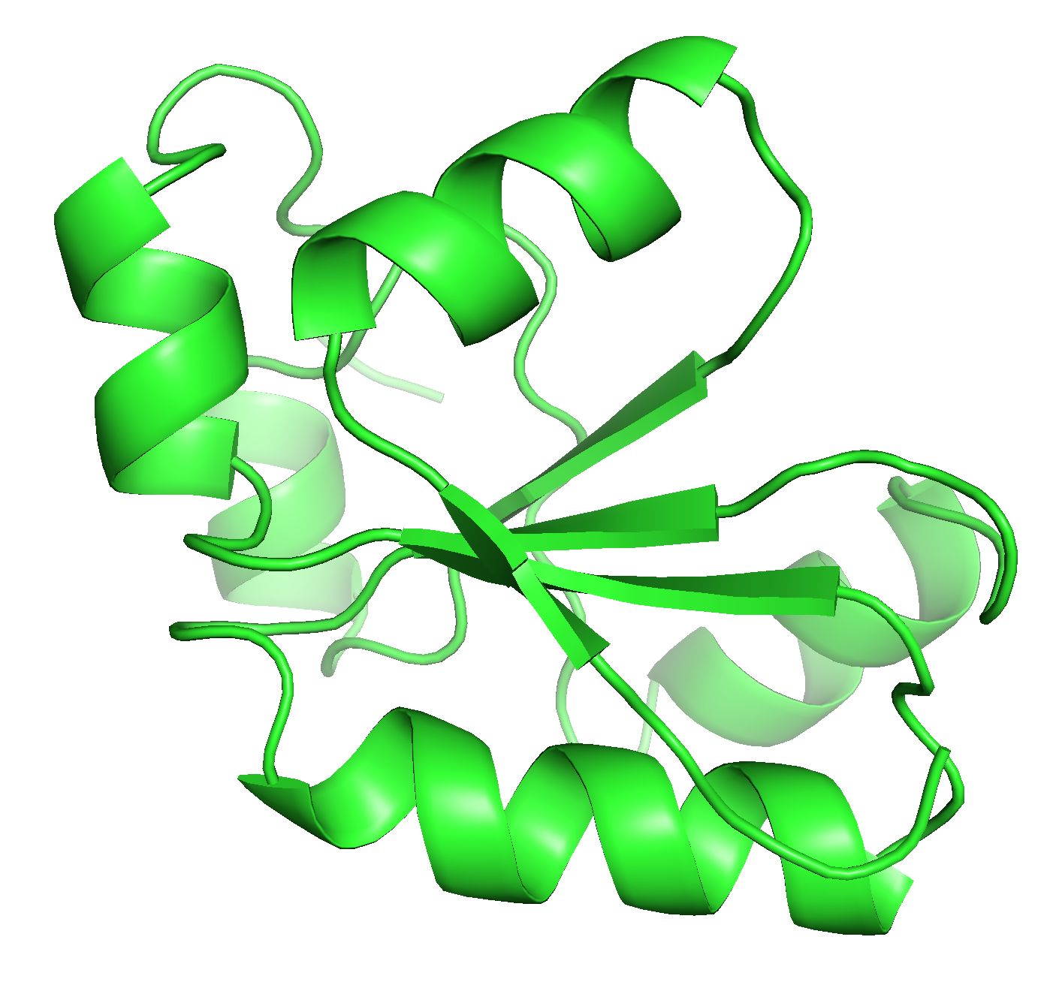
Top track: direct reparameterization using experimental data on designs
Experimental data on designs
Update energy function
Bottom track: use experimental data on designs to identify problems; reparameterization on high-quality benchmarks
Detect recurrent failure mode
Identify corresponding failure in high-quality benchmarks
e.g., steric clashing
e.g., relaxing high-resolution crystal structures

