Slide 1
Online Shopping Intention Analysis
Hadeel Alraddadi

Slide 2
outline
Online Shopping Intention Analysis
Introduction.
Dataset
Algorithms
Conclusion.

Slide 3
Introduction
e-commerce :
Statistics for online sales :
Aim :

Slide 4
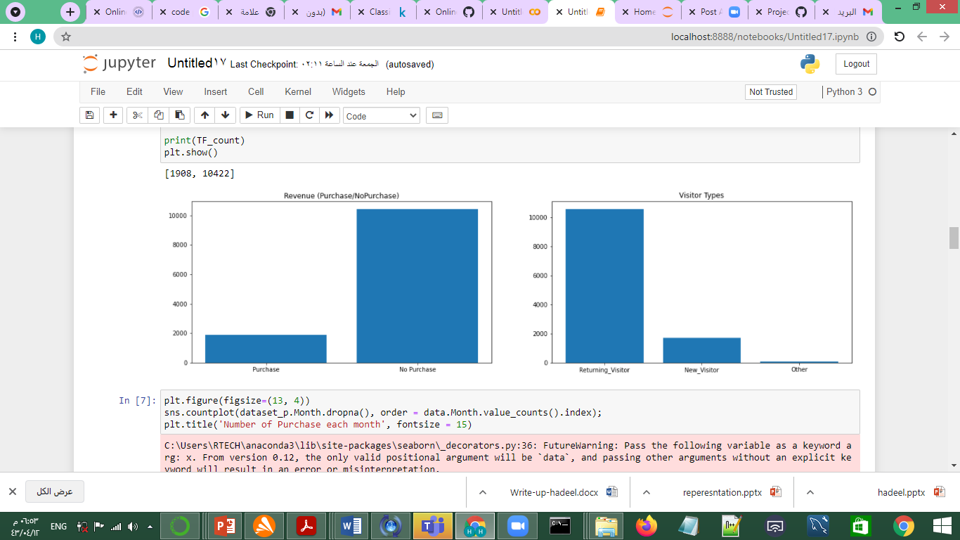
preprocessing
Notes:
Explain idea
motivation
Twitter features

Slide 5
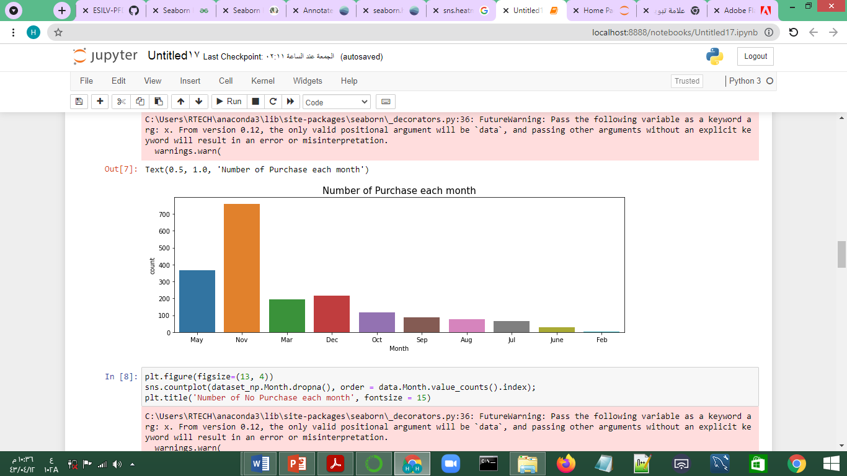
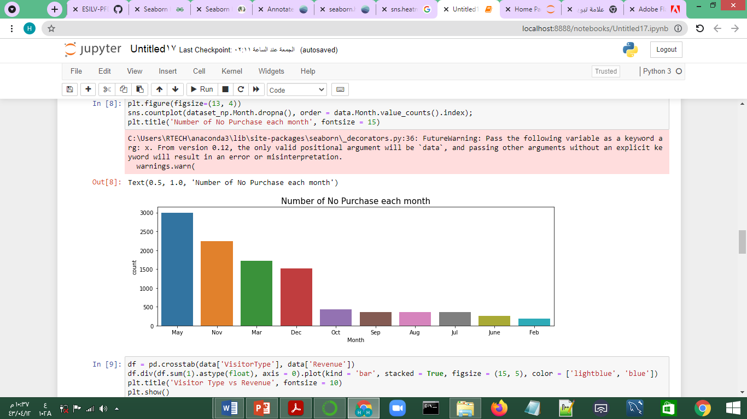
preprocessing
Notes:
Explain idea
motivation
Twitter features

Slide 6
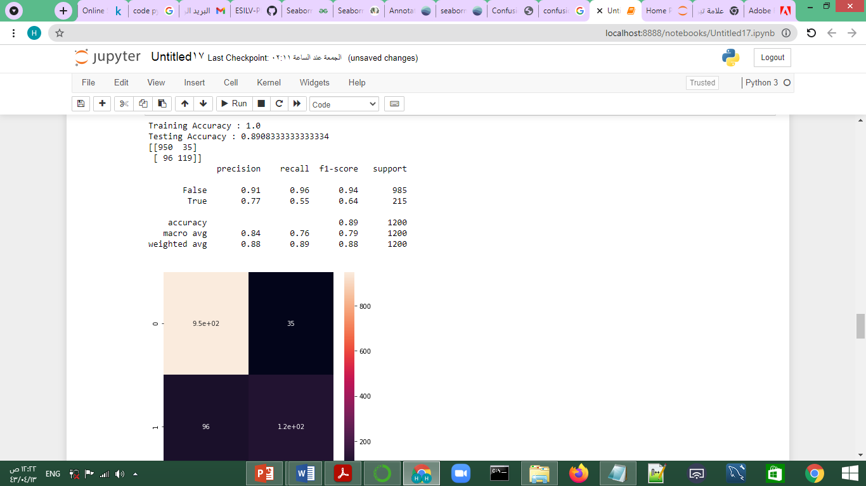
Random forest
Random forest performance

Slide 7
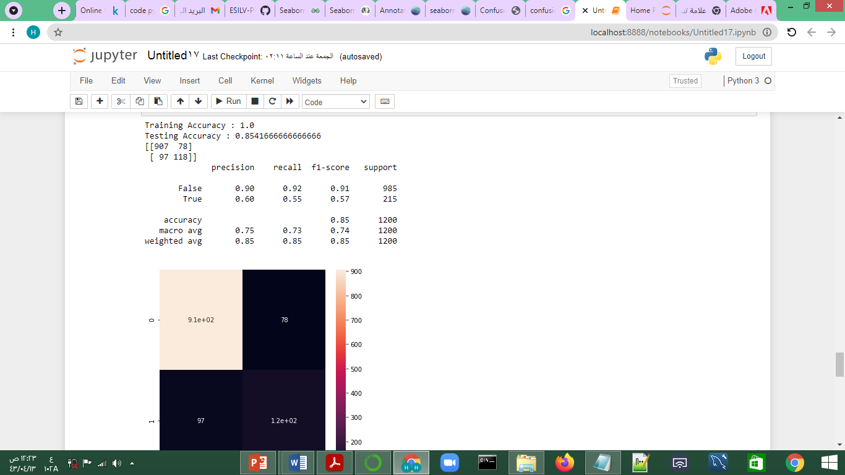
Decision Tree
Decision Tree performance

Slide 8

Logistic Regression
Logistic Regression performance

Slide 9
Conclusion.
By using a random forest classifier, we are able to achieve approximately 89% accuracy.

Slide 10
Thank you for listening.

