Slide 1


Capstone1
Hadeel-aldawsari

Slide 2

My End Point
I chose to make the end points specific to the customer's journey with his order. All the methods revolve around managing and handling orders, whether by the customer or the admin

Slide 3

Add To Cart
Create order
Admin handel order
Customer request for refund
Admin Confirm
refund request

Slide 4

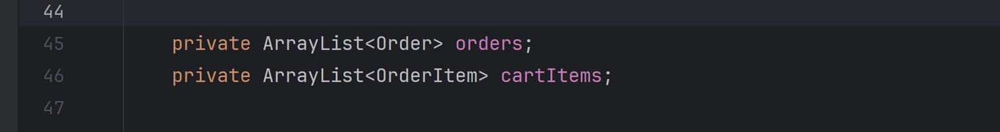
Add To Cart
Order item Model:
{ "id":"102",
"quantity":1}
Create order
User Model:
Admin handel order
Cart Service:
Customer request for refund
-check user exist
-check product if exist by order item
-check if product if out of stock
-check if the quantity is enough
Admin Confirm
refund request

Slide 5
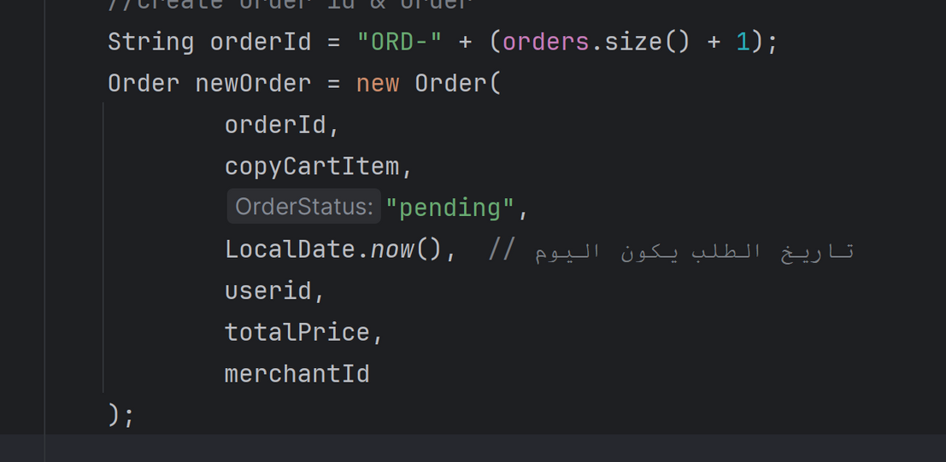
OrderService
Add To Cart
-get cart item and calculate the totals price
-check user balance
-deducted user balance
-reduce stock depending of the quantity
-create the order and add it to orderlist of the app + orderlist of user
-clear cart list
Create order
Admin handel order
Customer request for refund
Admin Confirm
refund request

Slide 6
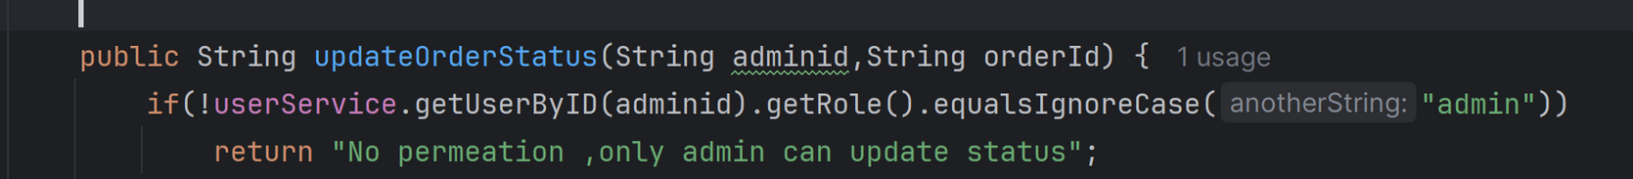
Add To Cart
Admin service
Create order
Admin handel order
-pending|progressing|delivered
Customer request for refund
Admin Confirm
refund request

Slide 7
Add To Cart
User service
Create order
Admin handel order
-The order status should be delivered
Customer request for refund
-if the validation done the status will be refund requested
Admin Confirm
refund request

Slide 8
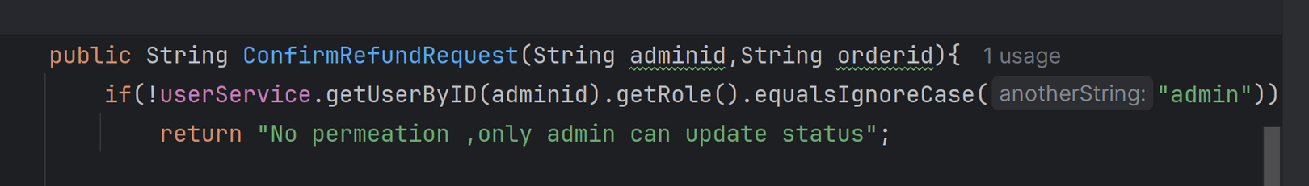
Add To Cart
Admin service
Create order
Admin handel order
-The order status will change to be refunded
Customer request for refund
-The list item in order will restock
-The balance of the user will be recharged
Admin Confirm
refund request

Slide 9
Thank you
Capstone1

