Slide 1
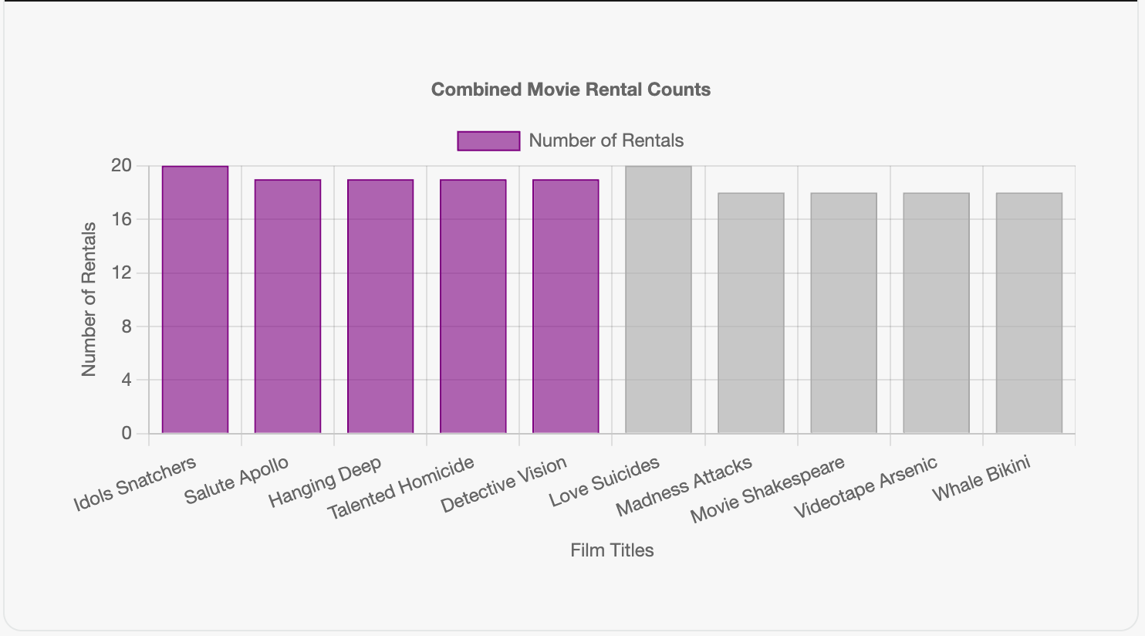
Q1) Which films are most frequently rented at each store?
<Love Suicides in store '1' and Idols Snatchers in store '2' have the highest number of rentals with a rental count of 20. based on the High demand for these films suggests stores should maintain adequate copies to meet customer needs. and also analysing rental patterns helps stores make informed decisions about future acquisitions and promotions based on customer preferences. correct '>

Slide 2
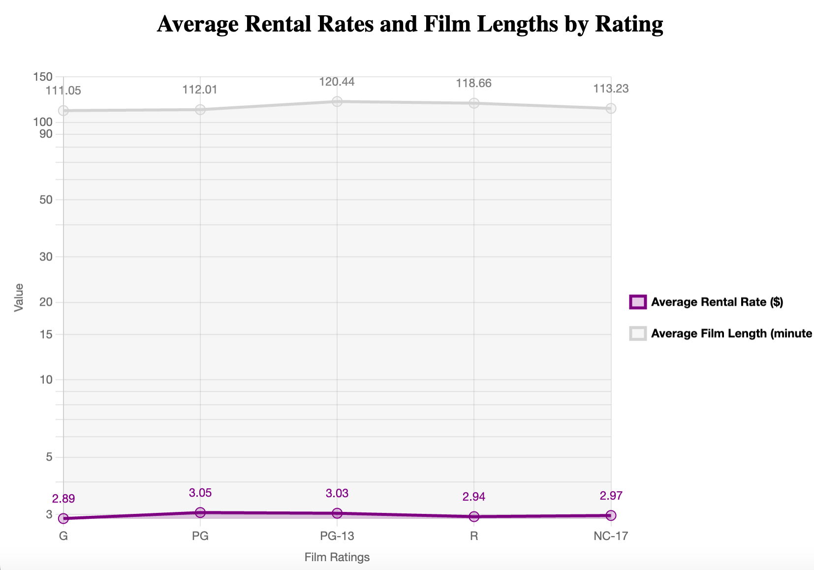
< Q2) How does the average rental rate vary across different film ratings, and is there a noticeable trend in rental rates in relation to film length? >
<
The chart indicates that average rental rates are stable across film ratings, ranging from $2.89 to $3.05 for G to NC-17 ratings, with no significant fluctuations. Meanwhile, average film lengths show a slight upward trend, peaking at 120.44 minutes for PG-13 films. However, the weak correlation between rental rates and film lengths suggests that rental pricing is not significantly influenced by film length. Overall, while film lengths increase slightly with higher ratings, rental rates remain consistent.>

Slide 3
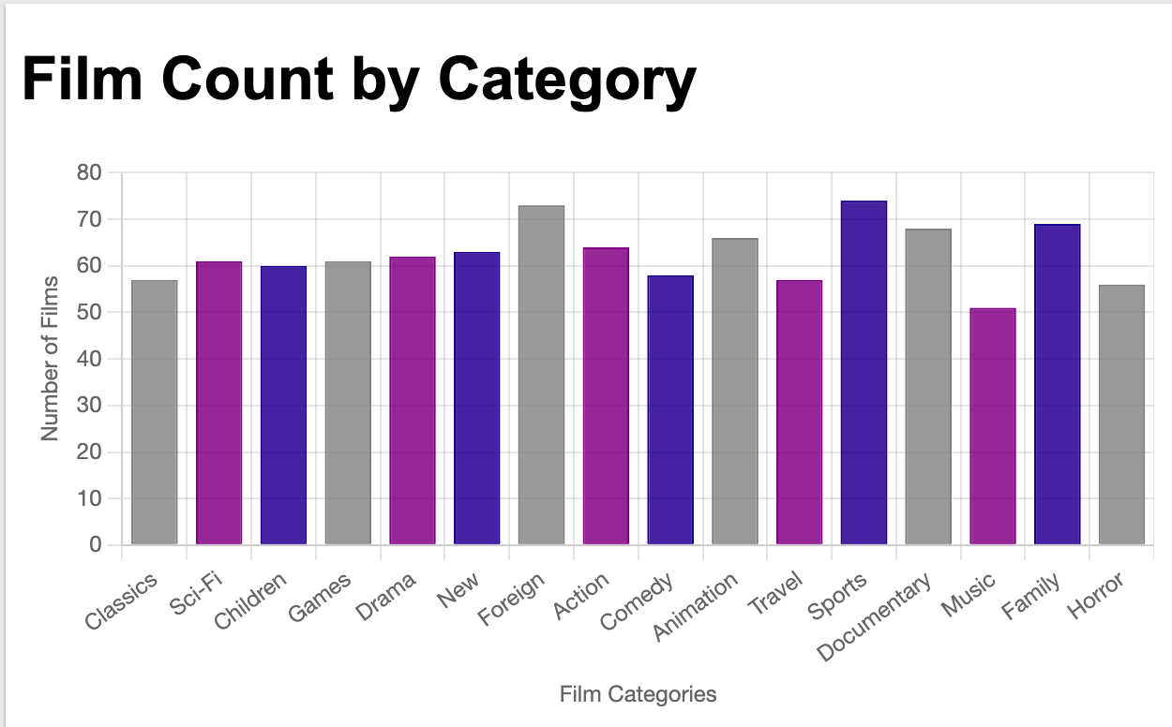
< Q3) How many films I have in each category and Which film category has the highest number of films? >
< According to the visualization The film counts by category are: Classics (57), Sci-Fi (61), Children (60), Games (61), Drama (62), New (63), Foreign (73), Action (64), Comedy (58), Animation (66), Travel (57), ,Documentary (68), Music (51), Family (69), and Horror (56)"
"Sports" category has the highest number of films, totalling 74>

Slide 4
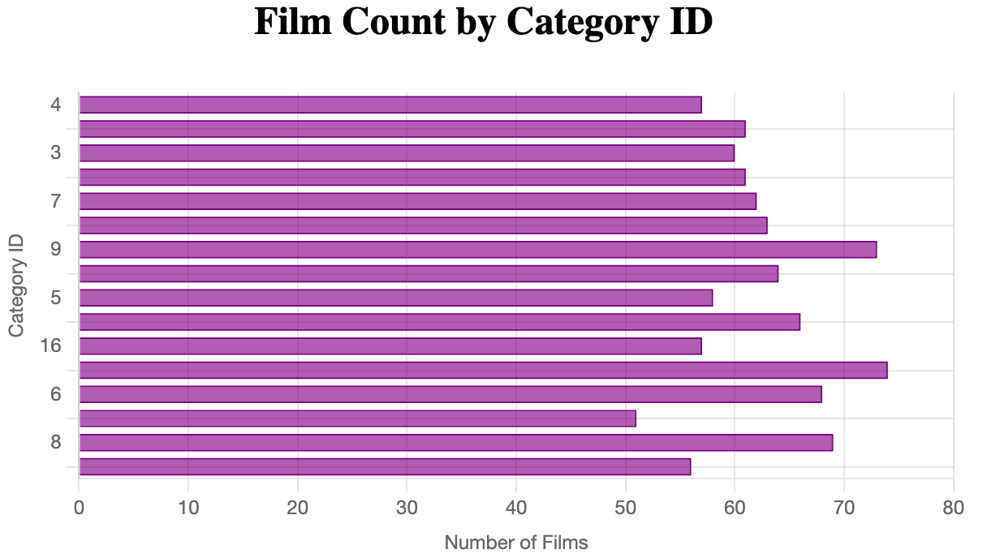
Q4) How does the distribution of film counts vary across different category IDs in the dataset? >
<The chart displays a varied distribution of film counts across category IDs. Category ID 15 has the highest count at 74 films, while category ID 12 has the lowest at 51 films. Categories 9 (73 films) and 13 (63 films) are also notable, indicating popularity. In contrast, categories 12 and 4 show lower representation, suggesting areas for growth or reduced interest. Overall, the data highlights significant differences in film counts across categories, reflecting diverse production focuses.>

