Slide 1


MovieRec4
Parents
An NLP-Based Recommender System
Yuki Hadeishi
yuki@openmind.com
linkedin.com/in/yuki-hadeishi/
Notes:
Welcome and Zumba! My capstone project was the construction of an NLP-based recommender system I call MovieRec4Parents.

Slide 2
The Problem
Parents are busy people
Kids need entertainment
Notes:
The central problem that inspired this project...

Slide 3
Problem statement
Parents need an easy-to-use recommender system that will send them to entertainment the entire family can enjoy--- without exposing their children to objectionable material.
Notes:
Family standards...

Slide 4
What parents do today
Consult the Web:
Common Sense Media
commonsensemedia.org/movie-reviews
Kids In Mind
Kids-in-mind.com
Rotten Tomatoes
rottentomatoes.com/browse/opening
Notes:
Common sense media--- reviews, information for parents about potentially objectionable material, rating on generally a 5 point scale on such things as sex, violence, commercialism, educational value…
Tomatometer… Tomato-meter?

Slide 5
MovieRec4Parents’ Approach:
Build a recommender based on words used in movie info
8625 movies’ info scraped from Common Sense Media
NLP conducted on text:
Count vs. TF-IDF Vectorization to form word tokens
Truncated SVD to reduce dimensionality
Build cosine similarity matrix
Non-text features used to filter movie results
Notes:
Describe Common Sense Media: web page for each movie with a few paragraphs of information--- general description of the movie, What Parents Need to Know, summaries of potentially objectionable material i the movie along with 5 point ratings on various measures important to parents…
Discuss the journey--- took text, turned it into individual word vectors, Term Frequency-Inverse Document Frequency--- how frequently the term occurs, controlling for the frequency in the whole corpus. Gives a better measure of how important the terms are.
Truncated SVD, way of abtracting out how word usage overlaps in movie reviews…
Then, built cosine similarity matrix to establish how similar different movies are to one another, based on the frequency with which words are used in movie reviews.

Slide 6
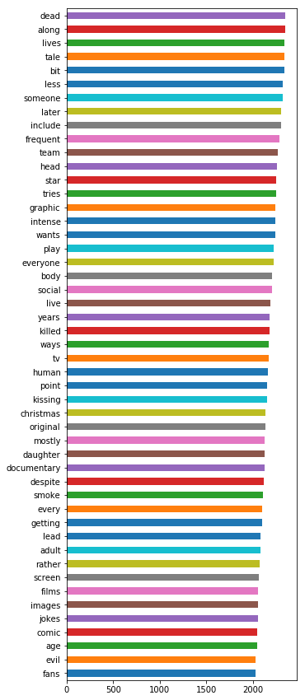
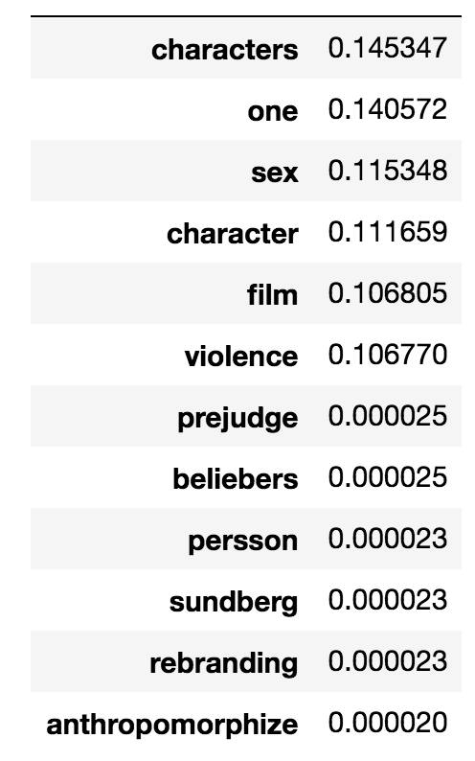
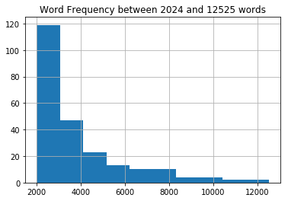
Natural Language Processing
Component 1
Notes:
Here we see a summary of some of the text analysis that went into this project. First, I analyzed the word frequency of some of the features by sheer count. This revealed that some words occurred at high frequency across many movies, such as the word “movie”, and so are informationally uninformative. OTOH, some words accurred with high frequency buy preferentially only in certain movies. To pay attention specifically to these words frequres

Slide 7
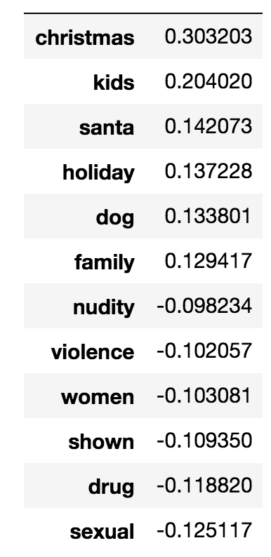
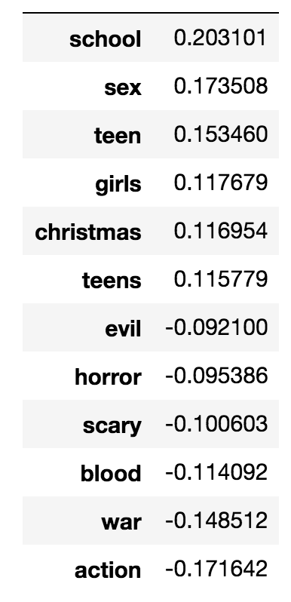
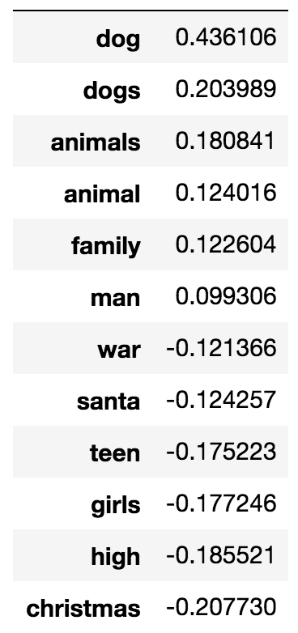
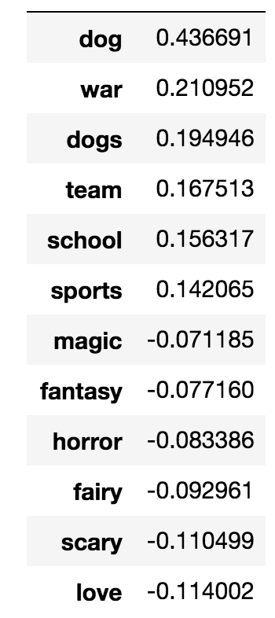
Natural Language Processing
Component 2
Component 3
Component 6
Component 8
Notes:
Here we see a other components that emerged from Truncated SVD.

Slide 8
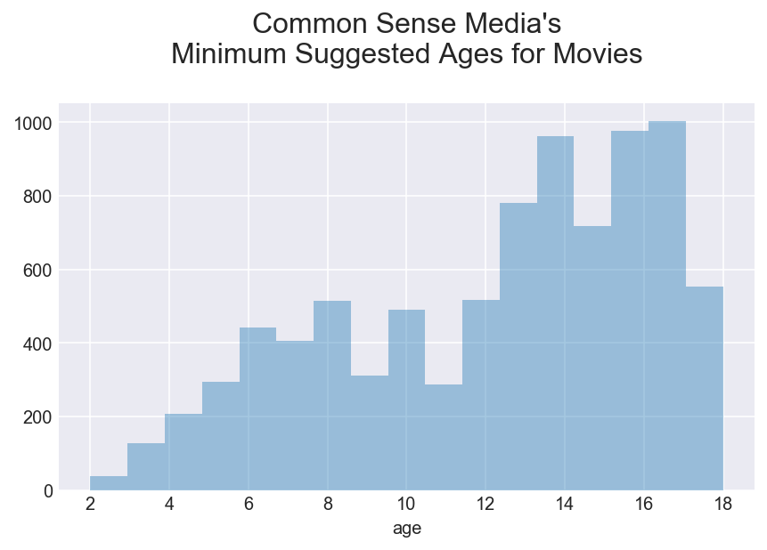
Notes:
“Non-Text” Data Analysis

Slide 9
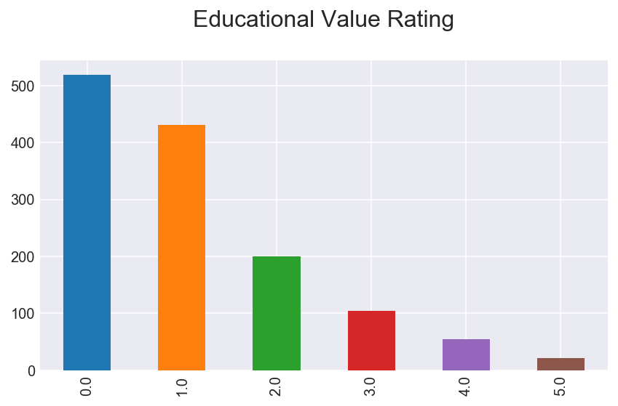
Notes:
There are a number of parent ratings for various thingds of important to parents WRT movies… Educational Value, Sexy Stuff, Violence and Scariness… for tweens and teens, those are called Sex and Violence

Slide 10
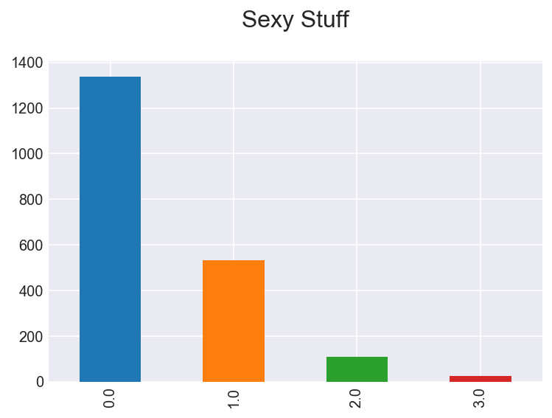
Notes:
“Non-Text” Data Analysis

Slide 11
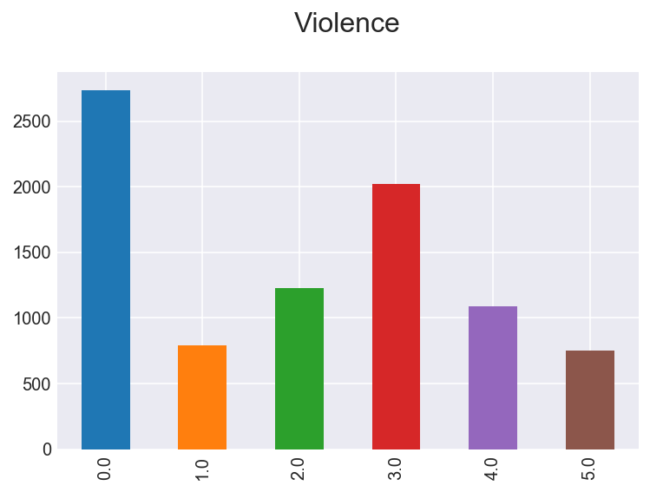
Notes:
At least there are some films that are rated 0 on the Violence scale, even today...

Slide 12

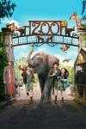
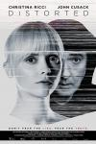


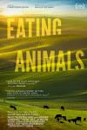


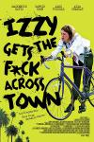
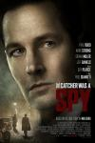

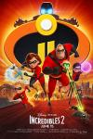

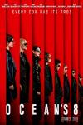

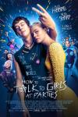
Try MovieRec4Parents!
Notes:
That said, movies are fun!
Hollywood...

Slide 13
Future Directions:
Update movie selection
Give a link to Common Sense Media
Join non-text data to feed cosine similarity matrix
Include more reviews from Common Sense Media and other sites
Collect user preferences, build collaborative recommender
Refine NLP: leverage sentiment and/or topic analysis
Bridge to other entertainment options

Slide 14
Questions?

