Slide 1
Cloud Computing
Presented By,
Yashwanth S
4VV22CS189

Slide 2
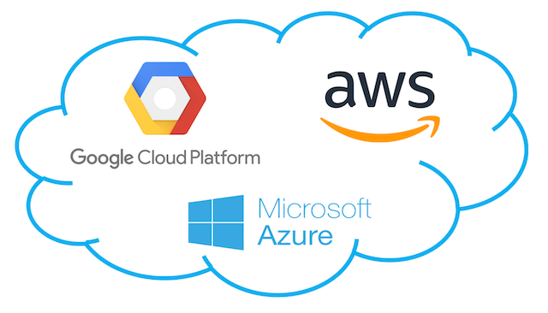
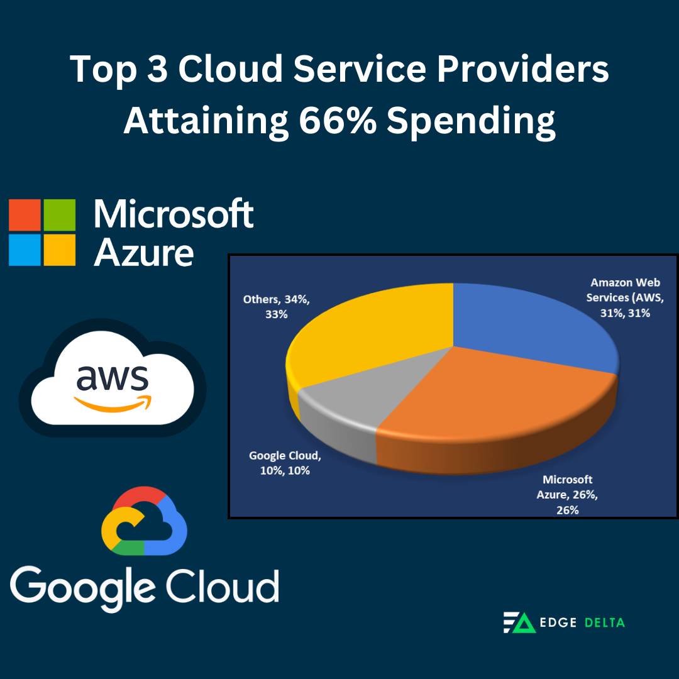
WHAT IS CLOUD COMPUTING.?
Cloud computing is the delivery of computing services over the internet ("the cloud") to provide faster innovation, flexible resources, and economies of scale. Instead of owning and maintaining physical hardware or data centers, individuals and organizations can access and use resources such as servers, storage, databases, networking, software, and analytics on-demand.
Key Features of Cloud Computing
On-Demand Self-Service
Broad Network Access
Resource Pooling
Scalability
Measured Service

Slide 3

BENEFITS OF CLOUD COMPUTING
Security
Performance
Recovery
Cost Efficiency
Flexibility

Slide 4
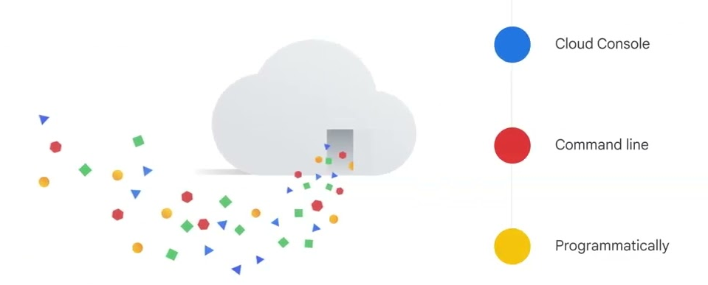
CYMBAL SUPERSTORE'S CLOUD SOLUTION ENVIRONMENT
Cymbal Superstore utilizes a Google Cloud Solution Environment to streamline operations, improve scalability, and ensure secure management of resources. This environment supports their transition to a modern, cloud-native infrastructure.
Implementation Steps for Cymbal Superstore
Provision Resources: Allocate compute instances, storage, and database services.
Configure Security: Set IAM roles and enable encryption for data security.
Establish Networking: Create VPCs and integrate load balancing for traffic management.
Enable Monitoring: Set up dashboards for real-time performance insights.
Test and Optimize: Validate resource configuration and optimize for cost and performance.
Benefits for Cymbal Superstore
Scalable infrastructure to handle growing demands.
Enhanced data security and compliance.
Cost-efficient resource management.
Real-time insights for operational efficiency.
Notes:
Ways to interact picture

Slide 5
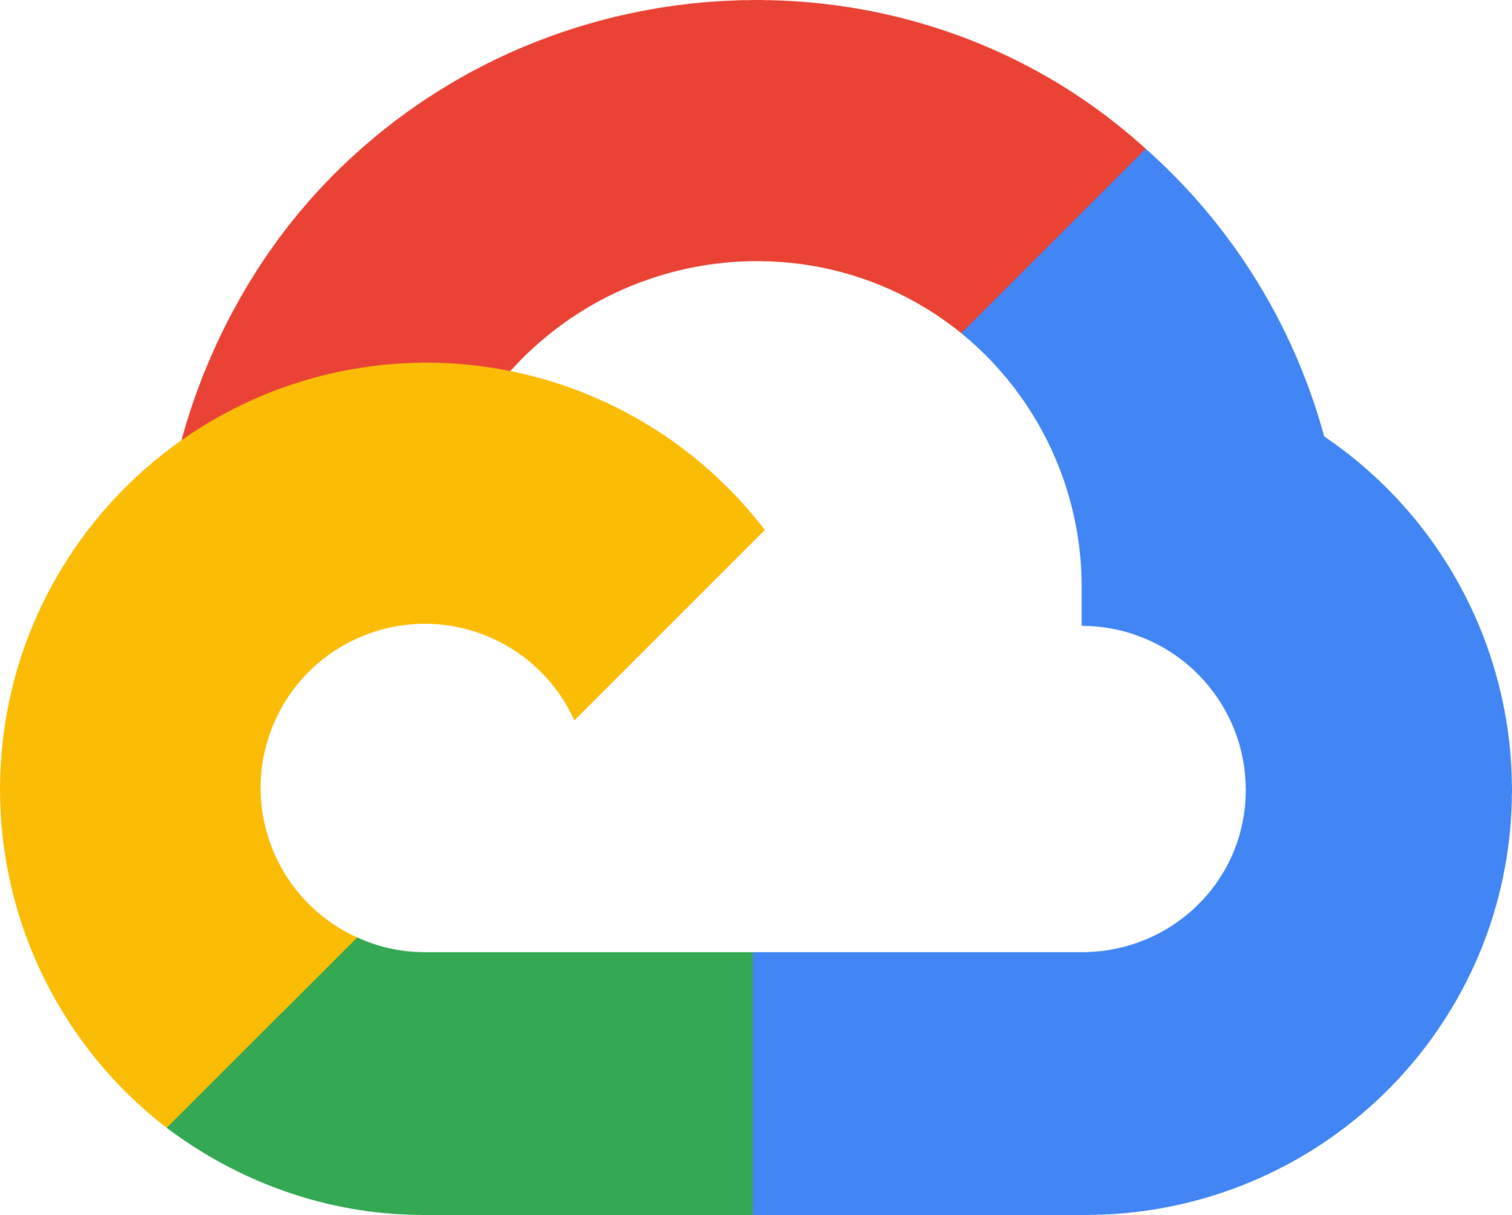
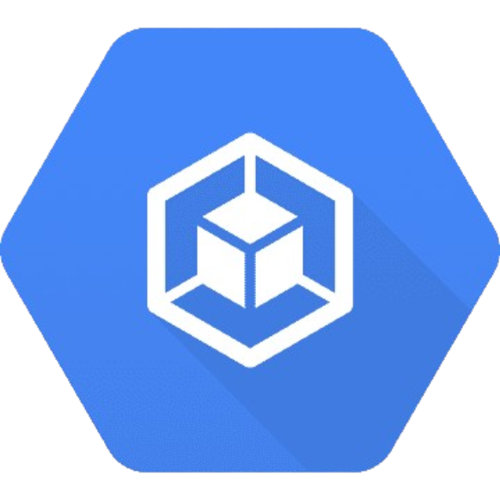
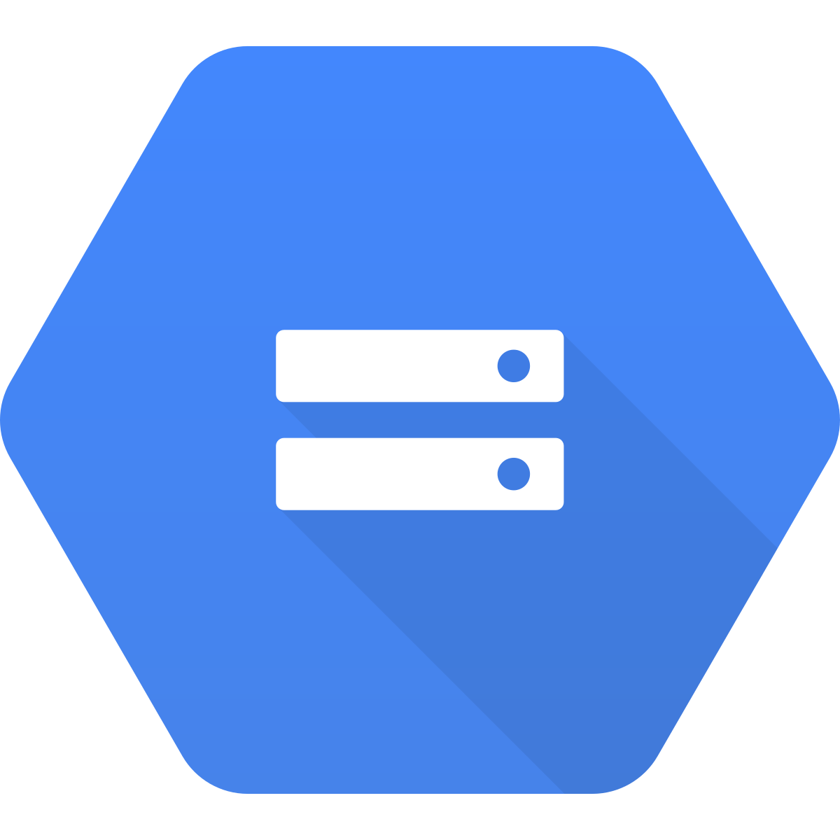
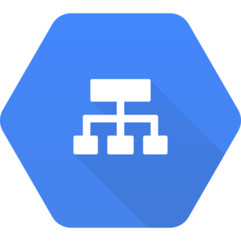
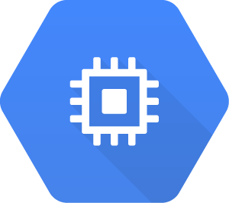

GOOGLE CLOUD FUNDAMENTALS: CORE INFRASTRUCTURE
Containers
IAM
Storage Options
Cloud Load Balancing
Cloud Engine

Slide 6
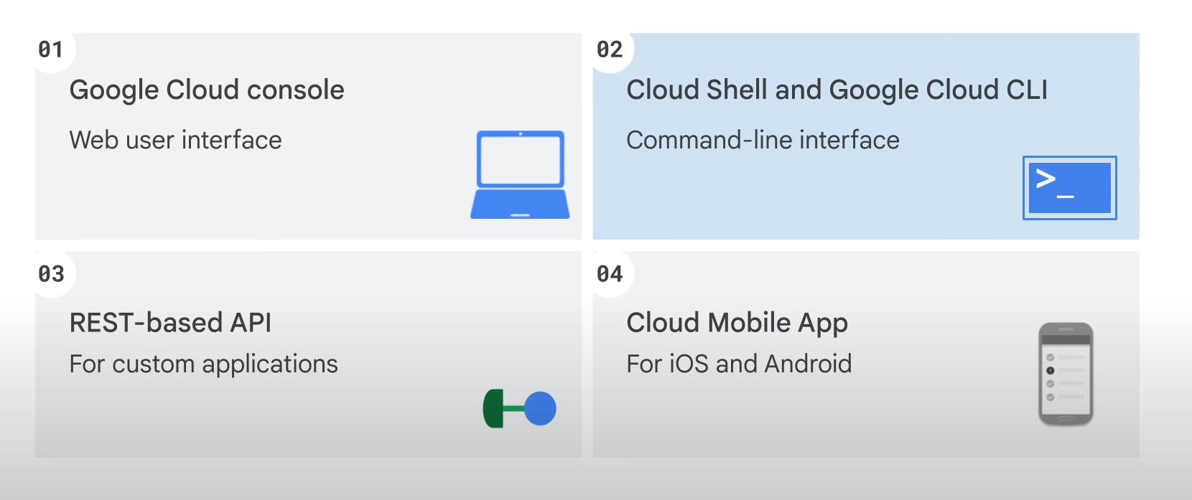
ESSENTIAL GOOGLE CLOUD INFRASTRUCTURE: FOUNDATION
Virtual Networks (VNet)
A Virtual Network is a logical representation of a network within a cloud platform, enabling secure communication between cloud resources like virtual machines, storage, and applications.
Key Features of Virtual Networks:
Isolation and Segmentation: Enables private networking for resources.
IP Address Management: Assigns internal and external IP addresses.
Network Security: Incorporates firewalls, VPNs, and network access controls.
Connectivity: Supports hybrid cloud models with on-premises integration via VPN or dedicated connections.
Benefits:
Enhanced security with isolation.
Scalability for expanding network requirements.
Flexibility to create subnets for better resource organization.
Virtual Machines (VMs)
A Virtual Machine is a software-based emulation of a physical computer, running an operating system and applications just like a traditional server.
Key Features of Virtual Machines:
Customizable Resources: Configure CPU, memory, and storage based on workload needs.
Multi-OS Support: Run Linux, Windows, or custom OS environments.
High Availability: Replication and redundancy for minimized downtime.
Snapshots and Backups: Easily create snapshots for recovery and scaling.
Benefits:
Cost-effective: Pay only for the resources used.
Scalability: Quickly scale up or down as needed.
Flexibility: Test and deploy applications without hardware constraints.

Slide 7
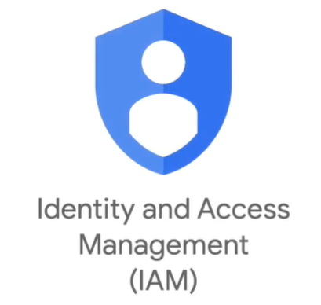
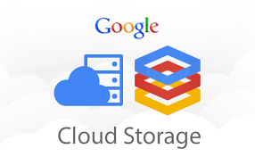
ESSENTIAL GOOGLE CLOUD INFRASTRUCTURE: CORE SERVICES
Resource Management
GCP Has 4 Core Services
Resource Monitoring involves tracking and managing the usage of resources such as CPU, memory, bandwidth, and storage in an IT environment to ensure optimal performance.
Benefits:
Real-time insights
Performance optimization
Early issue detection
Cost management
IAM (Identity and Access Management) ensures individuals have proper access to resources through identity management, access control, authentication, authorization, and activity monitoring.
Benefits:
Enhanced Security: Protects sensitive data and systems.
Compliance: Helps meet regulatory requirements.
Operational Efficiency: Simplifies user and access management.
Storage refers to methods of retaining data, while databases organize, manage, and retrieve that data efficiently. Storage ensures data retention, while databases optimize data access and manipulation.
Benefits:
Storage: Reliable data retention, scalability, and backup solutions.
Databases: Organized data management, fast retrieval, scalability, and efficient querying.
Resource Monitoring
Resource Management is the process of efficiently allocating and utilizing resources like time, money, personnel, and equipment to meet organizational goals.
Benefits:
Improved efficiency
Cost savings
Notes:
IAM (Identity and Access Management) ensures individuals have proper access to resources through identity management, access control, authentication, authorization, and activity monitoring.
Benefits:
Enhanced Security: Protects sensitive data by restricting unauthorized access.
Compliance: Helps meet regulatory requirements.
Operational Efficiency: Simplifies user management processes.
Convenience: Provides features like single sign-on (SSO) for a seamless experience.
Examples include AWS IAM, Azure Active Directory, and Okta.

Slide 8
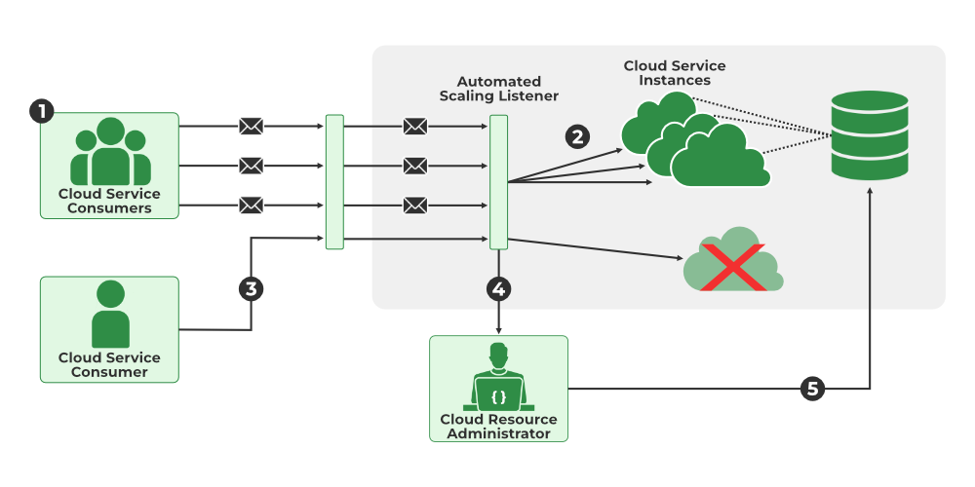
ELASTIC GOOGLE CLOUD INFRASTRUCTURE: SCALING AND AUTOMATION
Auto Scaling: Automatically adjust the number of instances based on demand to optimize performance and cost.
Managed Instance Groups: Simplify management and ensure high availability of instances by grouping them together.
Load Balancing: Distribute incoming traffic across multiple instances to ensure scalability and reliability.
Notes:
https://www.geeksforgeeks.org/automated-scaling-listener-in-cloud-computing/

Slide 9
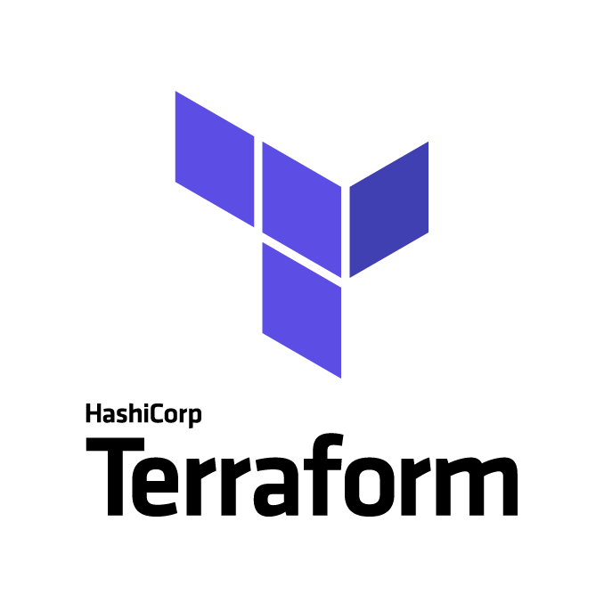
Infrastructure as Code with Terraform
Infrastructure as Code (IaC) with Terraform allows you to manage and provision IT infrastructure using code, automating tasks like creating and updating servers, networks, and databases.
Key Concepts:
Declarative Configuration: Define desired infrastructure state, and Terraform ensures it matches.
Provisioning: Automates the creation, update, and deletion of resources.
Version Control: Store infrastructure code in Git for collaboration and tracking.
State Management: Tracks infrastructure state for consistency.
Modules: Reusable configurations for common infrastructure patterns.
Benefits:
Consistency across environments
Automation of manual tasks
Scalable infrastructure management
Improved team collaboration
1
2

Slide 10
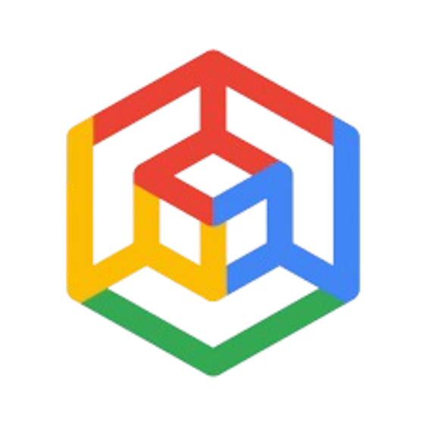
GOOGLE KUBERNETES ENGINE
Google Kubernetes Engine (GKE) is a managed, scalable platform provided by Google Cloud for running containerized applications using Kubernetes, an open-source container orchestration tool. GKE simplifies the process of deploying, managing, and scaling applications by automating infrastructure management tasks such as provisioning, monitoring, and scaling clusters.
Key Features:
Automated Cluster Management: GKE automatically handles tasks like cluster setup, scaling, and upgrading.
High Availability: Ensures reliable and fault-tolerant applications by distributing containers across multiple nodes.
Integrated Google Cloud Services: Seamlessly integrates with other Google Cloud services like Cloud Storage, Big Query, and Cloud Monitoring.
Auto-Scaling: Automatically scales applications based on resource demand and traffic.
Security: Provides robust security features such as role-based access control (RBAC), identity and access management (IAM), and network policies.

Slide 11
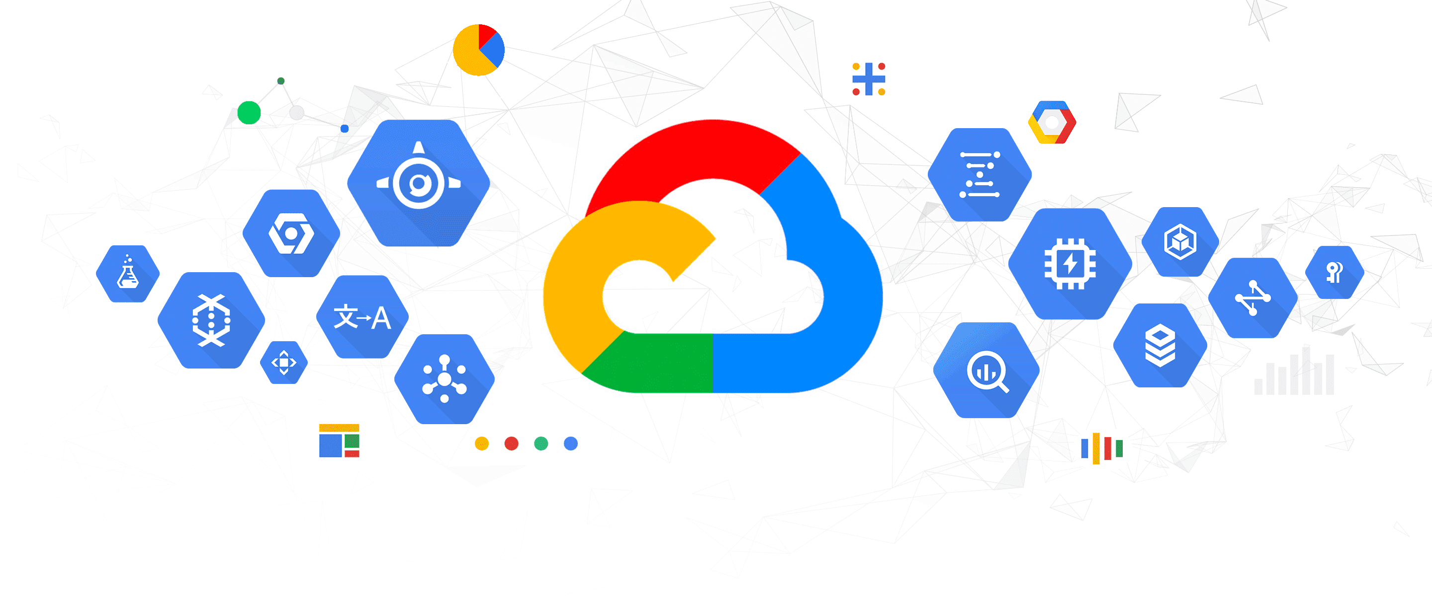
CONCLUSION
In conclusion, cloud computing has revolutionized the way businesses and individuals access and manage technology resources. By offering scalable, cost-effective, and secure solutions, it eliminates the need for heavy infrastructure investments and maintenance. With its flexibility, accessibility, and high reliability, cloud computing enables faster innovation and smoother operations. As the demand for digital transformation continues to grow, cloud computing will remain a key driver in shaping the future of technology and business.

Slide 12
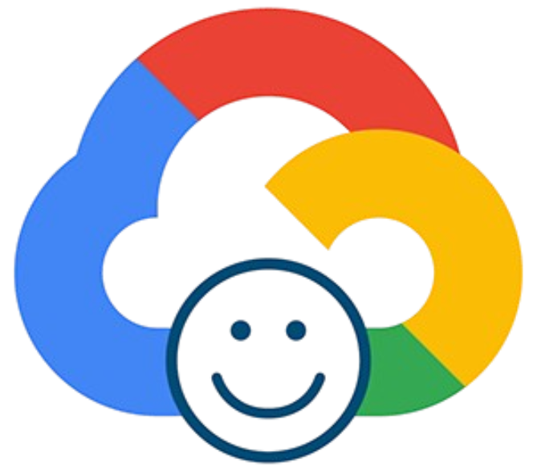
Thank You
Mars

