Slide 1


DATA ANALYST LEARNING PATH
Presented By,
Yashwanth S
4VV22CS189

Slide 2


INTRODUCTION
•The Google Data Analytics course is designed to provide a comprehensive overview of data analytics and its application in modern industries.
• The course covers various topics, including data collection, cleaning, analysis, and visualization.
• It focuses on using Google Cloud’s ecosystem to handle real-world data challenges.
•By the end of the course, learners will have the skills to analyze data, extract insights, and present findings using industry-leading tools like BigQuery and Looker.

Slide 3
KEY COMPONENTS OF GOOGLE CLOUD FOR DATA ANALYTICS
BigQuery
A serverless data warehouse that enables fast and efficient data analysis.
Cloud Dataproc
A managed service for running Apache Spark and Hadoop clusters.
Cloud Dataflow
A serverless service for batch and streaming data processing.
Cloud Dataprep
A tool that streamlines data preparation and cleansing for analysis.

Slide 4
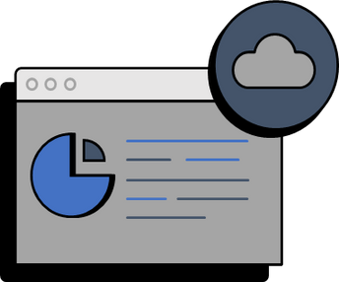
DISCUINTRODUCTION TO DATA ANALYTICS ON GOOGLE CLOUDSSION
Objective: Familiarize with Google Cloud’s data analytics tools
Key Topics:
Overview of data analytics lifecycle: Collection, Storage, Analysis, Visualization, and Action.
Introduction to Google Cloud’s data analytics products: BigQuery, Looker, AI/ML services.
Setting up a Google Cloud environment: Creating a project, enabling APIs, and setting up billing.

Slide 5

ANALYZING AND VISUALIZING DATA IN LOOKER
•Objective:
Learn how to use Looker to explore and visualize datasets.
•Key Topics:
•Introduction to Looker’s interface and its key features.
•Looker: A business intelligence (BI) tool that connects directly to your database for real-time data exploration and analysis.
•Building and sharing interactive dashboards.
•Using Looker’s data exploration tools: filters, pivots, and visualizations.

Slide 6

DEVELOPING DATA MODELS WITH LOOKML
•Objective:
Understand the principles of data modeling and apply them using LookML
•Key Topics:
•Introduction to LookML: Syntax, Structure, and Use Cases.
•LookML: Modeling language in Looker to define dimensions, measures, and business logic.
•Enables consistent, reusable data models.
•Creating and managing models: Exploring and creating views, explores, and joins.
•Best practices for data modeling: Ensuring accuracy, performance, and scalability.

Slide 7
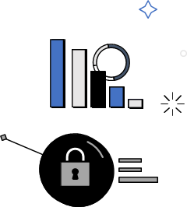
PREPARE DATA FOR ML APIS ON GOOGLE CLOUD
•Objective
Learn how to prepare data for machine learning using Google Cloud’s ML APIs.
•Key Topics:
•Data preprocessing: Cleaning, transforming, and normalizing data.
•Automate data preparation for analysis and machine learning.
•Integrating data with Google Cloud’s AI and ML APIs.
•Data quality considerations: Handling missing data, outliers, and
feature scaling.

Slide 8

PREPARE DATA FOR LOOKER DASHBOARDS AND REPORTS
•Objective:
•Optimize data for reporting and dashboarding in Looker.
•Key Topics:
•ETL (Extract, Transform, Load) processes: Best practices and tools.
•Structuring data for ease of use in Looker: Creating clean, usable datasets.
•Data optimization: Indexing, partitioning, and query optimization.
•Filtering: Narrow down data by applying conditions based on dimensions.
•Sorting & Pivoting: Organize data for better insights, with options to pivot tables for cross-analysis.

Slide 9

CREATE ML MODELS WITH BIGQUERY ML
•Objective:
•Build and train machine learning models directly within BigQuery.
•Key Topics:
•Introduction to BigQuery ML: Overview and Benefits.
•Model Types: Utilize BigQuery ML to build various types of models, such as linear regression, logistic regression, and time series forecasting.
•SQL-Based Model Creation: Define and train models using standard SQL queries directly in BigQuery, simplifying the ML workflow.
•Model evaluation: Accuracy, Precision, Recall, and Cross-Validation.

Slide 10
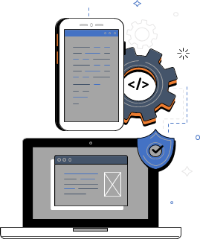
APPLYING ADVANCED LOOKML CONCEPTS IN LOOKER
•Objective:
•Deepen your understanding of LookML and apply advanced modeling techniques.
•Key Topics:
•Advanced LookML concepts: Derived tables, SQL runner, and custom fields.
•Implementing custom dimensions and measures.
•Optimizing LookML models for performance and scalability.

Slide 11
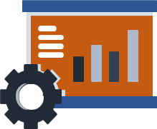
DERIVE INSIGHTS FROM BIGQUERY DATA
•Objective:
•Utilize BigQuery to run SQL queries and derive insights from large datasets.
•Key Topics:
•Introduction to BigQuery: Architecture, Features, and Use Cases.
•Writing and optimizing SQL queries in BigQuery: Create and execute SQL queries to retrieve, manipulate, and analyze data. SELECT, JOIN, WHERE, GROUP BY.
•Connect to BigQuery: Link Looker Studio to BigQuery to access and visualize your data.
•Build Reports: Design and customize reports to present insights and trends from BigQuery data

Slide 12
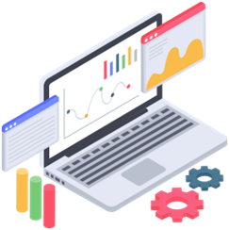
DATA CATALOG FUNDAMENTALS
•Objective:
•Learn the basics of Google Cloud’s Data Catalog for organizing and managing data assets.
•Key Topics:
•Introduction to Data Catalog: Features and Use Cases:Catalog is useful for organizations with large amounts of data spread across different sources. It helps data teams find and use data more efficiently, supports data governance by controlling who can access what data, and enhances collaboration by providing a clear overview of available data assets. This is particularly helpful for data-driven decision-making, data compliance, and improving productivity in data analytics.
•Metadata management: Creating, organizing, and searching for metadata.
•Data discovery and governance: Ensuring compliance and managing data access.

Slide 13

BUILD LOOKML OBJECTS IN LOOKER
•Objective:
•Build reusable LookML objects to streamline data analysis workflows.
•Key Topics:
•Creating LookML views, explores, and fields.
•Best practices for object creation: Reusability, modularity, and documentation.
•Managing and sharing LookML objects across teams.

Slide 14

MANAGE DATA MODELS IN LOOKER
•Objective:
•Learn to manage and optimize LookML data models in a production environment.
•Key Topics:
•Version control and collaboration: Using Git and other tools.
•Model optimization: Improving query performance and reducing costs.
•Managing large-scale models: Best practices for handling complexity.

Slide 15
CONCLUSION
•This learning path offered a comprehensive foundation for aspiring Data Analysts, combining theoretical knowledge with practical, real-world experience.
•Through a series of carefully selected on-demand courses, interactive labs, and skill badges, you will develop proficiency in leveraging Google Cloud technologies critical to the Data Analyst role.
•Upon completion, we were well-equipped to gather, analyze, and interpret data, uncover trends, and generate actionable insights. This expertise will enable us to address complex business challenges and contribute to informed decision-making within the organization.

Slide 16
THANK YOU

