Slide 1

Google Cloud
Platform and some
of its applications
presentetd By:
NITHIN R
4VV22CS103
Notes:
1

Slide 2
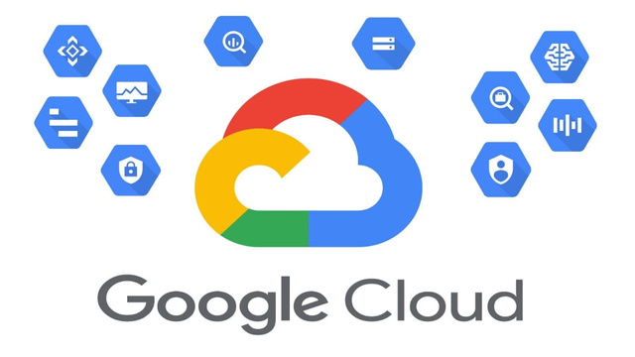
Introduction to Google Cloud Platform (GCP)
Discover the transformative power of Google Cloud Platform, a suite of cloud computing services that empowers businesses to innovate and grow. GCP provides a range of tools and services for data storage, processing, analytics, machine learning, and more.
Explore the architecture and key components of GCP, including Google Cloud Storage, Google Compute Engine, and Google Kubernetes Engine. Understanding these fundamentals will lay the foundation for your cloud engineering journey.
Notes:
2

Slide 3
Iaas and Paas Services in Google Cloud
Infrastructure as a Service (IaaS)
Platform as a Service (PaaS)
GCP provides IaaS services like Google Compute Engine (GCE), enabling you to provision virtual machines, storage, and networking resources. This approach allows you to manage and control your infrastructure, providing flexibility and customization.
GCP offers PaaS services like Google App Engine, simplifying application development and deployment. PaaS handles infrastructure management, allowing you to focus on application development and deployment.
Notes:
3

Slide 4





Key Cloud Computing Concepts and Terminology
Virtual Machines
Networking
Virtual machines are software-based representations of physical computers, enabling you to run multiple operating systems and applications on a single physical server.
Cloud networking allows you to connect and manage virtual machines, applications, and services across various cloud regions and zones, providing secure and scalable connectivity.
Databases
Cloud databases provide reliable and scalable storage and management for your data, offering a variety of options to suit different application requirements.
Notes:
4

Slide 5
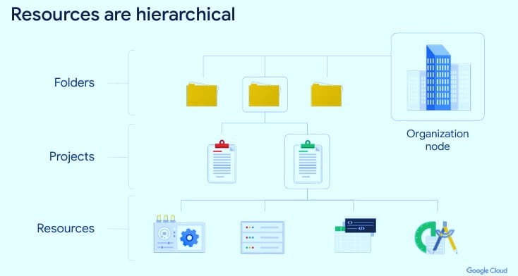
Resources and Access in the Cloud
IAM (Identity and Access Management)
Cloud Console
The Google Cloud Console is a web-based interface that provides access to various GCP services. It offers a user-friendly way to manage resources, monitor applications, and perform various administrative tasks.
IAM is a crucial component for managing user permissions and access to cloud resources. It allows you to control who can access what and how, ensuring security and compliance.
Notes:
5

Slide 6
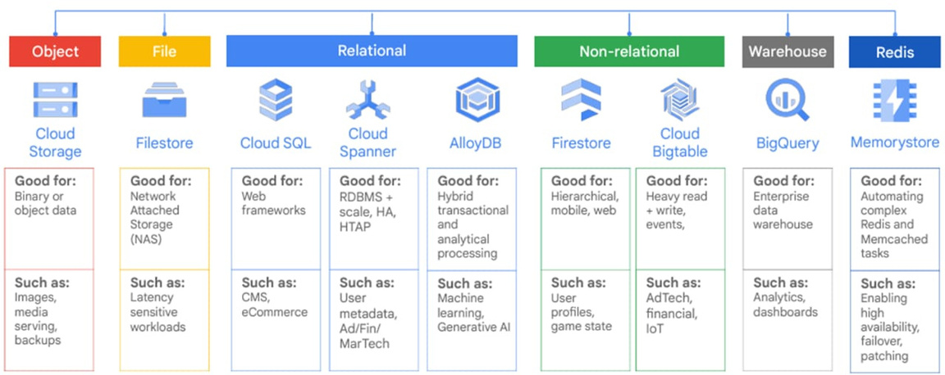
Storage in the Cloud
1
Google Cloud Storage (GCS)
2
Cloud SQL
3
Cloud Spanner
GCS is a scalable, durable, and cost-effective object storage service for storing data of all kinds, including images, videos, and backups.
Cloud SQL offers managed relational database services, providing high availability, scalability, and security for your database applications.
Cloud Spanner is a globally distributed, scalable, and consistent database service, ideal for mission-critical applications requiring high availability and data consistency.
Notes:
6

Slide 7




VIRTUAL MACHINES
1
Compute Engine
2
Virtual Machine Instances
3
Operating Systems
4
Applications
Virtual Machine (VM) is a software-based simulation of a physical computer that runs an operating system and applications, but is abstracted from the underlying hardwareIn cloud platforms like Google Cloud Platform (GCP), virtual machines are managed using services such as Google Compute Engine. Let’s dive into the layers that make up a VM architecture in Google Cloud and their relationship
1. Physical Layer (Hardware): This is the actual physical hardware, such as servers, storage devices, CPUs, and network interfaces, located in data centers
2. Compute Engine Layer : Google Compute Engine (GCE) is the service provided by Google Cloud to create, manage, and run virtual machines (VMs) on its infrastructure.
3. Virtual Machine Instances : A Virtual Machine Instance is an individual virtualized computer created using Google Compute Engine. Each instance has its own virtualized CPU, memory, storage, and network interfaces, and it runs its own Guest Os .
4. Operating System (Guest OS): The Operating System (OS) installed inside the virtual machine instance is referred to as the Guest OS. This can be any supported OS, such as Linux, Windows Server, or macOS.
Notes:
7

Slide 8
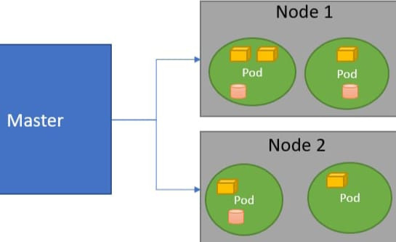
Introduction to Kubernetes and its Architecture
Kubernetes is an open-source container orchestration platform that automates the deployment, scaling, and management of containerized applications. It's a powerful tool for building and managing microservices-based applications.
1
At the core of Kubernetes lies the control plane, responsible for managing and coordinating the cluster. It includes components like the API server, scheduler, and controller manager, which work together to ensure the smooth operation of the cluster.
2
The worker nodes, also known as agents or minions, are the physical or virtual machines that run the actual containerized applications. Each worker node has a Kubernetes agent called a kubelet that communicates with the control plane.
3
Notes:
8

Slide 9
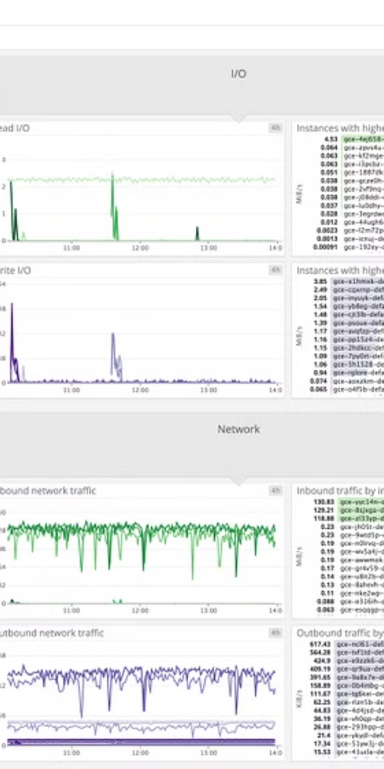



Managing Deployment using Kubernetes Engine
Google Kubernetes Engine (GKE) is a managed Kubernetes service on GCP, simplifying the deployment and management of Kubernetes clusters. It provides a scalable, reliable, and secure platform for running containerized applications.
GKE enables you to create and manage Kubernetes clusters with ease. It takes care of infrastructure management, allowing you to focus on deploying and scaling your applications.
You can deploy and manage your applications using tools like kubectl, a command-line interface for interacting with Kubernetes clusters. GKE provides seamless integration with other GCP services, making it a versatile and powerful platform for containerized deployments.
Notes:
9

Slide 10
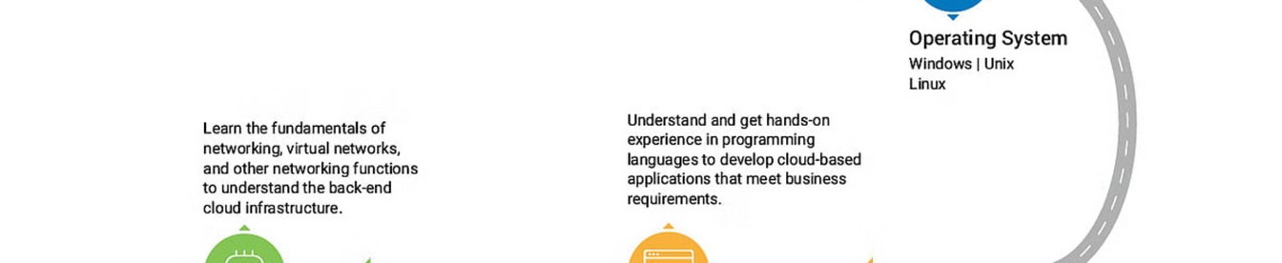
Career Opportunities in Cloud Engineering
1
2
3
High Demand
Diverse Skills
Growth Potential
Cloud Engineers are in high demand across various industries, as businesses increasingly adopt cloud technologies to improve efficiency, scalability, and innovation.
Cloud engineers possess a wide range of skills, including infrastructure management, application development, automation, and security, making them valuable assets to any organization.
The cloud computing industry is constantly evolving, offering exciting opportunities for career growth and advancement for Cloud Engineers.
Notes:
10

