Slide 1
Blockchain Technology
Module 2
Decentralization, Cryptography and Technical Foundations

Slide 2
Topics to be covered ….
Decentralization
Decentralization using Blockchain.
Blockchain and full ecosystem decentralization.
Decentralization
Smart contract
Decentralization organizations.
Decentralization autonomous organizations
Decentralization autonomous Corporation
Decentralization autonomous societies
Decentralization platform

Slide 3
Cryptography and Technical Foundation:
Mathematics
Cryptography
Cryptographic primitives
Symmetric Cryptography
DES
AES

Slide 4
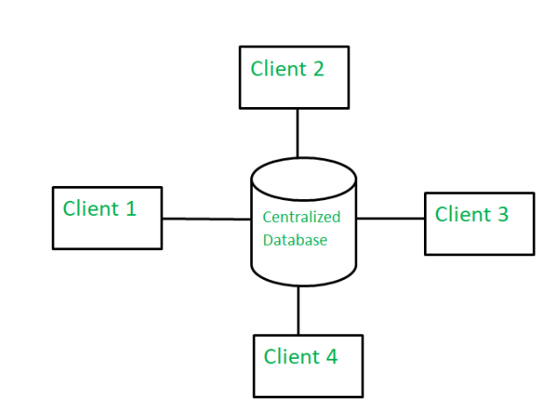
CENTRALIZED SYSTEM
centralized system is controlled by central authority →meaning all planning, policies and controls are managed by a single entity.
Examples : Instagram, YouTube and online shopping platforms.
Disadvantages of Centralized Systems:
Single Point of Authority
Single Point of Failure
Scalability Issues
Security Risks
Privacy Concerns

Slide 5
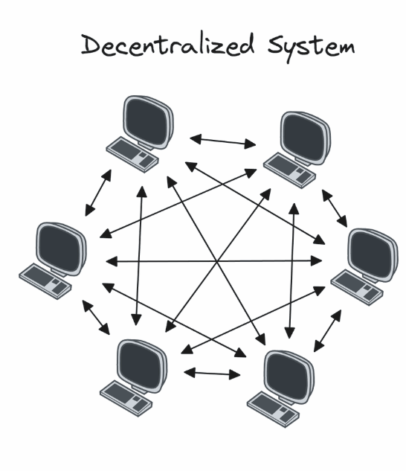
DECENTRALIZED SYSTEM
In a decentralized system, control and authority are distributed across multiple nodes instead of being centralized.
This improves efficiency, decision-making speed, motivation and reduces the burden on top management
Advantages of Decentralized Systems:
No Single Point of Failure
Equal Responsibility
Security & Privacy
Real-time Updates

Slide 6
The code runs on a peer-to-peer network of nodes and no single node has control over the dApp.
Bitcoin uses a blockchain decentralized ledger of transactions.
This enables a user to agree on some consensus algorithm without the need for a central trusted third party, intermediary, or service provider
Decentralized System: Mastodon
Mastodon is a decentralized social media platform where different servers (called instances) operate independently.

Slide 7
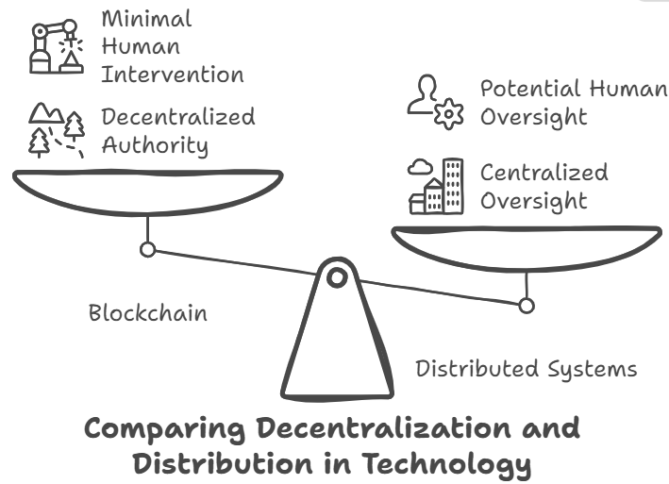
Decentralization Using Blockchain
Blockchain is a technology that enables decentralization without intermediaries. It operates through a consensus mechanism like Proof of Work (PoW) to determine decision-making authority.
Blockchain applications (e.g., Bitcoin) function autonomously or with minimal human intervention.

Slide 8
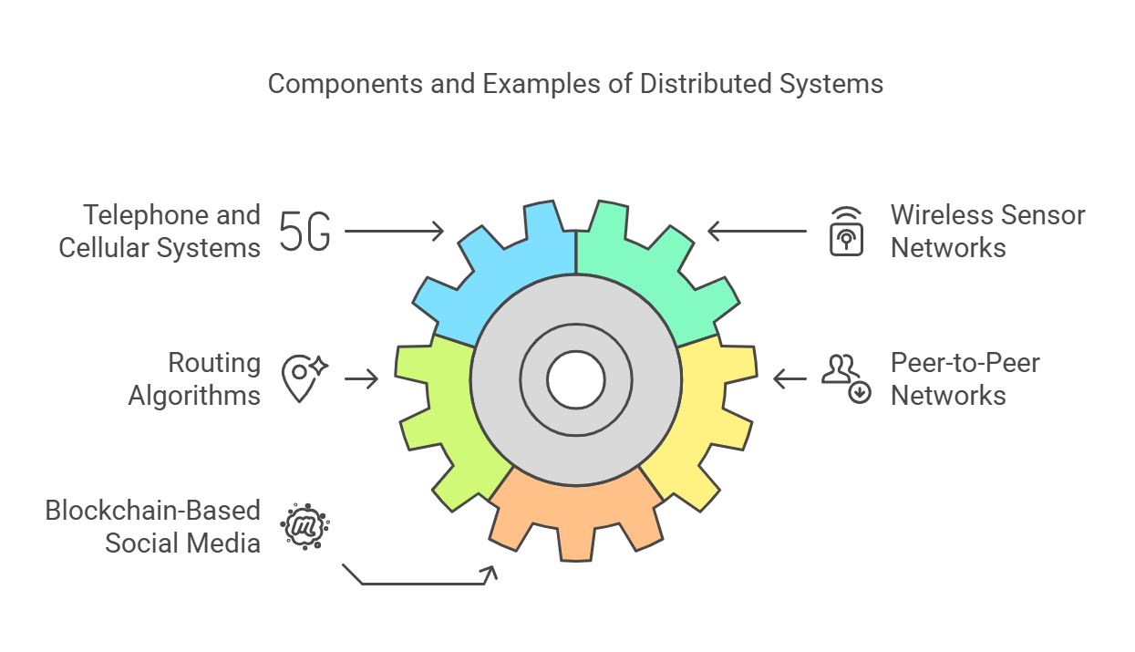
Distributed System
A distributed system consists of independent nodes communicating over a network to achieve a common goal.
Unlike decentralized systems, distributed systems may still have a central authority overseeing operations.
General Examples :Telephone and Cellular system, Wireless sensor networks, Routing algorithm, Peer to peer networks.
Blockchain-Based Social Media (e.g., Steemit)

Slide 9
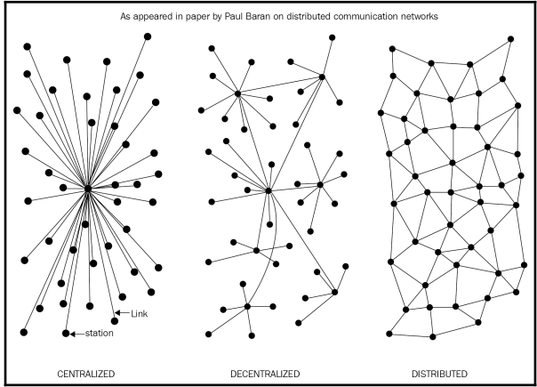
Different types of network/system

Slide 10
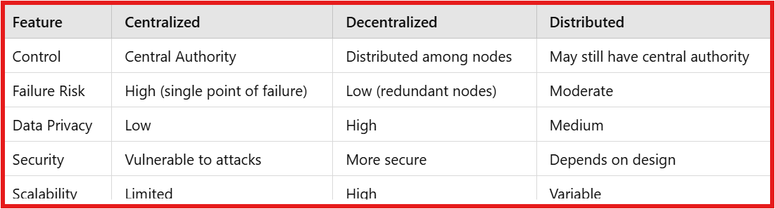

Slide 11
How to achieve Decentralization?

Slide 12
Methods of decentralization
There are two methods that can be used to achieve decentralization.
Disintermediation.
Through competition.

Slide 13
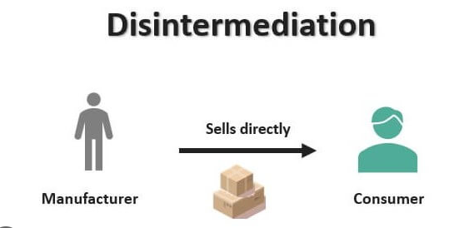
Disintermediation:
It refers to the removal of intermediaries or middlemen in a transaction or process, which is made possible by the use of a decentralized and trustless network.
Traditional Money Transfer:
You send money → Bank processes transaction → Friend receives money.
Decentralized Transfer with Blockchain:
You send money → Blockchain processes transaction → Friend receives money (without a bank).{All you need is the address of your friend on the blockchain.}

Slide 14
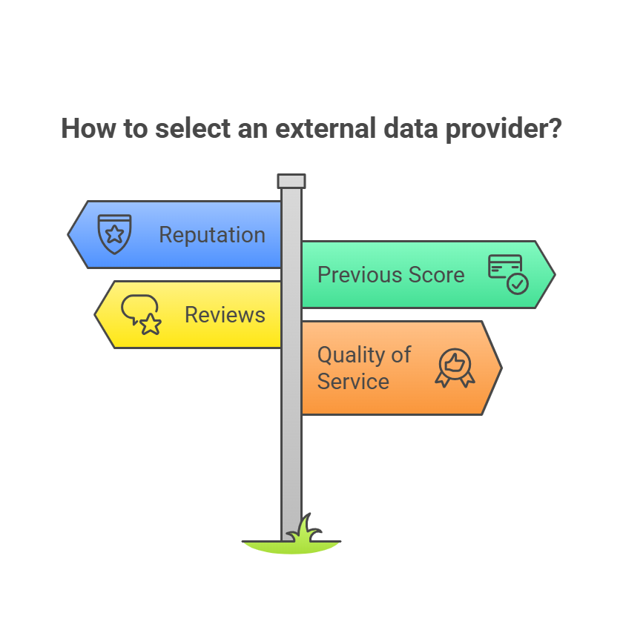
2. Through competition(Contest-Driven Decentralisation):
In this method, a group of service providers compete with each other in order to be selected for the provision of services by the system.
In the context of blockchain technology, a system can be envisioned in which smart contracts can choose an external data provider from a large number of providers based on their reputation, previous score, reviews and quality of service.

Slide 15
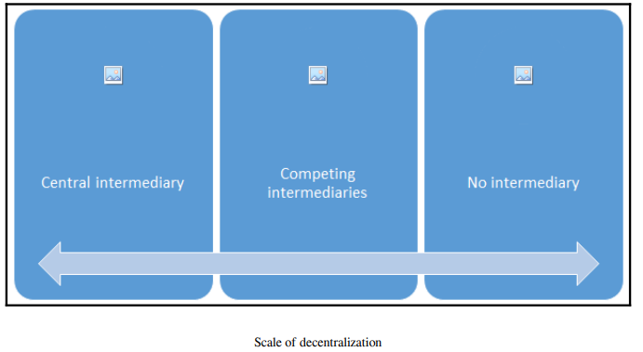
Scale of decentralization

Slide 16
1. Central Intermediary (Fully Centralized)
A single entity acts as the middleman, controlling all transactions, communications or processes.
Users must trust this central authority for access and decision-making.
Example:
Banks controlling financial transactions.
Facebook controlling social media interactions.
Centralized cloud providers like Google Drive or Dropbox.

Slide 17
2. Competing Intermediaries (Partially Decentralized)
Multiple intermediaries exist, allowing users to choose between different providers.
Each intermediary still has control over its own network, but users have alternatives.
Some level of competition and redundancy reduces risks but doesn’t eliminate intermediaries.
Example:
Multiple banks offering financial services (Visa, Mastercard, PayPal).
Different cloud service providers (AWS, Google Cloud, Microsoft Azure).
Federated systems like Mastodon, where different servers (instances) operate independently.

Slide 18
3. No Intermediary (Fully Decentralized or Distributed)
No middleman—users interact directly with each other.
Trust is established through cryptographic mechanisms or consensus algorithms.
Example:
Bitcoin and blockchain networks (users transact directly via peer-to-peer mechanisms).
IPFS (InterPlanetary File System) for decentralized file storage.
DAOs (Decentralized Autonomous Organizations), where governance is handled by smart contracts.

Slide 19
How to decentralize?
What is being decentralized?
What level of decentralization is required?
What blockchain is used?
What security mechanism is used?

Slide 20
Use case : Money transfer
Answer 1 : Money transfer system
Answer 2: Disintermediation.
Answer 3: Bitcoin.
Answer 4: Atomicity.

Slide 21
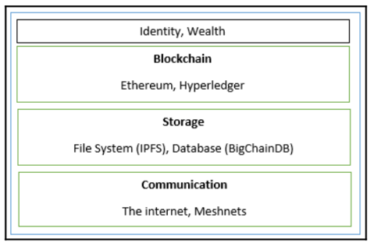
Blockchain and full ecosystem decentralization
In order to achieve complete decentralization, it is necessary that the environment around the blockchain is also decentralized.
These elements include
1.storage
2.communication
3.computation.

Slide 22
1) Storage
Data can be stored directly in a blockchain.
It does achieve decentralization.
Major disadvantage: not suitable for storing large amounts of data by design.
A better alternative is to use distributed hash tables (DHTs).
DHTs were originally used in peer-to-peer file sharing software, such as BitTorrent, Napster, Kazaa and Gnutella.

Slide 23
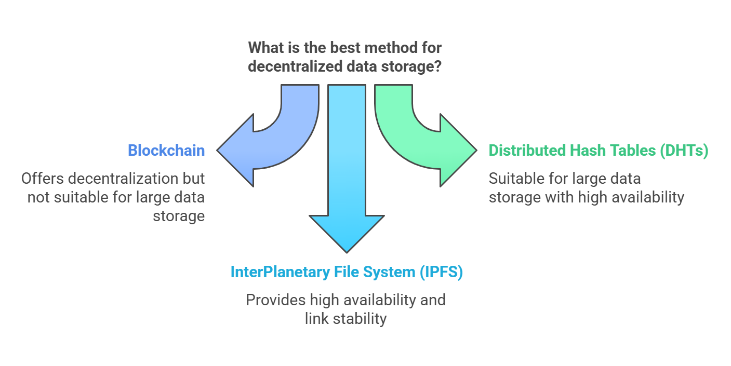
Two main requirements:
High availability and link stability, which means data should be available when required and network links should also always be accessible.
Inter Planetary File System (IPFS) possesses both of these properties. (decentralized ,p2p protocol for storing data, files and websites)

Slide 24
BigChainDB is another storage layer decentralization project aimed at providing a scalable, fast and linearly scalable decentralized database as opposed to a traditional filesystem.
BigChainDB complements decentralized processing platforms and file systems such as Ethereum and IPFS.

Slide 25
2) Communication
Communication media – Internet
Currently trusted on third party.
Internet is based on ISP-Internet Service Provider.
Using mesh network, we can talk directly to each other.
3) Computation
processing is achieved by a blockchain technology such as Ethereum.
Where smart contracts run on the network.

Slide 26
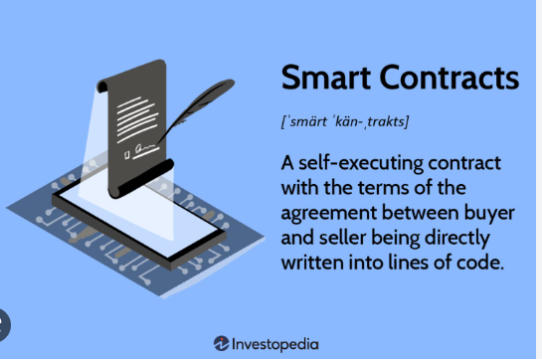
SMART CONTRACTS

Slide 27
Smart contracts are generally run on a blockchain due to the security benefits it provide.
A smart contract usually contains some business logic and a limited amount of data.
Actors or participants in the blockchain use these smart contracts or they run autonomously on behalf of the network participants.

Slide 28
Decentralized organizations
Decentralized organization (DOs) are software programs that run on a blockchain and are based on the idea of real human organizations with people and protocols.
Types:
Decentralized autonomous organizations (DAOs) - Fully Automated .
Decentralized autonomous corporations (DACs) – subset of DAO.
Decentralized autonomous societies (DASs) – Societies .

Slide 29
Decentralized organizations
Decentralized organization (DOs) are software programs that run on a blockchain and are based on the idea of real human organizations with people and protocols.
Example: GitHub Open-Source Projects
Many open-source projects on GitHub function as decentralized organizations. Developers from around the world collaborate, contribute code and make decisions collectively, often without a formal hierarchy.

Slide 30
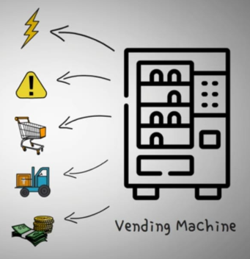

Slide 31
Decentralized autonomous organizations
DAO and DO are basically the same thing, but the main difference is that DAOs are autonomous, which means that they are fully automated and contain artificially intelligent logic, whereas DOs lack this feature and rely on human input in order to execute business logic.

Slide 32
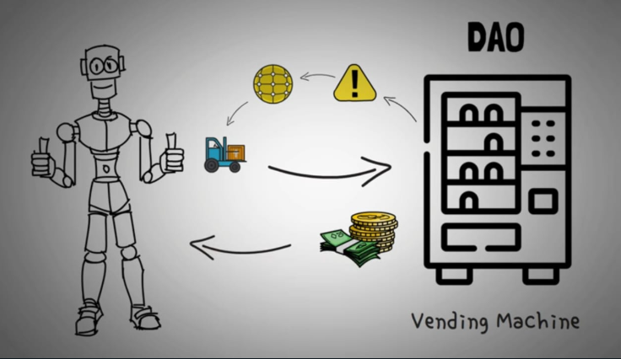

Slide 33
Decentralized autonomous corporations
It is same as DAO
It is smaller subset of DAOs.
Difference DAO-nonprofit, DACs make money via shares offered to the participants and paying dividends.
Runs a business automatically without human intervention.

Slide 34
Decentralized autonomous societies
Decentralized Autonomous Society (DAS) is an advanced concept where entire communities or societies operate on decentralized, blockchain-based governance principles.
Many services that a government offers can be delivered via blockchain, such as Government Identity Card systems, passport issuance, records of deeds, marriages and births.

Slide 35
Requirements of a Decentralized applications (DAPPs)
The DAPP should be fully open source and autonomous and no single entity should be in control of a majority of its tokens. All changes to the application must be consensus-driven based on the feedback given by the community.
Data and records of operations of the application must be cryptographically secured and stored on a public, decentralized blockchain in order to avoid any central points of failure.
A cryptographic token must be used by the application in order to provide access and rewards to those who contribute value to the applications, for example, miners in bitcoin.
The tokens must be generated by the decentralized application according to a standard cryptographic algorithm. This generation of tokens acts as a proof of the value to contributors (for example, miners).

Slide 36
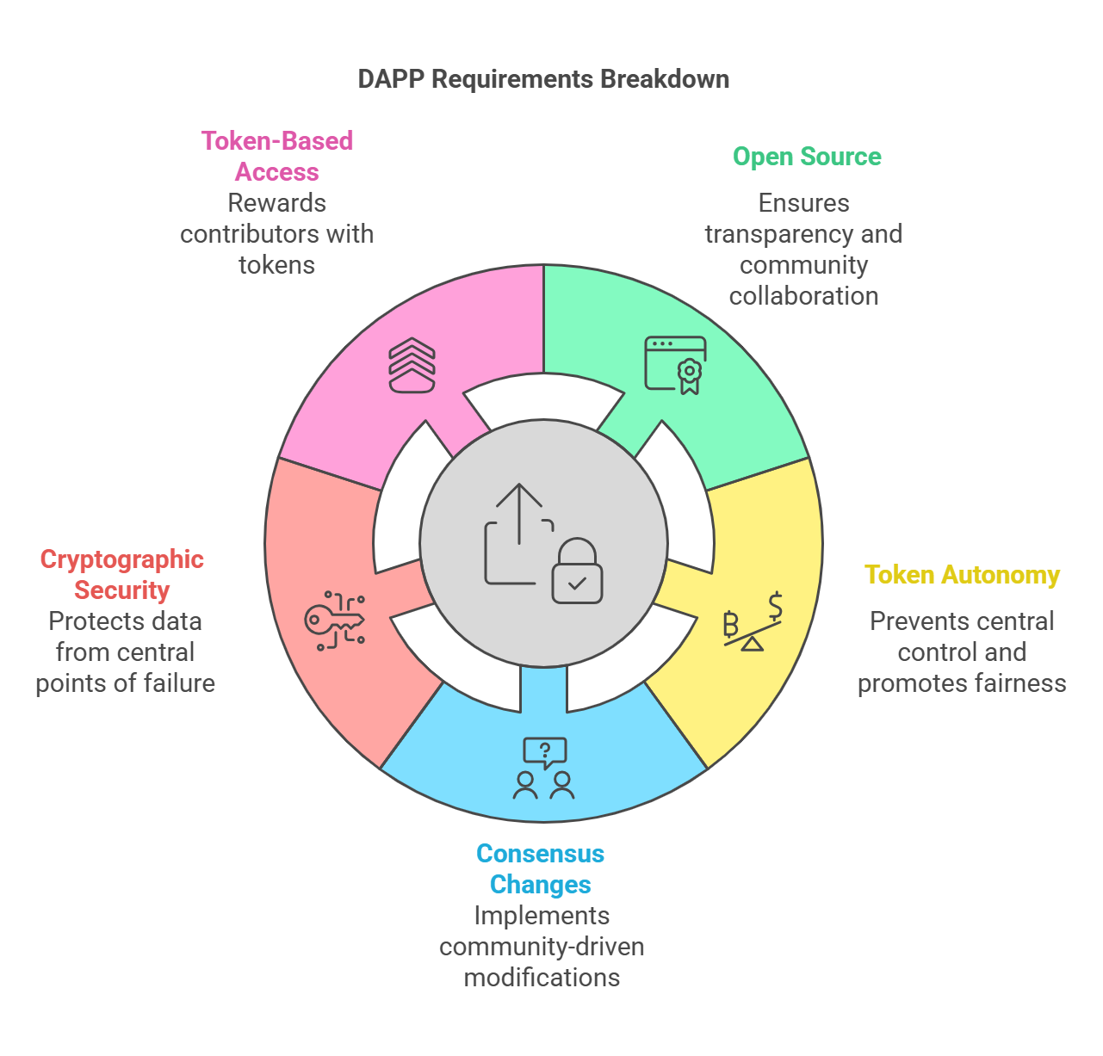

Slide 37
Operations of a DAPP
Proof of Work and Proof of Stake can be used to establishment the DAPP
DAPP can distribute tokens (coins) via mining, fundraising and development.
DAPP - Examples
KYC-Chain - manage Know Your Customer (KYC) data in a secure and convenient based on smart contracts.
OpenBazaar - commercial activities b/w buyer and seller using peer-peer, uses DHTs, It makes use of bitcoin as a payment network
Lazooz – smart transportation; It allows peer-to-peer ride sharing and users can be incentivized by proof of movement

Slide 38
PLATFORMS FOR DECENTRALIZATION
There are many platforms available for decentralization now.
Some prominent names are discussed here.
1.Ethereum
2.Maidsafe
3.Lisk

Slide 39
1) Ethereum
First blockchain to introduce a Turing-complete language (Solidity) for smart contracts.
Supports decentralized applications (dApps) and smart contracts.
Uses Ethers (ETH) as its currency token.
2) Maidsafe
Focuses on a decentralized internet using a Secure Access for Everyone (SAFE) network.
Utilizes unused computing resources like storage, processing power, and data connections.
Not a traditional blockchain but a distributed storage network.

Slide 40
3) Lisk (LSK)
A blockchain designed for JavaScript-based dApps.
Unlike Ethereum, which requires Solidity, Lisk uses JavaScript & TypeScript for development.
Features a Sidechain Development Kit (SDK), allowing independent blockchains to connect to its mainchain.

Slide 41
Cryptography and Technical Foundations
Mathematics
Set: A set is a collection of distinct objects.
Group: A group is a commutative set with one operation that combines two elements of the set.
Field: A field is a set that contains both additive and multiplicative groups.
A finite field: A finite field is a field with a finite set of elements.
Oder: This is the number of elements in a field. It is also known as the cardinality of the field.
Prime fields: This is a finite field with a prime number of elements.

Slide 42
Ring : If more than one operation can be defined over an abelian group, that group becomes a ring.
A Cyclic group: A cyclic group is a type of group that can be generated by a single element called the group generator.
An abelian group :An abelian group is formed when the operation on the elements of a set is commutative. A X B = B X A.
Modular arithmetic: known as clock arithmetic, numbers in modular arithmetic wrap around when they reach a certain fixed number.

Slide 43
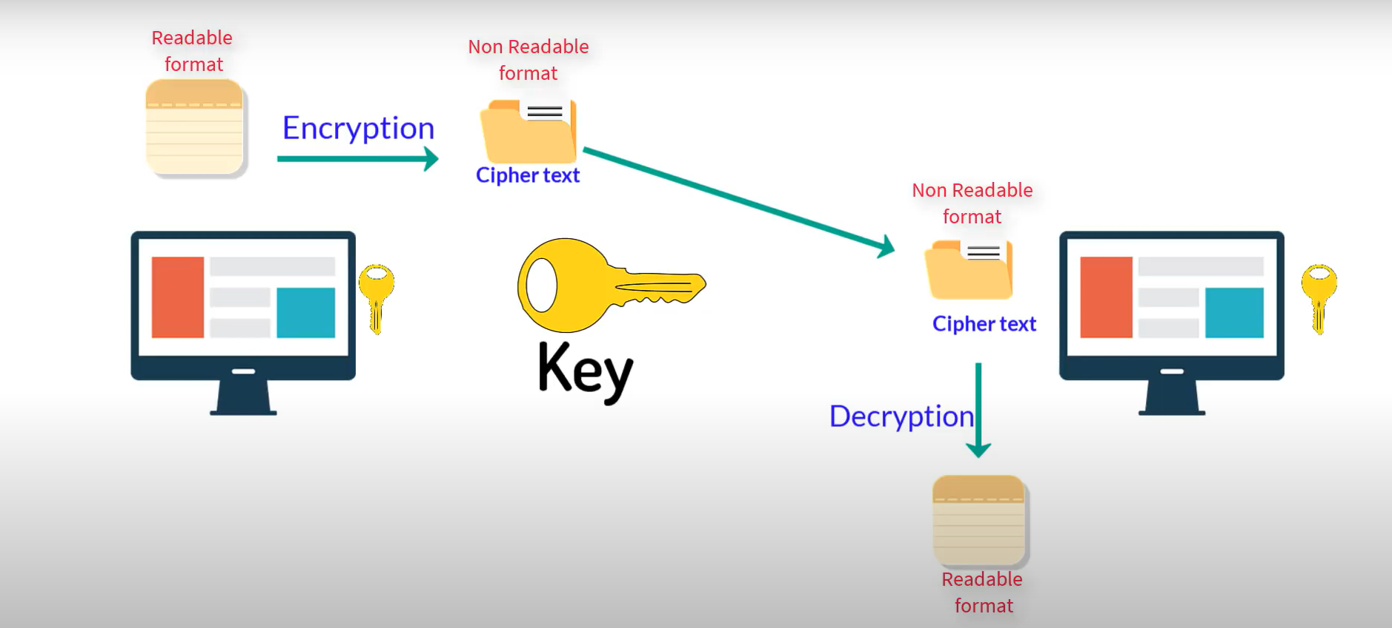
Cryptography

Slide 44
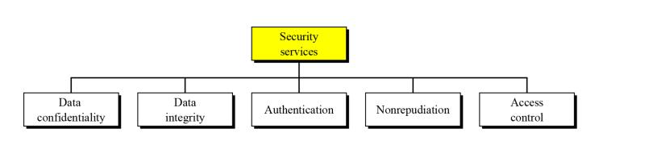
Cryptography
Cryptography provides various security services, and these security services are discussed here.

Slide 45
Cryptography
Confidentiality
Confidentiality is the assurance that information is only available to authorized entities.
Integrity
Integrity is the assurance that information is modifiable only by authorized entities.
Authentication
Authentication provides assurance about the identity of an entity or the validity of a message. There are two types of authentications
Entity authentication
Data origin authentication

Slide 46
Entity authentication
Entity authentication is the assurance that an entity is currently involved and active in a communication session.
This type of authentication is not very secure due to various reasons, such as password leakage.
The use of additional techniques for user identification is known as multifactor authentication or two-factor authentication.
Various factors are described here:
1. The first factor is something you have, such as a hardware token or smart card.
2. The second factor is something you are, which uses biometric features in order to identify the user.

Slide 47
Data origin authentication
The source of information is verified.
Data origin authentication implies data integrity because if a source is corroborated, then data must not have been altered. Various methods, such as Message Authentication Codes (MACs) and Digital signatures are most commonly used.

Slide 48
Non-repudiation
The non-repudiation protocol usually runs in a communication network and is used to provide evidence that an action has been taken by an entity (originator or recipient) on the network.
There are two communication models that can be used to transfer messages from originator A to recipient B:
1. Message is sent directly from originator A to recipient B.
2. Message is sent to a delivery agent from originator A, which then delivers the message to recipient B.
The main requirements of a non-repudiation protocol are fairness, effectiveness and timeliness.

Slide 49
Accountability
Accountability is the assurance that actions affecting security can be traced to the responsible party.
This is usually provided by logging and audit mechanisms in systems where a detailed audit is required due to the nature of the business, for example, in electronic trading systems.
Detailed logs are vital to trace an entity's actions.

Slide 50
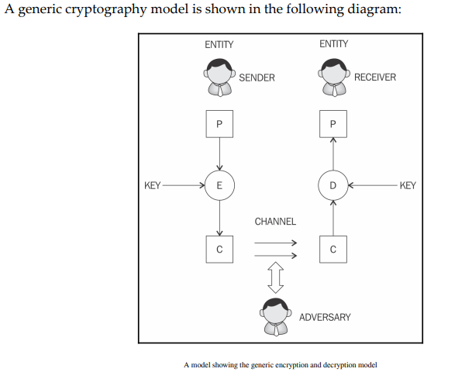
Cryptographic primitives

Slide 51
1.Entity: It is either a person or a system that sends, receives, or performs operations on data
2.Sender: Sender is an entity that transmits the data
3.Receiver: Receiver is an entity that takes delivery of the data.
4.Adversary: This is an entity that tries to circumvent the security service
5.Key: A key is some data that is used to encrypt or decrypt data
6.Channel: Channel provides a medium of communication between entities

Slide 52
Symmetric cryptography
Symmetric cryptography refers to a type of cryptography where by the key that is used to encrypt the data is the same for decrypting the data, and thus it is also known as a shared key cryptography.
There are two types of symmetric ciphers, stream ciphers and block ciphers.
Data Encryption Standard (DES) and Advanced Encryption Standard (AES)

Slide 53
Stream ciphers
These ciphers are encryption algorithms that apply encryption algorithms on a bit-by-bit basis to plain text using a key stream. There are two types of stream ciphers: synchronous and asynchronous.
In stream ciphers, encryption and decryption are basically the same function because they are simple modulo 2 additions or XOR operation.

Slide 54
Block ciphers
These are encryption algorithms that break up a text to be encrypted (plain text) into blocks of fixed length and apply encryption block by block.
It uses Confusion and Difusion properties.

Slide 55
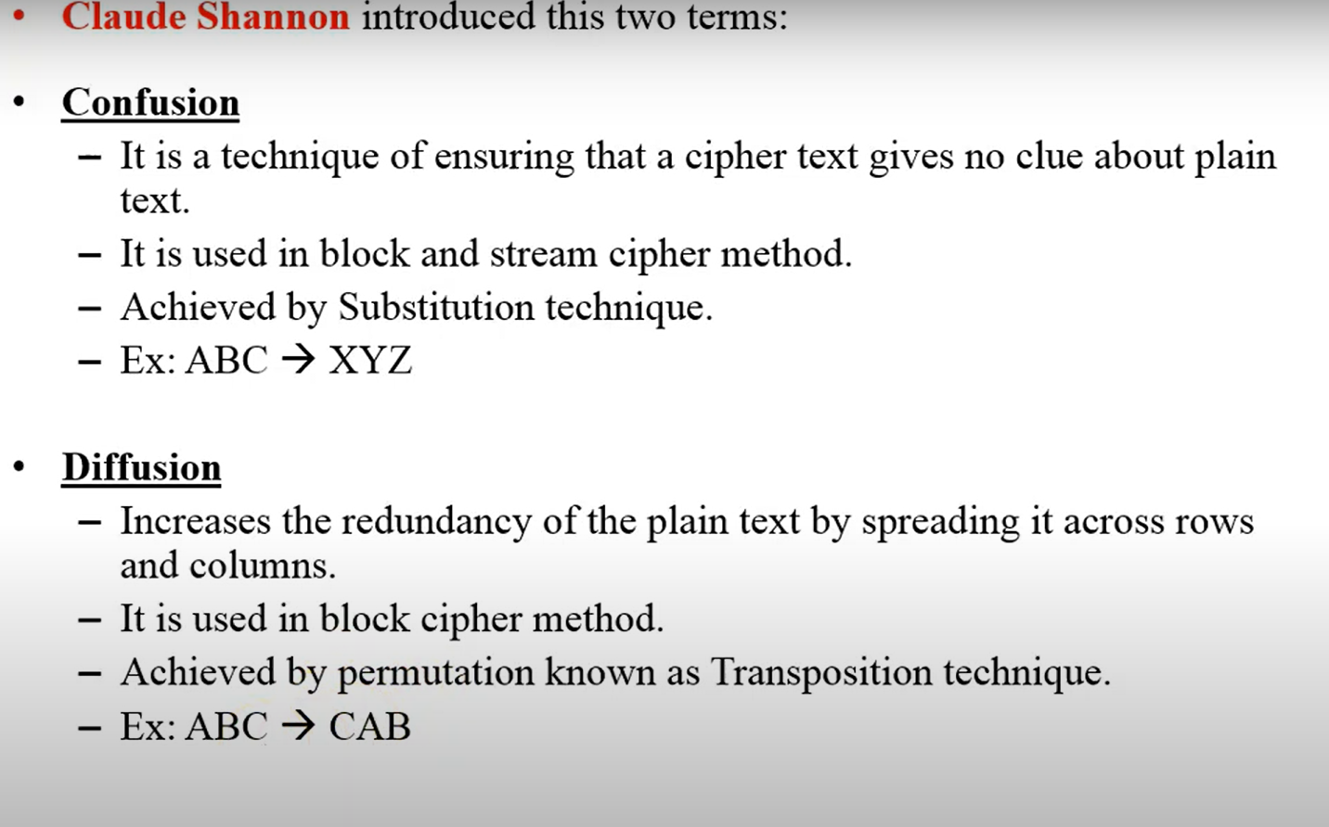

Slide 56
Various modes of operation for block ciphers are
Electronic Code Book (ECB),
Cipher block chaining (CBC),
Output Feedback Mode (OFB), or Counter mode (CTR).
These modes are used to specify the way in which an encryption function would be applied to the plain text.
First four categories of block cipher encryption modes.
Block encryption mode
Keystream generation modes
Message authentication modes
Cryptographic hashes

Slide 57
Block encryption mode
In this mode, plaintext is divided into blocks of fixed length depending on the type of cipher used and then the encryption function is applied on each block.
Keystream generation modes
In this mode, the encryption function generates a keystream that is then XORed with the plaintext stream in order to achieve encryption.
Message authentication modes
In this mode, a message authentication code is computed as a result of an encryption function. MAC is basically a cryptographic checksum that provides an integrity service.
Cryptographic hashes
Hash functions are basically used to compress a message to a fixed length digest. In this mode, block ciphers are used as a compression function to produce a hash of plain text.

Slide 58
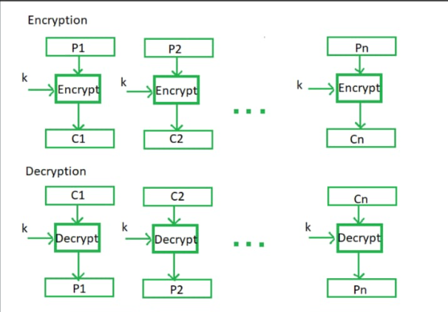
Electronic code book
This is a basic mode of operation in which the encrypted data is produced as a result of applying the encryption algorithm one by one separately to each block of plain text. This is the simplest mode but should not be used in practice as it is insecure and can reveal information.
It is used only for short messages

Slide 59
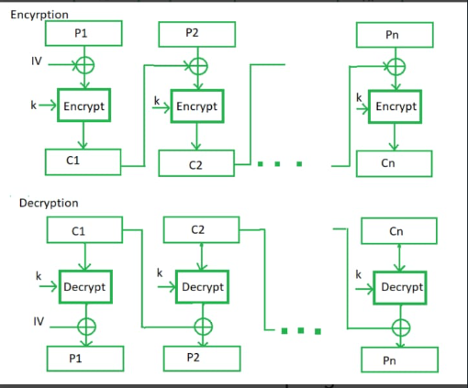
Cipher block chaining
In this mode, each block of plain text is XORed with the previous encrypted block. The CBC mode uses initialization vector IV to encrypt the first block. It is recommended that IV be randomly chosen:

Slide 60
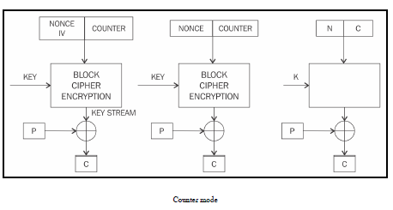
Counter mode
The CTR mode effectively uses a block cipher as a stream cipher.
In this case, a unique nonce is supplied that is concatenated with the counter value in order to produce a key stream:

Slide 61
Commonly used block cipher are:
1.Data Encryption Standard (DES)
2.Advanced Encryption Standard (AES)

Slide 62
DES
Introduced by the US National Institute of Standards and Technology (NIST).
Standard algorithm for encryption and was in main use during 1980s and 1990s.
It has been not proven to be very resistant against brute force attacks.
DES uses a key of only 56 bits, which has raised some concerns.
Triple DES (3DES), which proposed the usage of a 168-bit key using three 56-bit keys and the same number of executions of the DES algorithm, thus making brute force attacks almost impossible.
Limitations, such as slow performance and 64-bit block size, are not desirable.

Slide 63
Advanced Encryption Standard (AES)
AES standard, only a 128-bit block size is allowed. However, key sizes of 128-bit, 192-bit, and 256-bit are allowed.
AES steps:

Slide 64
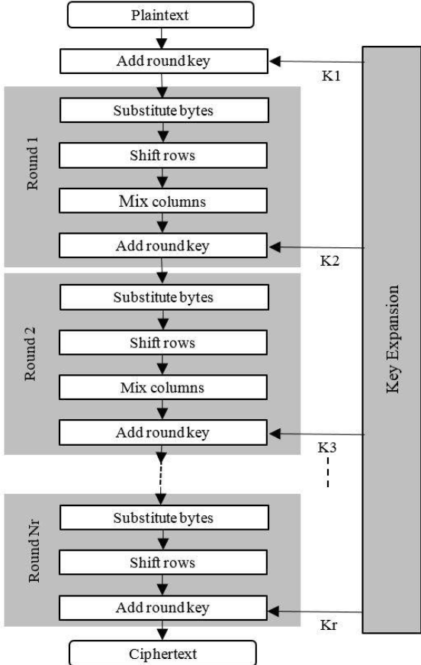

Slide 65
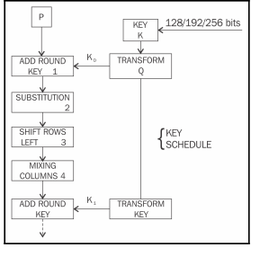

Slide 66
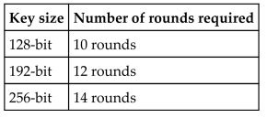
AES Steps:
1. During the AES Algorithm processing, a 4 by 4 array of bytes knows as state is modified using multiple rounds.
2. AES operates on fixed-size blocks of data, with a block size of 128 bits (16 bytes).
3. Full encryption requires 10 to 14 rounds depending on the size of the key.

Slide 67
4. Once the state is initialized with the input to the cipher, four operations are performed in four stages in order to encrypt the input.
These stages are:
AddRoundKey
SubBytes
ShiftRows
MixColumns

Slide 68
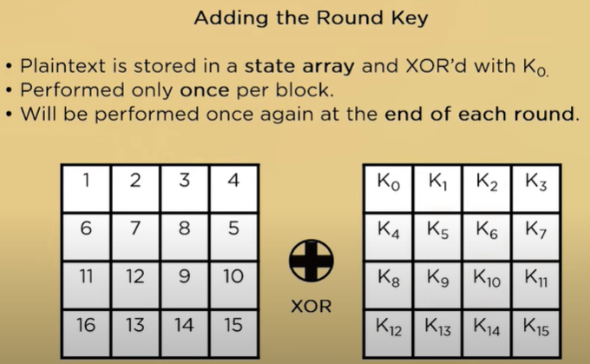
1. In the AddRoundKey step, the state array is XORed with a subkey, which is derived from the master key.

Slide 69
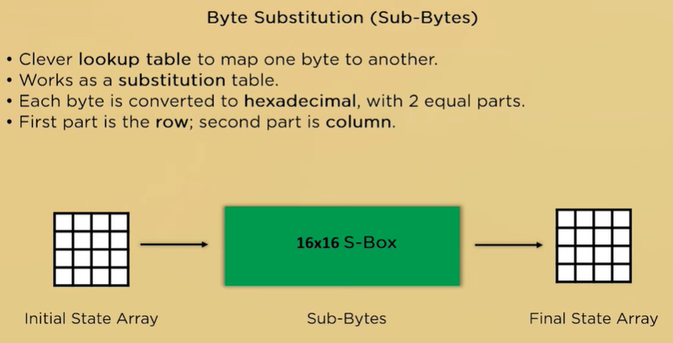
2. This is the substitution step where a lookup table (S-box) is used to replace all bytes of the state array.

Slide 70
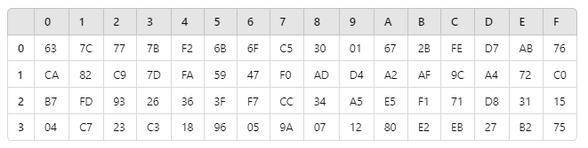
S-box (pre defined table)

Slide 71
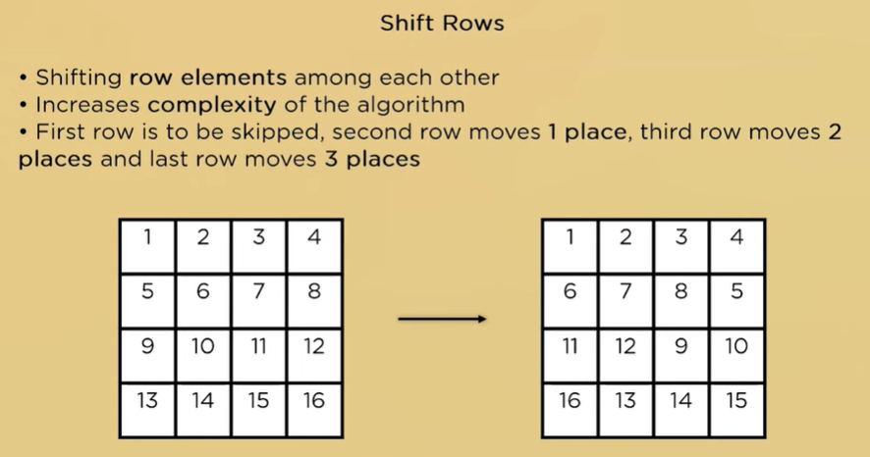
3. This step is used to shift each row except the first one in the state array to the left in a cyclic and incremental manner.

Slide 72
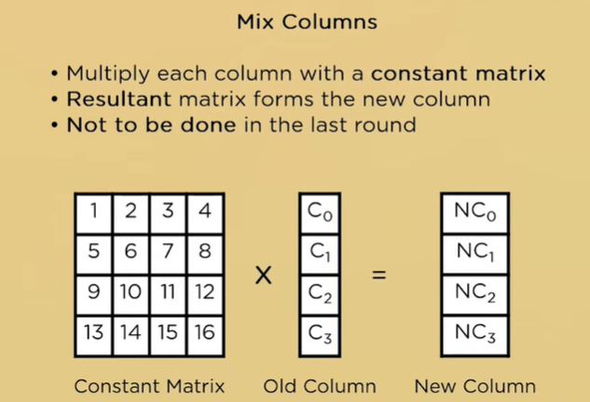
4. Finally, all bytes are mixed in this step in a linear fashion column-wise.

Slide 73
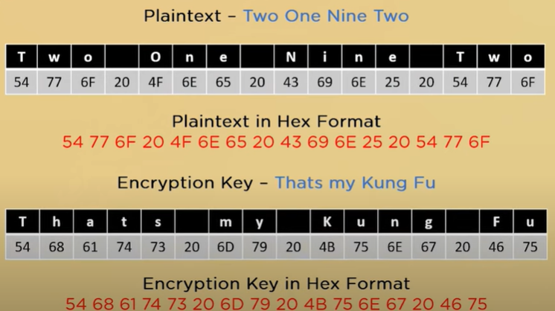

Slide 74
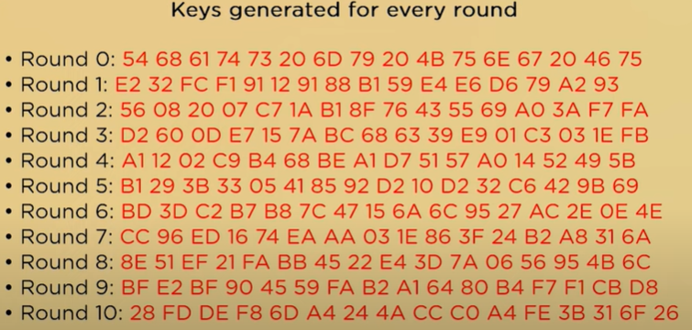

Slide 75
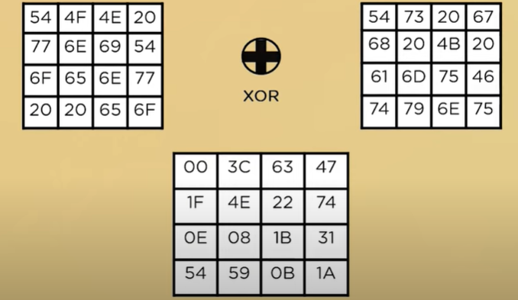

Slide 76
S-box (pre defined table)

Slide 77
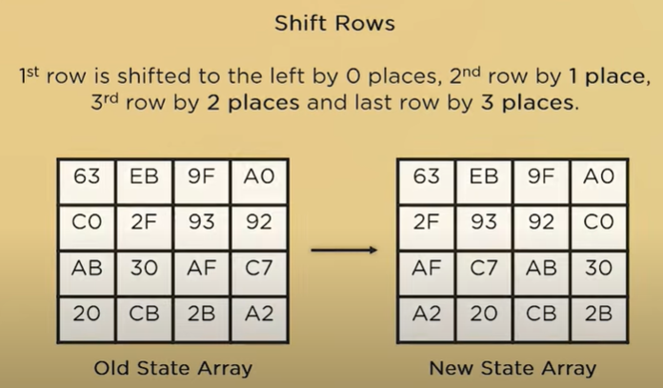

Slide 78
This combination of operations—confusion (SubBytes and AddRoundKey) and diffusion (ShiftRows and MixColumns)—ensures the high security of AES encryption.

