Slide 1

Blockchain Technology
Module 3- Cryptographic Primitives

Slide 2
Topics to be covered…
Cryptographic primitives:
Asymmetric cryptography.
Hash functions.
Secure Hash Algorithms (SHAs).
Merkle trees.
Patricia trees.
Distributed hash tables (DHTs).
Digital signatures.

Slide 3
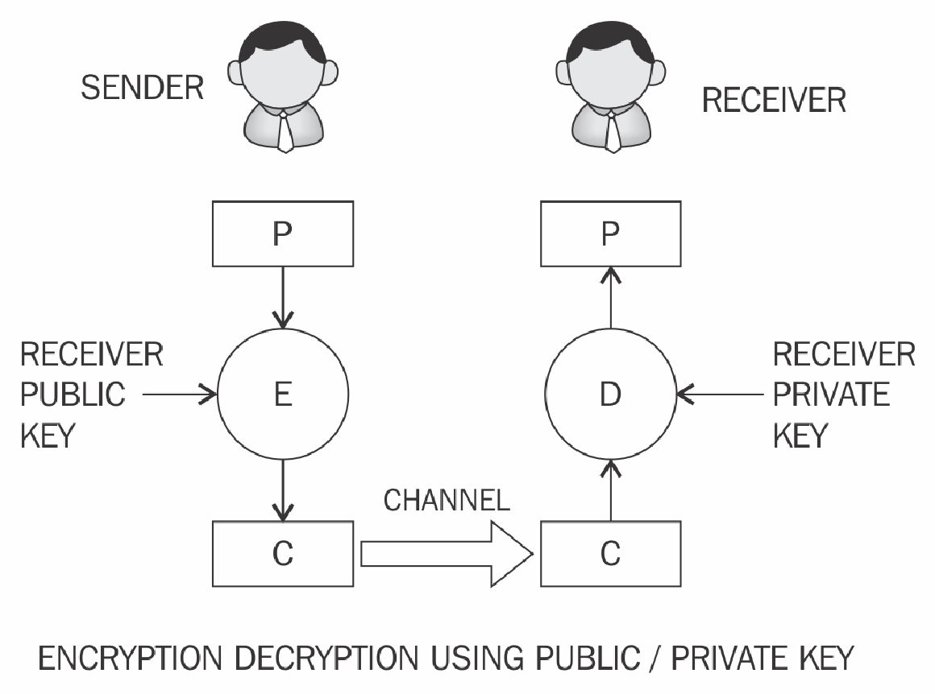
Asymmetric cryptography
Asymmetric cryptography refers to a type of cryptography whereby the key that is used to encrypt the data is different from the key that is used to decrypt the data.

Slide 4
Model is only used for message authentication and validation purposes:

Slide 5
Security mechanisms offered by public key cryptosystem include
Key establishment---- setting of Keys over a insecure channel
Digital signatures ---- Non-repudiation service
Identification------ Identify the entity involved in transaction
Encryption and decryption------- Confidentiality

Slide 6
1. Key Establishment
Purpose: Securely exchanging encryption keys over an insecure channel.
Mechanism: Public key cryptography enables secure key exchange.
Example:
Diffie-Hellman Key Exchange: Two parties securely establish a shared secret key over an insecure network.
RSA-based Key Exchange: A sender encrypts a secret key with the recipient’s public key, which can only be decrypted with the recipient’s private key.

Slide 7
2. Digital Signatures
Purpose: Provides authentication, integrity and non-repudiation.
Mechanism:
The sender signs a message using their private key.
The receiver verifies the signature using the sender's public key.
Example:
RSA, DSA and ECDSA digital signatures ensure that a document/message comes from a legitimate sender and has not been tampered with.

Slide 8
3. Identification
Purpose: Verifies the identity of an entity (e.g., user, device, or server) in a transaction.
Mechanism:
A challenge-response mechanism using a public-private key pair.
Example:
SSL/TLS Handshake: Websites prove their authenticity using X.509 certificates signed by Certificate Authorities (CAs).
Smart Cards & Digital IDs: Used for secure authentication

Slide 9
4. Encryption and Decryption
Purpose: Ensures confidentiality of data by converting plaintext into ciphertext.
Mechanism:
The sender encrypts the data with the recipient’s public key.
Only the recipient can decrypt it using their private key.
Example:
RSA Encryption: Often used in secure email (PGP), SSL/TLS, and secure messaging.
Elliptic Curve Cryptography (ECC): A lightweight alternative to RSA for secure encryption.

Slide 10
The private key remains on the receiver's side and there is no need to share keys in order to perform encryption and decryption.
Public key cryptography can be used to verify the integrity of the received message by the receiver.
There is no encryption being performed in this model. This model is only used for message authentication and validation purposes.

Slide 11
Public and private keys
A private key, as the names suggests, is basically a randomly generated number that is kept secret.
Private keys can be of various lengths depending upon the type and class of algorithms used.
Private key needs to be protected and no unauthorized access should be granted to that key.
RSA, typically, a key of 1024-bit or 2048-bits is used.
1024-bit key size is no longer considered secure and at least 2048 bit is recommended to be used in practice.

Slide 12
Public key cryptography algorithms are based on various underlying mathematical problems.
There are three main families of asymmetric algorithms.
Integer factorization.
Discrete logarithm
Elliptic curves
Integer factorization.
These schemes are based on fact that large integers are very hard to factor. RSA is the prime example of this type of algorithm.

Slide 13
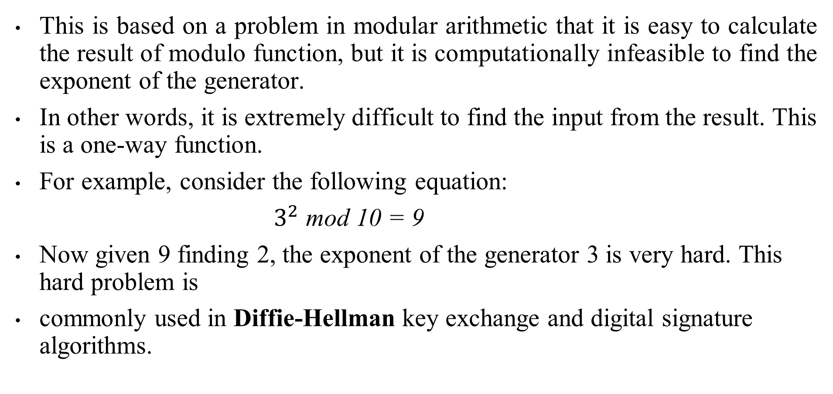
Discrete logarithm
This is based on a problem in modular arithmetic that it is easy to calculate the result of modulo function, but it is computationally infeasible to find the exponent of the generator.
In other words, it is extremely difficult to find the input from the result. This is a one-way function.
For example, consider the following equation:
$3^{2}$ mod 10 = 9
Now given 9 finding 2, the exponent of the generator 3 is very hard. This hard problem is
commonly used in Diffie-Hellman key exchange and digital signature algorithms.

Slide 14

Elliptic curves
Elliptic curve is an algebraic cubic curve over a field, which can be defined by an equation shown here. The curve is non-singular, which means that it has no cusps or self-intersections. It has two variables a, b, along with a point of infinity.
Elliptic curves can be defined over reals, rational numbers, complex numbers, or finite fields.
For cryptographic purposes, elliptic curve over prime finite fields is used instead of real numbers. Different curves can be generated by varying the value of a, b.
Mostly prominently used cryptosystems based on elliptic curves are Elliptic Curve Digital Signatures Algorithm (ECDSA) and Elliptic Curve Diffie-Hellman (ECDH) key exchange.

Slide 15
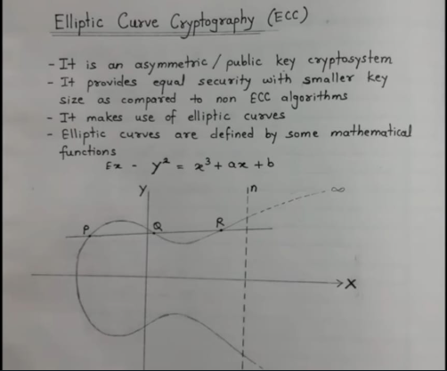

Slide 16
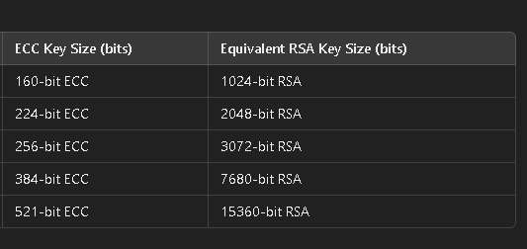

Slide 17
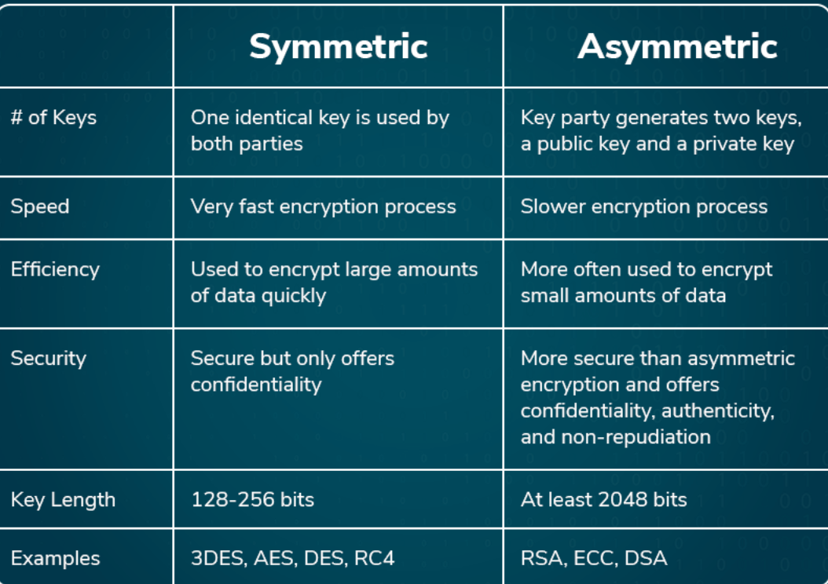

Slide 18
RSA
RSA was invented in 1977 by Ron Rivest, Adi Shamir, and Leonard Adelman, hence the name RSA.
This is based on the integer factorization problem, where the multiplication of two large prime numbers is easy but difficult to factor it back to the two original numbers.
An RSA key pair is generated by performing the steps described here.
Modulus generation:
Select p and q very large primes
Multiply p and q , n=p * q to generate modulus n
Generate co-prime:
Assume a number called e.
It should satisfy certain conditions, that is, it should be greater than 1 and less than
(p-1) (q-1)

Slide 19
Generate public key:
Modulus generated in step 1 and e generated in step 2 is pair that, together, is a
public key. This part is the public part that can be shared with anyone; however,
p and q need to be kept secret.
Generate private key:
Private key called d here and is calculated from p, q and e. Private key is basically
the inverse of e modulo (p-1)(q-1). In the equation form, it is this:
ed = 1 mod(p-1)(q-1) also written as de mod (p-1)(q-1) = 1

Slide 20
Problems
Given a Prime numbers 3 and 11, generate the private key and public key and encrypt and decrypt the message 2 using RSA Algorithm.

Slide 21
Given a Prime numbers 3 and 11, generate the private key and public key and encrypt and decrypt the message hello using RSA Algorithm.

Slide 22
Given Prime numbers are p=7 and q=11and public key is e = 7, compute the private key and encrypt message called hello

Slide 23
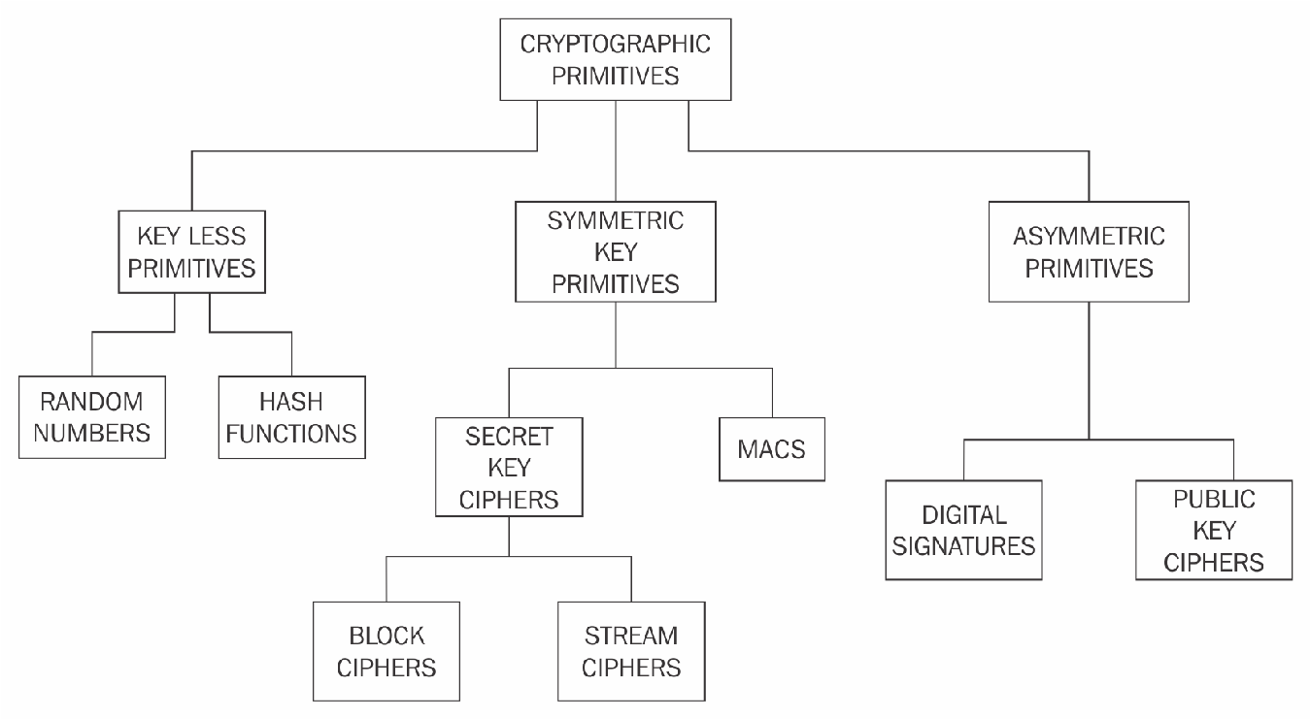
Cryptographic primitives

Slide 24
Hash functions
Hash functions are used to create fixed length digests of arbitrarily long input strings.
Hash functions are keyless and provide the data integrity service.
Various families of hash functions are available, such as MD, SHA-1, SHA-2, SHA-3, RIPEMD and Whirlpool.
Hash functions are commonly used in digital signatures and message authentication codes, such as HMACs.
They have three security properties, namely pre-image resistance, second pre-image resistance and collision resistance.

Slide 25
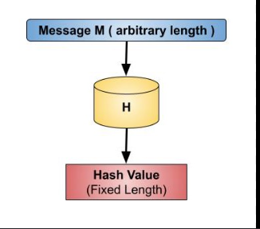

Slide 26
Hash functions are typically used to provide data integrity services.
These can be used as one-way functions and to construct other cryptographic primitives, such as MACs and digital signatures.
Some applications used hash functions as a means of generating pseudo random numbers (PRNGs).
Hash functions do not require a key.
There are two practical and three security properties of hash functions that must be met depending on the level of requirements of integrity.

Slide 27
Properties
Compression of arbitrary messages into fixed length digest: input text of any length and output a fixed length compressed message. usually between 128-bits and 512-bits.
Easy to compute: very quick to compute regardless of the message size. The efficiency may decrease if the message is too big but the function should still be fast enough for practical use.

Slide 28
Pre-image resistance
Consider an equation:
h(x) = y
Here, h is the hash function, x is the input, and y is the hash.
The first security property requires that y cannot be reverse computed to x. x is considered a pre-image of y, hence the name pre-image resistance. This is also called one-way property.
It is a one-way property , it is easy to generate a code given a message , but virtually impossible to generate a message a given code.
This property is important if the authentication techniques involves the use of a secret value. However , if the hash function is not one way , an attackers can easily discover the secrete value.

Slide 29
Second pre-image resistance
This property requires , given x and h(x) , it is almost impossible to find any other message m , where m != x and hash of m = hash of x.
h(m) = h(x).
This property is also known as weak collision resistance.

Slide 30
Collision resistance
This property requires that two different input messages should not hash to the same output.
In other words, h(x) != h(z). This property is also known as strong collision resistance.

Slide 31
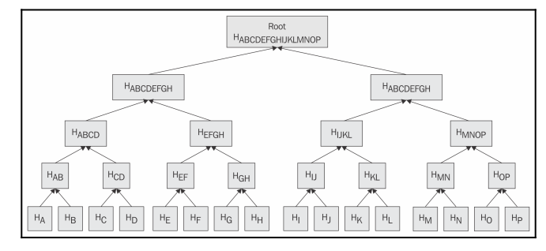
Merkle trees
Ralph(f) Merkle
which makes it easy to understand.
Merkle trees allow secure and efficient verification of large data sets.
It is a binary tree
first, the inputs are placed at the leaves (node with no children)
then values of pairs of child nodes are hashed together in order to produce a value for the parent node (internal node) until a single hash value known as Merkle root is achieved:

Slide 32
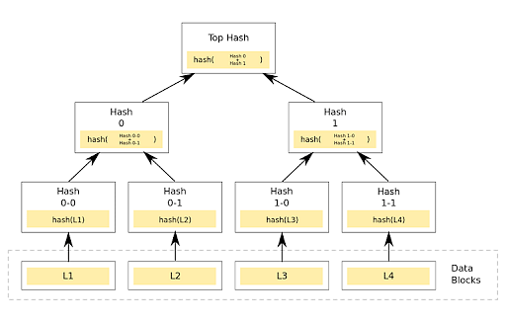

Slide 33
Bitcoin uses Merkle Trees to efficiently verify transactions within a block.
Scenario:
Imagine a Bitcoin block contains 4 transactions:
Tx1: Alice → Bob (1 BTC)
Tx2: Charlie → Dave (0.5 BTC)
Tx3: Eve → Frank (2 BTC)
Tx4: George → Henry (1.5 BTC)
Instead of storing all transactions separately, Bitcoin creates a Merkle Tree:

Slide 34
🔹 Step 1: Hash Transactions
H1 = SHA-256(Tx1)
H2 = SHA-256(Tx2)
H3 = SHA-256(Tx3)
H4 = SHA-256(Tx4)
🔹 Step 2: Pairwise Hashing
H12 = SHA-256(H1 + H2)
H34 = SHA-256(H3 + H4)
🔹 Step 3: Compute Merkle Root
Merkle Root = SHA-256(H12 + H34)
The Merkle Root is stored in the Bitcoin block header.

Slide 35
Patricia trees
To understand Patricia trees – know the concept of a trie.
A trie or a digital tree is an ordered tree data structure used to store a dataset.
Practical Algorithm to Retrieve Information Coded in Alphanumeric (Patricia),
known as Radix tree,
is a compact representation of a trie in which a node that is the only child of a parent is merged with its parent.
Merkle-Patricia tree, based on the definitions of Patricia and Merkle, is a tree that has a root node that contains the hash value of the entire data structure.

Slide 36
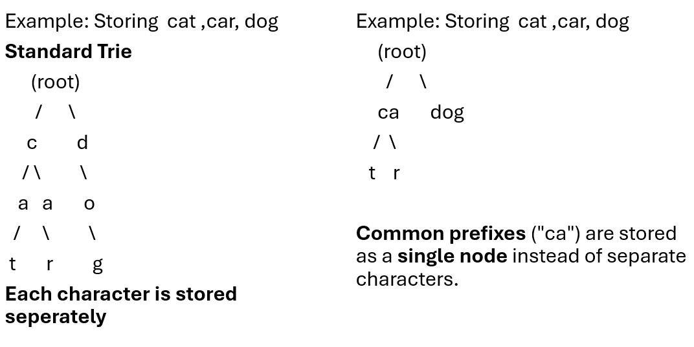
Example: Patricia Trie vs. Standard Trie

Slide 37
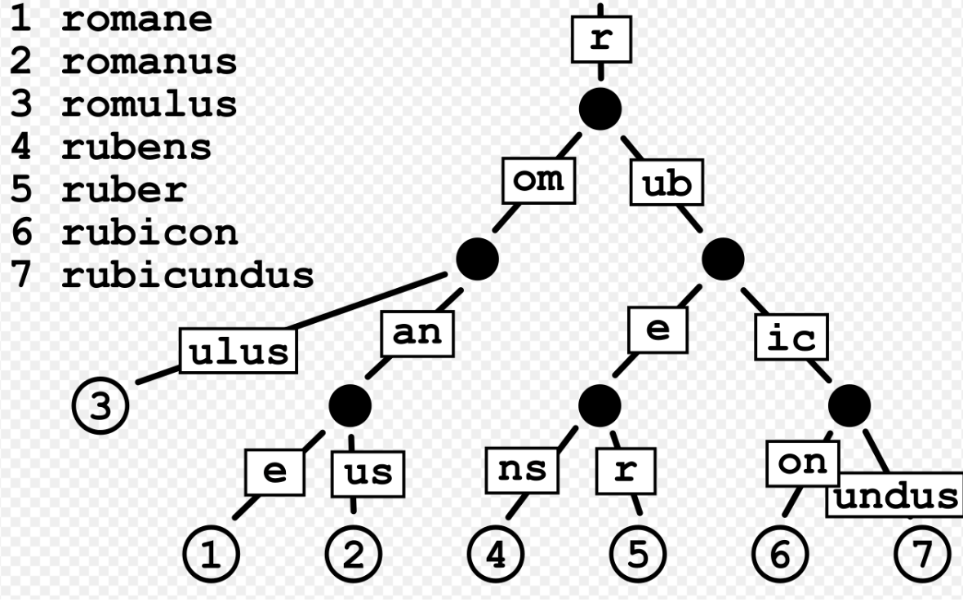

Slide 38
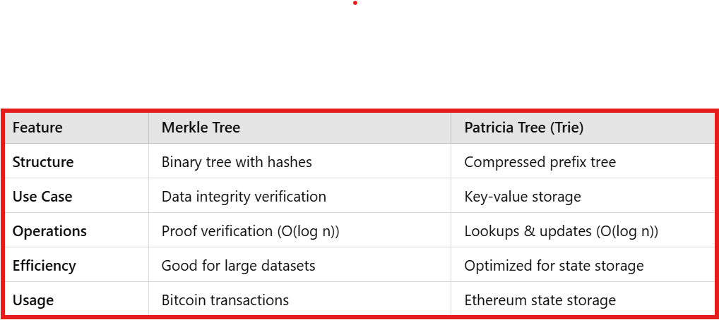

Slide 39
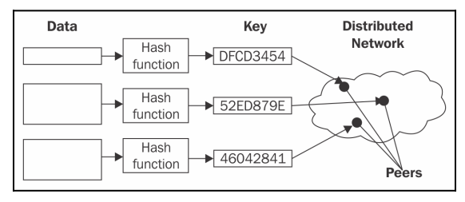
Distributed hash table
A hash table is a data structure that is used to map keys to values.
Distributed hash table is a data structure where data is spread across various nodes and nodes are equivalent to buckets in a peer-to-peer to network
DHTs provides decentralization, fault tolerance and scalability.

Slide 40
The diagram represents a Distributed Hash Table (DHT), a key concept in peer-to-peer (P2P) networks like BitTorrent, IPFS and blockchain-based storage systems.
Data → Hash Function → Key
Raw data is processed using a cryptographic hash function (e.g., SHA-256, MD5).
The hash function produces a unique key (hash value) for the data.
This key is used to store and retrieve the data efficiently.
2. Key → Distributed Network
The generated key is used to locate data within a distributed peer-to-peer network.
Instead of storing all data on a single server, it is distributed across multiple peers (nodes).
Each peer stores a portion of the data, and lookup requests are routed to the correct node.

Slide 41
Example: Storing a File in IPFS
A user uploads a file.
IPFS hashes the file and generates a content-based address (CID).
The file is distributed among multiple nodes in the network.
Retrieval: Any user can request the file using its CID, and the network finds the nearest node storing it.

Slide 42
Digital signature
A digital signature is an authentication mechanism that enables the creator of a message to attach a code that acts as a signature.
The signature is formed by taking the hash of the message and encrypting the message with the creator’s private key.
The signature guarantees the source and integrity of the message.
The digital signature standard (DSS) is an NIST standard that uses the secure hash algorithm (SHA).
Digital signatures are used to provide data origin authentication and nonrepudiation.

Slide 43
Properties:
It must verify the author and the date and time of the signature.
It must authenticate the contents at the time of the signature.
It must be verifiable by third parties, to resolve disputes.
Thus, the digital signature function includes the authentication function.

Slide 44
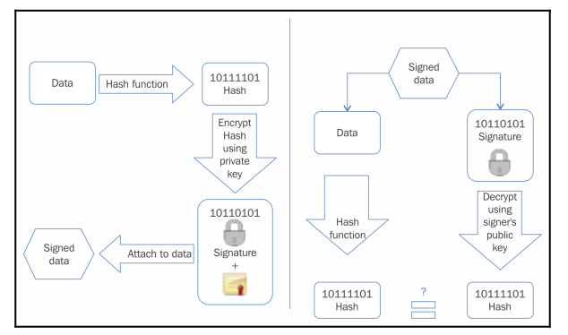

Slide 45
Two approaches to use digital signatures with encryption
Sign then encrypt
The sender digitally signs the data using the private key, appends the signature to the data, and then encrypts the data and the digital signature using the receiver's public key.
Encrypt then sign:
The sender encrypts the data using the receiver's public key and then digitally signs the encrypted data

Slide 46
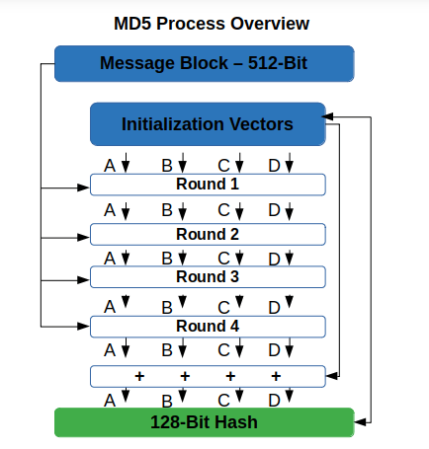
Message Digest (MD)
Message Digest functions were very popular in early 1990s.
MD4 and MD5 are members of this category.
Both MD functions are found to be insecure and not recommended for use any more.
MD5 is a 128-bit hash function that was commonly used for file integrity checks.

Slide 47
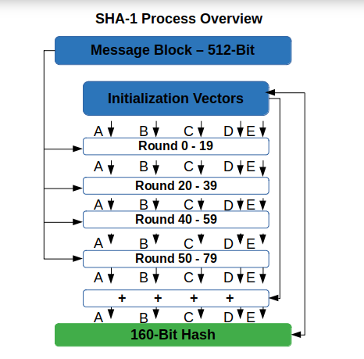
Secure Hash Algorithms (SHAs)
SHA-0: This is a 160-bit function introduced by NIST in 1993.
SHA-1: SHA-1 was introduced later by NIST as a replacement of SHA-0. This is also a 160- bit hash function.
SHA-1 is used commonly in SSL and TLS implementations.
It should be noted that SHA-1 is now considered insecure and is being deprecated by certificate authorities.
Key length too short to resist to attacks.
Attack: The "SHAttered" attack (2017) demonstrated a collision in SHA-1.

Slide 48
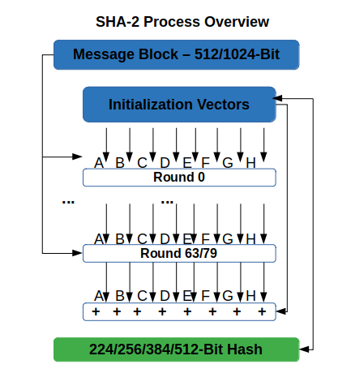
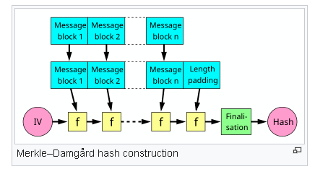
SHA-2 (Secure Hash Algorithm 2) is a set of cryptographic hash functions designed by the United States National Security Agency (NSA) and first published in 2001. They are built using the Merkle–Damgård construction, from a one-way compression function from a specialized block cipher.
This category includes four functions defined by the number of bits of the hash: SHA-224, SHA-256, SHA-384 and SHA-512.

Slide 49
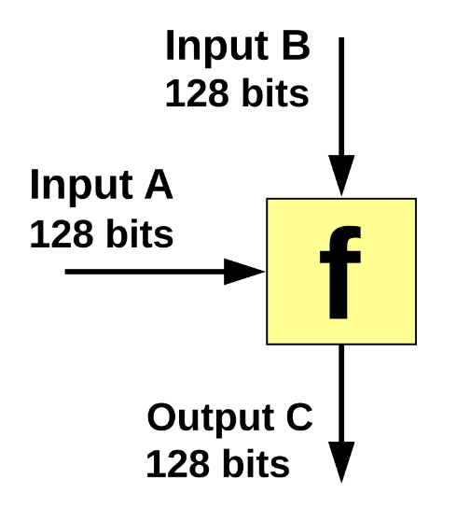
RIPEMD: RIPEMD is the acronym for RACE Integrity Primitives Evaluation Message Digest. It is based on the design ideas used to build MD4. There are multiple versions of RIPEMD, including 128-bit, 160-bit, 256-bit, and 320-bit.
Whirlpool: This is based on a modified version of Rijndael cipher known as W. It uses the Miyaguchi-Preneel compression function, which is a type of one-way function used for the compression of two fixed length inputs into a single fixed length output. It is a single block length compression function

Slide 50
SHA-256
SHA-256 has the input message size < 2^64-bits. Block size is 512-bits and has a word size of 32-bits.
Output is 256-bit digest.
The compression function processes a 512-bit message block and a 256-bit intermediate hash value.
There are two main components of this function:
compression function and
A message schedule.

Slide 51
The algorithm works as follows:
Pre-processing:
1. Padding of the message, which is used to make the length of a block to 512-bits if it is smaller than the required block size of 512-bits.
2. Parsing the message into message blocks that ensure that the message and its padding is divided into equal blocks of 512-bits.
3. Setting up the initial hash value, which is the eight 32-bit words obtained by taking the first 32-bits of the fractional parts of the square roots of the first eight prime numbers.
These initial values are randomly chosen in order to initialize the process and gives a level of confidence that no backdoor exists in the algorithm.

Slide 52
Hash computation:
1. Each message block is processed in a sequence and requires 64 rounds to compute the full hash output. Each round uses slightly different constants to ensure that no two rounds are the same.
2. First, the message schedule is prepared.
3. Then, eight working variables are initialized.
4. Then, the intermediate hash value is calculated.
5. Finally, the message is processed and the output hash is produced.

Slide 53
Design of SHA3 (Keccak)
The structure of SHA-3 is very different from the usual SHA-1 and SHA-2.
A newer approach called sponge and squeeze construction is used in
Keccak, which is basically a random permutation model.
Different variants of SHA3 have been standardized, such as SHA3-224, SHA3-256, SHA3-384, SHA3-512, SHAKE128, and SHAKE256.

Slide 54
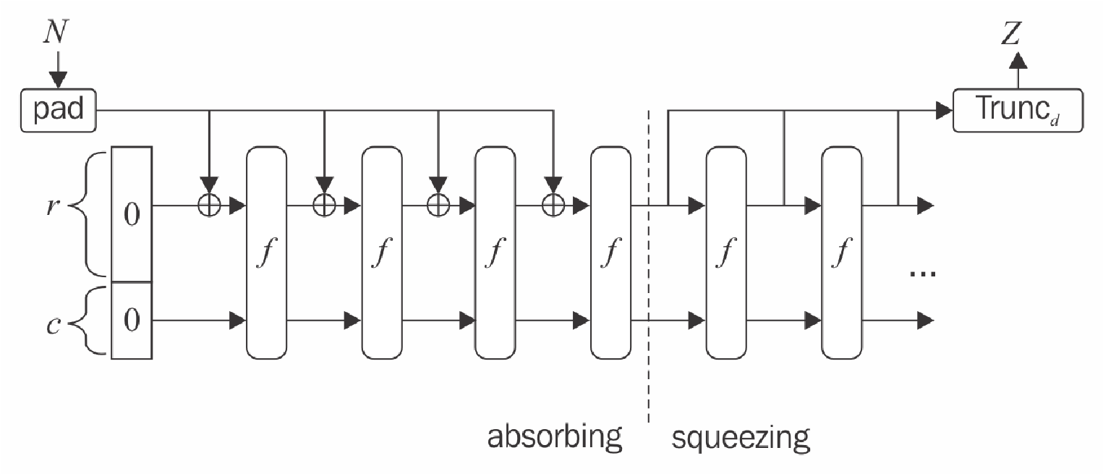
The following diagram shows the sponge and squeeze model that is the basis of SHA3 or Keccak.

Slide 55
The following diagram shows the sponge and squeeze model that is the basis of SHA3 or Keccak.
In sponge first, the data is absorbed into the sponge after applying padding, where it is then changed into a subset of permutation state using XOR and then the output is squeezed out of the sponge function that represents the transformed state.
Rate is the input block size of a sponge function,
whereas capacity determines the generic security level

