Slide 1

Blockchain Technology
Module 4- Bitcoin

Slide 2
Topics required…
Bitcoin definition
Transactions - life cycle
Transactions - structure
Blockchain: The structure of block
The structure of a block header
Wallets.
Smart Contracts: History
Definition
Ricardian contracts

Slide 3
Bitcoin
Bitcoin is the first application of the blockchain technology.
Bitcoin has started a revolution with the introduction of the very first fully decentralized digital currency and one that has proven to be extremely secure and stable.
In 2008, a paper on bitcoin, Bitcoin: A Peer-to-Peer Electronic Cash System was written by Satoshi Nakamoto. The first key idea introduced in the paper was that purely peer-to-peer electronic cash that does need an intermediary bank to transfer payments between peers.

Slide 4
The key issue that has been addressed in bitcoin is an elegant solution to the Byzantine Generals problem along with a practical solution of the double-spend problem.
The value of bitcoin has increased significantly since 2011, as shown in the following graph.

Slide 5
Bitcoin definition
Bitcoin can be defined in various ways; it's a protocol, a digital currency and a platform.
It is a combination of peer-to-peer network, protocols and software that facilitate the creation and usage of the digital currency named bitcoin.
Bitcoin with a capital B is used to refer to the Bitcoin protocol, whereas bitcoin with a lowercase b is used to refer to bitcoin, the currency.

Slide 6
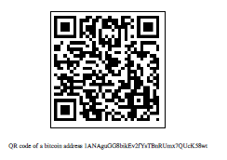
Keys and addresses
Elliptic curve cryptography is used to generate public and private key pairs in the Bitcoin network.
The bitcoin address is created by taking the corresponding public key of a private key and hashing it twice, first with the SHA256 algorithm and then with RIPEMD160.
The resultant 160-bit hash is then prefixed with a version number and finally encoded with a Base58Check encoding scheme.
The bitcoin addresses are 26-35 characters long and begin with digit 1 or 3.
A typical bitcoin address looks like a string shown here:
1ANAguGG8bikEv2fYsTBnRUmx7QUcK58wt

Slide 7
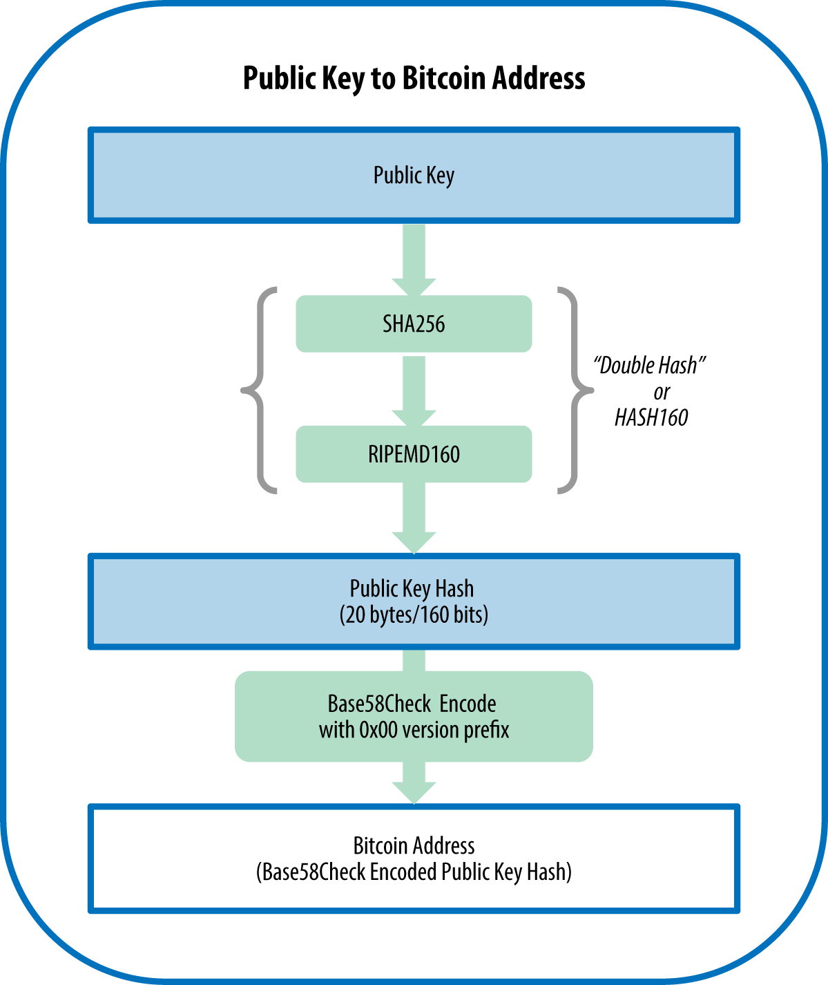

Slide 8
Currently, there are two types of addresses, the commonly used P2PKH and another P2SH type, starting with 1 and 3, respectively.
P2PKH- pay to publilc key hash.
P2SH- Pay to script hash.
P2SH Address Example:
3J98t1WpEZ73CNmQviecrnyiWrnqRhWNLy
From bitaddress.org private key and bitcoin address in a paper wallet

Slide 9
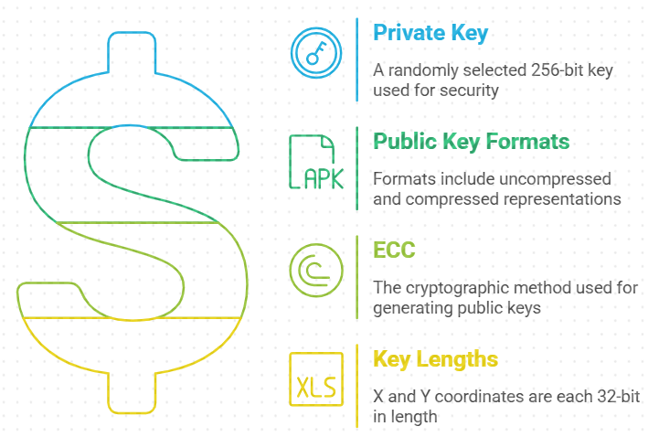
Public keys in bitcoin
In public key cryptography, public keys are generated from private keys.
Bitcoin uses ECC (Elliptic curve cryptography).
A private key is randomly selected and is 256-bit in length.
Public keys can be presented in an uncompressed or compressed format.
Public keys are basically x and y coordinates on an elliptic curve and in an uncompressed format and are presented with a prefix of 04 in a hexadecimal format.
X and Y coordinates are both 32- bit in length

Slide 10
Keys are identified by various prefixes, described as follows:
Uncompressed public keys used 0x04 as the prefix.
Compressed public key starts with 0x03 (if the y 32-bit part of the public key is odd).
Compressed public key starts with 0x02 (if the y 32-bit part of the public key is even).

Slide 11
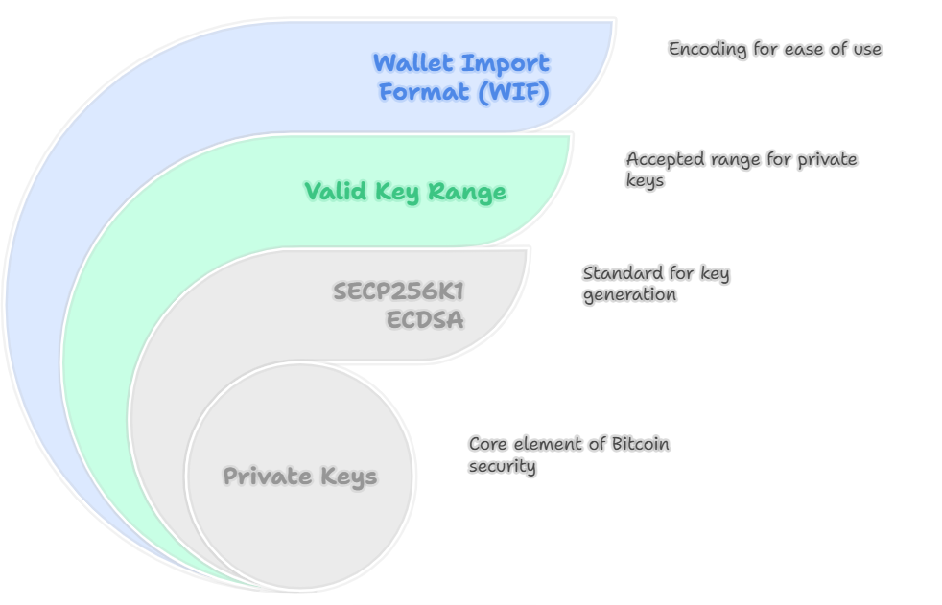
Private keys in bitcoin
Private keys are basically 256-bit numbers chosen in the range specified by the SECP256K1 ECDSA recommendation.
Any randomly chosen 256-bit number from 0x1 to 0xFFFF FFFF FFFF FFFF FFFF FFFF FFFF FFFE BAAE DCE6 AF48 A03B BFD2 5E8C D036 4140 is a valid private key.
Private keys are usually encoded using Wallet Import Format (WIF) in order to make them easier to copy and use.

Slide 12
Bitcoin currency units

Slide 13
Base58Check encoding
This encoding is used to limit the confusion between various characters, such as 0OIl as they can look the same in different fonts.
The encoding basically takes the binary byte arrays and converts them into human-readable strings.
This string is composed by utlilizing a set of 58 alphanumeric symbols.

Slide 14
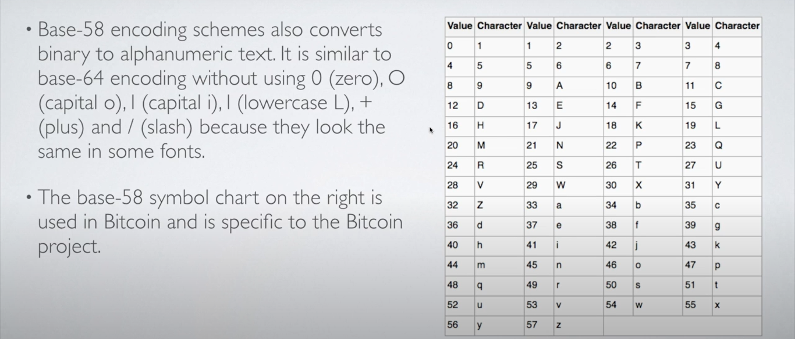

Slide 15
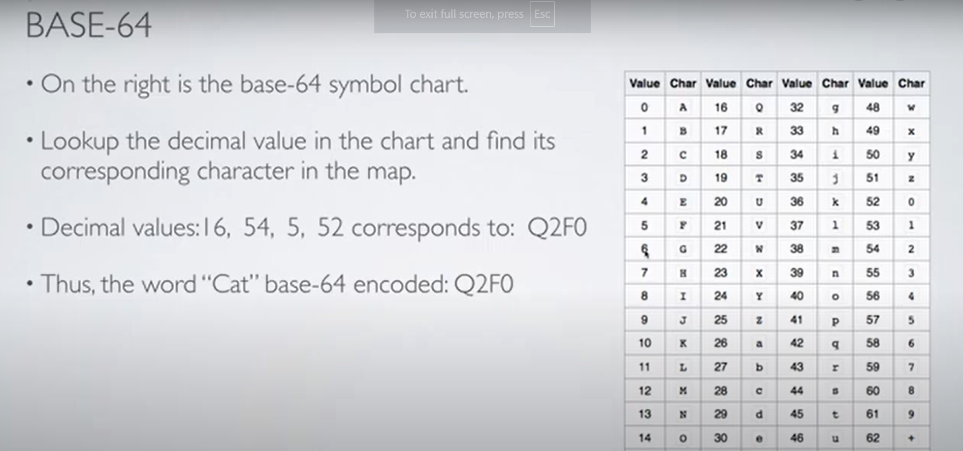

Slide 16
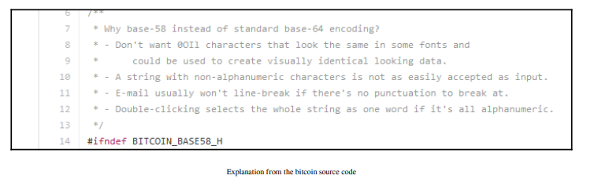
Why base58 instead of base64

Slide 17
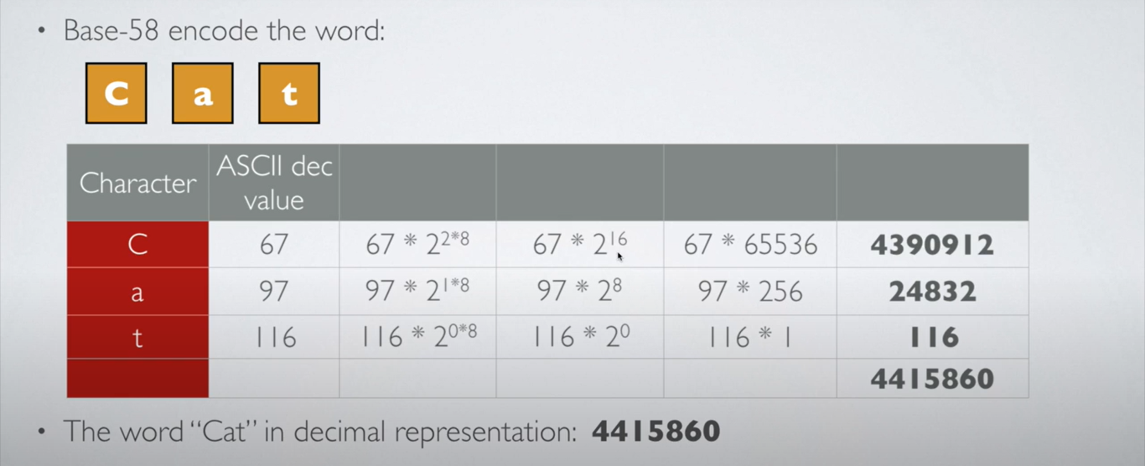

Slide 18
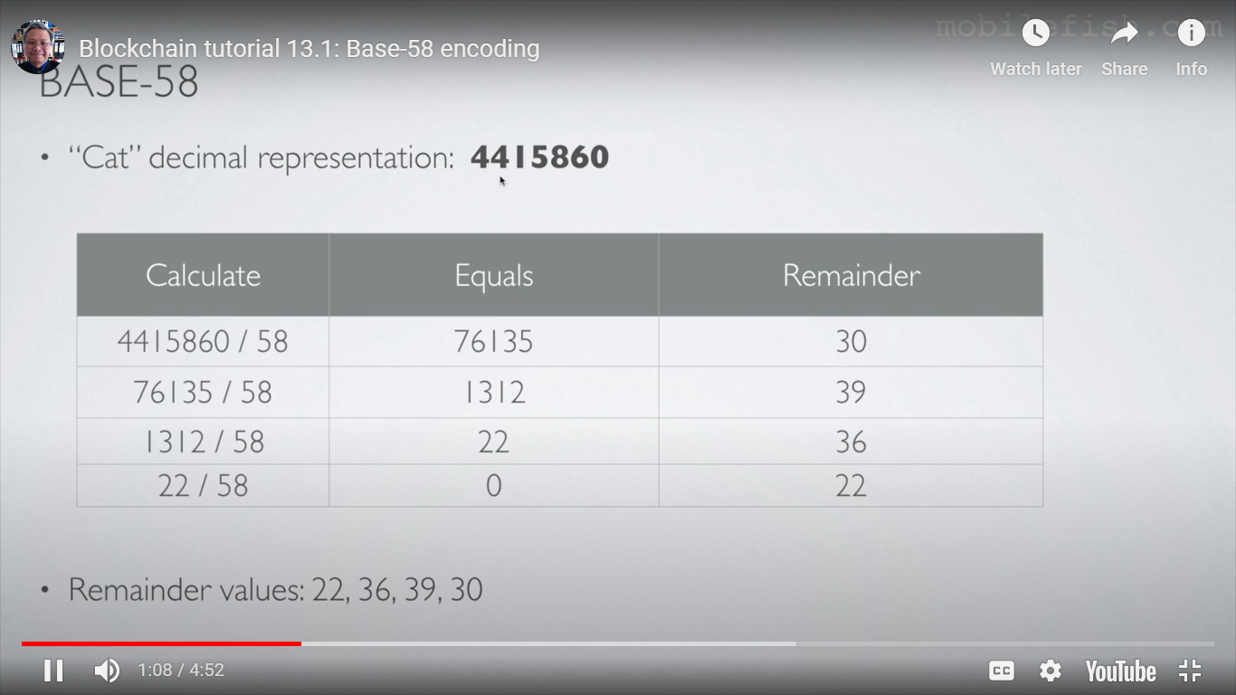

Slide 19
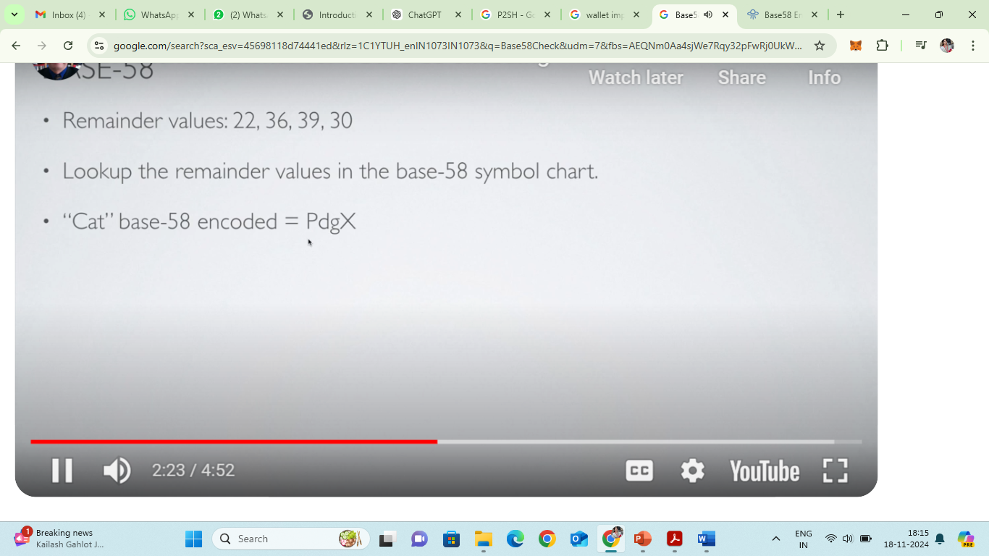

Slide 20
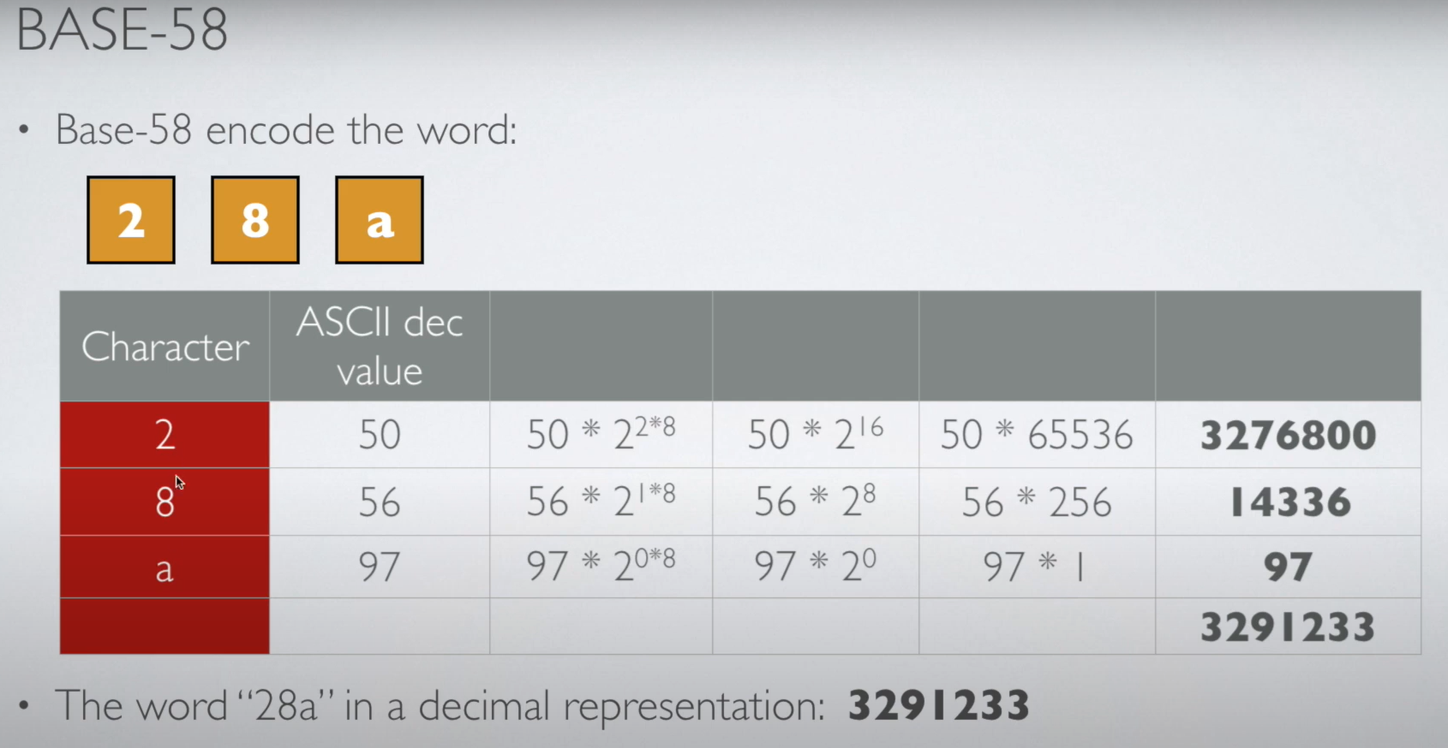

Slide 21
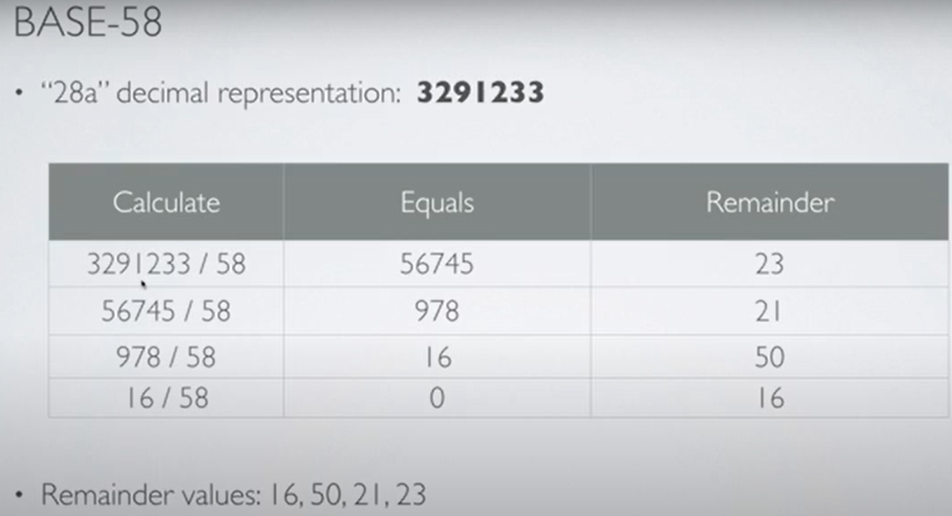

Slide 22
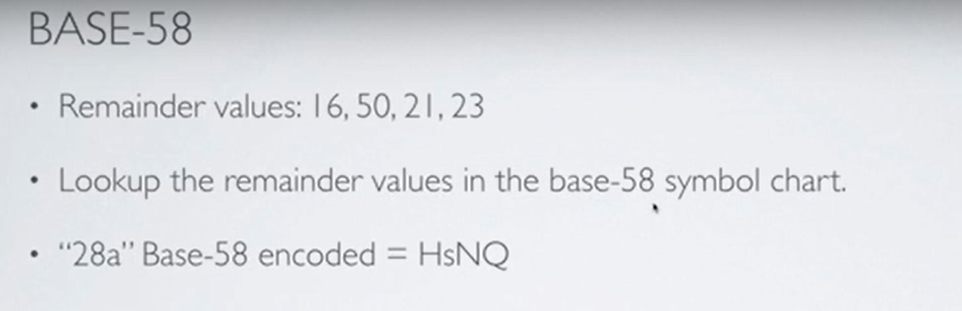

Slide 23
Vanity addresses
As bitcoin addresses are based on base58 encoding, it is possible to generate addresses that contain human-readable messages.
https://vanitygen.net/
Public address encoded in QR

Slide 24
Vanity addresses are generated using a purely brute-force method. An example is shown in the following screenshot:

Slide 25
Transactions
Transactions are the core of bitcoin ecosystem.
Each transaction is composed of at least one input and output.
Inputs can be thought of as coins being spent that have been created in a previous transaction and outputs as coins being created.
If a transaction is minting new coins, then there is no input and therefore no signature is needed.
If transaction is to sends coins to some other user (a bitcoin address), then it needs to be signed by the sender with their private key and a reference is also required to the previous transaction in order to show the origin of the coins.

Slide 26
The transaction life cycle
A user/sender sends a transaction using wallet software or some other interface.
2. The wallet software signs the transaction using the sender's private key.
3. The transaction is broadcasted to the Bitcoin network using a flooding algorithm.
4. Mining nodes include this transaction in the next block to be mined.
5. Mining starts once a miner who solves the Proof of Work problem broadcasts the newly mined block to the network.
6. The nodes verify the block and propagate the block further, and confirmation starts to generate.
7. Finally, the confirmations start to appear in the receiver's wallet and after approximately six confirmations, the transaction is considered finalized and confirmed.

Slide 27
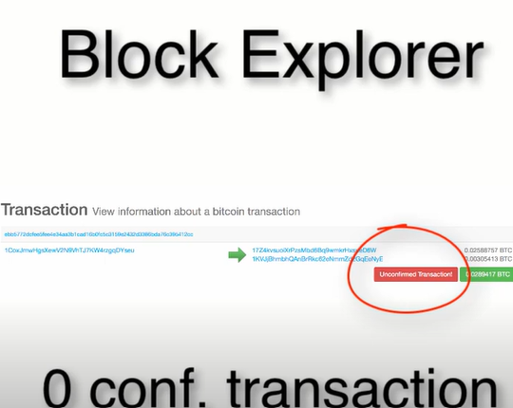
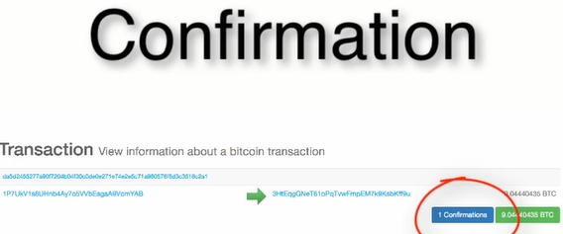

Slide 28
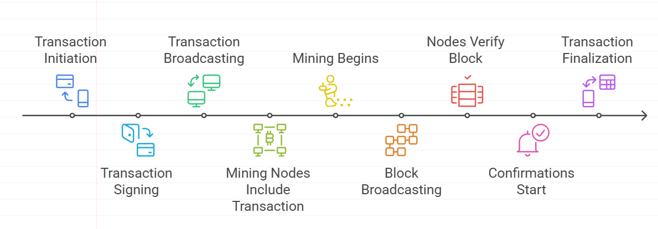

Slide 29
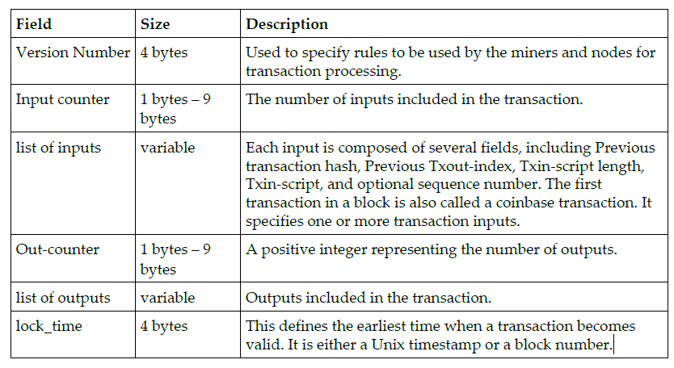
The transaction structure
A transaction at a high level contains metadata, inputs and outputs. Transactions are combined to create a block. The transaction structure is shown in the following table:

Slide 30
Metadata: This part of the transaction contains some values such as the size of the transaction, the number of inputs and outputs, the hash of the transaction and a lock_time field. Every transaction has a prefix specifying the version number.
Inputs: Generally, each input spends a previous output. Each output is considered an Unspent Transaction Output (UTXO) until an input consumes it.
Outputs: Outputs have only two fields, and they contain instructions for the sending of bitcoins. The first field contains the amount of Satoshis, whereas the second field is a locking script that contains the conditions that need to be met in order for the output to be spent.
Verification: Verification is performed using bitcoin's scripting language.

Slide 31
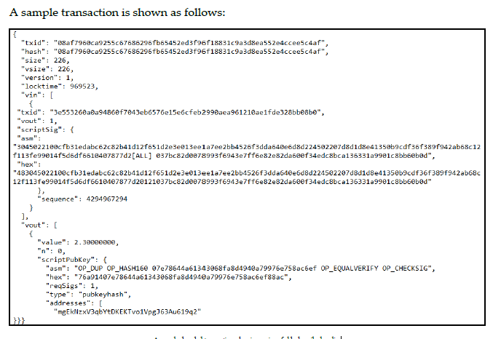

Slide 32
The script language
Bitcoin uses a simple stack-based language called script.
The various categories of the scripting Opcodes are constants, flow control, stack, bitwise logic, splice and arithmetic, cryptography and lock time.
This scripting language is based on a Forth-like syntax and uses a reverse polish notation in which every operand is followed by its operators.
It is evaluated from the left to the right using a Last in First Out (LIFO) stack.
Scripts use various Opcodes or instructions to define their operation.

Slide 33
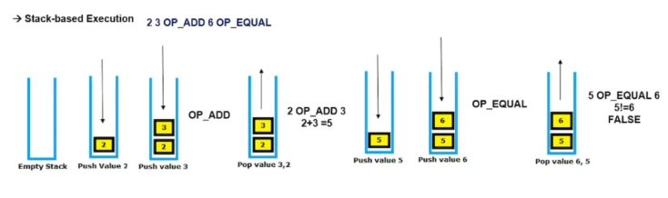
Example

Slide 34
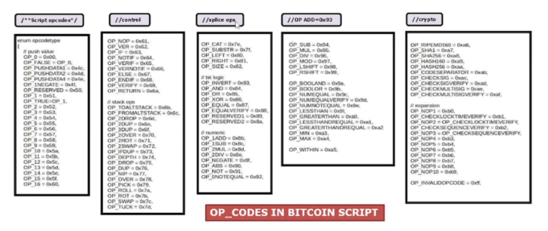

Slide 35
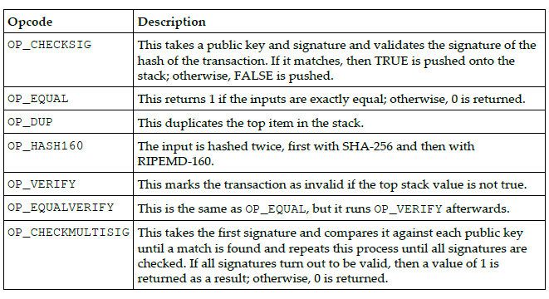
Commonly used Opcodes
All Opcodes are declared in the script. file in the bitcoin reference client source code.

Slide 36
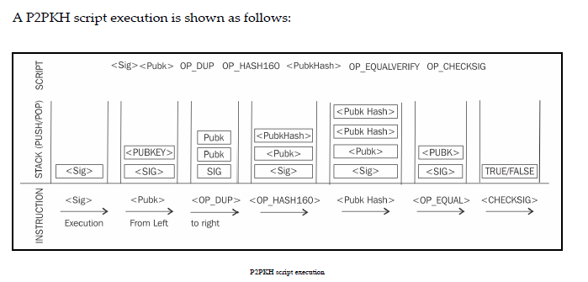

Slide 37
Blockchain
Blockchain is a public ledger of a timestamped, ordered and immutable list of all transactions on the bitcoin network.
Each block is identified by a hash in the chain and is linked to its previous block by referencing the previous block's hash.
Blockchain is a distributed ledger of transaction.

Slide 38
Data structure of a Bitcoin block
Field | Size | Description
Block size | 4 bytes | The size of the block.
Block header | 80 bytes | This includes fields from the block header described in the next section.
Transaction counter | Variable | The field contains the total number of transactions in the block. Size ranges from 1-9 bytes.
Transactions | Variable | All transactions in the block.

Slide 39
Data structure of block header
Field | Size | Description
Version | 4 bytes | The block version number that dictates the block validation rules follow.
Previous block header hash | 32 bytes | This is a double SHA256 hash of the previous block's header.
Merkle root hash | 32 bytes | This is a double SHA256 hash of the Merkle tree of all transactions included in the block.
Timestamp | 4 bytes | Contains the approximate creation time of the block in Unix-epoch time format.
Difficulty target | 4 bytes | Current difficulty target of the network
Nonce | 4 bytes | Arbitrary number that miners change repeatedly to produce a hash that is lower than the difficulty target.

Slide 40
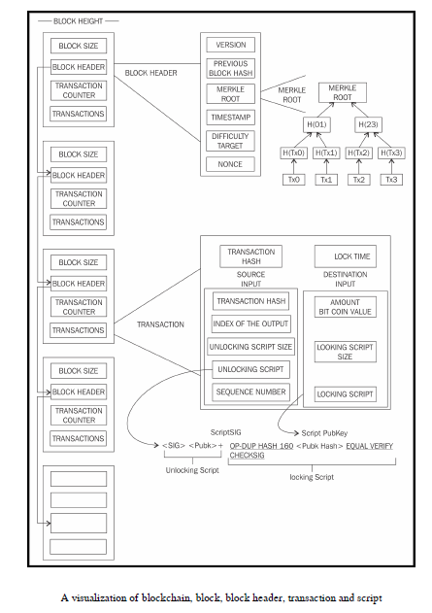

Slide 41
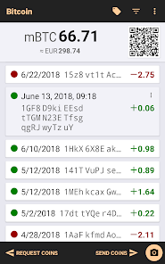

Wallets
The wallet software is used to store private or public keys and bitcoin address.
It performs various functions, such as receiving and sending bitcoins.
Private keys can be generated in different ways and are used by different types of wallets.
Wallets do not store any coins and there is no concept of wallets storing balance or coins for a user.
In the bitcoin network, coins do not exist; instead, only transaction information is stored on the blockchain.

Slide 42
Wallet Types
In bitcoin, there are different types of wallets that can be used to store private keys.
Non-deterministic wallets
Deterministic wallets
Hierarchical deterministic wallets
Brain wallets
Paper wallets
Hardware wallets
Online wallets
Mobile wallets

Slide 43
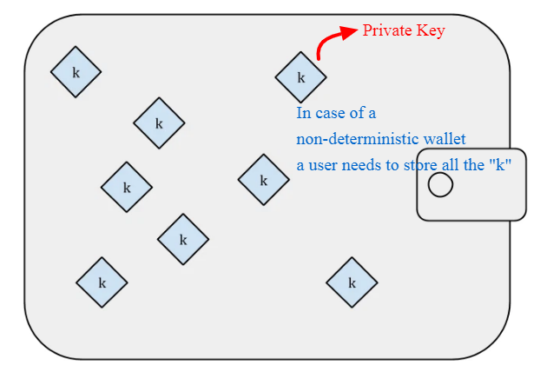
Non-deterministic wallets
These wallets contain randomly generated private keys and are also called “Just a Bunch of Key wallets”.
Managing a large number of keys is very difficult.
There is a need to create regular backups of the keys and protect them appropriately in order to prevent theft or loss.

Slide 44
Features:
Generate each private key independently and randomly.
No relationship between keys.
Each address has a separate private key.
Requires backing up each private key individually.
Advantages:
Simple design.
Good for one-time or short-term use.
Disadvantages:
Hard to manage many keys.
Backup is complex and risky.
Example:
Early Bitcoin Core wallets.

Slide 45
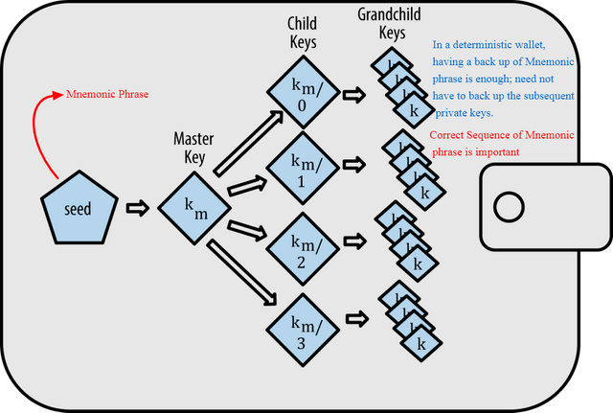
Deterministic wallets
keys are derived out of a seed value via hash functions.
This seed number is generated randomly and commonly represented by human-readable “mnemonic code words”.
Mnemonic code words are defined in BIP39.
private key management comparatively easier.

Slide 46
Features:
All keys are derived from a single seed phrase (usually 12 or 24 words).
One seed can regenerate all addresses/keys.
Easier backup and restoration.
Advantages:
Single backup is enough.
Predictable and organized.
Disadvantages:
If the seed is lost, all funds are lost.
Less privacy if all addresses are derived visibly from the same seed.
Example:
Electrum Wallet.

Slide 47
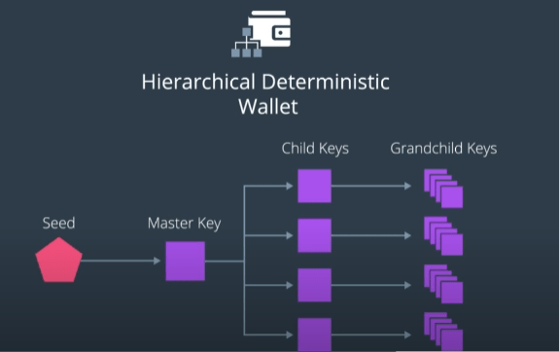
Hierarchical deterministic wallets
Defined in BIP32 and BIP44, HD wallets store keys in a tree structure derived from a seed.
The seed generates the parent key (master key), which is used to generate child keys and subsequently grandchild keys.
The complete hierarchy of private keys in an HD wallet is easily recoverable if the master private key is known.
It is because of this property that HD wallets are very easy to maintain and are highly portable.

Slide 48
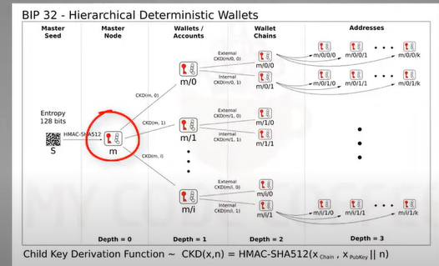

Slide 49
Features:
An advanced form of deterministic wallets.
Keys are generated in a tree-like structure from a master seed.
Allows for multiple accounts, chains and addresses from one seed.
Follows BIP32/BIP44 standards.
Advantages:
Single backup for all accounts.
Great for managing multiple addresses.
Can generate new addresses without internet access.
Disadvantages:
Slightly more complex for beginners.
Still vulnerable if the seed phrase is exposed.
Example:
Ledger Nano S/X, Trezor, Exodus.

Slide 50
Brain wallets
The master private key can also be derived from the hash of passwords that are memorized.
Features:
A type of wallet where the private key is generated from a memorized passphrase
No physical or digital storage needed.
Only stored in the user's memory.
Brain wallets can be stored as a sequence of 12-24 words (often called a mnemonic).

Slide 51
Advantages:
No risk of physical theft or hardware failure.
Extremely portable.
Disadvantages:
Vulnerable to weak passphrases and brute-force attacks.
If forgotten, funds are lost forever.
Example:
A manually created SHA-256 hash of a phrase like “MySecret123!”

Slide 52
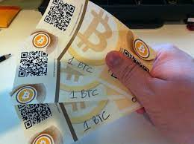

Paper wallets
As the name implies, this is a paper-based wallet with the required key material printed on it.
It requires physical security to be stored.

Slide 53
Features:
A physical printout of your private key and Bitcoin address, often as QR codes.
Offline and not connected to any device.
Advantages:
Immune to hacking and malware.
Great for cold storage.
Disadvantages:
Easily damaged or lost.
Must be generated securely offline.
Example:
Created using tools like bitaddress.org (offline mode).

Slide 54
Hardware wallets
Another method is to use a tamper-resistant device to store keys.
This tamper-resistant device can be custom-built or with the advent of NFC-enabled phones, this can also be a secure element (SE) in NFC phones.
Trezor and Ledger wallets (various types) are the most commonly used bitcoin hardware wallets.

Slide 55
Features:
Physical devices designed to securely store private keys offline.
Keys are stored in a secure chip.
Connects via USB or Bluetooth.
Advantages:
Very secure against malware and online attacks.
Ideal for long-term and large holdings.
Disadvantages:
Costly compared to software wallets.
Can be lost or damaged (though recovery is possible with a seed phrase).
Example:
Ledger Nano S/X, Trezor, Coldcard.

Slide 56

Online wallets
They are stored entirely in online and are provided as a service usually via cloud.
They provide a web interface to the users to manage their wallets and perform various functions such as making and receiving payments.
Easy to use but imply that the user trust the online wallet service provider.

Slide 57
Features:
Wallets hosted on the internet, often by third-party services.
Accessible via browser.
Managed by custodians or user-controlled.
Advantages:
Easy to use.
Accessible from anywhere.
Disadvantages:
High risk of hacking and phishing.
Trust required in third parties.
Example:
Blockchain.com, Coinbase (custodial), MetaMask (for Ethereum).

Slide 58
Mobile wallets
They are installed on mobile devices. They can provide various methods to make payments.
At most the notable ability to use smart phone cameras to scan QR codes quickly and make payments.
Mobile wallets are available for the Android platform and iOS, for example, breadwallet, copay and Jaxx.

Slide 59
Features:
Wallets designed for smartphones.
Light clients.
Includes QR scanning, NFC and in-app payments.
Advantages:
Convenient for everyday transactions.
Portable and easy to use.
Disadvantages:
Less secure than hardware or paper wallets.
Vulnerable to phone theft and malware.
Example:
Trust Wallet, Mycelium, BlueWallet.

Slide 60
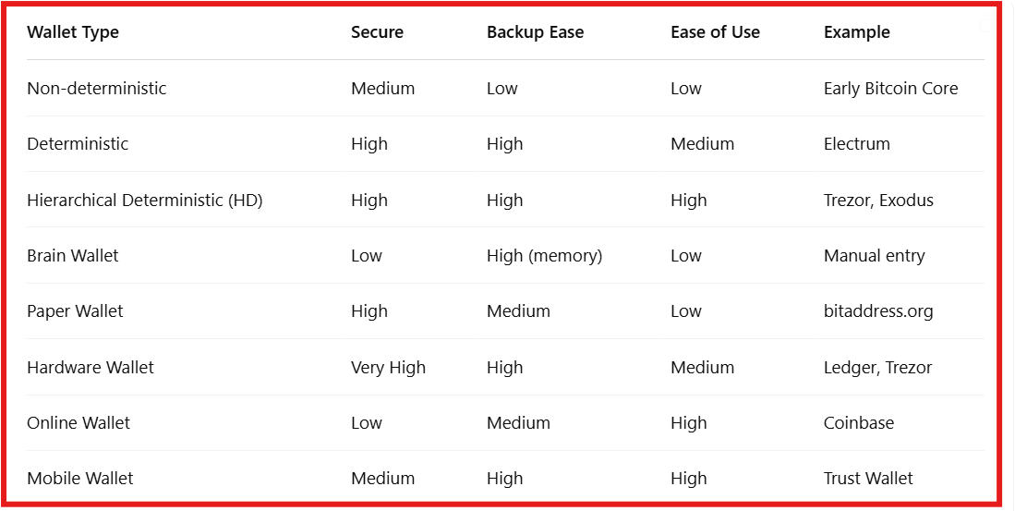

Slide 61
Smart Contracts

Slide 62
Smart Contracts Definition
“A smart contract is a secure and unstoppable computer program
representing an agreement that is automatically executable and
enforceable.”

Slide 63
Smart Contracts
There is also on-going debate on the question of whether code is acceptable as a contract in a court of law.
This raises several questions around how a smart contract can be legally binding:
can it be developed in such a way that it is readily acceptable and understandable in a court of law?
How can dispute resolution be implemented within the code, and is it possible?
If smart contract code is written in a way that both humans and machines can understand, it becomes more transparent and trustworthy. This makes it easier to use in legal contexts, as non-programmers (like lawyers or judges) can also interpret its meaning, not just developers.

Slide 64
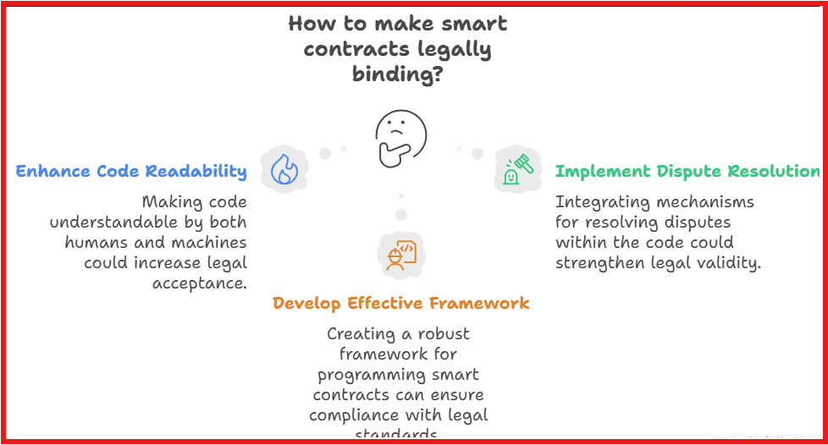

Slide 65
A smart contract has the following four properties:
Automatically executable.
Enforceable.
Semantically sound.
Secure and unstoppable.
The first two properties are required as a minimum, whereas the latter two may not be required or implementable in certain scenarios and can be relaxed.
This issue of interpretation was addressed by Ian Grigg with his invention of Ricardian contracts.

Slide 66
Ricardian contracts
Ricardian contracts were originally proposed in the Financial Cryptography in 7 Layers paper by Ian Grigg in late 1990s.
These contracts were used initially in a bond trading and payment system called Ricardo.
The key idea is to write a document which is understandable and acceptable by both a court of law and computer software.
Ricardian contracts address the challenge of issuance of value over the Internet.
It identifies the issuer and captures all the terms and clauses of the contract in a document in order to make it acceptable as a legally binding contract.

Slide 67
Example:
Let’s say Alice wants to purchase digital art from Bob.
Human-Readable Legal Text:
“This agreement is between Alice (buyer) and Bob (seller) for the purchase of a digital artwork titled “Sunset Dreams.” Alice agrees to pay 1 ETH to Bob. Upon receipt of payment, Bob will transfer ownership of the NFT (token ID: 12345) to Alice. Both parties agree to the terms as outlined here.”

Slide 68
2. Machine-Readable Data (Embedded or Attached):
{
"buyer": "0xAliceAddress",
"seller": "0xBobAddress",
"price": "1 ETH",
"nft_token_id": 12345,
"nft_contract": "0xNFTContractAddress",
"conditions": {
"transfer_upon_payment": true
},
"hash": "0xa3f5c...e91a2" // Hash of the full human-readable contract
}
3. Digitally Signed by Both Parties:
Both Alice and Bob cryptographically sign the contract with their private keys, locking in agreement.

Slide 69
A Ricardian contract is a document that has several of the following properties:
A contract offered by an issuer to holders
A valuable right held by holders and managed by the issuer
Easily readable by people (like a contract on paper)
Readable by programs (parseable, like a database)
Digitally signed
Carries the keys and server information
Allied with a unique and secure identifier

Slide 70
The contracts are implemented by producing a single document that contains the terms of the contract in legal prose and required machine-readable tags.
This document is digitally signed by the issuer using their private key.
This document is then hashed using a message digest function to produce a hash by which the document can be identified.
This hash is then further used and signed by parties during the performance of the contract in order to link each transaction, with the identifier hash thus serving as evidence of intent.

Slide 71
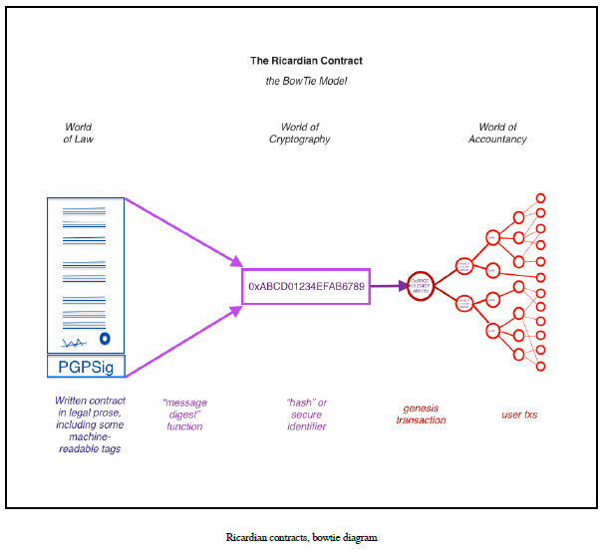

Slide 72
World of Law
Represents the human-readable legal prose.
This is a written contract (in natural language) that may include machine-readable tags (like metadata).
It is digitally signed to ensure authenticity.
This written document is then run through a message digest function (like SHA-256) to create a unique hash.
World of Cryptography
The hash acts as a secured identifiers.
The identifiers becomes link between legal document and digital signature.

Slide 73
World of Accountancy
The identifier (hash) is used in the genesis transaction, which initiates activity on a blockchain or ledger.
From this transaction, a whole network of user transactions branches out.
These transactions are programmatically tied back to the original legal agreement via the secure identifier.

Slide 74
Ricardian Contracts
The semantics of a contract can be divided into two types:
operational semantics and denotational semantics.
Operational Semantics : defines the actual execution, correctness and safety of the contract.
Denotational Semantics: Encompasses both the denotational and operational semantics of a legal agreement. Also capable of encoding legal prose and code (business logic) in it.

Slide 75
Bitcoin uses simple smart contracts focused only on automatic execution by computers. In contrast, a Ricardian contract is designed to be readable by humans while also including parts that machines can process, bridging the gap between legal documents and code..
This can be viewed as legal semantics vs operational performance (semantics vs performance) as shown in the following diagram.

Slide 76
A Ricardian contract can be represented as a tuple of three objects, namely Prose, parameters and code.
Prose represents the legal contract in regular language.
code represents the program that is a computer-understandable representation of legal prose.
parameters join the appropriate parts of the legal contract to the equivalent code.
Ricardian contracts have been implemented in many systems, such as CommonAccord, OpenBazaar, OpenAssets and Askemos.

Slide 77
Example: Ricardian Contract for a Token Sale
RicardianContract = (Prose, Parameters, Code)
Prose (Human-readable legal text):
“This Agreement, made on April 20, 2025, is between Alice (the "Seller") and Bob (the "Buyer"). The Seller agrees to sell, and the Buyer agrees to purchase, 1,000 utility tokens (TOK) at a price of 0.05 ETH per token. Payment shall be made via Ethereum, and tokens will be transferred to the Buyer's wallet upon confirmation of payment. This contract is binding and enforceable under applicable law”

Slide 78
2. Parameters (Structured data for both human and machine)
{
"seller": "0xABC123...",
"buyer": "0xDEF456...",
"token_symbol": "TOK",
"token_amount": 1000,
"price_per_token_eth": 0.05,
"payment_currency": "ETH",
"contract_date": "2025-04-20"
}

Slide 79
3. Code (Smart contract or executable logic)
// Simplified ERC20 token sale logic
function buyTokens() public payable {
require(msg.value == tokenAmount * pricePerToken);
token.transfer(msg.sender, tokenAmount);
}

Slide 80
Smart contract templates
Smart contracts can be implemented for any industry where required but most current use cases are related to the financial industry.
Recent work in smart contract specific to the financial industry has proposed the idea of smart contract templates.
The idea is to build standard templates that provide a framework to support legal agreements for financial instruments.
This was proposed by Clack et al in their paper named Smart Contract Templates: Foundations, design landscape and research directions.

Slide 81
The paper also proposed that domain specific languages should be built in order to support design and implementation of smart contract templates.
A language named CLACK, a common language for augmented contract knowledge has been proposed and research has begun to develop the language.
This language is intended to be very rich and provide a large variety of functions ranging from supporting legal prose to the ability to be executed on multiple platforms and cryptographic functions.

Slide 82
Smart contracts run on blockchains, which are deterministic and isolated environments. This ensures security and consistency — but it also means that smart contracts cannot natively access off-chain (external) data, such as:
Asset prices (e.g., ETH/USD)
Weather data
Sports scores
IoT sensor readings
KYC/AML information
Legal rulings or news events
Yet, many business use cases — especially in finance, insurance, supply chain, etc. — depend on real-world data.

Slide 83
What is an Oracle?
An oracle is a trusted third-party service that fetches, verifies and feeds external data into the blockchain so that smart contracts can use it.

Slide 84
Oracles
Oracles are an important component of the smart contract ecosystem.
Oracles can be used to provide external data to smart contracts.
Depending on the industry and requirements, Oracles can deliver different types of data ranging from weather reports, real-world news, and corporate actions to data coming from Internet of Things (IoT) devices.
Oracles are also capable of digitally signing the data proving that the source of the data is authentic.
Smart contracts can then subscribe to the Oracles, and the smart contracts can either pull the data, or Oracles can push the data to the smart contracts.

Slide 85
Oracles should not be able to manipulate the data they provide and must be able to provide authentic data.
Even though Oracles are trusted, it may still be possible in some cases that the data is incorrect due to manipulation.
Therefore, it is necessary that Oracles are unable to change the data.
It might be acceptable for a smart contract designer to accept data for an oracle that is provided by a large reputable trusted third party, but the issue of centralization still remains. These types of Oracles can be called standard or simple Oracles.
Another type of Oracle, which essentially emerged due to the decentralization requirements, can be called decentralized Oracles.
These types of Oracles can be built based on some distributed mechanism.
It can also be envisaged that the Oracles can themselves source data from another blockchain which is driven by distributed consensus, thus ensuring the authenticity of data.

Slide 86
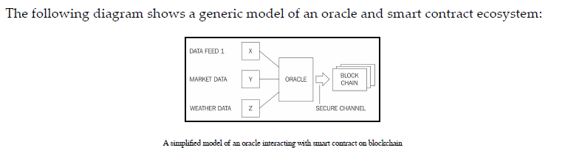
For example, one institution running their own private blockchain can publish their data feed via an Oracle that can then be consumed by other blockchains.
For example, this can be used in telemetry and IoT. However, this approach however requires a mechanism in which hardware devices cannot be tampered with.
This can be achieved by using tamper-proof devices.

