Slide 1
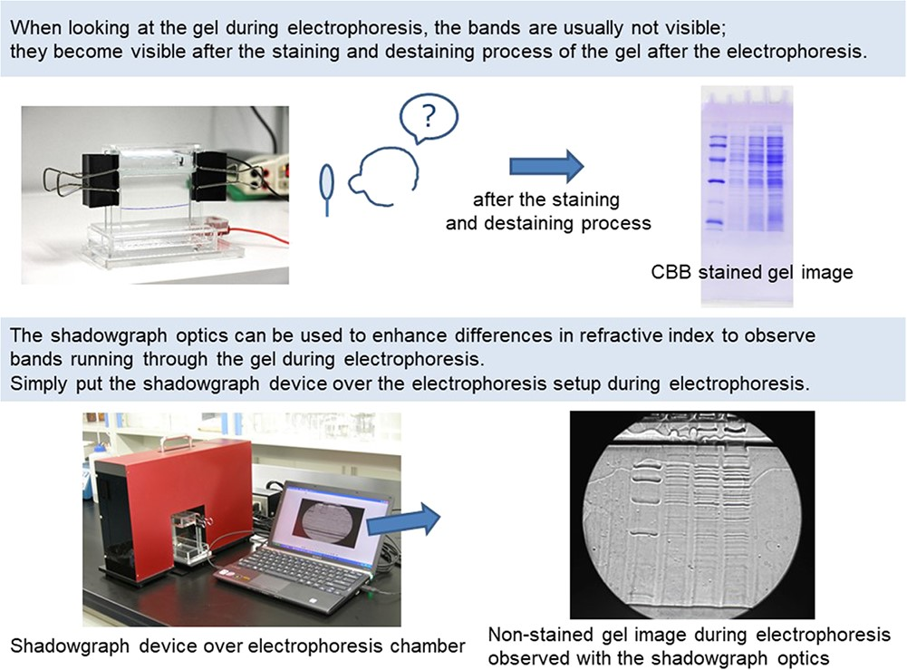

Graphical Abstract
Notes:
Graphical Abstract
Unless provided in the caption above, the following copyright applies to the content of this slide: © The Author(s) 2022. Published by Oxford University Press on behalf of the Japanese Biochemical Society. All rights reserved This article is published and distributed under the terms of the Oxford University Press, Standard Journals Publication Model (https://academic.oup.com/journals/pages/open_access/funder_policies/chorus/standard_publication_model)

